Slide 1
Survival analysis for 5 cancer diagnoses
Healthcare analytics – Mallika thanky – 3/6/18

Slide 2
agenda
Data Overview
Survival Analysis
Thyroid Cancer
Lung Cancer
Melanoma
Colorectal Cancer
Pancreatic Cancer
Conclusion

Slide 3
Data overview

Slide 4
Data preparation
Removed from the analysis:
4315 patients with no cancer diagnosis
5 patients with diagnosis after 8/25/2016
29 patients with multiple cancer diagnoses
2 patients with Null race
1 patient with a diagnosis date after death date
25 patients with a diagnosis date before 1/1/2000
One as early as 1960 – skewed results
Created:
death flag where 1 = patients who died before 8/25/16 [Event flag in the functions]
“Time to Event” variable (in days) [Time vector in the functions]
For patients who died before 8/26/16, death date minus diagnosis date
For patients who survived beyond 8/25/16, 8/25/16 minus diagnosis date
Age Category

Slide 5
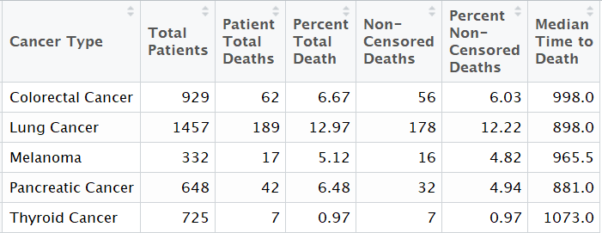
Overall comparisons

Slide 6
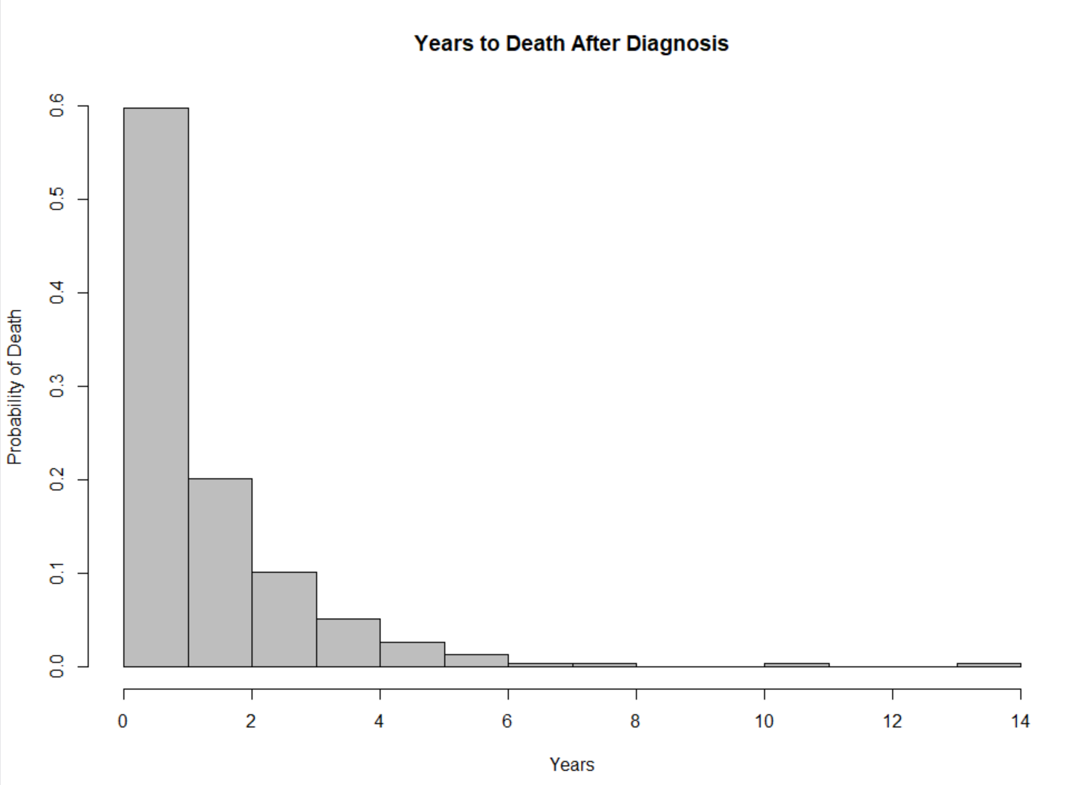
Patients who died did so exponentially

Slide 7
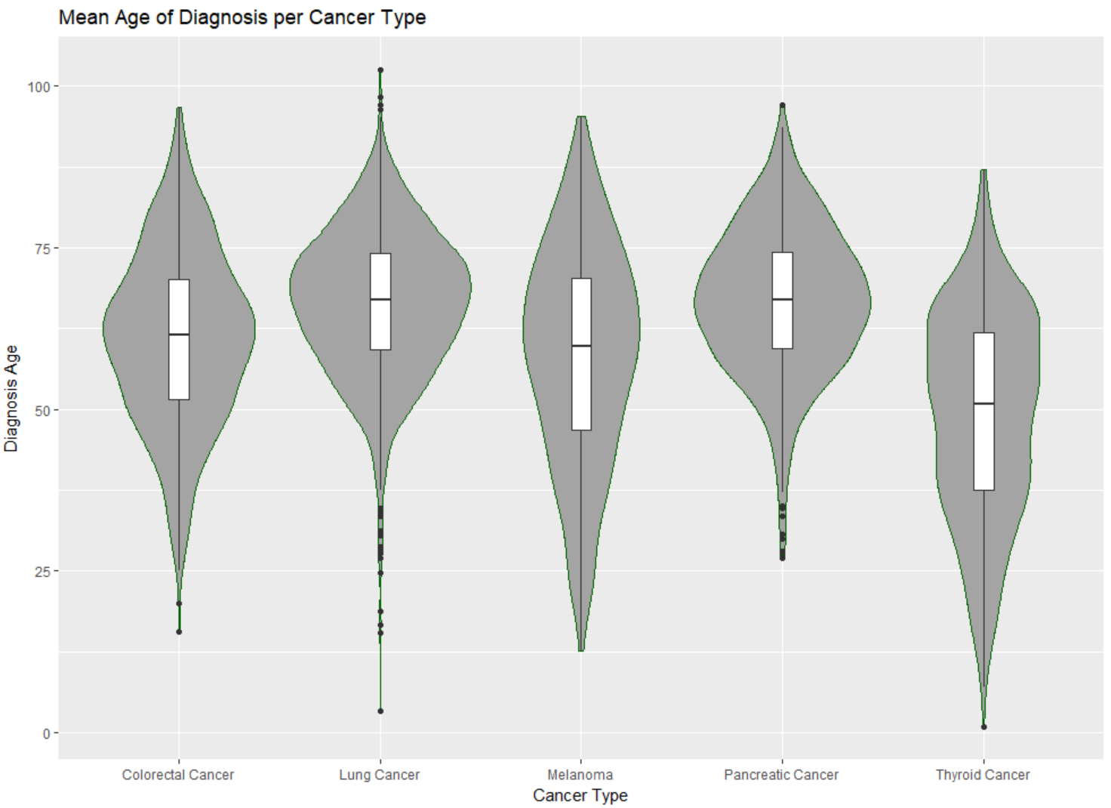
age at diagnosis looked different across the cancer types
Notes:
Thyroid earlier; Melanoma and Thyroid large range; Maybe 2 separate distributions in Thyroid Cancer

Slide 8
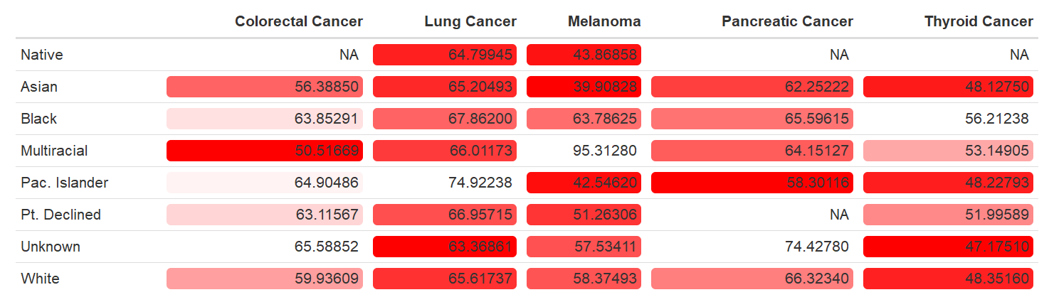
Race appeared to impact mean age of diagnosis

Slide 9
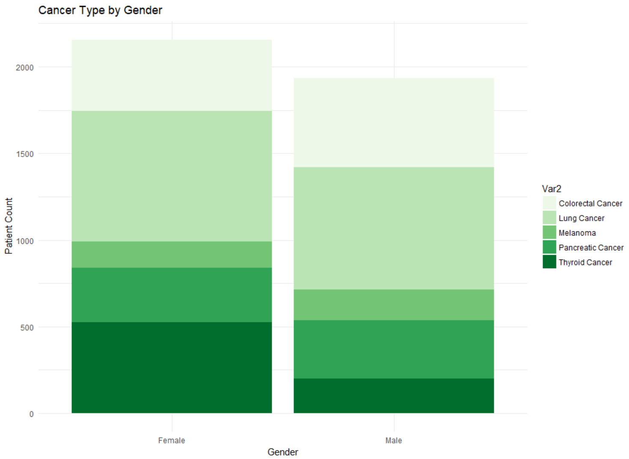
Gender appeared to impact cancer type
Notes:
Larger proportional of males with colorectal and pancreatic cancer; much larger proportion of females with thyroid cancer

Slide 10
Thyroid cancer

Slide 11
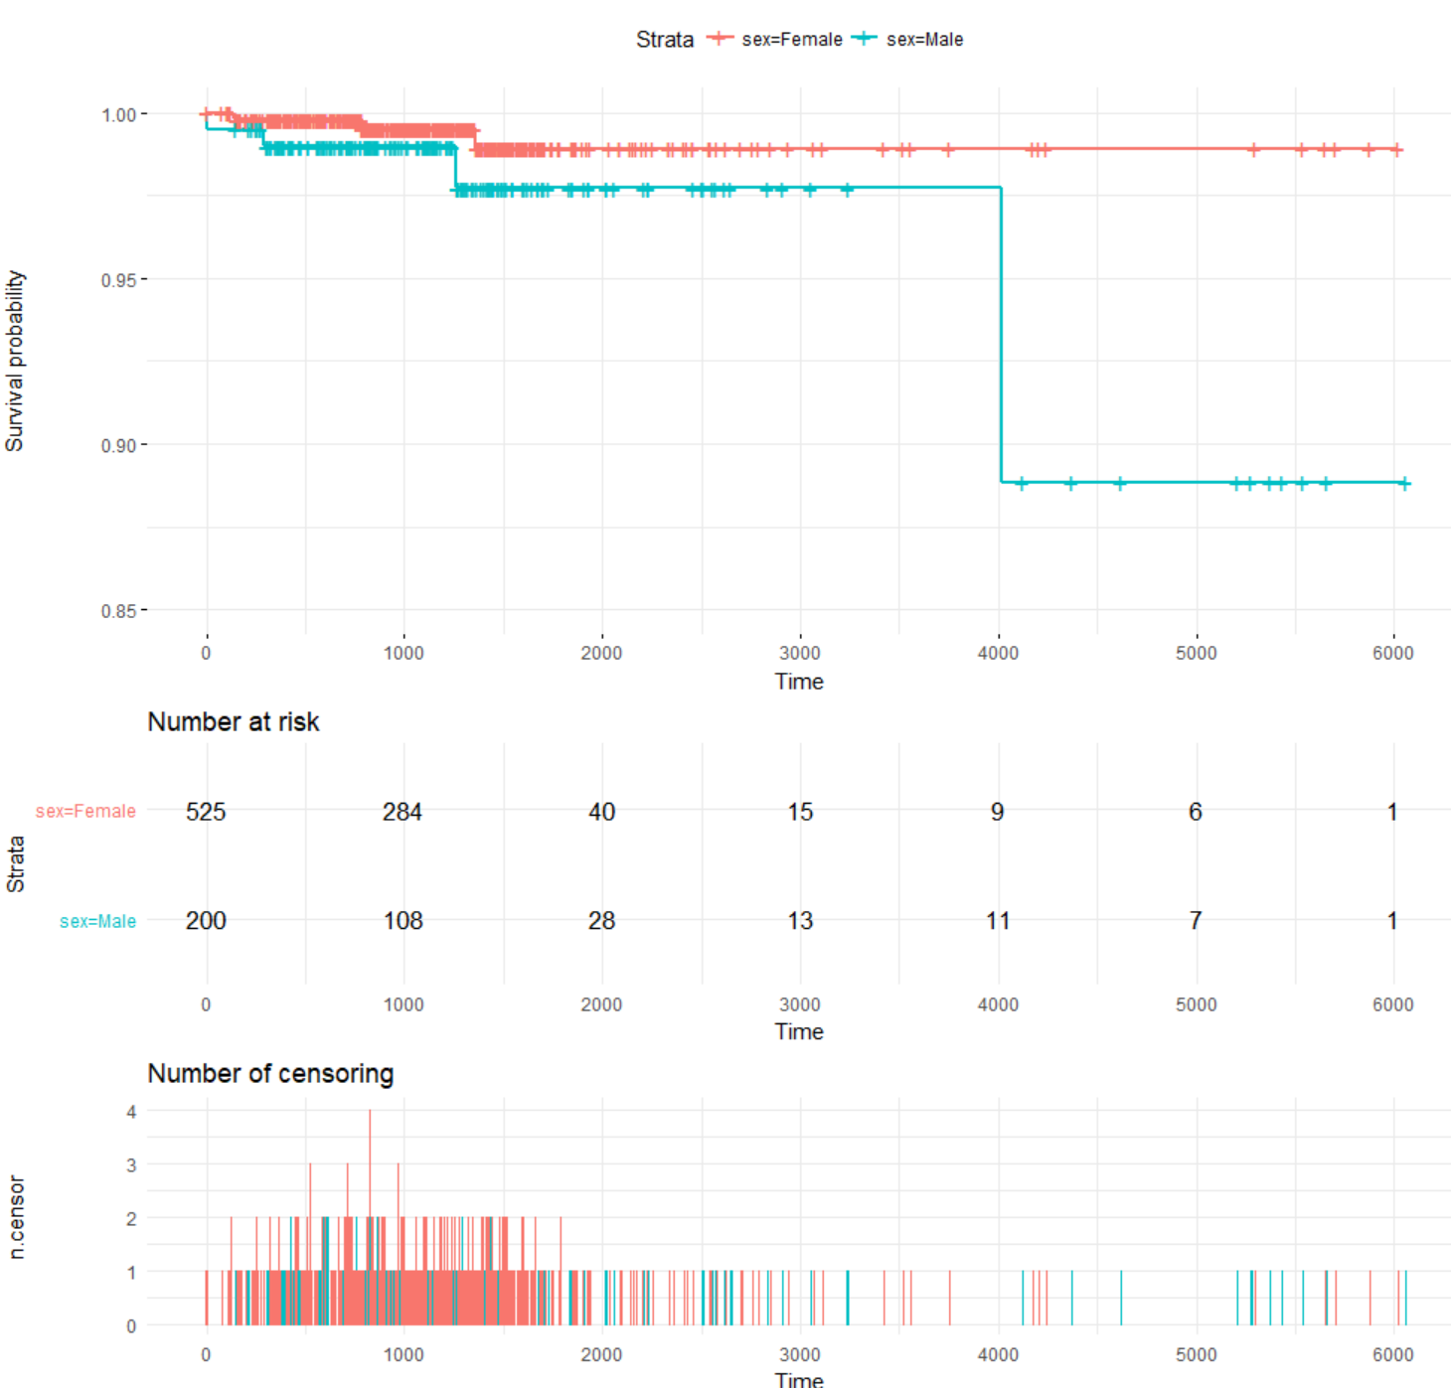
Gender did not significantly affect thyroid cancer survival
Log Rank test shows gender not significant (p-value = 0.141)

Slide 12
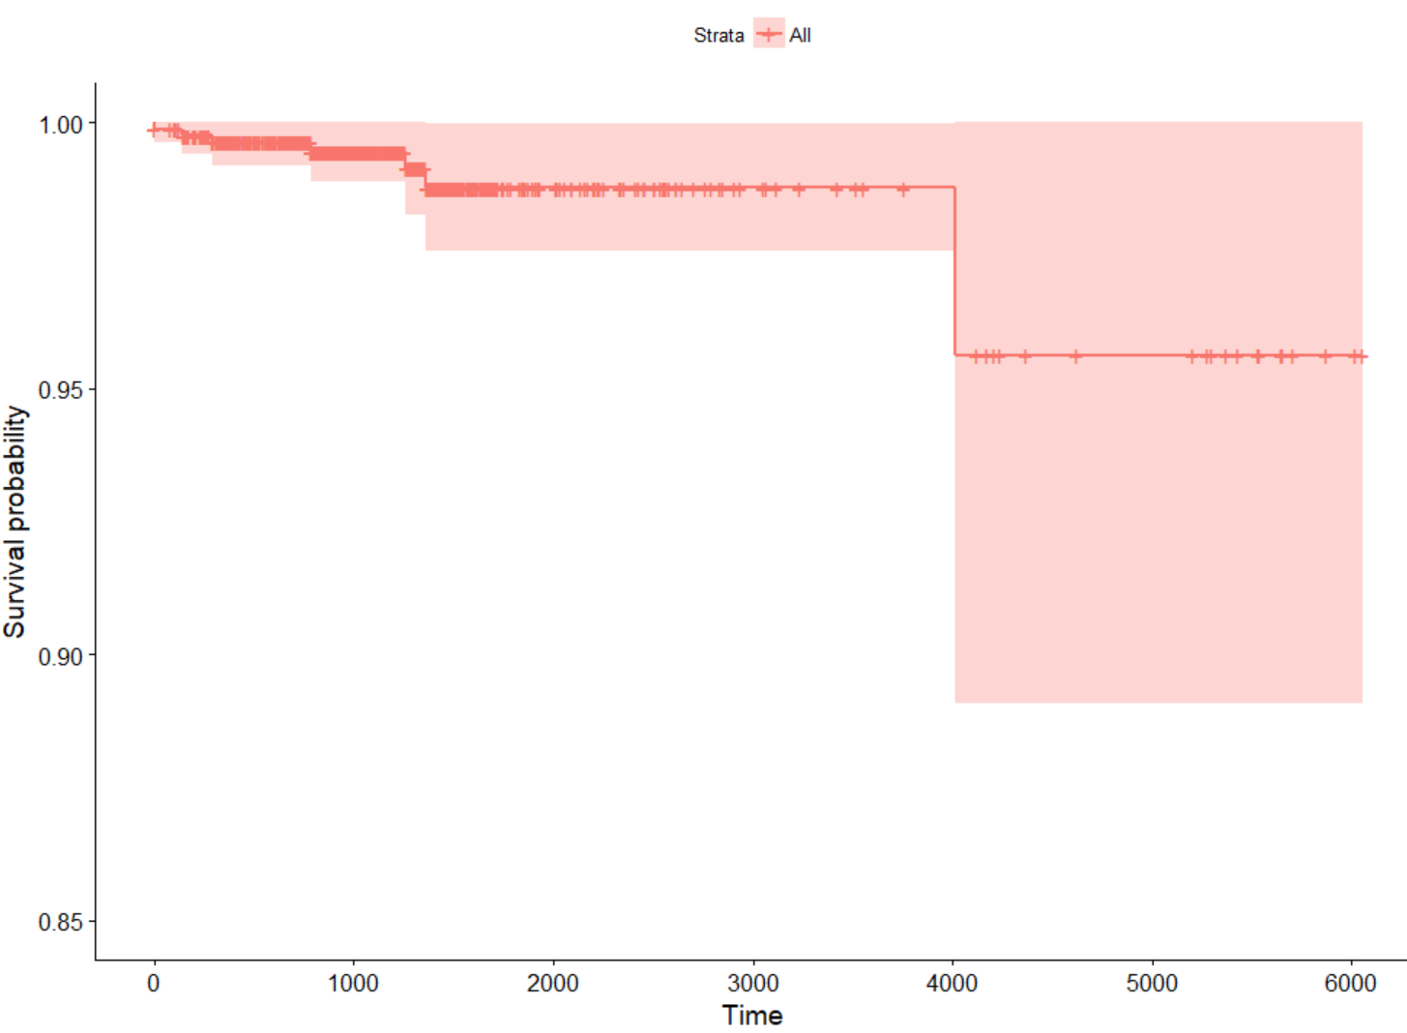
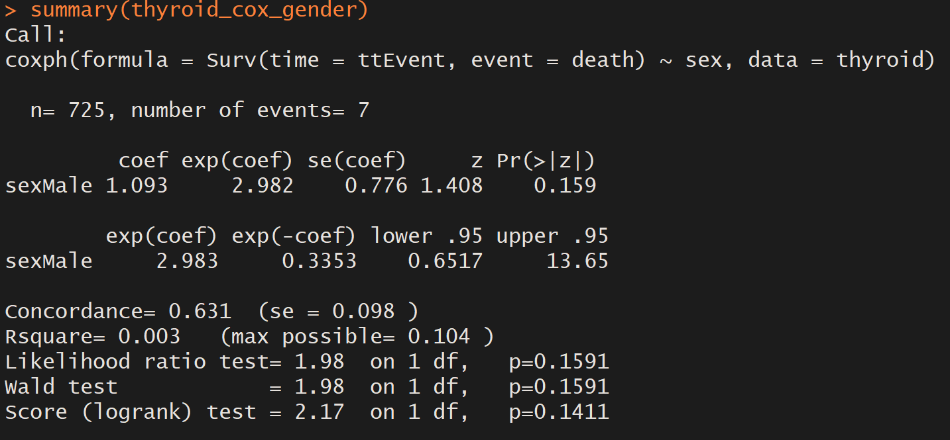
males have higher hazard rate, but still insignificant
Notes:
This chart shows mean HR for both groups.

Slide 13
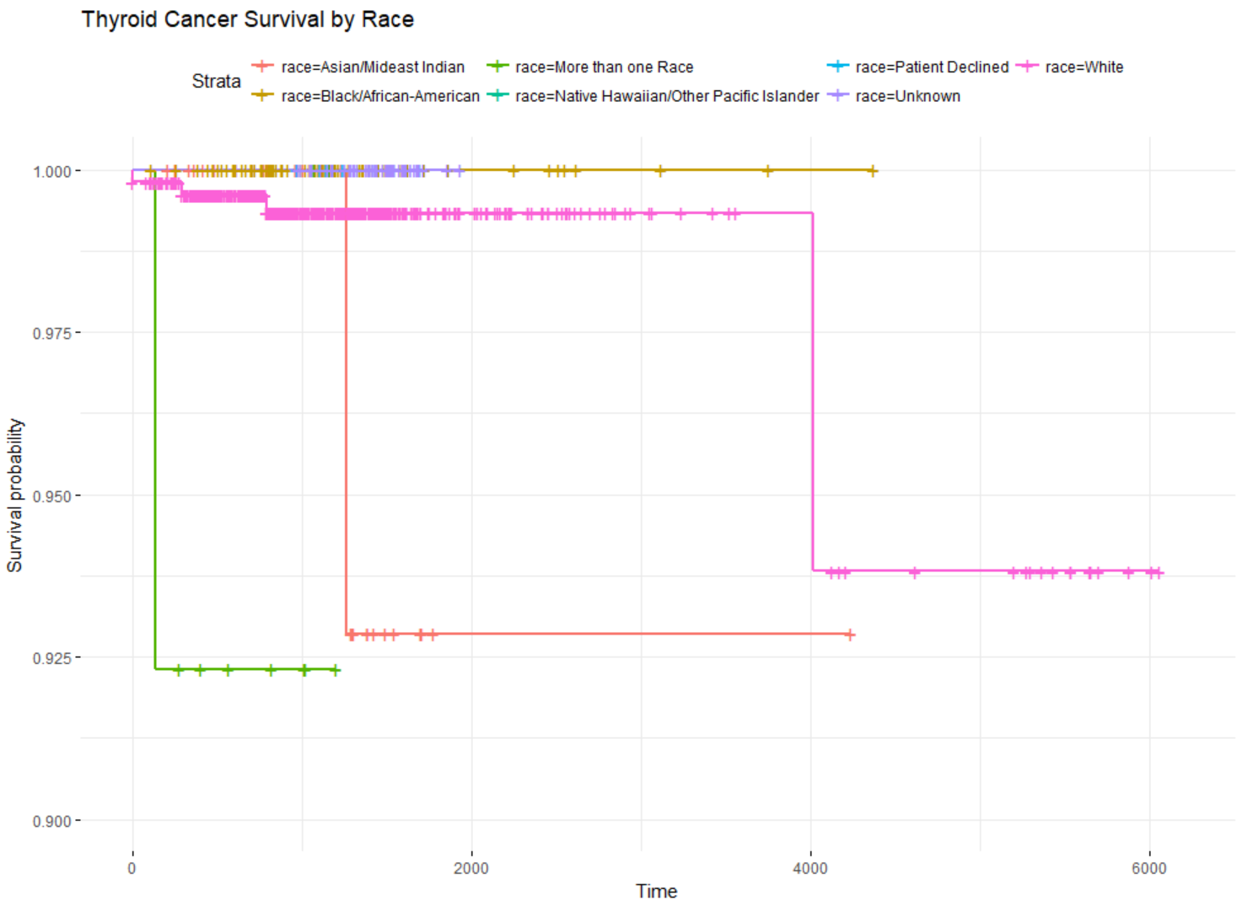
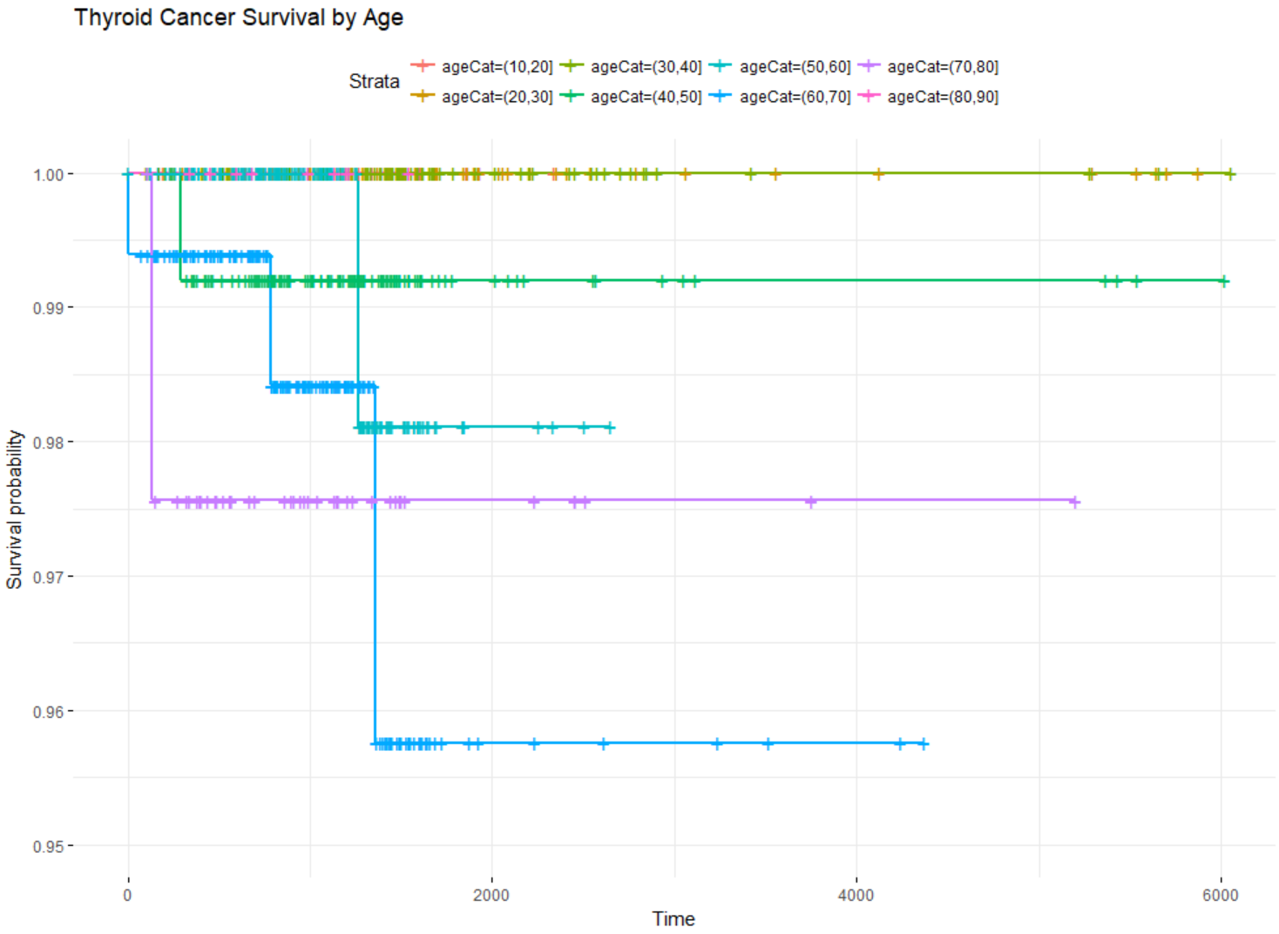
Race was significant for survival of thyroid cancer
Log Rank IS significant with p-value < 0.01
Log Rank not significant with p-value = 0.516
70-80 year old patients’ rate declines fast but stabilizes
60-70 year old patients’ rate declines quickly at 1500 days
Cox PH main assumption violated (survival curves cross); only performed Kaplan-Meier analysis for race/age.
Notes:
Log Rank looks at expected versus actual proportions of events.
KM is univariate analysis of survival time (categorical only).
Cox PH is multivariate analysis of survival time (cat + continuous).

Slide 14
Lung cancer

Slide 15
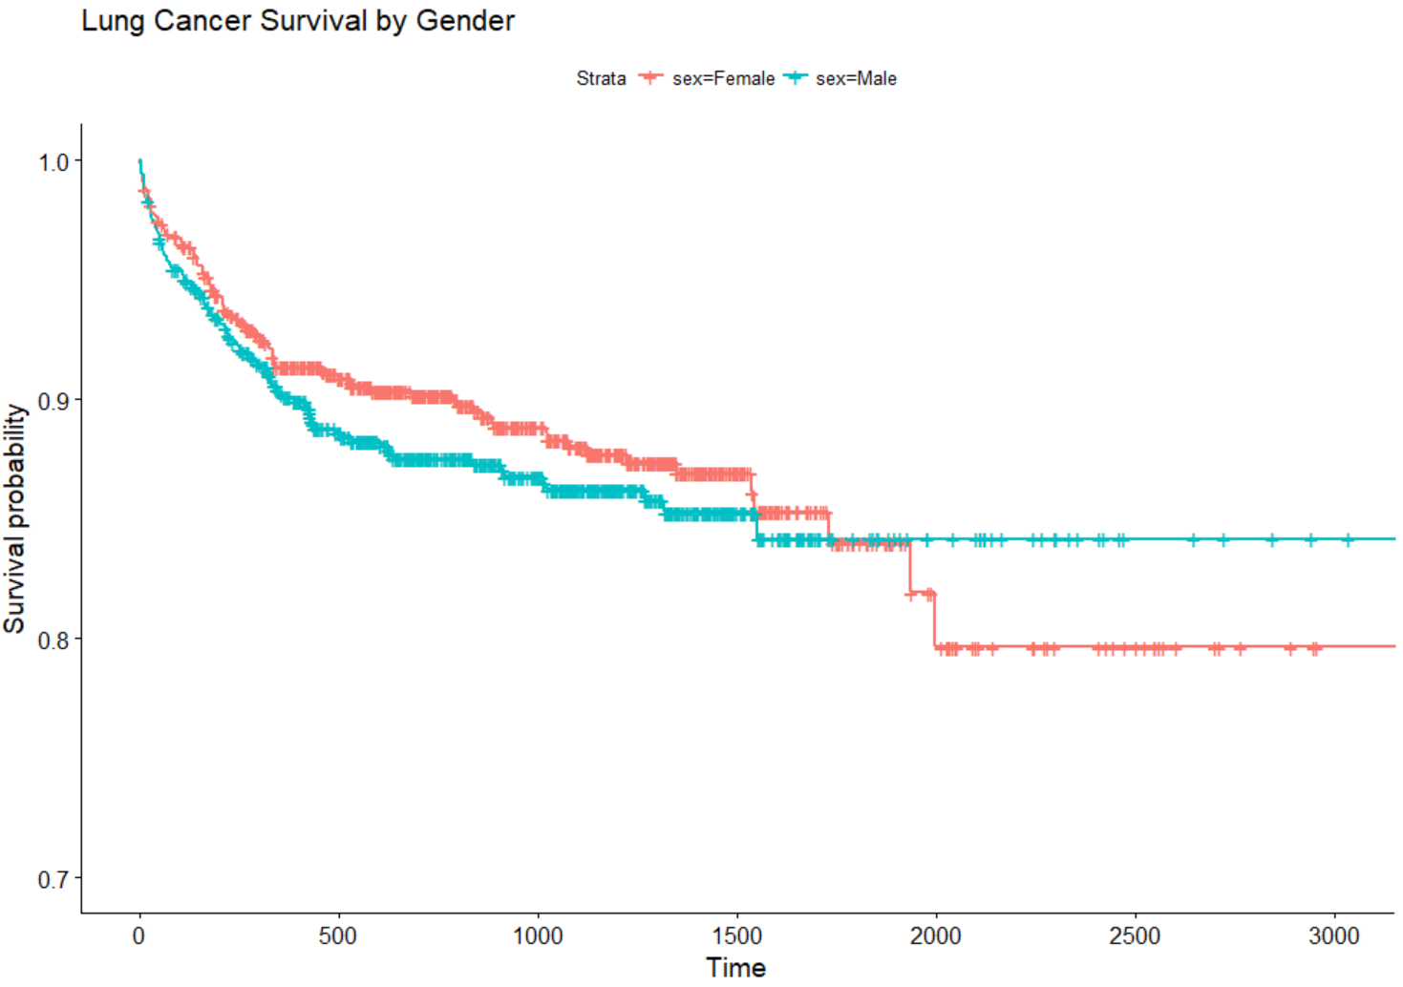
Gender does not significantly affect lung cancer survival
Insignificant Log Rank for Gender
Males have lower survival rate until around 1500 days

Slide 16
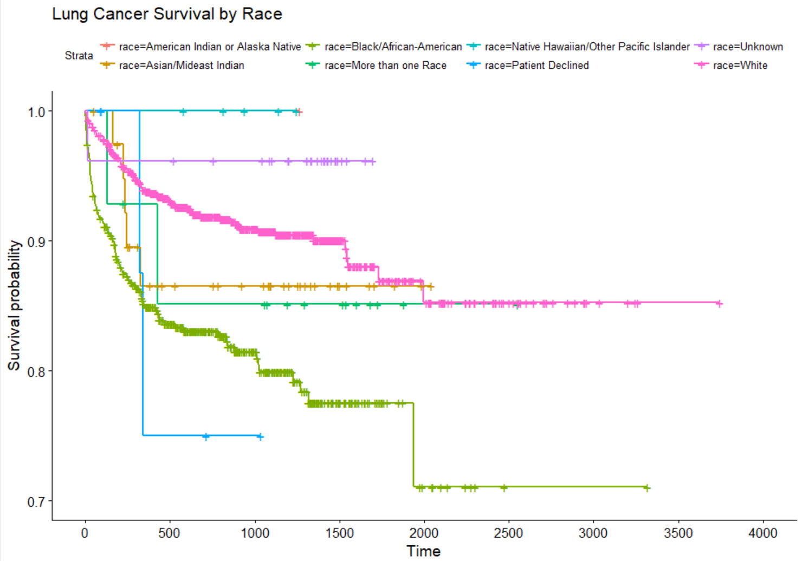
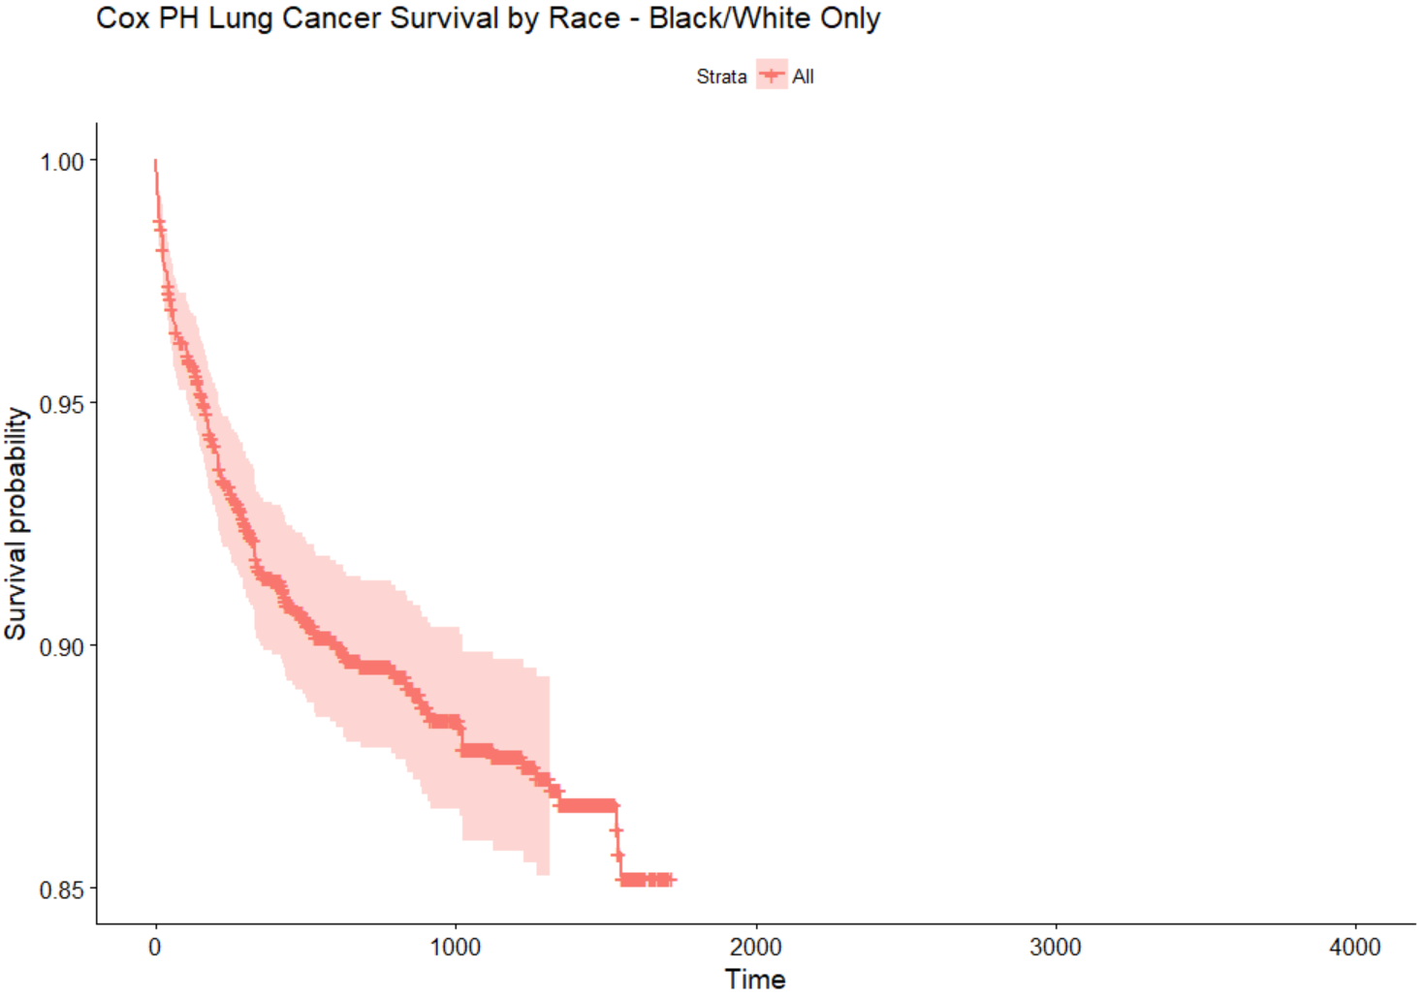

Race was significant for lung cancer, and white patients’ survival rate declined about half as fast as that of black patients
Log Rank is significant with p-value < 0.01
Notes:
B/W curves look proportional – did Cox PH

Slide 17
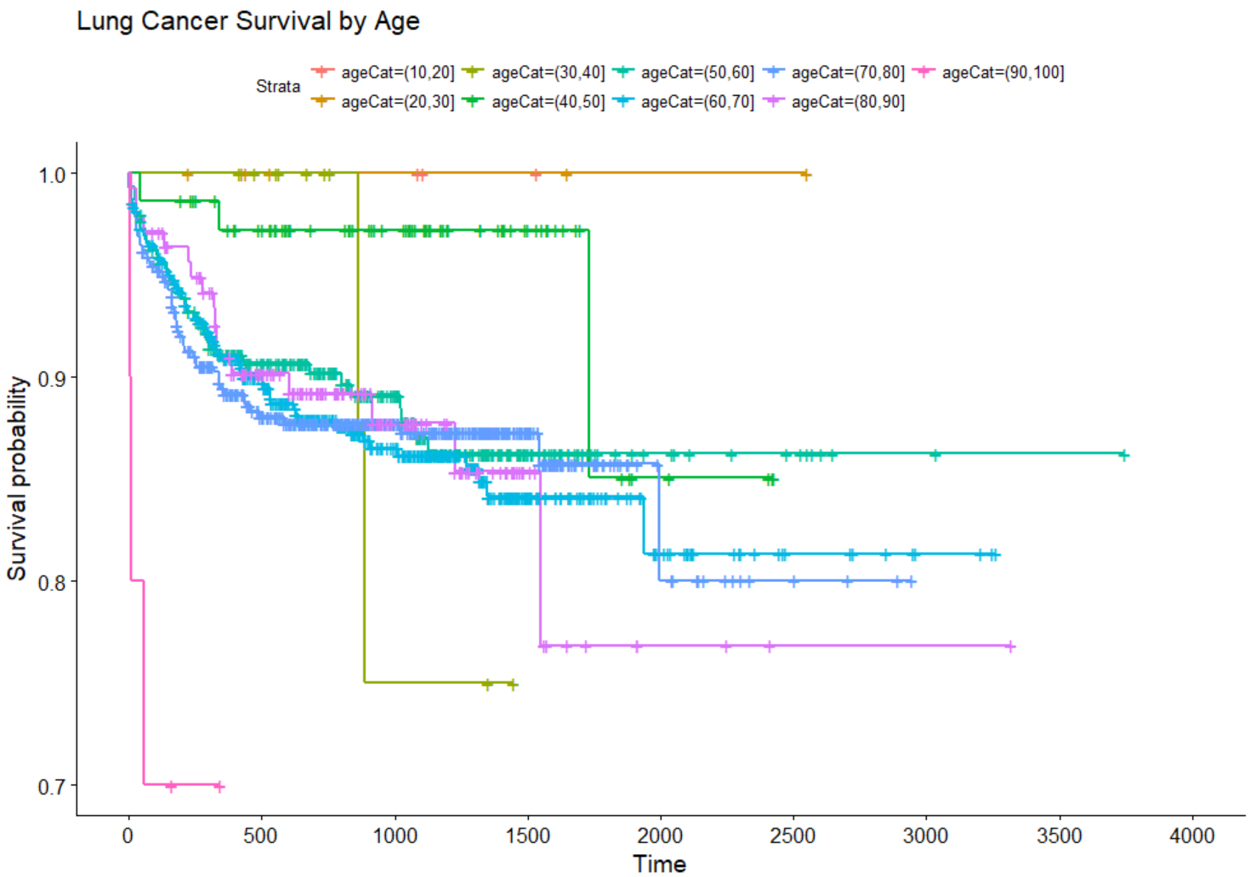
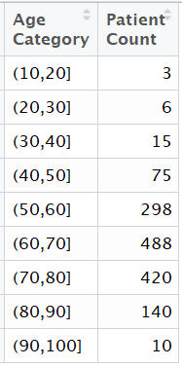
Age was significant in survival of lung cancer by age category
Log Rank is significant with p-value = 0.01
30-40 year old patients had surprising drop at 1000 days but could be due to small sample size

Slide 18
melanoma

Slide 19
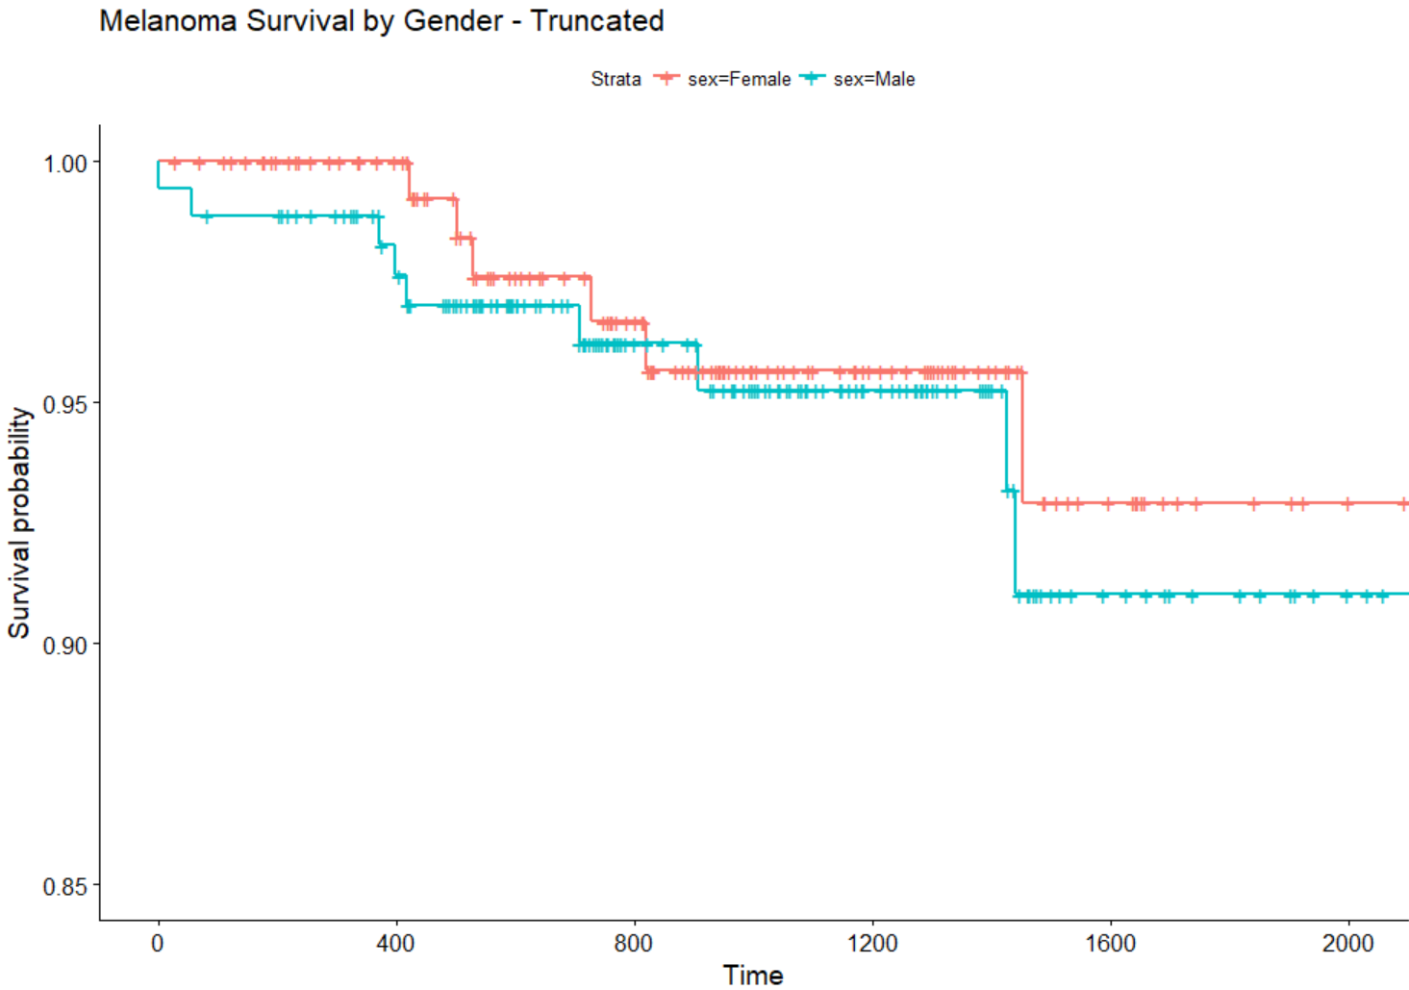
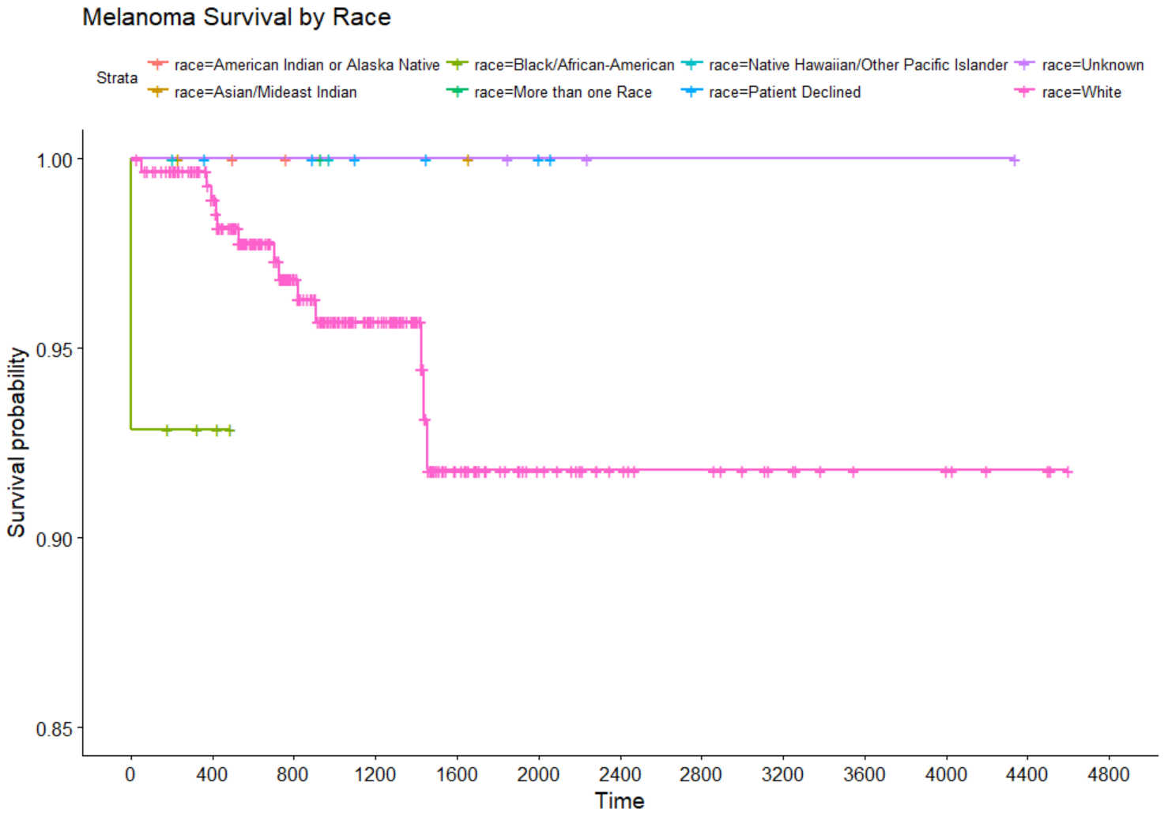
Neither gender nor race significantly impacted melanoma survival
Log Rank not significant with p-value = 0.93
Genders briefly cross at 900 days
Log Rank not significant with p-value = 0.55
91% of people with melanoma were white

Slide 20
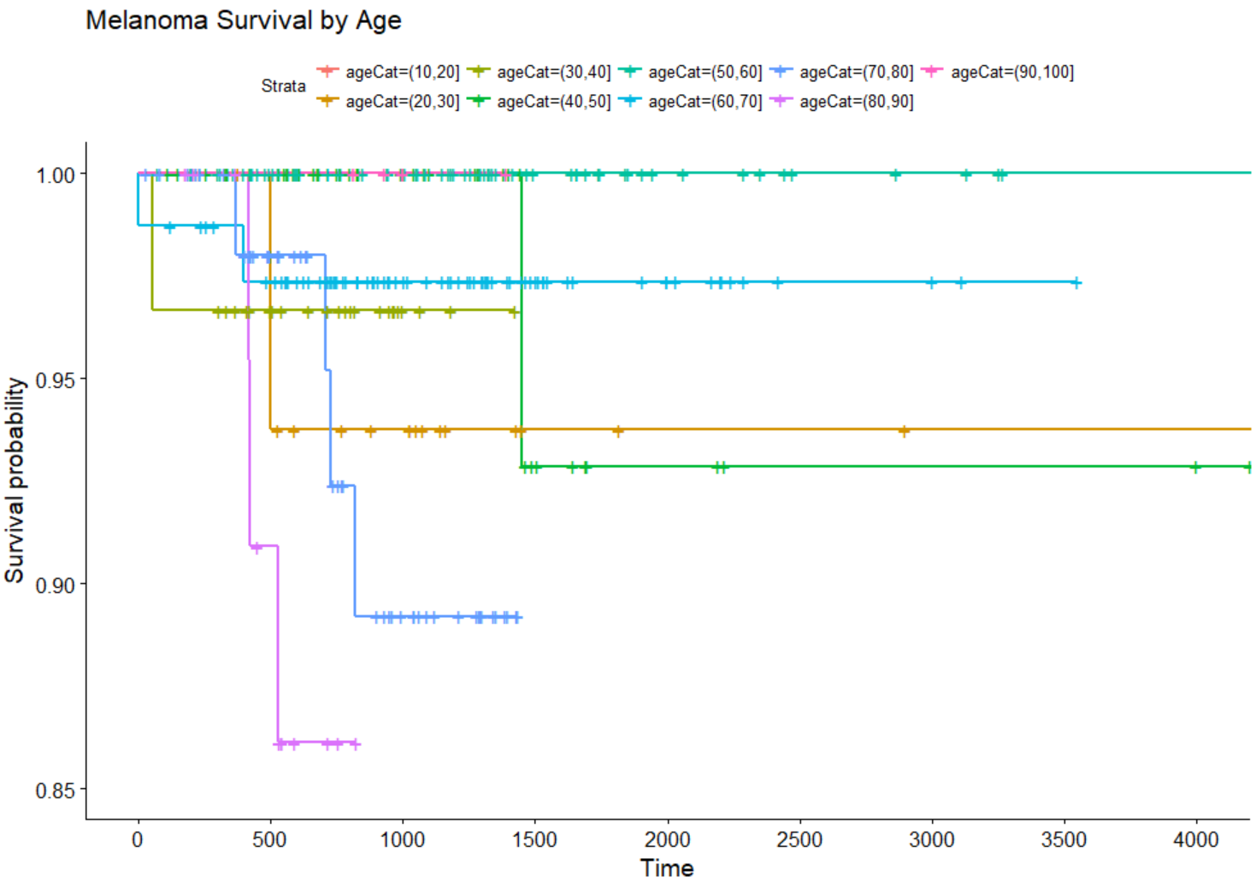
However, age had a significant impact
Log Rank is significant with p-value = 0.005
Survival curves cross
Older people have much lower survival rates
Notes:
Older people

Slide 21
Colorectal cancer

Slide 22
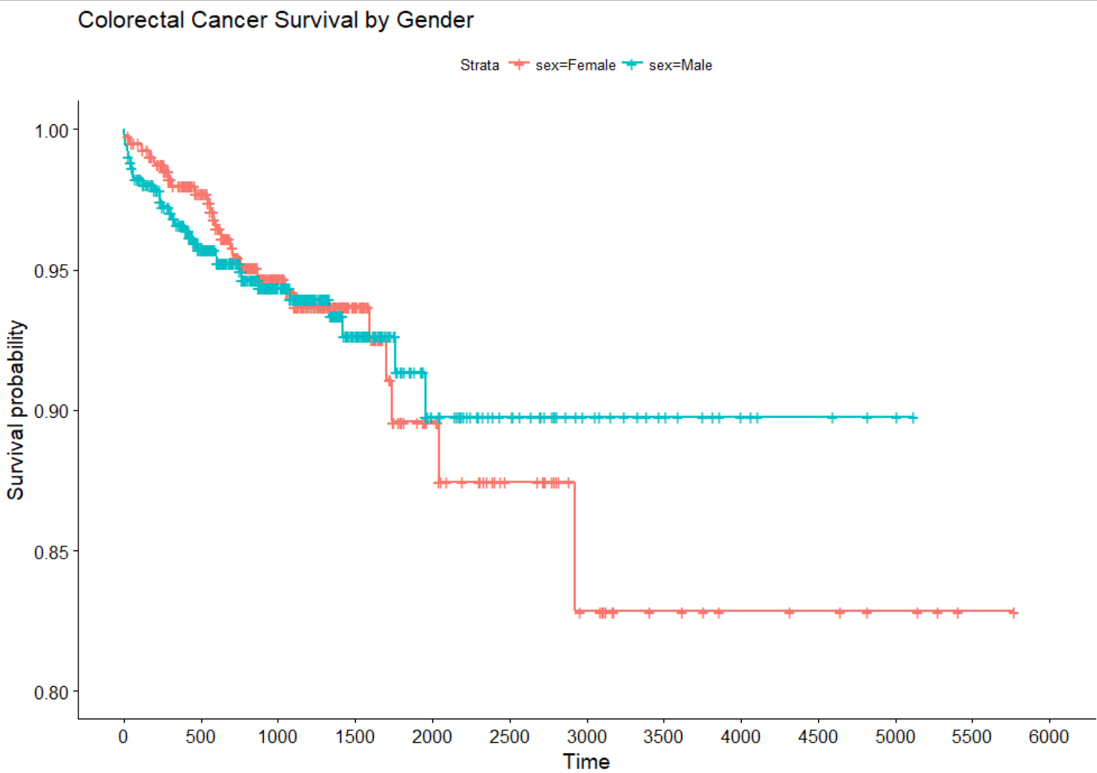
Gender is significant for colorectal cancer
Log Rank is significant with p-value < 0.01
Males have lower survival rate until around 1000 days

Slide 23
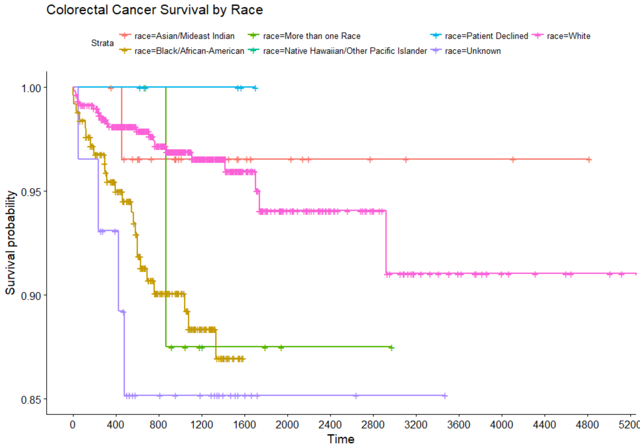
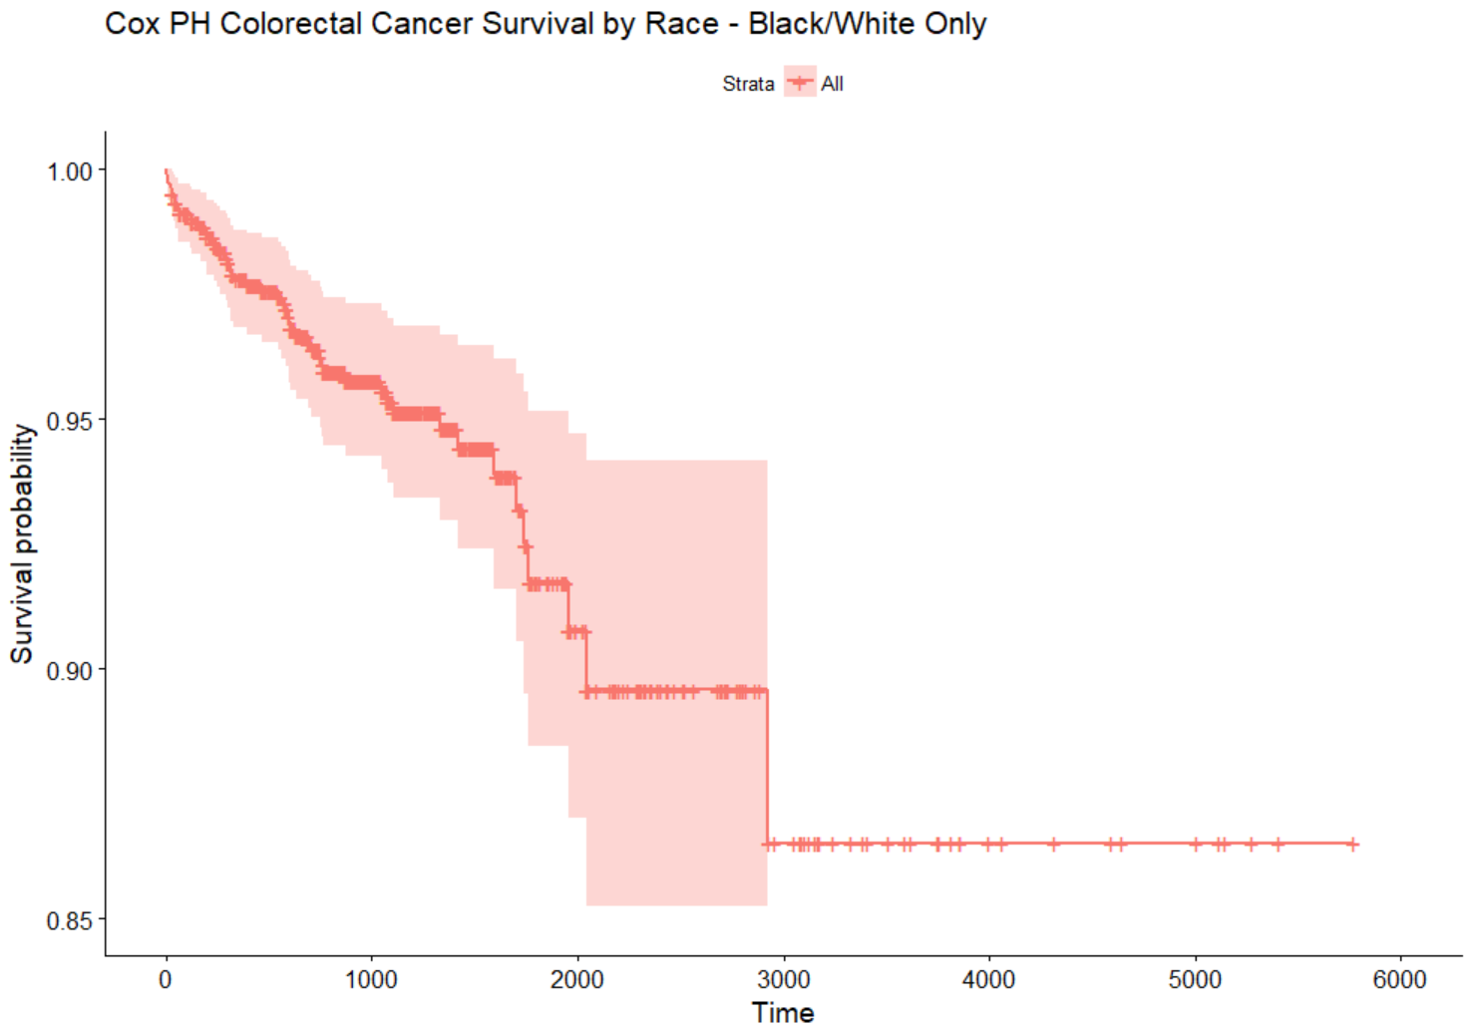
Black patients’ survival of colorectal cancer declines at almost 5x the rate of that of white patients
Log Rank is significant with p-value < 0.01
Notes:
Tried Cox PH with race + gender + race*gender and AA, Males were not significant (no interactions were) – Pacific Islander and AA were significant

Slide 24
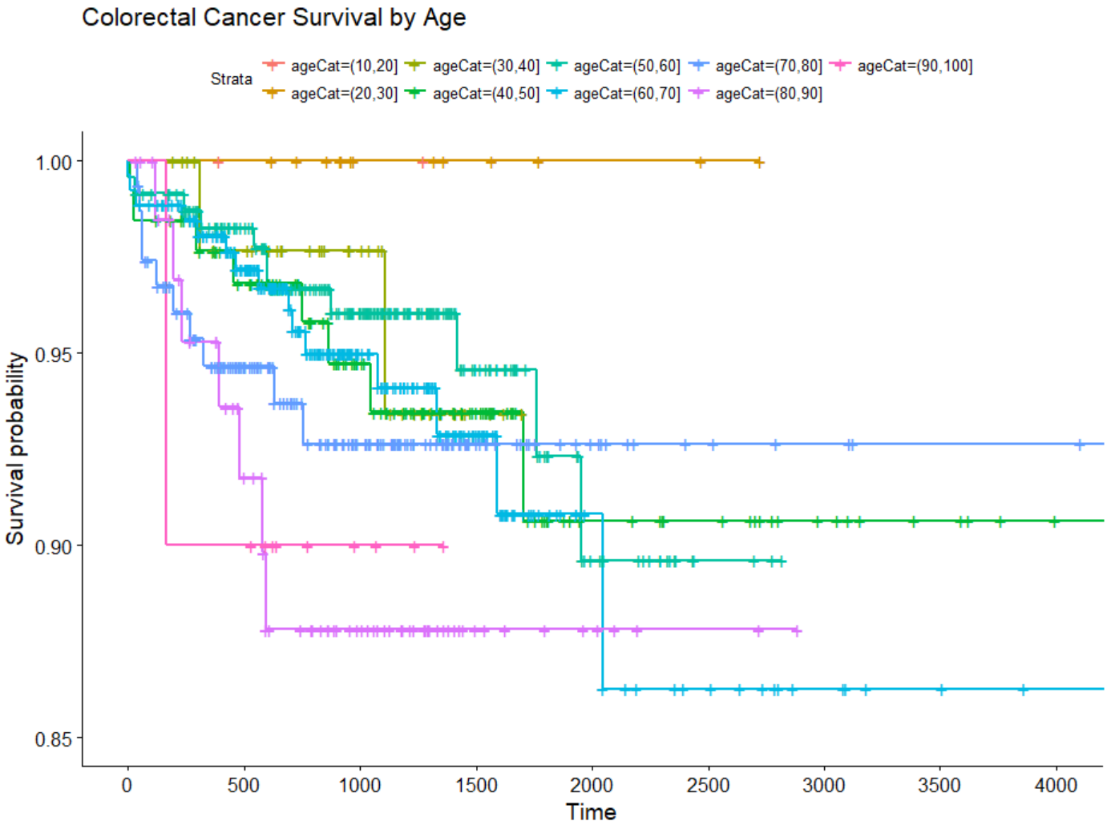
Age was not significant in survival of colorectal cancer
Log Rank not significant with p-value = 0.69

Slide 25
Pancreatic cancer

Slide 26
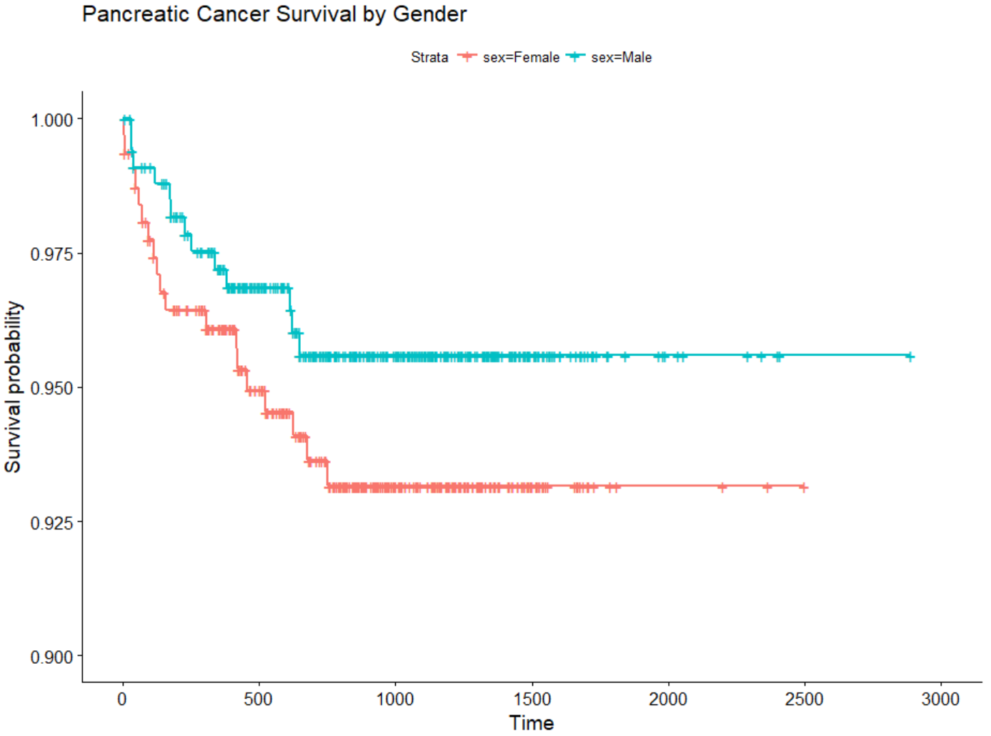
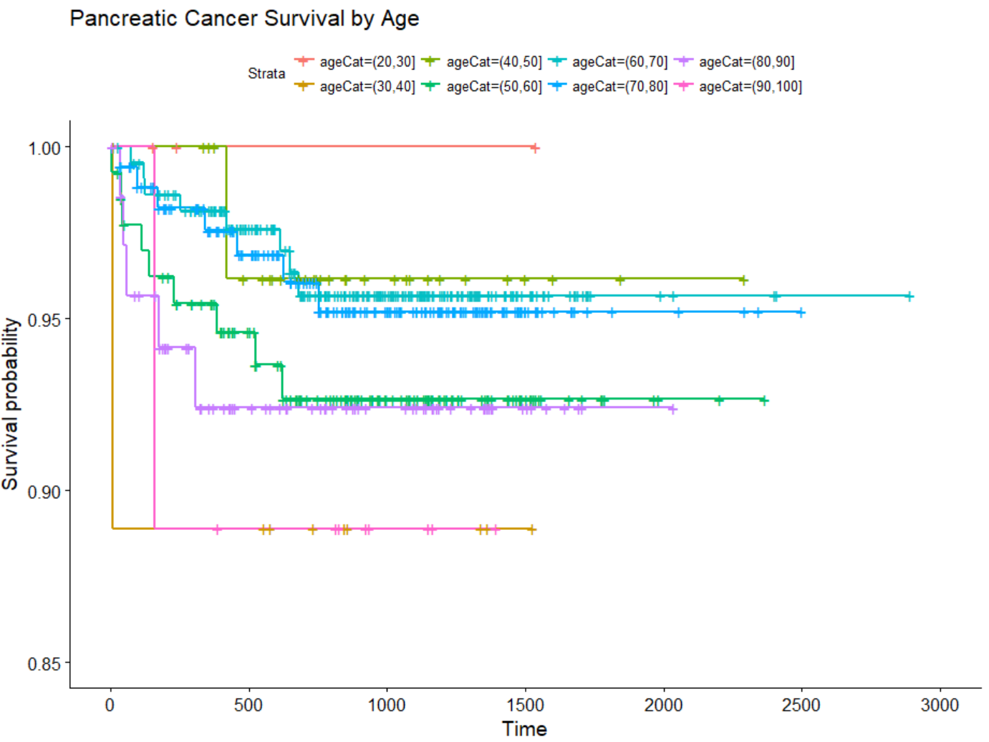
Neither age nor Gender significantly affected survival of pancreatic cancer
Difference between males and females not significant at p-value = 0.209
Performed Cox PH since the curves barely cross – no significant difference noted in Hazard Rate
Difference between races not significant at p-value = 0.7

Slide 27
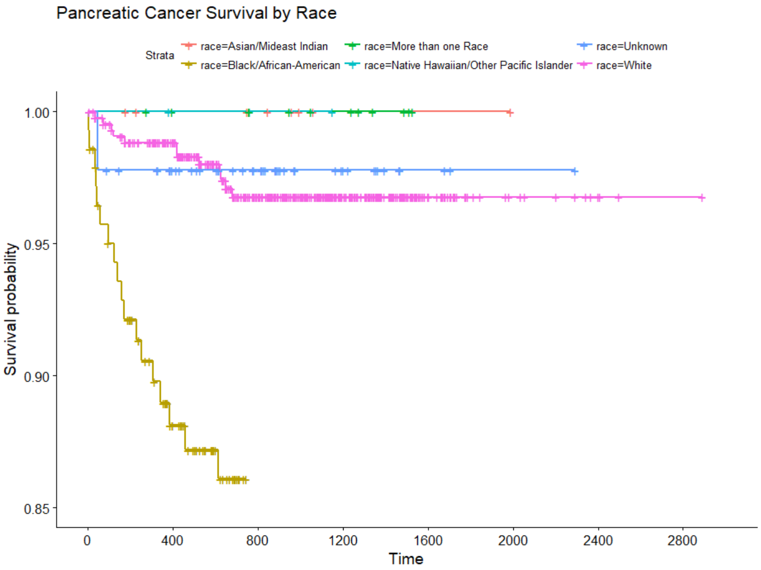
Race was a significant factor in pancreatic cancer survival
Log rank significant at p-value < 0.01
Hazards are not proportional, so can’t do Cox PH analysis on Black/White patients

Slide 28
conclusions
Race is significant for every cancer type except melanoma
In cases where survival curves by race don’t cross, white and black patients’ hazards are often proportional
In 2/5 cancers where this is the case, black patients’ survival declines quicker than that of white patients
Gender is only significant for colorectal cancer, though males’ survival curves were frequently observed to be lower than that of females, and often crossed briefly around 1500 days
Age is significant for melanoma and lung cancer
Observed unexpected survival rates for some groups of lung cancer patients – may be due to sample size
Multivariate analysis and interactions were hard to study due to frequent violation of Cox PH assumption of proportional hazards

