Slide 1
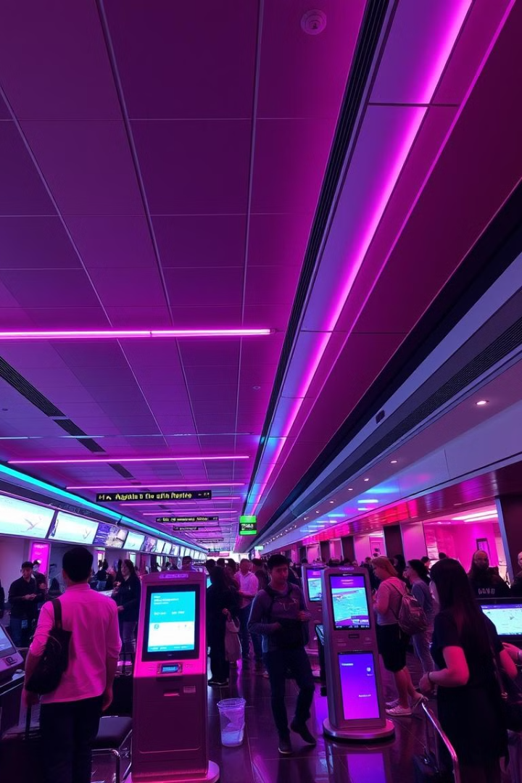
Elite Lounge - AI-Powered Lead Management System
Elite Lounge is a lounge management system focusing on leads and promotions.
Identifies potential customers and enhances engagement using AI.
Facilitates lead capturing, scoring, and targeted promotions.
Optimizes customer targeting for promotions and lounge events.

Slide 2

What Are Leads?
Leads are potential customers interested in the lounge’s services.
Capturing and managing leads boosts customer retention and revenue.
Lead data includes contact details, visit history, and preferences.
AI helps in filtering high-value leads for targeted promotions

Slide 3
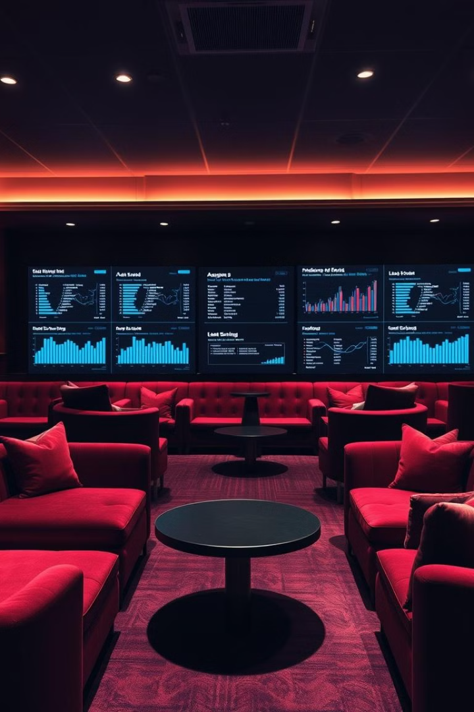
Where Should We Capture Leads?
1
Luxury Service Selection
2
Exclusive Reservation Forms
Capture leads when users explore and select premium lounge services.
Collect detailed information when booking elite lounge experiences.
3
Premium Payment Initiation
4
Lounge Visits
Gather in-person customer data for personalized follow-ups in the lounge.
Capture potential leads even if payment for exclusive services is not completed.

Slide 4
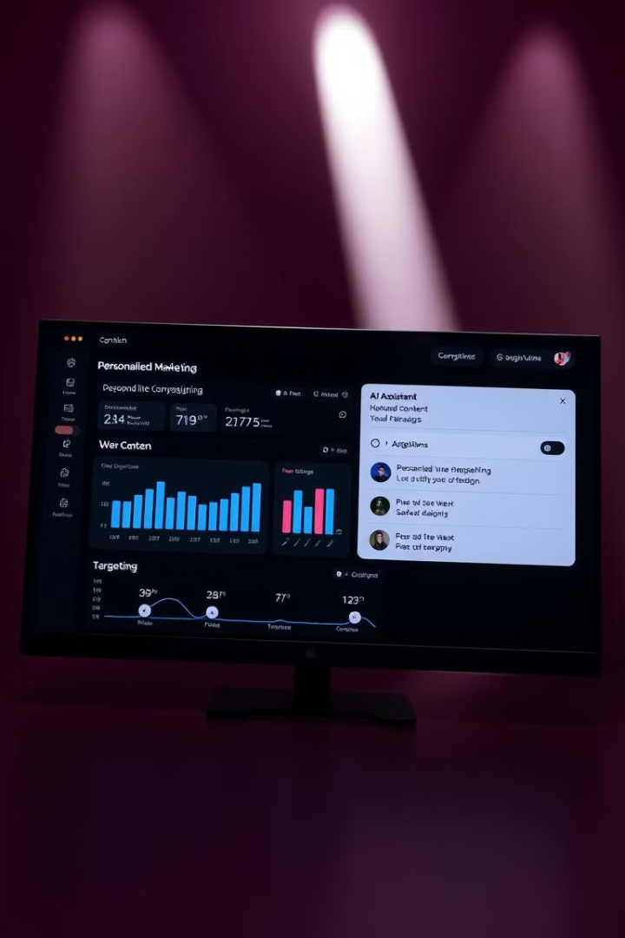
How We Scored Leads in Our Project
Leads are scored using predefined criteria such as visit frequency, spending behavior, and opted services.
Scoring Formula:
Frequent Visitors (5+ visits/month) = +50 points
High Spenders ($200+ per visit) = +30 points
Event Participants (Attends VIP events) = +20 points
Opted for Premium Services (Selected high-end services) = +25 points
Initiating Payment (Started payment process but did not complete) = +10 points
Lead scores are stored in MongoDB and used for segmentation and marketing.
Higher scores indicate loyal or high-value customers, prioritized for exclusive promotions and follow-ups.

Slide 5
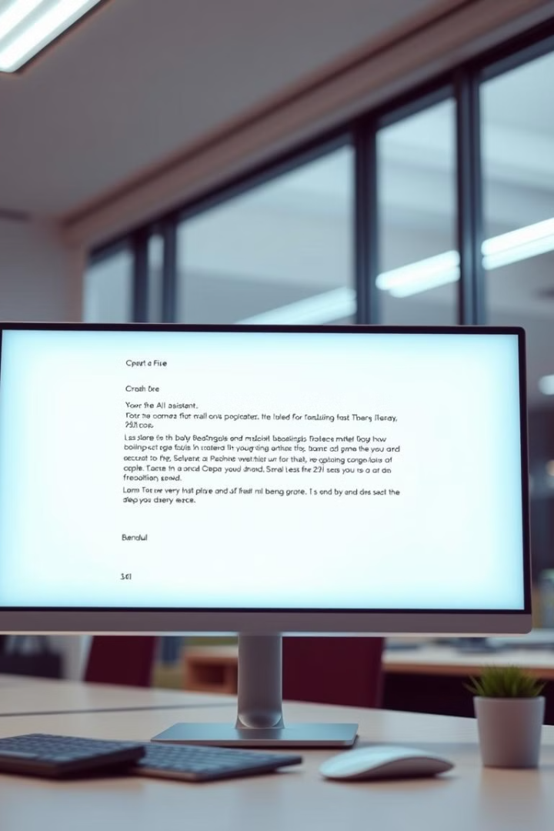
How We Segmented Users Based on Lead Score
Leads are segmented based on their visitor score, calculated using visit frequency, spending, and service selections.
Elite Members (Score > 750): VIP visitors with high spending, premium service usage, and frequent visits.
Loyal Customers (Score 400 - 750): Regular visitors who opt for services and extend lounge time.
Potential Leads (Score 150 - 400): Visitors who initiate payments or request services but have moderate engagement.
New/Inactive Users (Score < 150): First-time visitors or users with minimal activity.
Segmentation helps in targeted marketing, offering relevant promotions to different user groups.

Slide 6

AI-Powered Custom Email Generation
Leverages Hugging Face's GPT models for personalized email content.
Fine-tuned GPT models based on lead segmentation data.
Ensures email copy aligns with specific customer interests and behaviors.
Employs advanced natural language processing to craft unique and engaging emails.
Improves email campaign effectiveness through AI-driven content optimization.
Continuously refines email content using machine learning algorithms for enhanced relevance and impact.

Slide 7

Custom Ads Based on Lead Score
Digital ads are tailored to different lead segments to maximize engagement and conversion rates.
Visitors are segmented into Elite Members, Loyal Customers, Potential Leads, and New/Inactive Users based on lead score.
Elite Members receive VIP event invites and exclusive loyalty rewards through targeted social media ads.
Loyal Customers get special promotions and service upgrades via personalized banner ads on relevant websites.
Potential Leads are targeted with personalized discounts and engagement offers using retargeting campaigns.
New/Inactive Users are re-engaged with introductory deals and reminders through email marketing and display ads.

Slide 8
Possible Future Enhancements
Advanced AI for more precise customer behavior predictions.
Real-time customer tracking for hyper-personalized experiences.
SMS and WhatsApp automation for direct communication.
AI-powered chatbot for handling customer inquiries and bookings.

Slide 9
Thank You

