Slide 1
Gamified Learning Platform for Rural Education Software
University Project
Review-1
Batch Number: CSE_171
Under the Supervision of,
Dr./Mr./Ms./Prof. Fathima Shana E
Professor / Associate Professor / Assistant Professor
School of Computer Science and Engineering
Presidency University
Roll Number | Student Name
20221CSE0344 | THEJAS MAYUR S
20221CSE0345 | VINAY S
20221CSE0382 | MALLIKARJUN A S
Name of the Program:
Name of the HoD: Dr. Asif Mohamed H B
Name of the Program Project Coordinator: Dr. Jayavadivel Ravi
Name of the School Project Coordinators: Dr. Sampath A K , Dr. Geetha A

Slide 2
Content
Problem Statement
Objectives
Background and Related work for title Selection
Analysis of Problem Statement
Innovation or Novel Contributions
Git-hub Link
Timeline of the Project
References

Slide 3
Problem Statement Number: SIH-25048
Category (Hardware / Software / Both) : Software
Problem Description:
Rural students lack resources
Traditional teaching not engaging
Different learning speeds unsupported
Language barriers reduce understanding
Weak STEM concept clarity
Low performance, low interest

Slide 4
Objectives
Gamified Learning Platform
STEM Education
Interactive Game-Based Learning
Multilingual Content, Regional Language Support
Student Progress Tracking
Learning Analytics , Scores & Performance
Rewards & Levels
Improved Learning Outcomes

Slide 5
Background and Related work for title Selection
High quality needs internet
Urban focused limited languages
Gamification boosts engagement retention
Rural challenges unmet platforms
No integrated rural solution

Slide 6
Technology Stack Components:
Frontend (Student & Teacher Interface)
HTML, CSS, JavaScript
React (for interactive UI)
Backend (Application Logic)
Python (Flask / FastAPI)
Database
MySQL / PostgreSQL
Gamification Engine
Score, levels, badges, rewards logic
Content Management System
Stores STEM lessons, quizzes, and games
Multilingual Support
Language translation (Google Translator API)
Cloud Services
Hosting, data storage, and API services

Slide 7
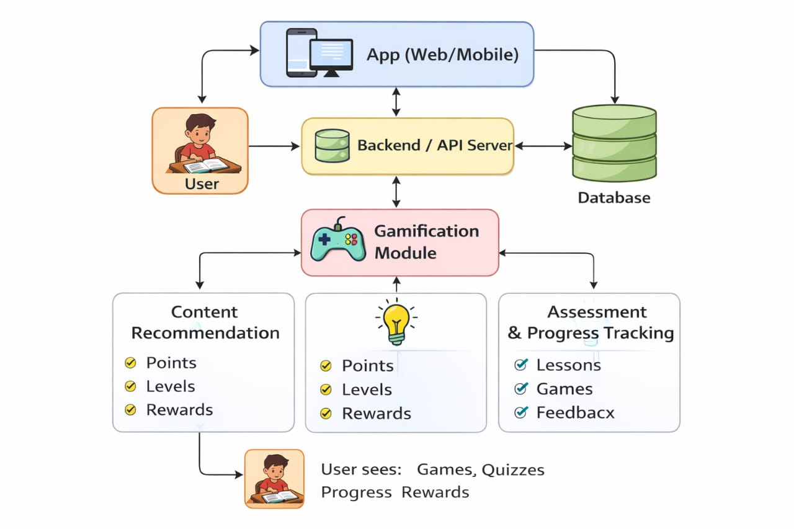
Analysis of Problem Statement (contd...)

Slide 8
Innovation or Novel Contributions
Gamification-based STEM Learning
Multilingual Learning Support
Student Progress Tracking and Rewards
Rural-Focused Digital Education Platform

Slide 9
Github Link
The Github link provided should have public access permission.
Github Link:
https://github.com/vinay18082004/University_project_CSE_171.git

Slide 10
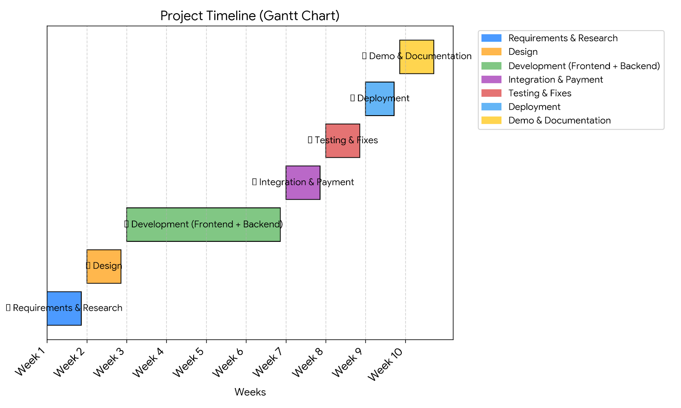
Timeline of the Project (Gantt Chart)

Slide 11
References (IEEE Paper format)
[1] “Beronova: Designing an Offline Interactive Educational Mobile Game App for STEM Learning,” International Journal for Novel Research and Development (IJNRD), 2025.
[2] X. You and M. Sanmugam, “Literature Analysis on the Impact of Gamified Education on Engagement, Motivation, and Learning Outcomes among Rural Children in China,” J. Pendidikan Teknol. Informasi dan Komunikasi, vol. 3, no. 2, pp. 68–79, 2024.
[3] L. F. Dos Santos, W. Oliveira and J. Hamari, “The Effects of Ecological Gamification on Learners’ Engagement: A Quasi-Experimental Study,” in Proceedings of the 2024 IEEE International Conference on Advanced Learning Technologies (ICALT), pp. 8-9.
[4] S. Capecchi, A. Lieto, F. Patti, R. G. Pensa, A. Rapp, F. Vernero and S. Zingaro, “A Gamified Platform to Support Educational Activities about Fake News in Social Media,” IEEE Transactions on Learning Technologies, vol. XX, no. X, pp. 1–15, Apr. 2024, doi: 10.1109/TLT.2024.3410088.
[5] P. Palee, “Interactive Learning Platforms and STEAM Education with Gamification,” Journal of Advanced Research in Technology and Innovation, 2024.

Slide 12
References (IEEE Paper format) with pros and cons
Paper Title | Pros (Advantages) | Cons (Limitations)
Beronova: Designing an Interactive Educational Android-Based Mobile Game Application for Enhanced STEM Education | • Useful for rural areas • Improves STEM engagement through gamified learning | • Limited to selected STEM subjects
Literature Analysis on the Impact of Gamified Education on Engagement, Motivation, and Learning Outcomes Among Preschool Children in Rural Communities in China | • Improves motivation and learning • Preserves rural cultural values | • Depends on digital infrastructure • Focused only on preschool children
The Effects of Ecological Gamification on Learners’ Engagement: A Quasi-Experimental Study | • Supports personalized gamification • Improves learner engagement | • Small sample size • Results may not apply to all learners
A Gamified Platform to Support Educational Activities About Fake News in Social Media | • Develops critical thinking • Provides teacher monitoring and reports | • Needs teacher supervision • Focused only on fake news topic

Slide 13


