Slide 1
Gamified Learning Platform for Rural Education Software
University Project
Review-3
Batch Number: CSE_171
Under the Supervision of,
Ms. Fathima Shana E
Assistant Professor
School of Computer Science and Engineering
Presidency University
Roll Number | Student Name
20221CSE0344 | THEJAS MAYUR S
20221CSE0345 | VINAY S
20221CSE0382 | MALLIKARJUN A S
Name of the Program: University Project
Name of the HoD: Dr. Asif Mohamed H B
Name of the Program Project Coordinator: Dr. Jayavadivel Ravi
Name of the School Project Coordinators: Dr. Sampath A K , Dr. Geetha A

Slide 2
MAIN GAME SYSTEM ALGORITHM
START
1. Initialize Score = 0
2. Initialize Health = 100
3. Initialize Progress = 0
4. Initialize Combo = 1
5. Read:
SUBJECT selected by student
GRADE selected by student
6. Route Game based on:
SUBJECT + GRADE
7. Load appropriate game mode
Example:
Grade 6 → Arcade
Grade 8 → Shooter
Grade 10 → MCQ
END

Slide 3
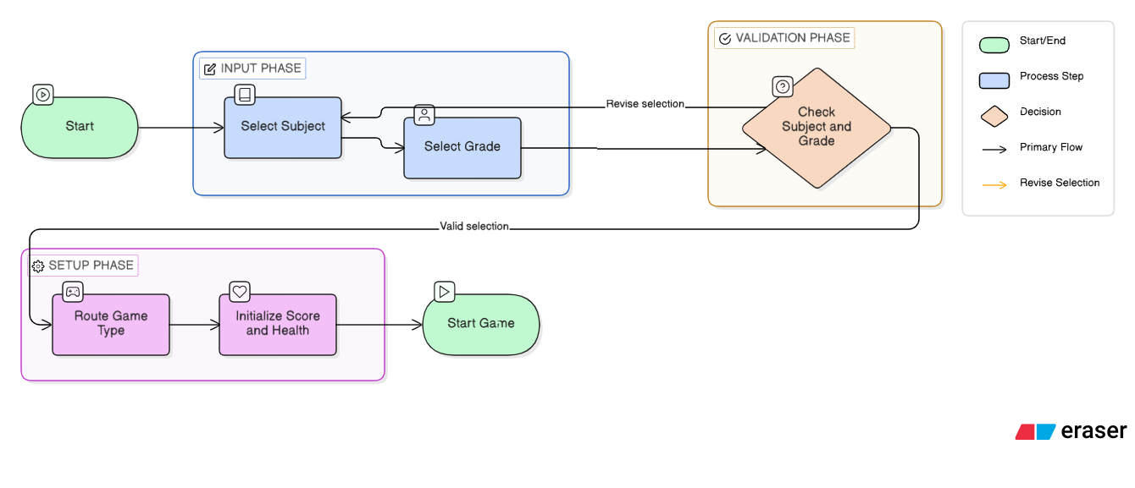
FLOW CHART

Slide 4
MCQ GAME LOGIC
START
1. Load Question Bank
2. Translate questions if needed
3. Shuffle Options
4. Display Question
5. Wait for Player Selection
6. IF answer is correct THEN
Score = Score + 25
Show "Correct"
Increase Progress
ELSE
Reduce Life
Show "Wrong"
7. Move to Next Question
8 IF Time = 0 OR Lives = 0
End Game
END

Slide 5
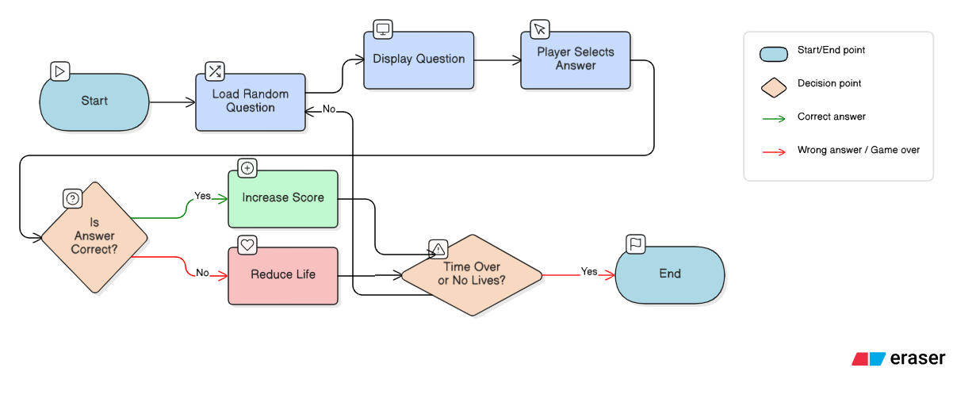
FLOW CHART

Slide 6
MULTI-LANGUAGE SYSTEM
START
1. Detect Selected Language
2. IF Language = English
Display Original Text
ELSE
Send Text for Translation
3. Replace UI Text
4. Display Translated Game
5. IF Translation fails
Use English (Fallback)
END

Slide 7
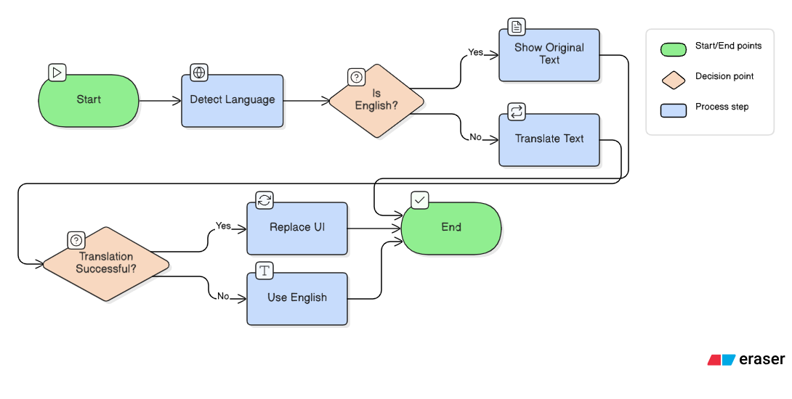
FLOW CHART

Slide 8
NOTIFICATION SYSTEM
START
1. Receive Message
2. Assign Type (Success / Error / Info)
3. Create Notification Box
4. Display to User
5. Wait for Duration
6. Auto Remove Notification
END

Slide 9
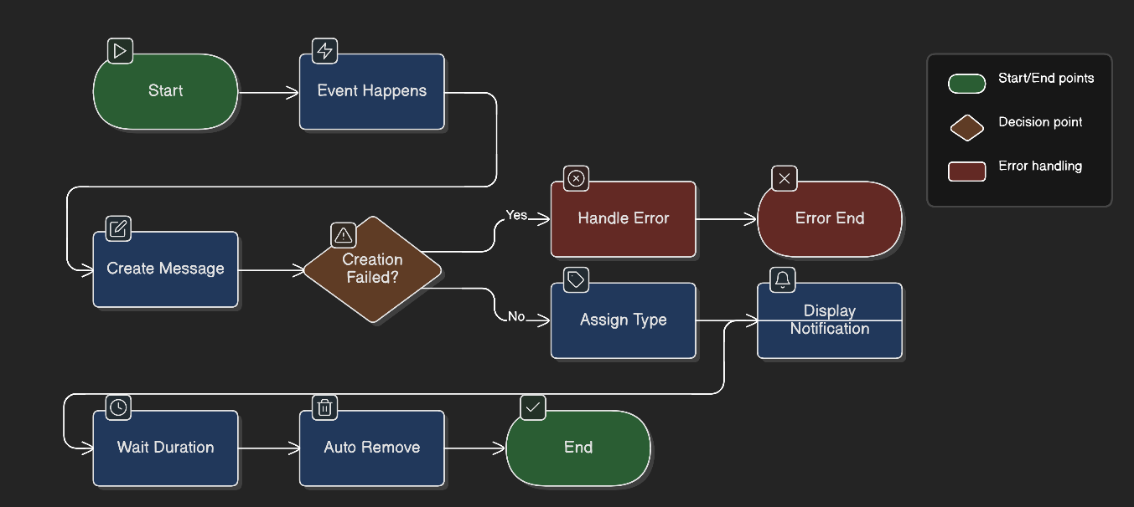
FLOW CHART

Slide 10
GAME SESSION STORAGE
START
1. User logs in
2. Start Game Session
3. Store:
User ID
Subject
Grade
Score
Accuracy
Time
4. Save in Database
5. Update XP
6. Update Level
END

Slide 11
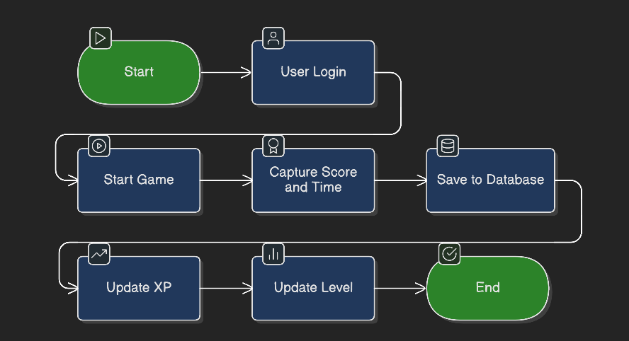
FLOW CHART

Slide 12
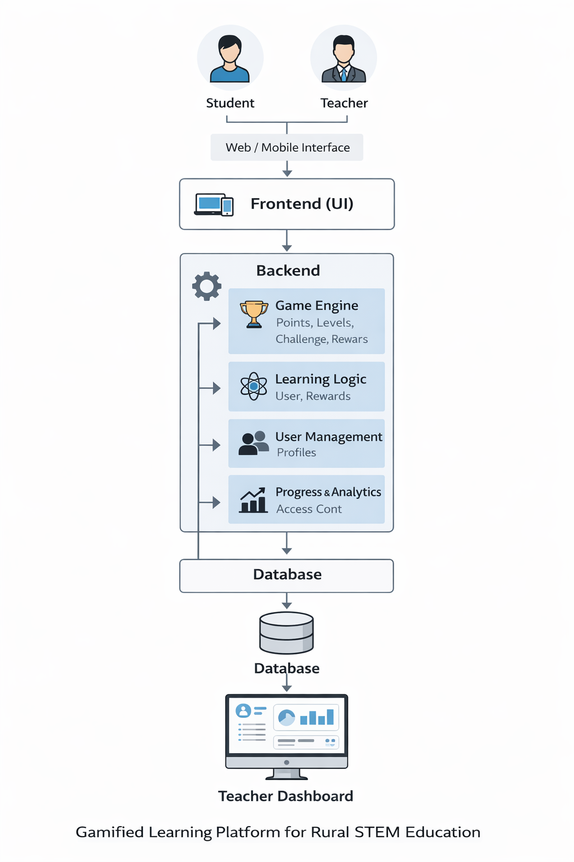
System Architecture

Slide 13
Technology Stack Components:
Frontend (Student & Teacher Interface)
HTML, CSS, JavaScript
Backend (Application Logic)
Python (Flask / FastAPI)
Database
PostgreSQL
Gamification Engine
Score, levels, badges, rewards logic
Content Management System
Stores STEM lessons, quizzes, and games
Multilingual Support
Language translation (Google Translator API)

Slide 14
Github Link
The Github link provided should have public access permission.
Github Link:
https://github.com/vinay18082004/University_project_CSE_171.git

Slide 15
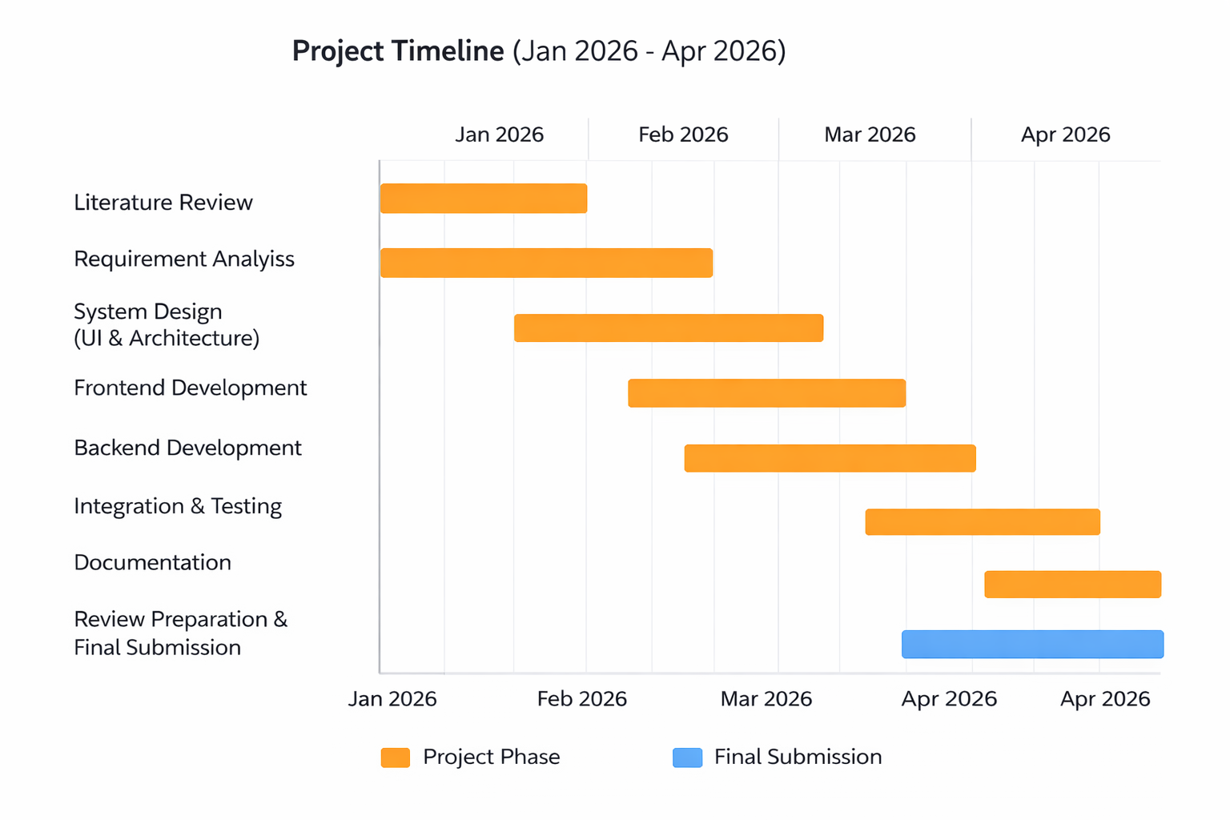
Timeline of the Project (Gantt Chart)

Slide 16


