Slide 1
Gamified Learning Platform for Rural Education Software
University Project
Review-4
Batch Number: CSE_171
Under the Supervision of,
Ms. Fathima Shana E
Assistant Professor
School of Computer Science and Engineering
Presidency University
Roll Number | Student Name
20221CSE0344 | THEJAS MAYUR S
20221CSE0345 | VINAY S
20221CSE0382 | MALLIKARJUN A S
Name of the Program: University Project
Name of the HoD: Dr. Asif Mohamed H B
Name of the Program Project Coordinator: Dr. Jayavadivel Ravi
Name of the School Project Coordinators: Dr. Sampath A K , Dr. Geetha A

Slide 2
Abstract
Problem: Low STEM engagement in rural education
Objective: Improve learning through gamification
Solution: Gamified STEM learning platform
Approach: Research-driven design and modular architecture

Slide 3
Problem Statement Number: SIH-25048
Category (Hardware / Software / Both) : Software
Problem Description:
Rural students lack resources
Traditional teaching not engaging
Different learning speeds unsupported
Language barriers reduce understanding
Weak STEM concept clarity
Low performance, low interest

Slide 4
Key Conclusions from Literature Survey
Gamification improves engagement and learning outcomes.
Personalised gamification is more effective than generic design.
Challenge-based learning outperforms passive learning.
STEM learning benefits from interactive games.
Simple UI improves usability and engagement.
Feedback, rewards, and progress tracking sustain motivation
Teacher monitoring improves learning effectiveness
Context-aware content increases rural learner participation
Performance tracking validates learning outcomes

Slide 5
Objectives
Gamified Learning Platform
STEM Education
Interactive Game-Based Learning
Multilingual Content, Regional Language Support
Student Progress Tracking
Learning Analytics , Scores & Performance
Rewards & Levels
Improved Learning Outcomes

Slide 6
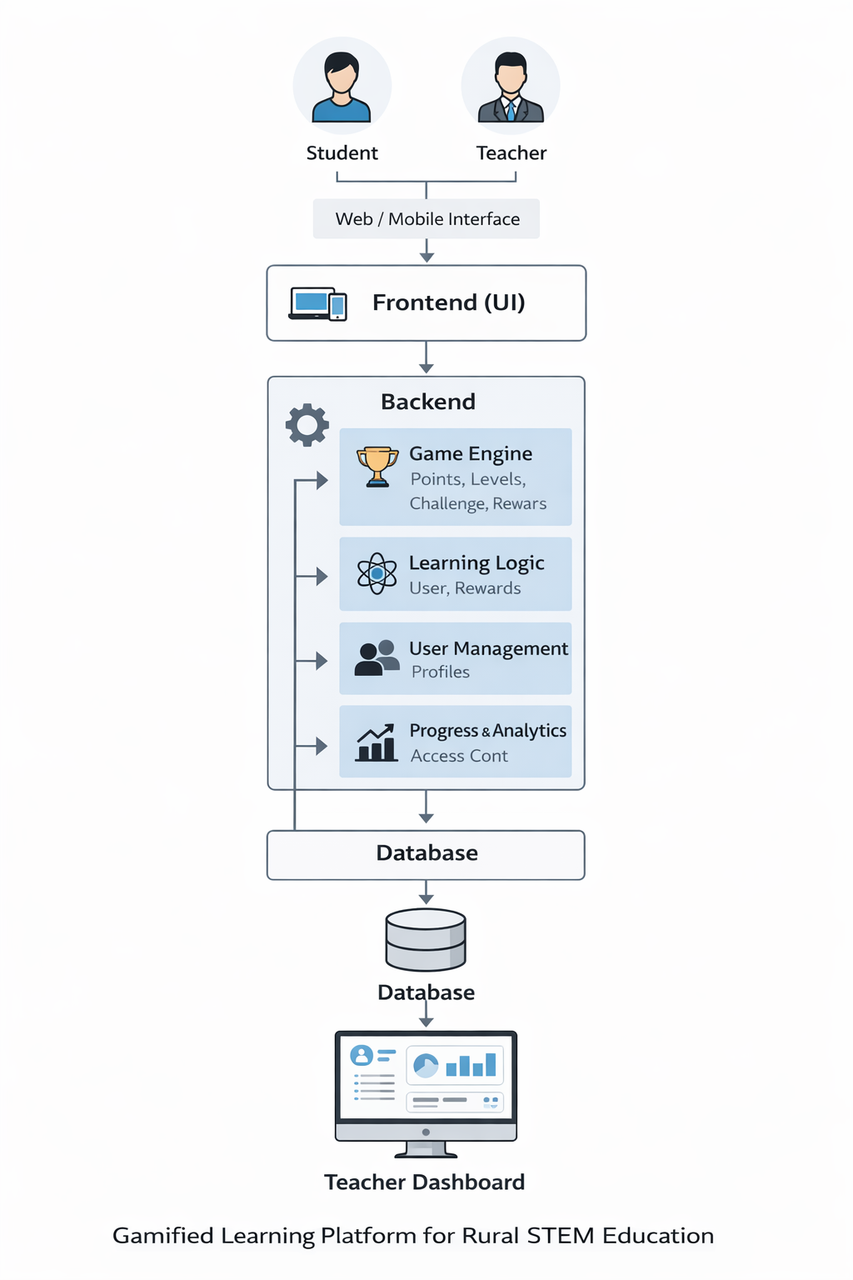
System Architecture

Slide 7
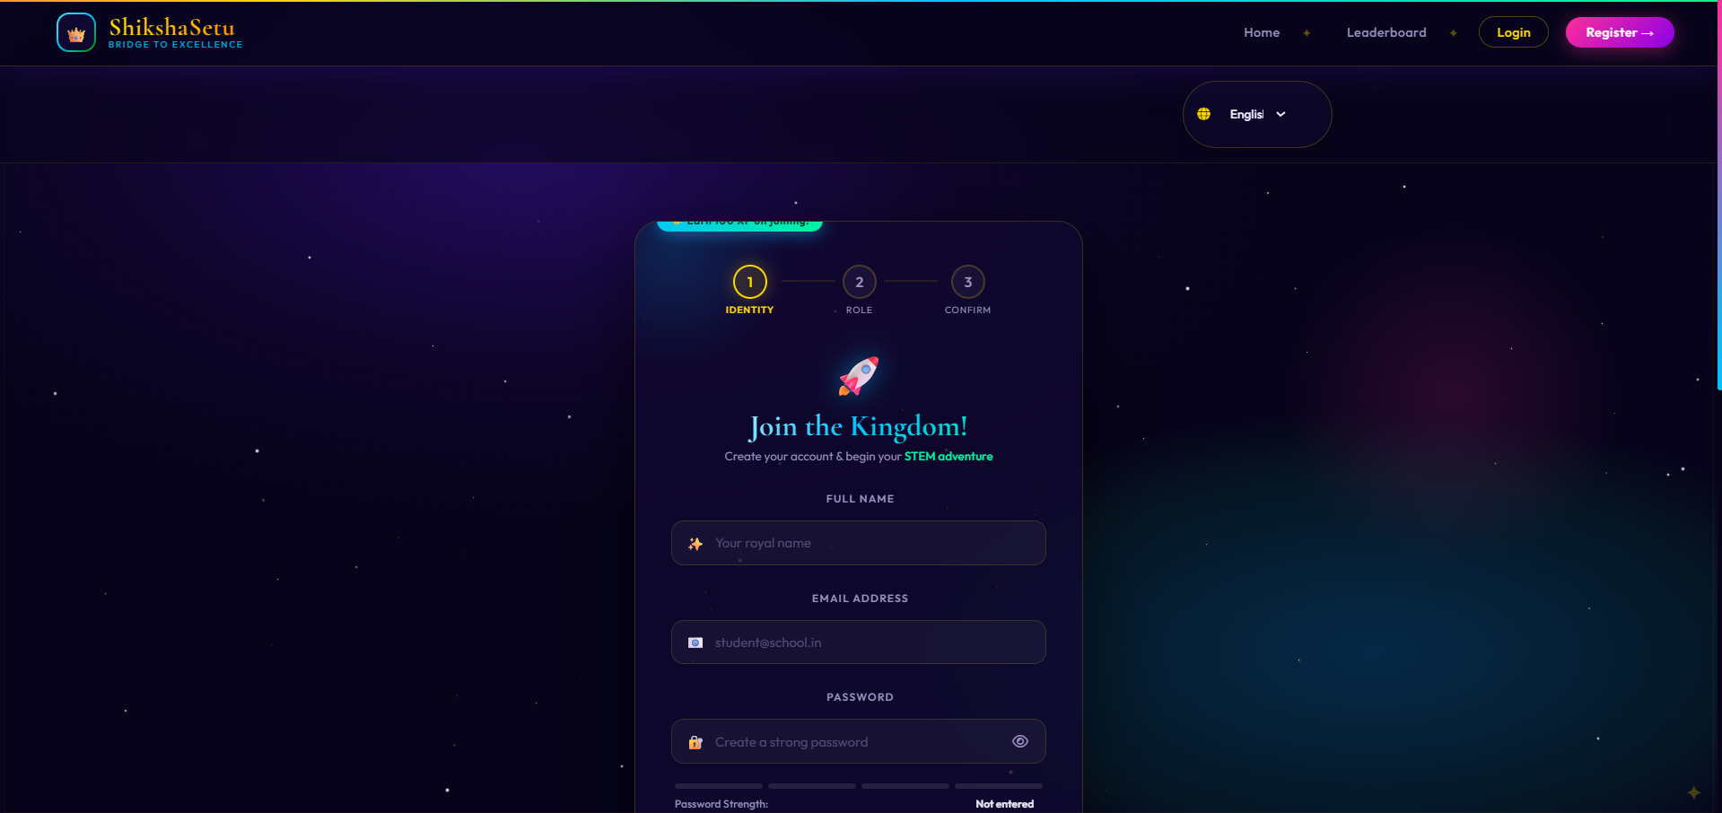
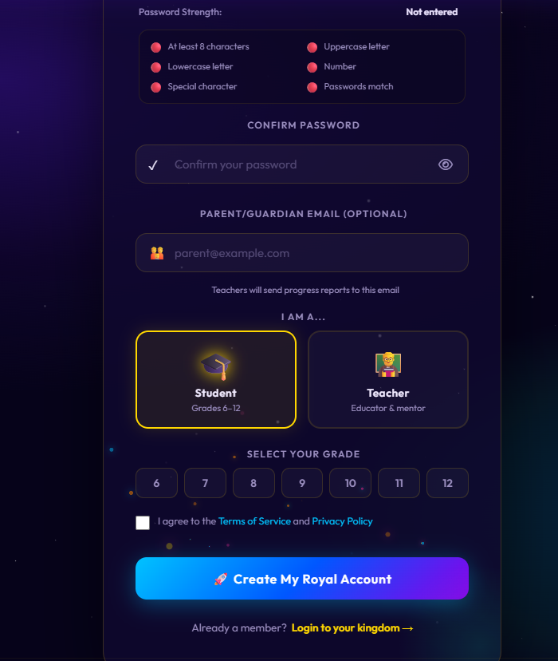
REGISTRATION

Slide 8
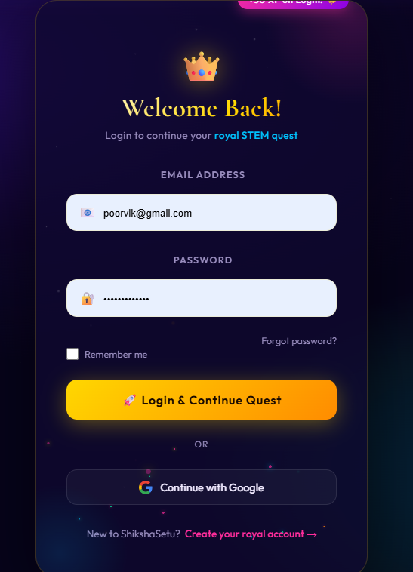
LOGIN

Slide 9
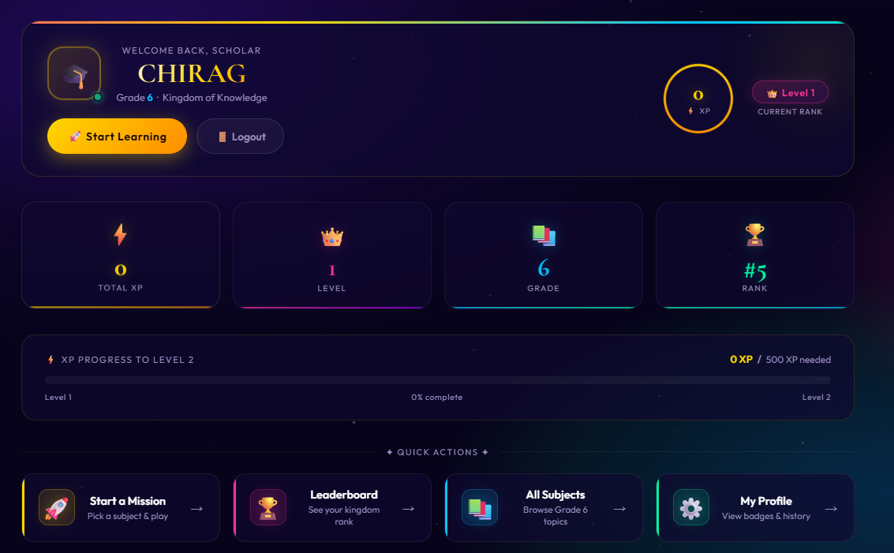
STUDENT DASHBOARD

Slide 10
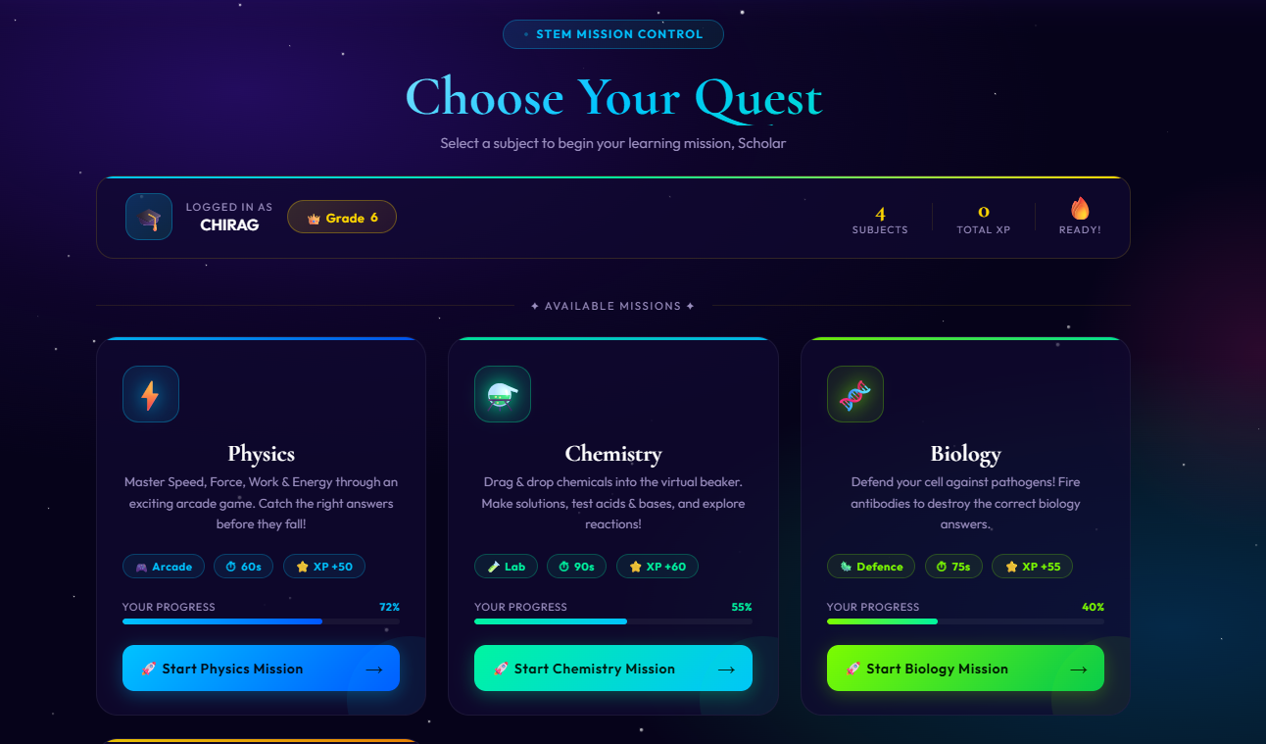
GAMING INTERFACE

Slide 11
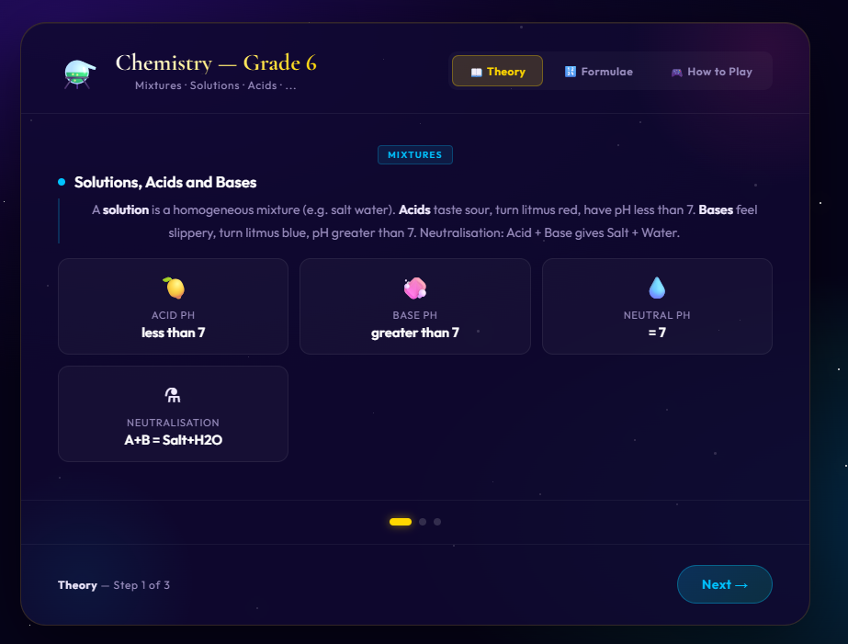
SUBJECT NOTES

Slide 12
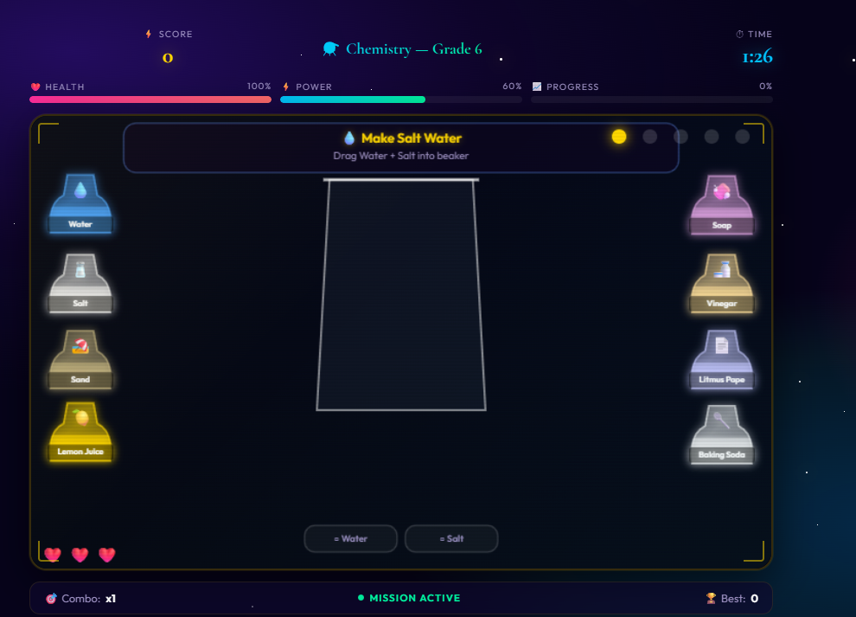
GAME

Slide 13
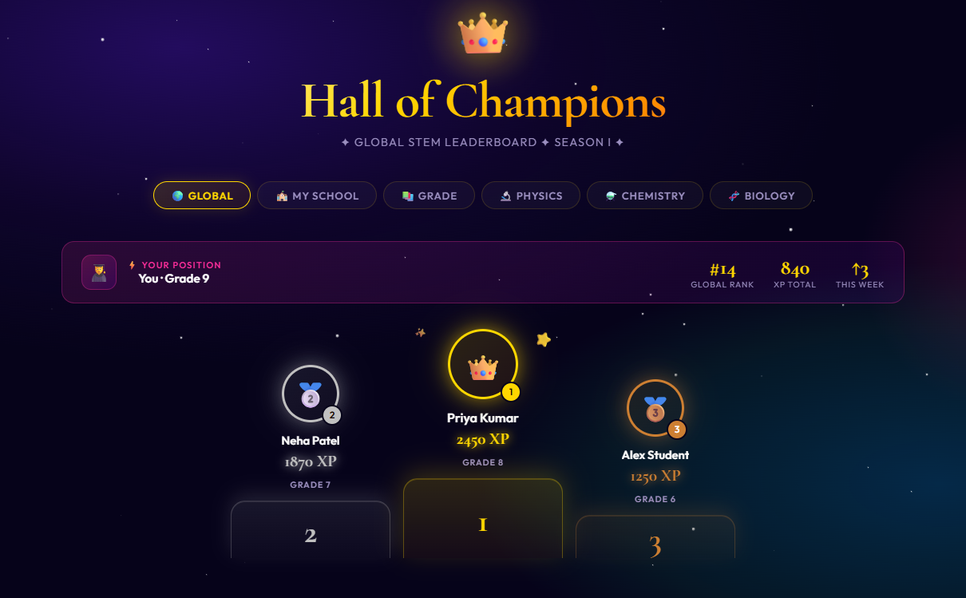
LEADER BOARD

Slide 14
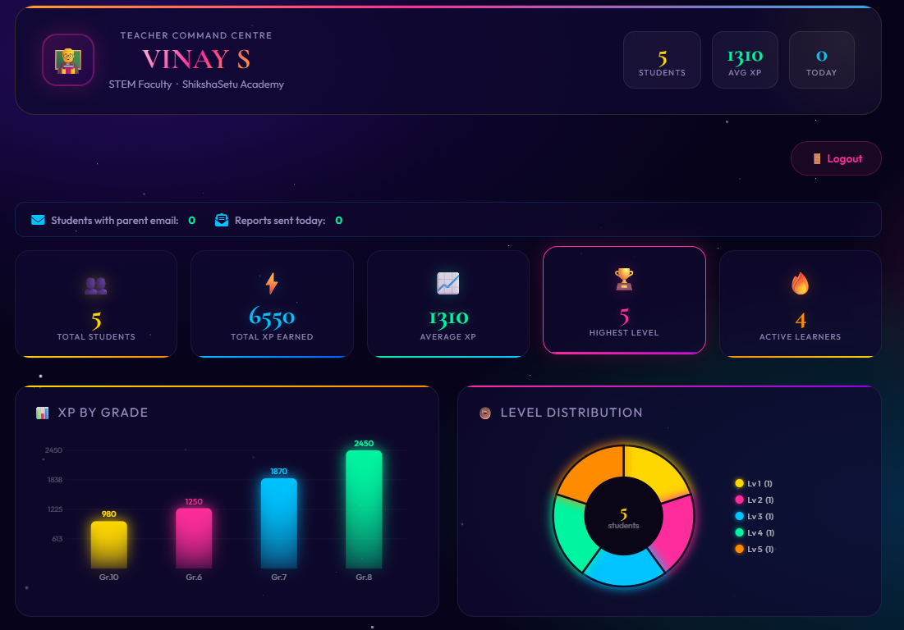
TEACHERS DASHBOARD:

Slide 15
Technology Stack Components:
Frontend (Student & Teacher Interface)
HTML, CSS, JavaScript
Backend (Application Logic)
Python (Flask / FastAPI)
Database
SQL lite
Gamification Engine
Score, levels, badges, rewards logic
Content Management System
Stores STEM lessons, quizzes, and games
Multilingual Support
Language translation (Google Translator API)

Slide 16
Innovation or Novel Contributions
Gamification-based STEM Learning
Multilingual Learning Support
Student Progress Tracking and Rewards
Rural-Focused Digital Education Platform

Slide 17
Github Link
The Github link provided should have public access permission.
Github Link:
https://github.com/vinay18082004/University_project_CSE_171.git

Slide 18
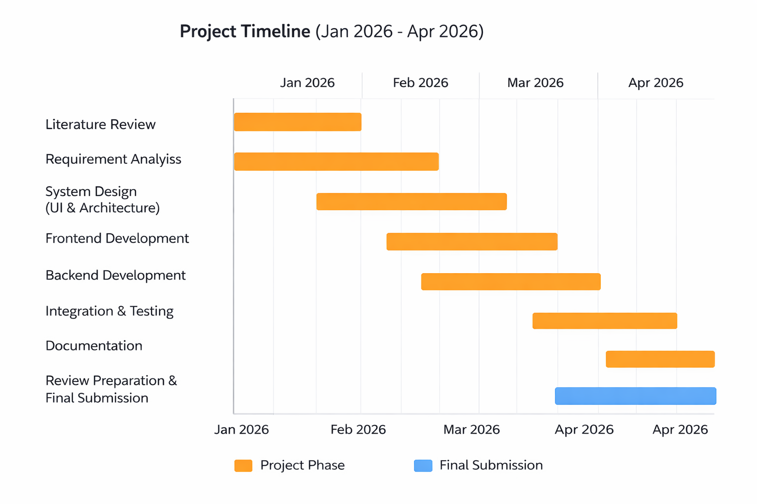
Timeline of the Project (Gantt Chart)

Slide 19


