Slide 1
Summer Internship
E-commerce Website
MALLIKARJUN REDDY
121910315001
B-15

Slide 2
Abstract
Electronic Commerce is process of doing business through computer networks. A person sitting on his chair in front of a computer can access all the facilities of the Internet to buy or sell the products.Unlike traditional commerce that is carried out physically with effort of a person to go & get products, ecommerce has made it easier for human to reduce physical work and to save time. E-Commerce which was started in early 1990’s has taken a great leap in the world of computers, but the fact that has hindered the growth of e-commerce is security.

Slide 3
Security is the challenge facing e-commerce today & there is still a lot of advancement made in the field of security.The main advantage of e-commerce over traditional commerce is the user can browse online shops, compare prices and order merchandise sitting at home on their PC.For increasing the use of e-commerce in developing countries the B2B e-commerce is implemented for improving access to global markets for firms in developing countries. For a developing country advancement in the field of e-commerce is essential. The research strategy shows the importance of the e-commerce in developing countries for business applications.

Slide 4
Why Web Development ?
Creation of a good working website with numerous features requires knowledge of certain tools and some design concepts. These tools and concepts are essential for developing a website that produces an interactive experience for the user. The following tools mentioned below are required for the creation of an adequate website.

Slide 5
Introduction to E-commerce Web Page
The following project is developed as E-commerce website that can be accessible by the user to access content that is connected via the backend of the website. An e-commerce website is one that allows people to buy and sell physical goods, services, and digital products over the internet rather than at a brick-and-mortar location. Through an e-commerce website, a business can process orders, accept payments, manage shipping and logistics, and provide customer service.

Slide 6
● Building real-world projects with MEAN Stack.
● Building complex APIs, login interfaces, and authentications.
● Using JSON Web Tokens to authenticate.
● Understanding database patterns, tokens, and sessions.
● Working with modern Angular frameworks.

Slide 7
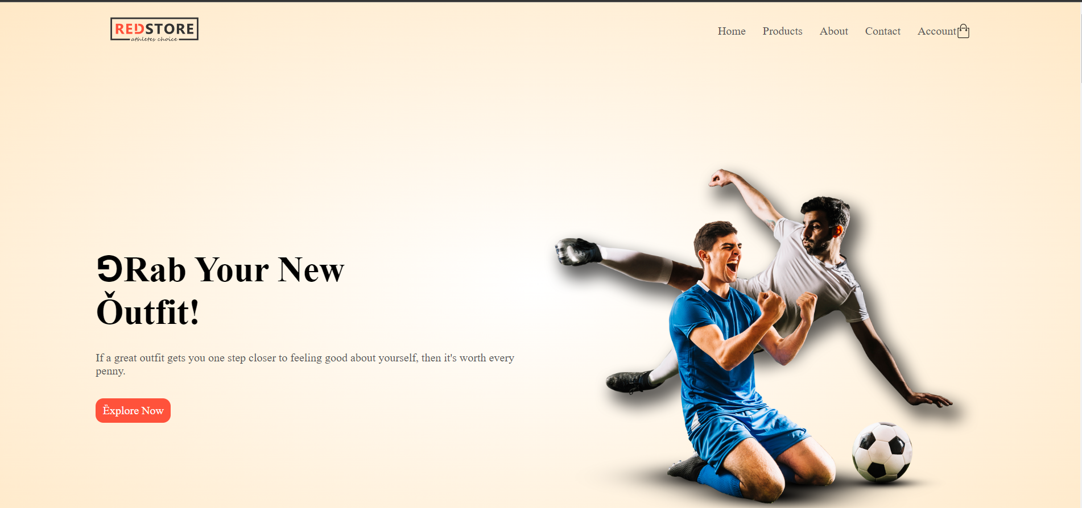
Project Preview

Slide 8
Technologies Used
HTML
CSS
JavaScript(Js)
Bootstrap

Slide 9
HTML
HTML stands for Hyper Text Markup Language, which is the most widely used language on the Web to develop web pages.
HTML was created by Berners-Lee in late 1991 but "HTML 2.0" was the first standard HTML specification which was published in 1995.
HTML 4.01 was a major version of HTML and it was published in late 1999.
Currently we are having the HTML5 version which is an extension to HTML 4.01, and this version was published in 2012.

Slide 10
CSS
CSS is used to control the style of a web document in a simple and easy way.
CSS is the acronym for "Cascading Style Sheet".
This tutorial covers both the versions :
CSS1
CSS2
CSS3
gives a complete understanding of CSS, starting from its basics to advanced concepts

Slide 11
JavaScript(Js)
JavaScript is a lightweight, interpreted programming language.
It is designed for creating network-centric applications.
It is complementary to and integrated with Java.
JavaScript is very easy to implement because it is integrated with HTML.
It is open and cross-platform

Slide 12
Bootstrap
Bootstrap is the most popular HTML, CSS and JavaScript framework for developing a responsive and mobile friendly website.
● It is absolutely free to download and use.
● It is a front-end framework used for easier and faster web development.
● It includes HTML and CSS based design templates for typography, forms, buttons, tables, navigation, modals, image carousels and many others.
● It can also use JavaScript plugins.
● It facilitates you to create responsive designs.

Slide 13
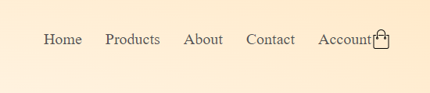
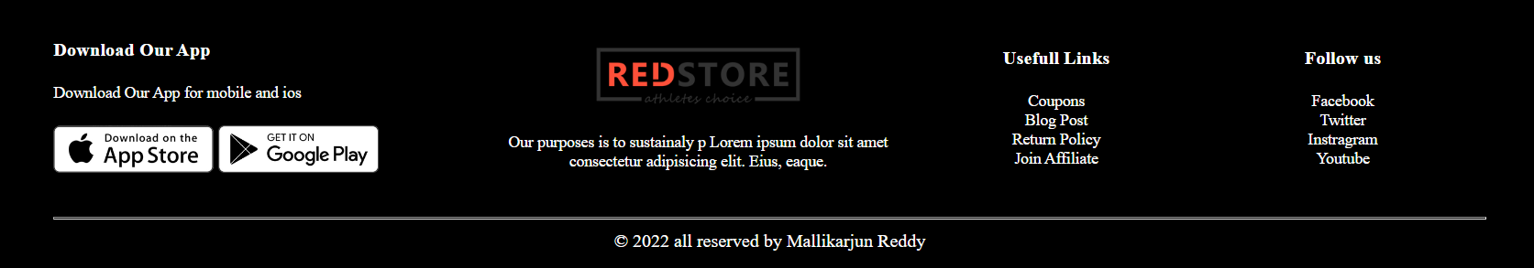
WORKING

Slide 14
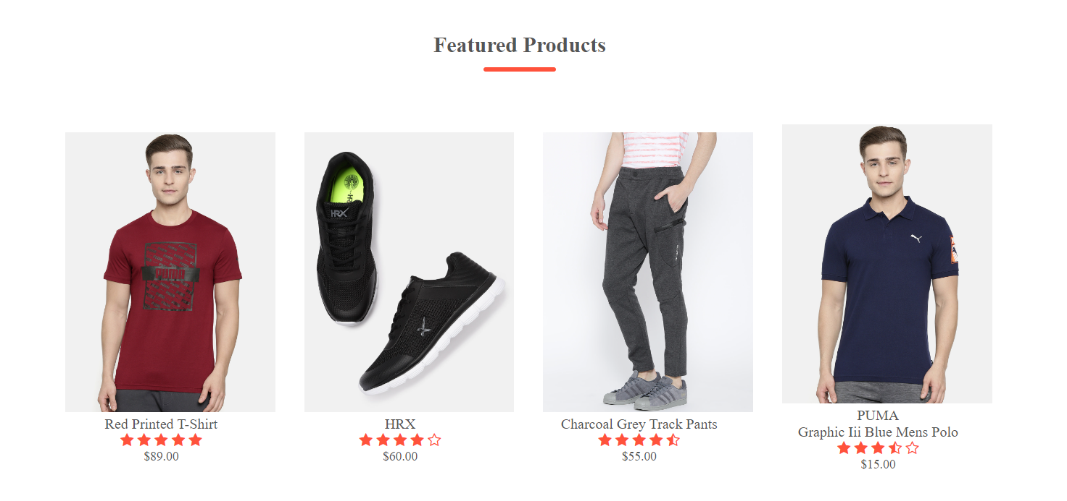

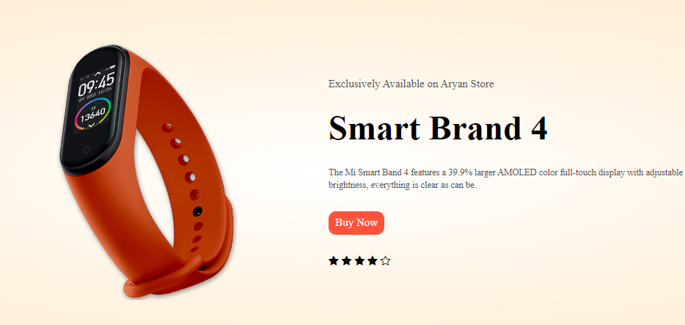

Slide 15
Functionalities
User-Friendly Design. Perhaps the most important feature customers want in an ecommerce site is a good user experience
Mobile-Friendly Features
24/7 Customer Service
User Reviews
User Features and Discounts
Extensive Product Information.

Slide 16
Conclusion
In general, today’s businesses must always strive to create the next best thing that consumers will want because consumers continue to desire their products, services etc. to continuously be better, faster, and cheaper.
In this world of new technology, businesses need to accommodate to the new types of consumer needs and trends because it will prove to be vital to their business’ success and survival.
E-commerce is continuously progressing and is becoming more and more important to businesses as technology continues to advance and is something that should be taken advantage of and implemented.

Slide 17
There are several factors and variables that need to be considered and decided upon when starting an e-commerce business.
Some of these include: types of e-commerce, marketing strategies, and countless more.
If the correct methods and practices are followed, a business will prosper in an e-commerce setting with much success and profitability.

