Slide 1
Kubernetes

Slide 2
Kunbernetes
Kubernetes is an open source container orchestration engine for automating deployment, scaling, and management of containerized applications.

Slide 3
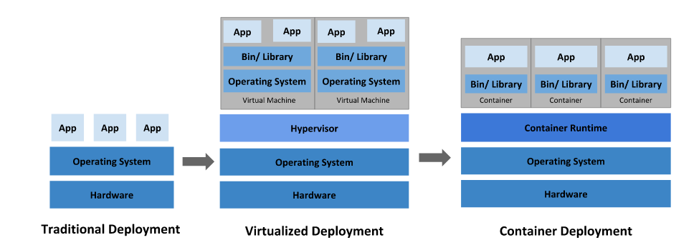
Going back in time

Slide 4
Traditional deployment era: Early on, organizations ran applications on physical servers. There was no way to define resource boundaries for applications in a physical server, and this caused resource allocation issues. For example, if multiple applications run on a physical server, there can be instances where one application would take up most of the resources, and as a result, the other applications would underperform. A solution for this would be to run each application on a different physical server. But this did not scale as resources were underutilized, and it was expensive for organizations to maintain many physical servers.
Virtualized deployment era: As a solution, virtualization was introduced. It allows you to run multiple Virtual Machines (VMs) on a single physical server's CPU. Virtualization allows applications to be isolated between VMs and provides a level of security as the information of one application cannot be freely accessed by another application.
Virtualization allows better utilization of resources in a physical server and allows better scalability because an application can be added or updated easily, reduces hardware costs, and much more. With virtualization you can present a set of physical resources as a cluster of disposable virtual machines.
Each VM is a full machine running all the components, including its own operating system, on top of the virtualized hardware.
Container deployment era: Containers are similar to VMs, but they have relaxed isolation properties to share the Operating System (OS) among the applications. Therefore, containers are considered lightweight. Similar to a VM, a container has its own filesystem, CPU, memory, process space, and more. As they are decoupled from the underlying infrastructure, they are portable across clouds and OS distributions.
Containers have become popular because they provide extra benefits, such as:
Agile application creation and deployment: increased ease and efficiency of container image creation compared to VM image use.
Continuous development, integration, and deployment: provides for reliable and frequent container image build and deployment with quick and easy rollbacks (due to image immutability).
Dev and Ops separation of concerns: create application container images at build/release time rather than deployment time, thereby decoupling applications from infrastructure.
Observability not only surfaces OS-level information and metrics, but also application health and other signals.
Environmental consistency across development, testing, and production: Runs the same on a laptop as it does in the cloud.
Cloud and OS distribution portability: Runs on Ubuntu, RHEL, CoreOS, on-premises, on major public clouds, and anywhere else.
Application-centric management: Raises the level of abstraction from running an OS on virtual hardware to running an application on an OS using logical resources.
Loosely coupled, distributed, elastic, liberated micro-services: applications are broken into smaller, independent pieces and can be deployed and managed dynamically – not a monolithic stack running on one big single-purpose machine.
Resource isolation: predictable application performance.
Resource utilization: high efficiency and density.

Slide 5
Why Kubernetes and what it can do
Containers are a good way to bundle and run your applications. In a production environment, you need to manage the containers that run the applications and ensure that there is no downtime. For example, if a container goes down, another container needs to start. Wouldn't it be easier if this behavior was handled by a system?
That's how Kubernetes comes to the rescue! Kubernetes provides you with a framework to run distributed systems resiliently. It takes care of scaling and failover for your application, provides deployment patterns, and more.

Slide 6
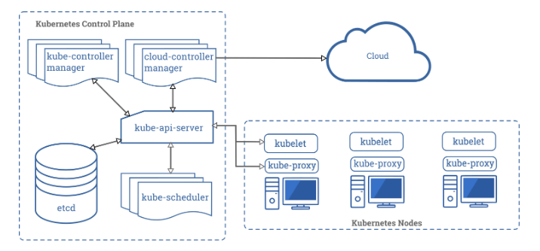
Kubernetes cluster with all the components

