Slide 1
DOCKER

Slide 2
Why Docker?
Compatability
Portability
Easy to develop and deploy
Efficient use of system resource
Lightweight containers
Faster development life cycle

Slide 3
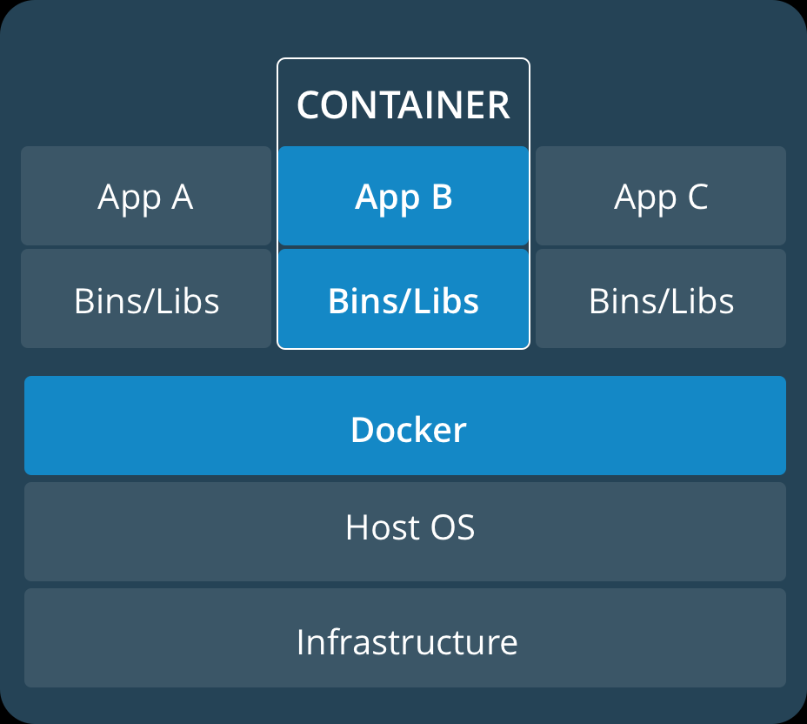
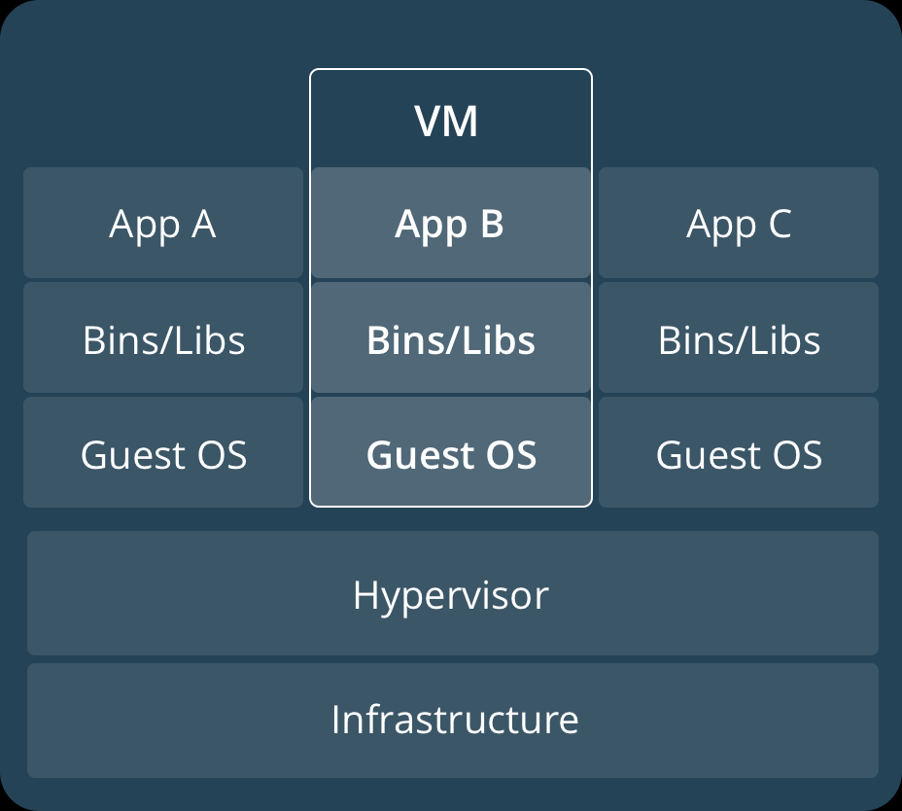
Container vs Virtual Machine
CONTAINER
VIRTUAL MACHINE

Slide 4
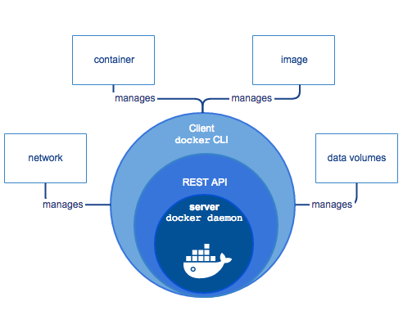
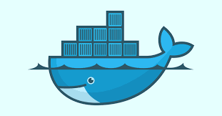
Docker
Docker is an open-source engine that automates the deployment of application inside the containers.
Provides an isolated environment from the infrastructure.

Slide 5
Container
Image
Docker image is a read-only template to create docker container. Often, image is based on the another image.
Docker container is the runnable instance of the image. By default, a container is relatively well isolated from other containers and its host machine.
Registry
Docker registry stores Docker images. Docker hub is a public repository that anyone can use. Docker is configured to look for images on Docker hub by default.

Slide 6
Run Docker Image
Docker Hub provides official image for many application.
Pull docker image
docker pull <image_name>
docker pull ubuntu
docker pul ubuntu:16.04
Run docker image
docker run -it --name <container_name> <image_name>
docker run -it --name ubuntudemo ubuntu

Slide 7
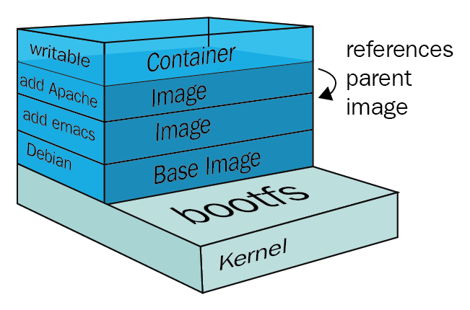
Build own docker image
Each instructions in a Dockerfile creates a layer in the image.
Docker images are immutable, but you can add an extra layer and save them as a new image.
Container/Writable layer: Containers may share access to the underlying layer of a docker images but this layer is unique to the containers.

Slide 8
Dockerfile Commands
FROM - initializes a new build stage and sets the Base Image for subsequent instructions. (FROM ubuntu)
RUN - execute any commands in a new layer on top of the current image and commit the results.(RUN apt-get install python)
LABEL - adds metadata to an image.(LABEL descripition - “Sample image”)
MAINTAINER - sets the author field of the generated images.(MAINTAINER maintainer = “xyz@abc.co.in”)
ENV - sets the environment variable.() (ENV <key> <value>)

Slide 9
ADD and COPY
COPY - copies new files or directories from <src> and adds them to the filesystem of the container at the path <dest>.
ADD - copies new files, directories or remote file URLs from <src> and adds them to the filesystem of the image at the path <dest>.

Slide 10
CMD and ENTRYPOINT
ENTRYPOINT - Configure a container that will run as an executable.
CMD - to provide defaults for an executing container. These defaults can include an executable, or they can omit the executable, in which case you must specify an ENTRYPOINT instruction as well.
FROM UBUNTU
ENTRYPOINT [“echo”]
CMD [“Welcome”]
1) docker run -t ubuntu
Welcome
2) docker run -t ubuntu “Hello World”
Hello World
FROM UBUNTU
CMD [“echo”,“Welcome”]
1) docker -t ubuntu
Welcome
2) docker run -t ubuntu echo “Hello World”
Hello World

Slide 11
Dockerfile
Sample docker file for creating docker images.
Create docker image.
FROM python:latest
RUN pip install -r requirements.txt
RUN mkdir /var/www
COPY . /var/www
WORKDIR /var/www
ENTRYPOINT ["python"]
CMD ["app.py"]
Application
app.py
requirements.txt
Dockerfile
docker build -t <image_name>:<version> <path_to_dockerfile>
docker build -t pythonapp:1.0.0 .

Slide 12
Container and Logs
-it -> Interactive
-d -> Background -> Returns container id.
To run, start and stop containers.
Run Container
docker run <-it/-d> --name <container_name> <image_name>
docker run -it --name pyapplication -p 5000:5000 pythonapp:1.0.0
docker run -d --name pyapplication -p 5000:5000 pythonapp:1.0.0
docker attach pyapplication
Stop container
sudo docker stop <container_name>
sudo docker stop pyapplication
Start container
sudo docker start <container_name>
sudo docker start pyapplication
Docker Logs
docker logs <container_name/container_id>

Slide 13
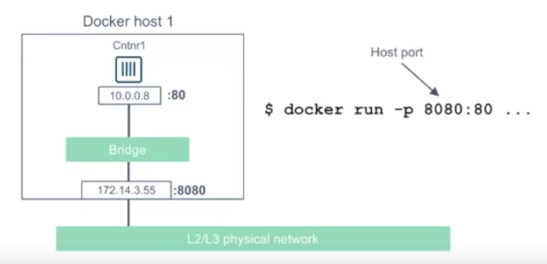
Port Mapping
docker run -it --name nginxapp -p 8080:80 nginx

Slide 14
Delete Container/Image
Delete an image
Delete a container
Remove image
sudo docker rmi <image_name:version>
sudo docker rmi pythonapp:1.0.0
Remove container
sudo docker rm <container_name>
sudo docker rm pyapplication

Slide 15
Basic Docker commands
To list Docker Images
docker images
To list running containers
docker ps
To list all containers
docker ps -a
To create new image from an existing container
docker commit <container_id/container_name> <new_image_name>

Slide 16
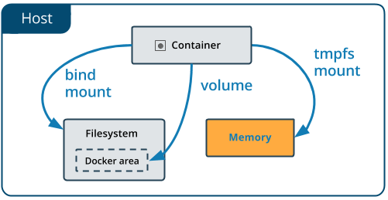
Docker Volume
Volumes are the preferred mechanism for persisting data generated by and used by Docker containers.
Easy to backup.
Shared among multiple
containers.
Managed using docker
commands.

Slide 17
Docker volume commands
Create Volume
docker volume create <volume_name>
docker volume create mystorage
Inspect volume
docker volume inspect <volume_name>
docker volume inspect mystorage
Remove specified volume
docker volume rm <volume_name>
docker volume rm mystorage
Remove unused volume
docker volume prune

Slide 18
Attach volume
Volume:
docker run --name <container_name> -v <volume_name>:/data/db -p 27017:27017 <image_name>
docker run --name mongo1 -v mystorage:/data/db -p 27017:27017 mongo
Bind Mount:
docker run --name <container_name> -v <system_path>:/data/db -p 27017:27017 <image_name>
docker run --name mongo1 -v /mywork/dockerstorage/mongoinfo:/data/db -p 27018:27017 mongo
Tmpfs:
docker run --name mongo1 --tmpfs /data/db -p 27018:27017 mongo
docker run -d --name devtest --mount source=myvol2,target=/app nginx

Slide 19
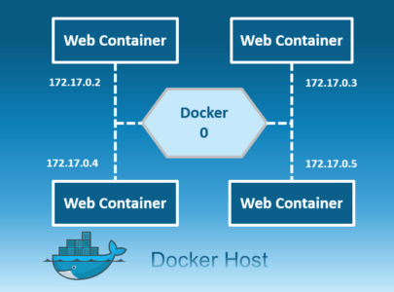
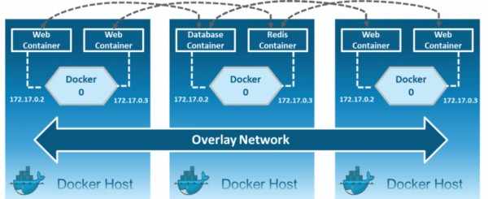
Docker Network
Connect docker containers together, or connect docker containers to non-Docker workloads.

Slide 20
Docker Network
bridge: Communication among containers in the same docker daemon.
overlay: Communication among containers on the different docker daemon.
host: remove network isolation between the container and the Docker host, and use the host’s networking directly.
macvlan: allow you to assign a MAC address to a container, making it appear as a physical device on your network.
none: disable all networking.
network plugins: install and use third-party network plugins with Docker.

Slide 21
Network commands
List Network drivers
docker network ls
Inspect driver
docker network inspect bridge
Create Bridge Network
docker network create --driver=bridge <bridge_name>
docker network create --driver=bridge my-bridge
docker run -d --network <bridge_name> <image_name>
docker run -d --network my-bridge myapp
Connect running container to the network
docker network connect <network_name> <container name>
docker network connect my-bridge pyapplication

Slide 22
Docker compose
version: '3'
services:
db:
image: postgres
environment:
- POSTGRES_DB=postgres
- POSTGRES_USER=postgres
- POSTGRES_PASSWORD=postgres
web:
build: .
command: python manage.py runserver 0.0.0.0:8000
volumes:
- .:/code
ports:
- "8000:8000"
depends_on:
- db
tool for defining and
running multi-container
Docker applications.
Command :
docker-compose up

