Slide 1

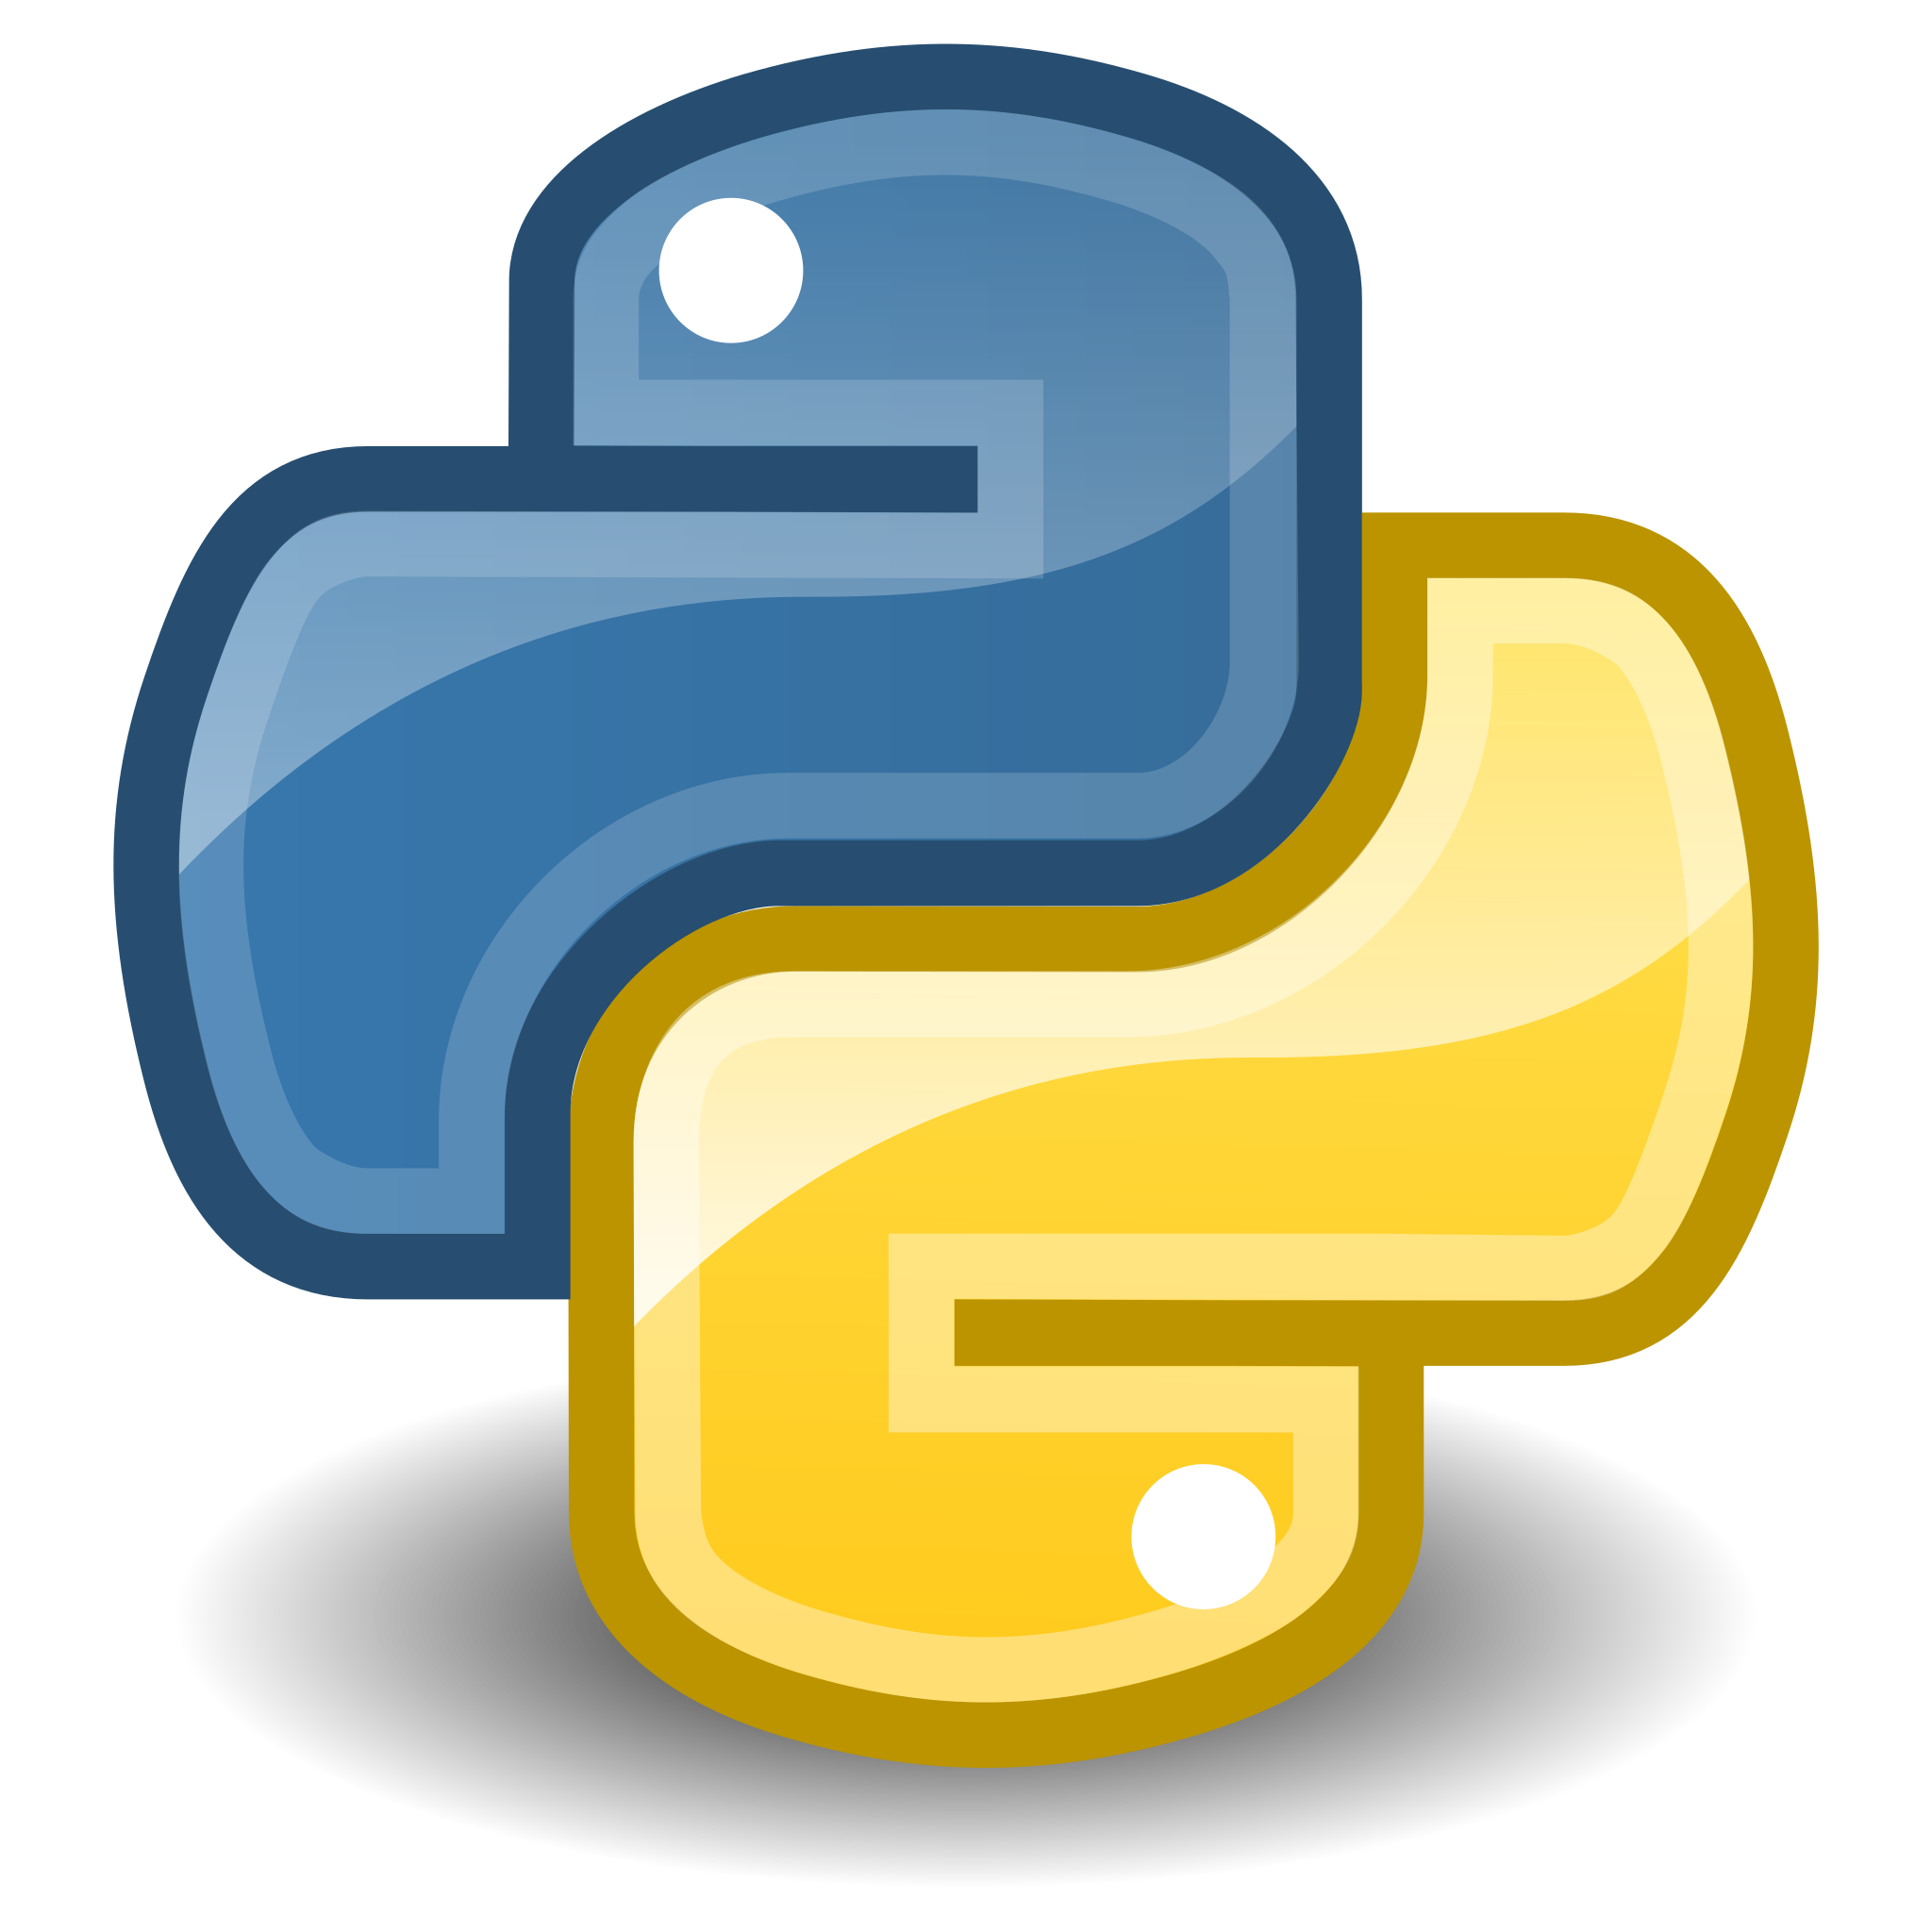
Python Libraries,
Technologies Overview

Slide 2
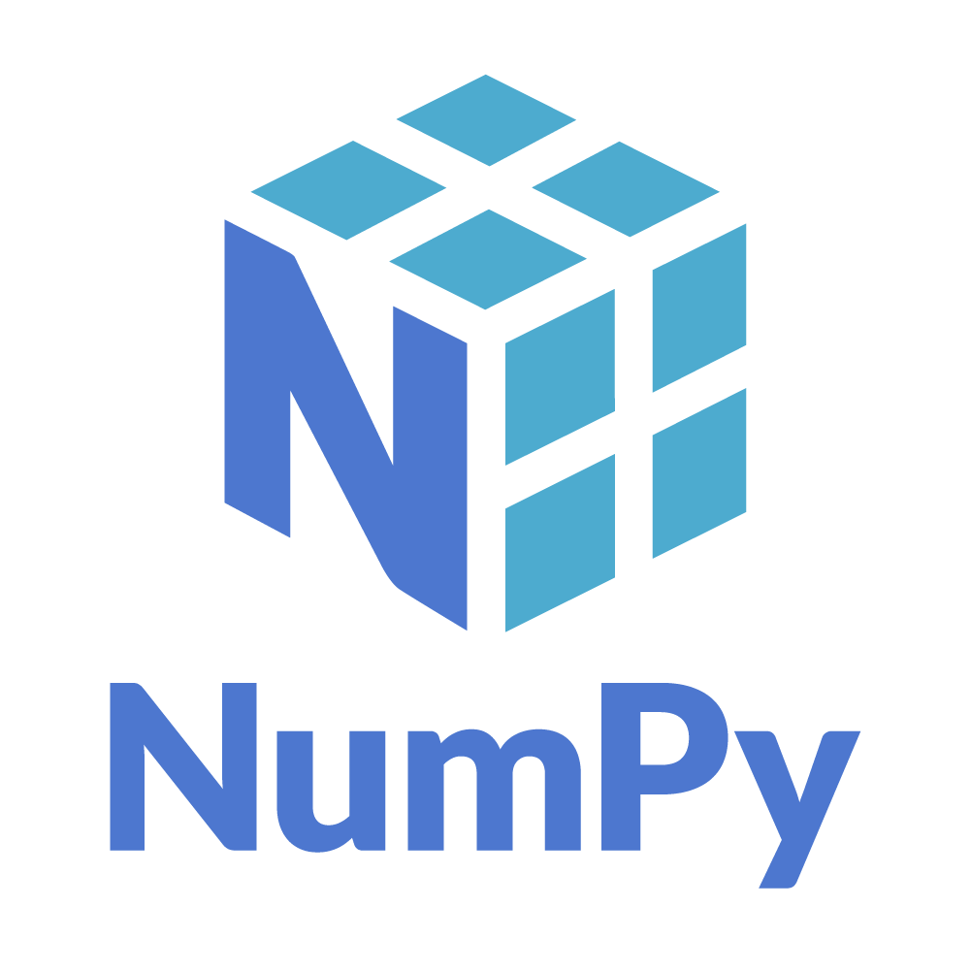
Numpy — (Python Library)
Installation: pip3 install numpy
Importing: import numpy as np
Main Purpose: Array Data Structure
Advanced Array Handling

Slide 3

Pandas — (Python Library)
Installation: pip3 install pandas
Importing: import pandas as pd
Main Purpose: Tabular Data / Data Frames
Advanced Data Analysis

Slide 4
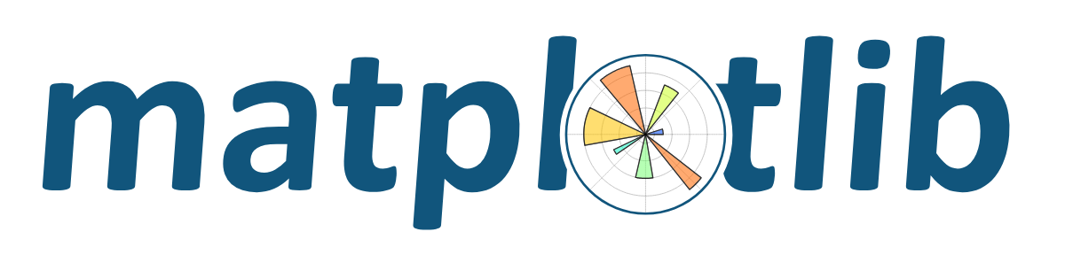
Matplotlib — (Python Library)
Installation: pip3 install matplotlib
Importing: import matplotlib.pyplot as plt
Main Purpose: Data Visualization
Other Libraries: Plotly, Seaborn

Slide 5
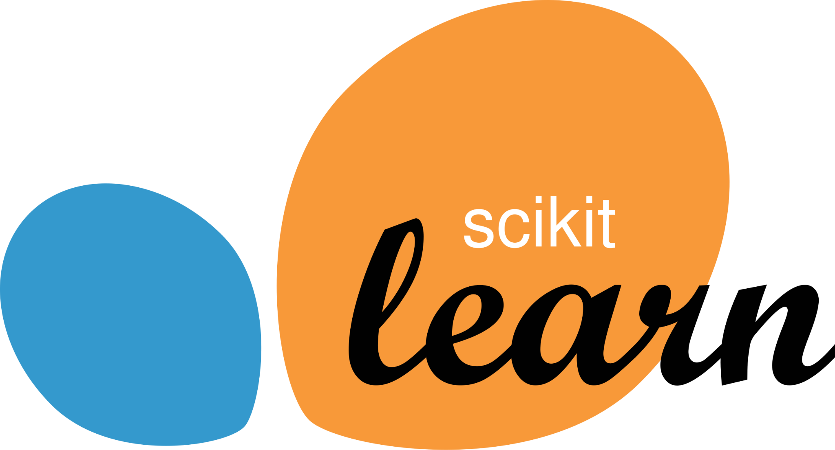
Scikit-Learn — (Python Library)
Installation: pip3 install scikit-learn
Importing: import sklearn
Main Purpose: Machine Learning
Everything related to Machine Learning
> ML Algorithms
Linear Regression
Logistic Regression
Decision Trees
Support Vector Machines

Slide 6
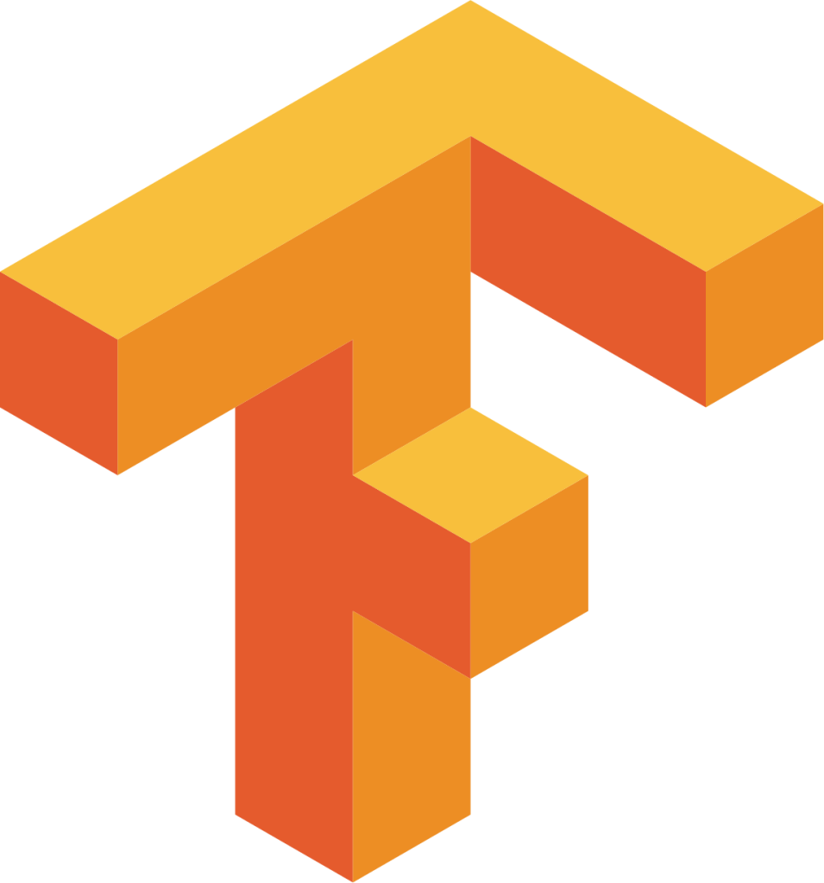
Tensorflow — (Python Library)
Installation: pip3 install tensorflow
Importing: import tensorflow as tf
Main Purpose: Deep Learning, Industry Applications
Everything related to Deep Learning
Other Libraries: PyTorch, Open-CV, NLTK, Spacy etc.

Slide 7
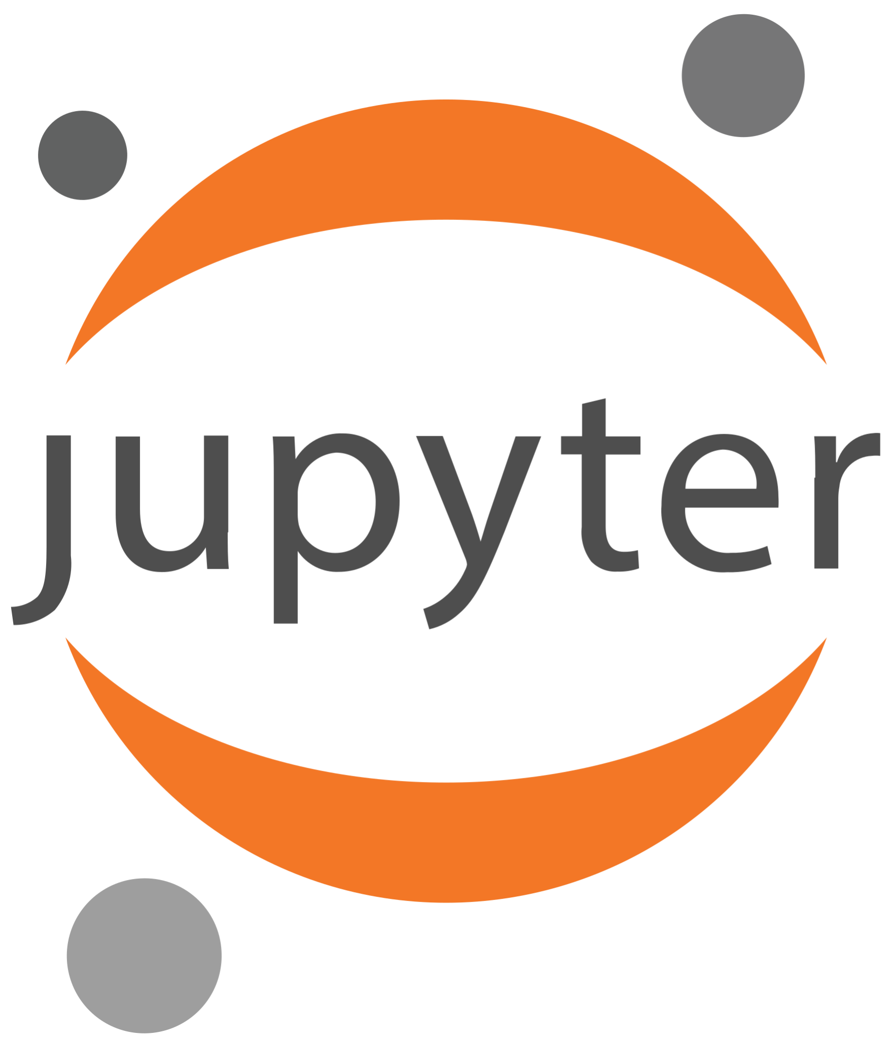
Jupyter Notebooks — (Editor)

