Slide 1
Linear Algebra
y = ax₁ + bx₂ + cx₃ + dx₄ + c
y = ax₁ + bx₂ + cx₃ + d
y = ax₁ + bx₂ + c
y = ax₁ + b
y = b

Slide 2
Linear Equations
Coefficients and Constants
Scalars, Vectors, Matrices
Vector representation, Data Points
Vector addition, Scalar multiplication
Dot product
Matrix multiplication
Solving a Linear Equation
1d, 2d, 3d, 4d . . . . Nd, (Hyper Dimensions)

Slide 3
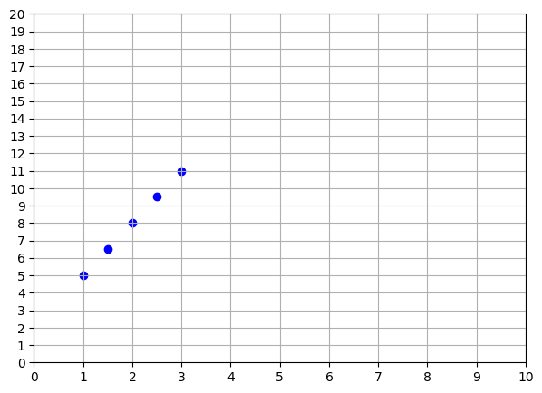
Tabular Data
X₁ | Y
1.0 | 5.0
1.5 | 6.5
2.0 | 8.0
2.5 | 9.5
3.0 | 11.0

Slide 4
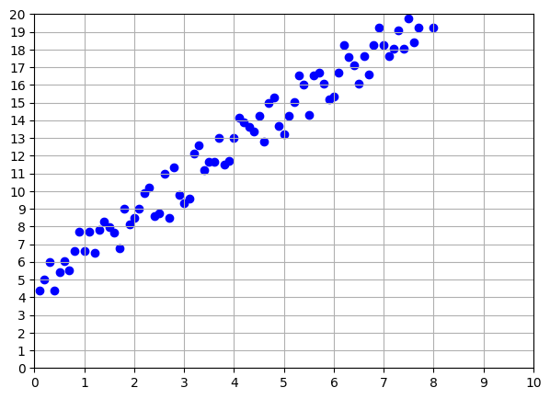
Real world data

Slide 5
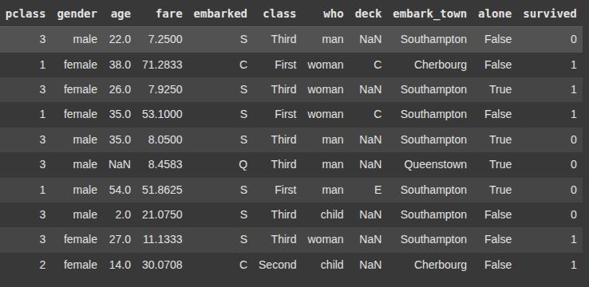
Titanic dataset

