Slide 1

14GHz PLL for 100Gigabit Ethernet Applications in 40nm CMOS
Nandu Bhagwan
Analog Bits Inc.
Space for affiliation logo
05/02/19
© 2011 AnalogBits
Notes:
Save as “familyname”_”date”.ppt, eg: smith_110830.ppt
The final accepted version will be “familyname”_final.ppt

Slide 2
Problem Statement
100Gigabit Ethernet Application
  Moving from 10G to 100G
  Employs OIF-CEI-28G*
  Requires Design of High-Performance PLL
  Requires Stringent Jitter Specifications for PLL
Need to precisely analyze and predict
  PLL Phase noise
  PLL Jitter (RMS Jitter and Deterministic Jitter)
Need to exploit (or live with) 40nm CMOS and next-generation 28nm CMOS
* Optical Internetworking Forum Common Electrical Interface
05/02/19
© 2011 AnalogBits

Slide 3
Alternate Methods To
Analyze Phase Noise & Jitter
Typically, we use one or more of the following methods:
  Block-Level AFS Noise Analysis + Transfer Function:
    Extract individual noise of component blocks using
      AFS Transient Noise or
      AFS PSS/OSCNOISE
    Compute their transfer functions to output
    Use Matlab, Python, Excel, etc. to aggregate
  Full PLL Transient Noise:
    Run AFS Transient Noise on full PLL instance
  Full PLL PSS:
    Run AFS PSS on full PLL
  4. Build the chip, measure, and then hope…!!
05/02/19
© 2011 AnalogBits

Slide 4
PLL Analysis Methods: Pros and Cons
Method
1
(Block-level AFS)
2
PLL Transient Noise
3
PLL PSS
Effective Analysis Range
Full band
High frequency (limited by run-time)
Full band
Spur Evaluation
No
Yes
No
Convergence Issues
No (minimal)
None
Possible
Accuracy
Determined by transfer function calculation only
Full loop sim: accurate for higher frequency offsets
Only full loop sim to get low frequency noise
Simulation Run-Times
Fast
Most intensive
Moderate (after convergence)
05/02/19
© 2011 AnalogBits

Slide 5
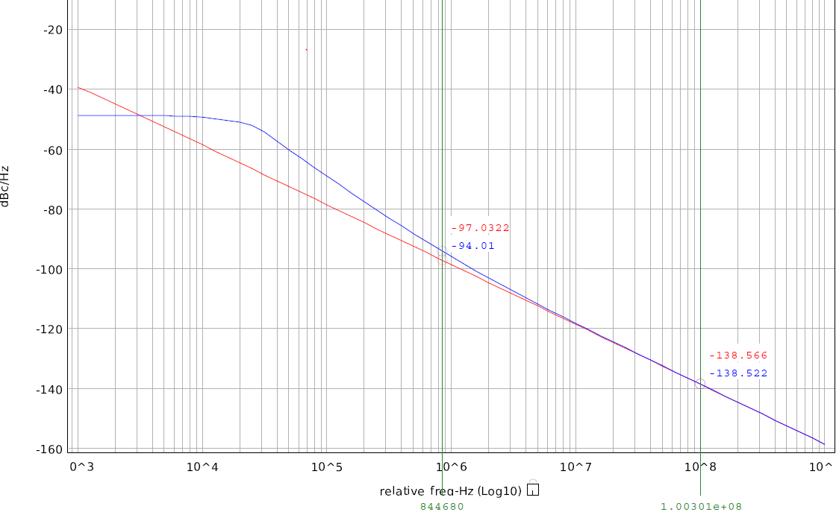
Method 1:
Example of Block Level Extraction for VCO
Circuit Inventory
Accuracy Settings
Simulation Runtime
  23 mins on 4 Xeon X5460 @3.16GHz CPUs
bsim4v5_0 280
bsource_c 257
bsource_i 187
capacitor 203
diode 2
inductor 180
mutual inductor 6
resistor 6
vsource 50
total noise
white noise
.oscnoise v clk vss dec 10 1k 1g tperiod=75p npoints=100 tstab=400n
+ percentnoiseatoffset= 1e6 10e6 100e6 totalnoise=0 savetstab=1
05/02/19
© 2011 AnalogBits

Slide 6
Method 2:
Closed Loop PLL TN Simulation
Circuit Inventory
  bsim4v5_0 1133
  bsource_c 277 bsource_i 481
  capacitor 429 diode 40
  inductor 196 mutual inductor 6
  resistor 12 vsource 78
Accuracy Settings
  .option reltol=1e-5 fast=2 $ maxstep=2p delmax=2p
  .tran 2p '1024*44*tper' noisefmax='14e9' noisefmin='300e3’
Simulation Run Time
  11 days on 4 Xeon X5460 @3.16GHz CPUs
05/02/19
© 2011 AnalogBits

Slide 7
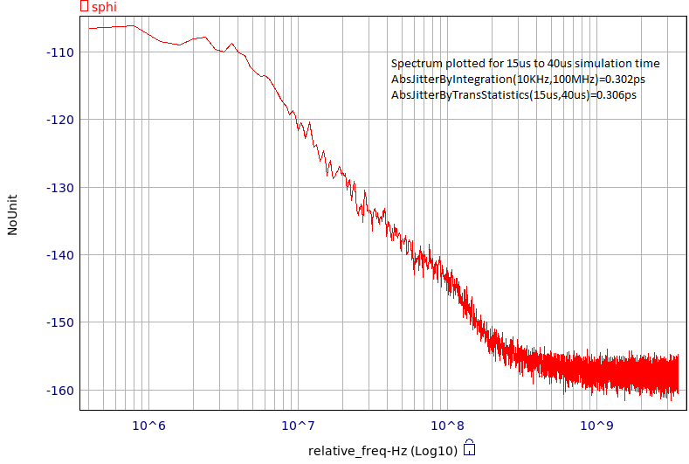
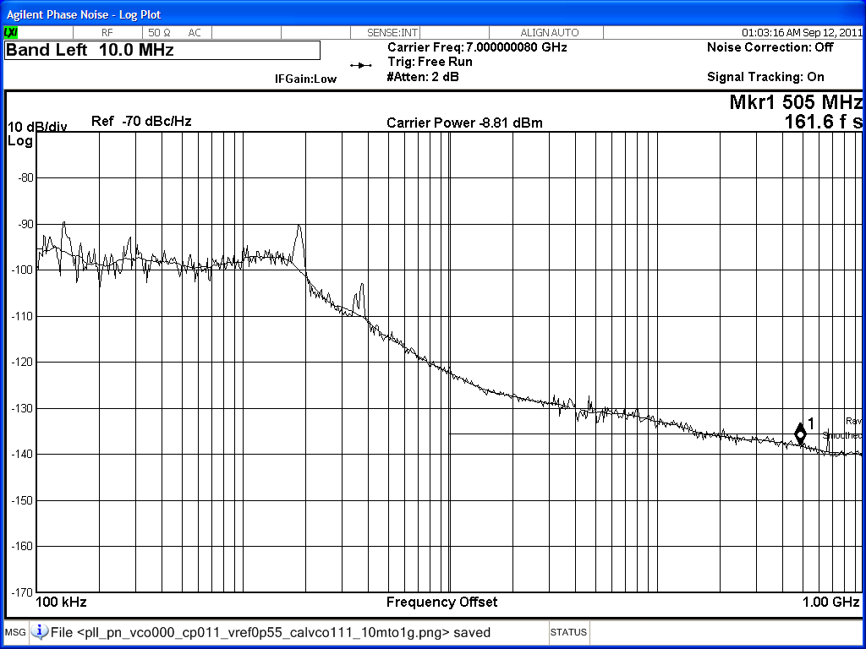
Method 2: Silicon Correlation
① 1M
①
1MHz
Dominated by REFCLK noise
AFS results
②
10MHz
Good match
② 10M
③
100MHz
Start seeing buffer noise
④
1GHz
Buffer noise & test equip noise floor
③ 100M
Refclk Noise (not modelled) dominates
④ 1G
Noisy REFCLK on eval board
Only real point for comparison
Driver Noise (not in Simulation) dominates
①
Noise Floor of Measurement Equipment
②
Silicon
AFS
③
①
95dB
105
④
②
120
122
③
133
143
Silicon measurements
④
141
155
05/02/19
© 2011 AnalogBits

Slide 8
Summary
Using both analysis methods important
Silicon correlation was good
AFS Experience:
  Good: Speed and Accuracy
  Needs Improvement: User Interface
Bottom Line: Taped-out based on AFS results
05/02/19
© 2011 AnalogBits

Slide 9
Future Work
Investigate Method #3:
  Run PSS on a closed-loop PLL
  Correlate results with
    Method 1: Block-level AFS
    Method 2: Full instance AFS TN
    Silicon measurements
Further refine 28nm PLL analysis
05/02/19
© 2011 AnalogBits

