Slide 1

Practical Noise Analysis for 14GHz PLL and Silicon Correlation
Nandu Bhagwan
GHz Circuits, Inc.
WSA: Advances in Noise Analysis for RF Circuits

Slide 2
Outline
Introduction
Problem Statement
Noise Analysis of a 14GHz PLL
Compare Different Simulation Methods
Present Measured Results
Correlate Silicon to Simulations
Future Advances
Summary

Slide 3
Introduction
Application: 100Gigabit Ethernet
Moving from 10G to 100G, 100GBASE-LR4
Employs OIF-CEI-28G (28 Gbps SERDES)
Requires Design of High-Speed PLL (28 GHz, effective)
Requires Stringent Jitter Specifications for PLL (<500fs)
Need to precisely analyze and predict
PLL Phase noise
PLL Jitter (Random and Deterministic Jitter)
Need to exploit (or live with) 40nm CMOS and next-generation 28/20/14nm CMOS issues

Slide 4
Problem Statement
Cost: PLL Simulations are very expensive
Time
Compute resources
Breadth: Impossible to do one comprehensive simulation
To verify phase noise across full spectrum
Creativity: Have to resort to ingenious techniques
Cannot be ad-hoc, must be structured
Have to be reliable predictor of Silicon performance

Slide 5
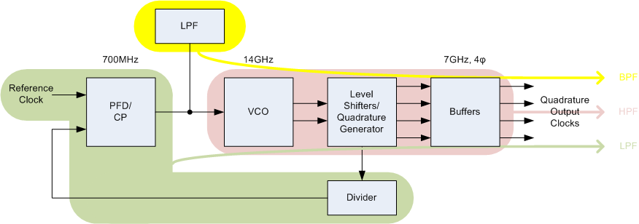
PLL Blocks & Noise Contribution Characteristics

Slide 6
Noise Analysis Methods
Architectural Analysis:
Extract individual parameters and noise contributions of sub-blocks using commercial RF simulators
Plug these into Architectural Simulator (e.g. TOPS¹)
Frequency Domain
Time Domain
Transient Noise Analysis:
Run Transient Noise on full-loop PLL instance
PSS/PNOISE Analysis:
Run PSS/PNOISE on full-loop PLL instance
¹: TOPS is a proprietary GHz Circuits Architectural Simulator

Slide 7
Noise Analysis Methods: Pros & Cons
Simulation Method | 1 Architectural | 2 Transient Noise | 3 PSS/PNOISE
Effective Analysis Range | Full Band | High Frequency (limited by run time) | Full Band
Spur Evaluation | Freq Domain: No Time Domain: Yes | Yes | No
Noise Modeling of RefClk, Supply, etc. | Yes | No | No
Simulation Setup/Complexity | Simple | Simple | Complex
Convergence Issues | Minimal | None | Possible
Accuracy | Implementation Dependent | Limited by run time (for Low Freq Offsets) | Limited by convergence & Tool issues
Simulation Time | Fast | Long | Moderate to Long, if and after convergence

Slide 8
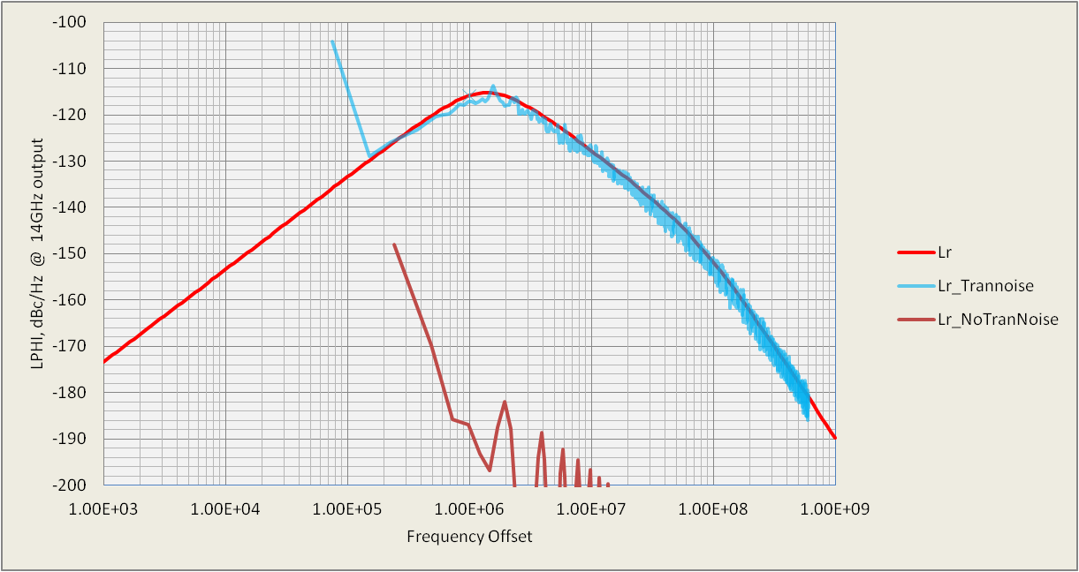
Simulation Correlation: Noise Contributor - LPF RZ
Ignore 1st point in LPHI as calculation artifact
Transient Noise
Architectural
Phase Noise dBc/Hz
Noise floor difference between transient simulation and transient noise simulation
Linearized Verilog-A models, only noise contributor is LPF Rz
Good match validates Architectural Simulator or conversely Transient Noise simulation
Notice difference between numerical noise and small signal random noise – when Transient Noise is turned ON and OFF

Slide 9
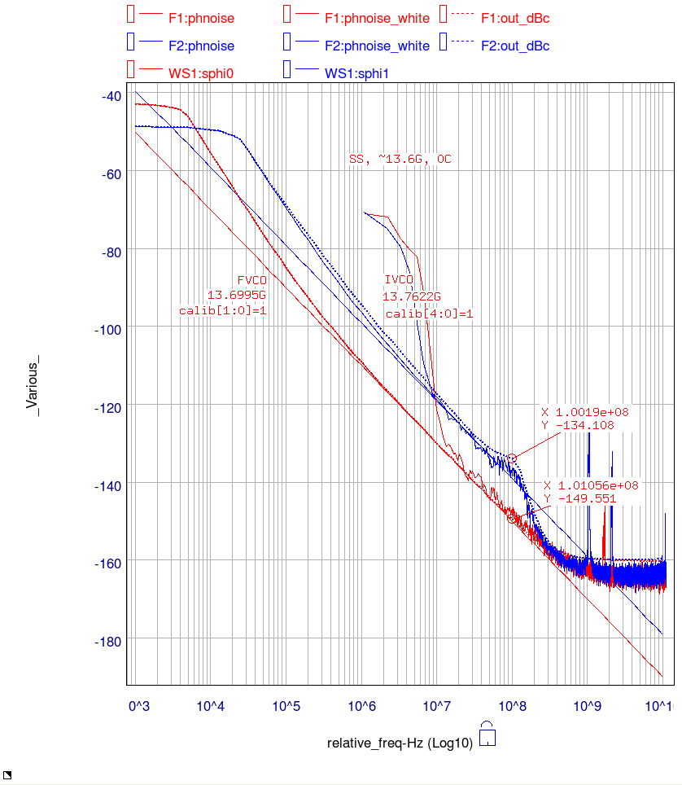
Simulation Correlation: Open Loop VCO
 | VCO 1 | VCO 2
VDD | 1.8V | 1.2V
FOUT | 13.7 – 13.8 GHz
Conditions | SS, Lo T (0º)
Types of Analysis | Transient Noise PSS/PNOISE
Remember
this hump
Phase Noise dBc/Hz
Spurs are transformation artifacts, ignore
Good correlation between PSS/PNOISE and Transient Noise

Slide 10
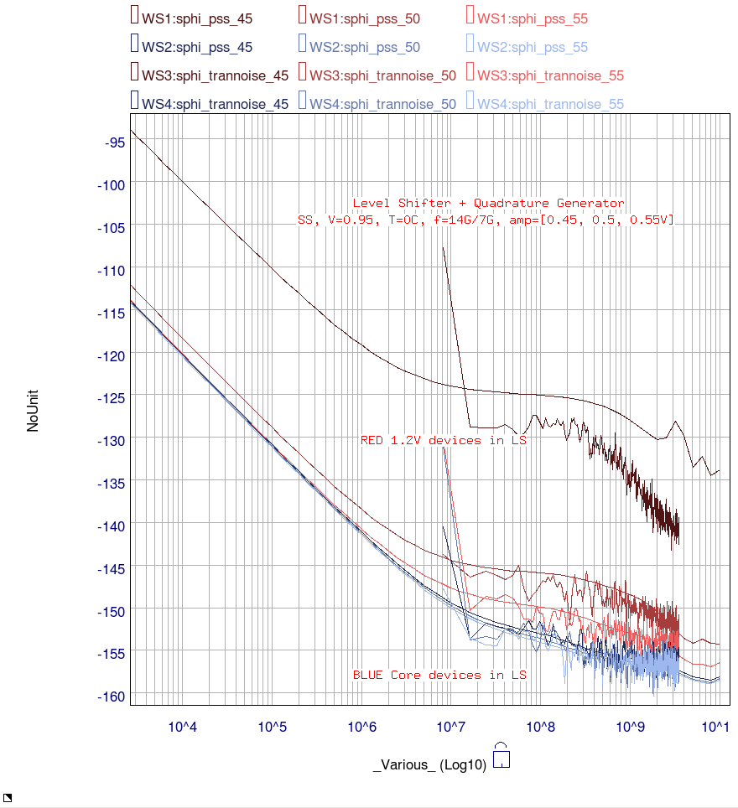
Simulation Correlation Level Shifters + Quadrature Generator
 | OP Stage 1 | OP Stage 2
Devices used | 1.2V | 0.9 V
VDD | 1V
FOUT | 14GHz
Conditions | SS, 0.95 V, 0ºC
Types of Analysis | Transient Noise PSS/PNOISE
Phase Noise dBc/Hz
0.45V
Circuit scale by 10% removed to deteriorate circuit performance
Good correlation between PSS/PNOISE and Transient Noise
Except for very deteriorated signals at low VCO amplitudes when 1.2V devices are used in level shifter
0.50V
0.55V

Slide 11
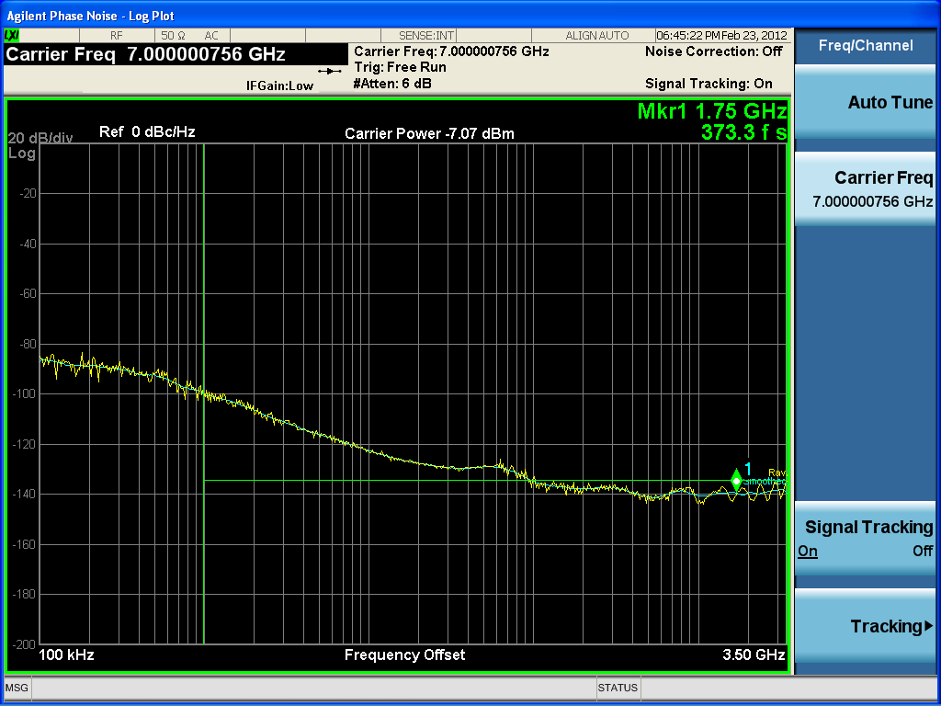
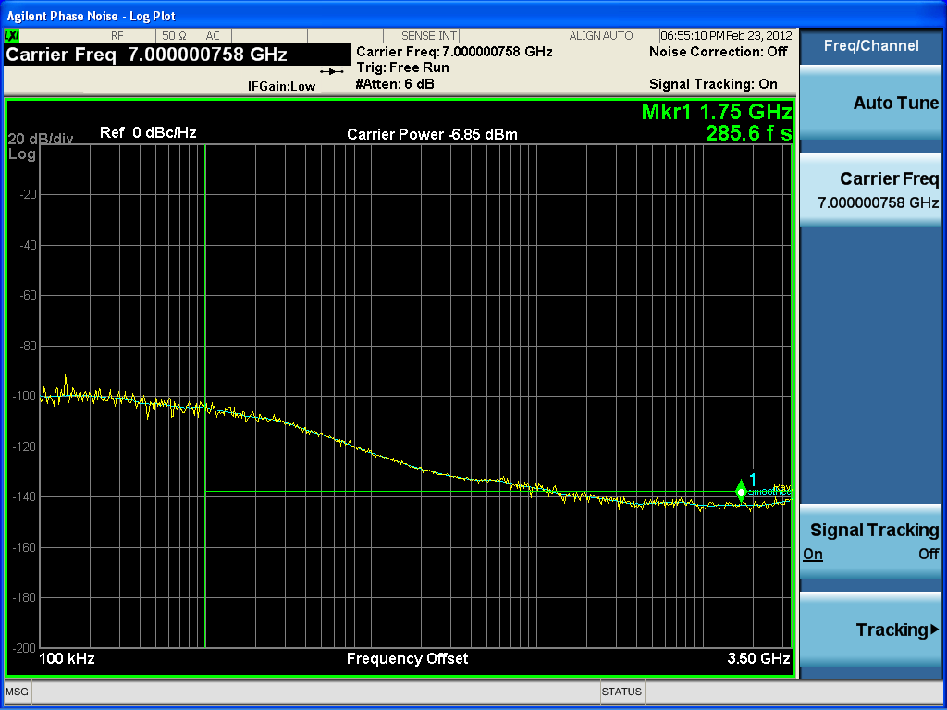

Silicon Measurements/ Correlation
Jitter integrated from 1MHz to 3.5GHz
Span of interest for SERDES is 10MHz to 3.5GHz

Slide 12
Measurements: FF Wafers
Low PLL BW
Medium PLL BW
Higher PLL BW
Phase Noise dBc/Hz
Frequency Offset, Hz

Slide 13
Measurements: SS Wafers
Low PLL BW
Medium PLL BW
Higher PLL BW
Phase Noise dBc/Hz
Frequency Offset, Hz

Slide 14
Measurements: Observations
Low Frequency Offsets
For a clean reference clock, Phase Noise at output improves with increase in BW, even under casual observation
Higher Frequency Offsets
Differences are not so apparent visually
Integration BW for this presentation 1M-3.5G
Actual Requirements 10M-3.5G

Slide 15
Measurements: Observations
RMS Jitter (fs), ∫1MHz↔3.5GHz, F_{OUT}=7GHz
Spec for this application < 500 fs
FF | Low Amp | Med Amp | Hi Amp
Low BW | 378 |  | 337
Med BW |  | 360
Hi BW | 303 |  | 285
SS | Low Amp | Med Amp | Hi Amp
Low BW | 384 |  | 373
Med BW |  | 366
Hi BW | 333 |  | 307

Slide 16
Silicon Correlation
Methodology: Pick 2 extremes
SS wafers, Low Amplitude, Low Bandwidth, worst phase-noise
FF wafers, High Amplitude, High BW, best phase-noise
Architectural Analysis:
Frequency Domain Analysis is presented
Transient Noise Analysis:
Focus should be on higher frequency offsets
PSS/PNOISE Analysis:
Focus should be on lower frequency offsets if not full band
P

Slide 17
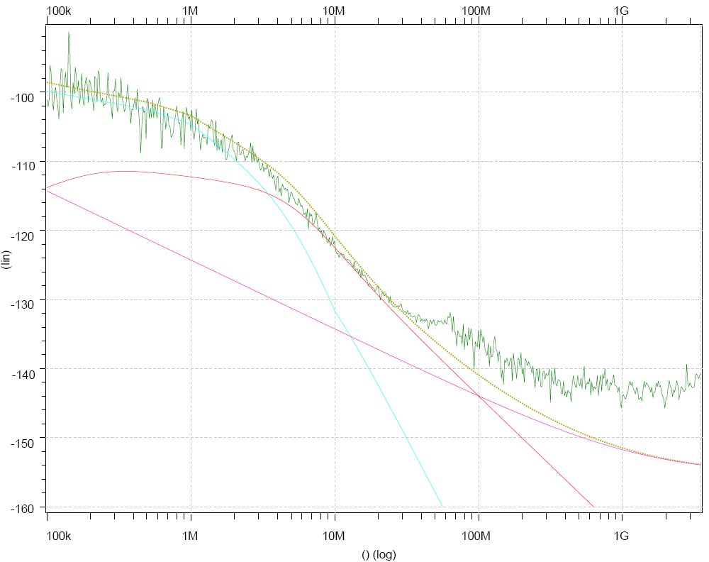
Silicon Correlation (Best Case) FF Wafers, High BW, High VCO Amp
LEGEND:
LMEAS
LSIM - Total
LSIM – REF
LSIM – VCO
LSIM - OPSTG
Refclk Dominated
VCO Dominated
Phase Noise dBc/Hz
Noise floor of Meas. Eqpt.
FF Wafers
V: 1.2V, 1V
Room Temp
BW ~ 4.2MHz
Amp ~ 0.55V
F_{out} = 7GHz
Jitter = 285 fs

Slide 18
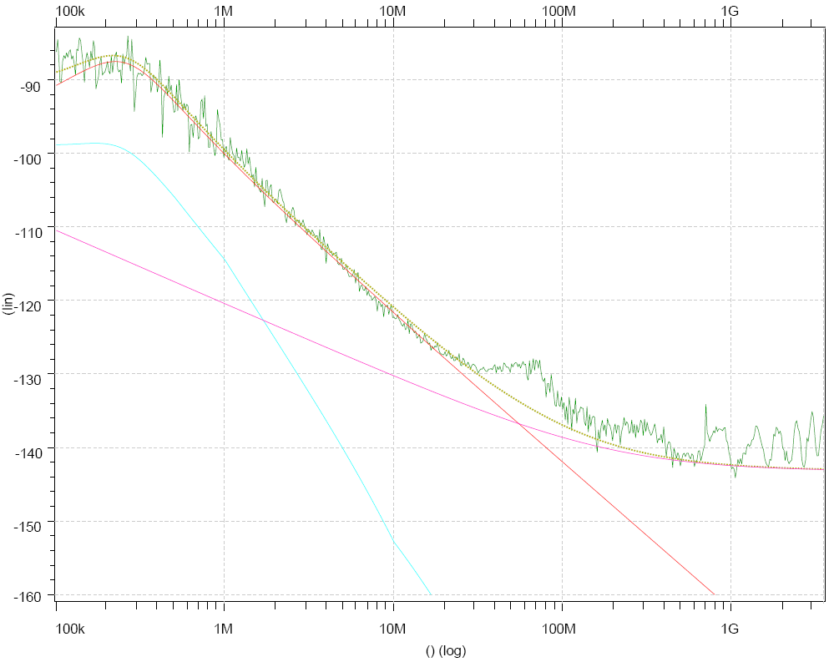
Silicon Correlation (Worst Case) SS Wafers, Low BW, Low VCO Amp
LEGEND:
LMEAS
LSIM - Total
LSIM – REF
LSIM – VCO
LSIM - OPSTG
Remember this hump ?
Amplitude Modulation
VCO Dominated
Phase Noise dBc/Hz
Output Stages Dominated
SS Wafers
V: 1.2 V, 1 V
Room Temp
BW ~ 450 KHz
Amp ~ 0.35 V
F_{out} = 7 GHz
Jitter = 384 fs

Slide 19
Next Steps
Compare full loop Transient Noise and PSS/PNOISE results with Silicon
Extensions to TOPS
Frequency domain analysis is currently for LTI 3rd order systems
Add non-linear, time varying and higher order functionality
Transient analysis is currently for non-linear time varying and higher order systems
Add random noise analysis to transient domain simulations

Slide 20
Summary
Discussed Challenges for 100GBE -SerDes application PLL design
Concentrated on Noise Analysis of the 14GHz PLL
Compared 3 Different Methods
Presented Silicon Measurements
Correlated Silicon Measurements to Simulation Results
Identified important Next Steps

