Slide 1
Design Methodology for Silicon-Accurate Jitter Analysis for 28nm Interface IP for 100GBASE-LR4 Applications
Alan Rogers - Analog Bits
Nandu Bhagwan – GHz Circuits, Inc
Ravi Subramanian - Berkeley Design Automation
October 16, 2012
Space for affiliation logo

Slide 2



Introduction
Presenting verification results of Integer-N PLL IP
Three way collaboration between:
Analog Bits: 28nm IP macro for 100 Gigabit Ethernet
TSMC: Reference flow development and 28nm process
BDA: Device Noise Analysis in the AFS Platform
2

Slide 3
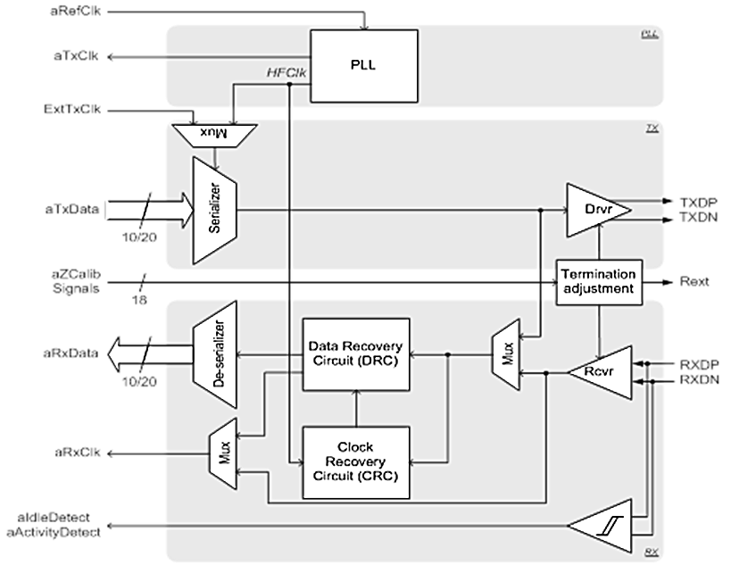
SerDes IP Targets SoC Applications
Multi-Rate, multi-Protocol, programmable SERDES IP
Minimize power, latency and area
Stringent verification challenges (phase noise & jitter)
PLL
PLL determines the
phase noise & jitter
specs

Slide 4
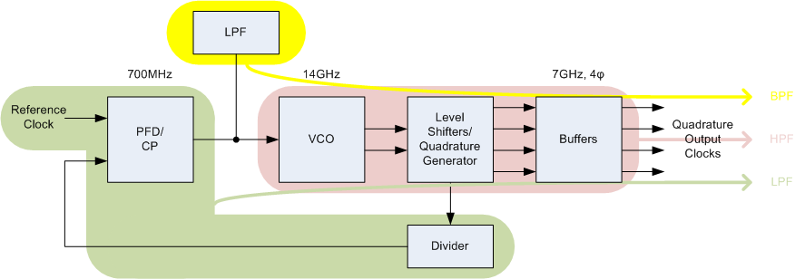
PLL IP Verification Challenges
Need to precisely analyze and predict PLL Phase noise & jitter
PLL Simulations are very expensive (time & compute resources)
Traditional SPICE simulators do not have performance and capacity
Need full-spectrum device noise to accurately verify phase noise
Need nanometer SPICE accuracy to predict silicon performance
PLL noise sources

Slide 5
PLL Analysis Methods: Pros and Cons
Simulation Method
Architectural
Block-level
Transient Noise
Closed-Loop
Effective Analysis Range
Full Band
Full band
(Low freq limited by runtime)
Spur Evaluation
Freq Domain: No
Time Domain: Yes
Yes
Noise Modeling of RefClk, Supply, etc.
Yes
Needs to be added to netlist
Simulation Setup/Complexity
Simple
Simple
Convergence Issues
Minimal
None
Accuracy
Implementation Dependent
Nanometer SPICE
Simulation Time
Fast
Intensive for low
offset frequencies

Slide 6
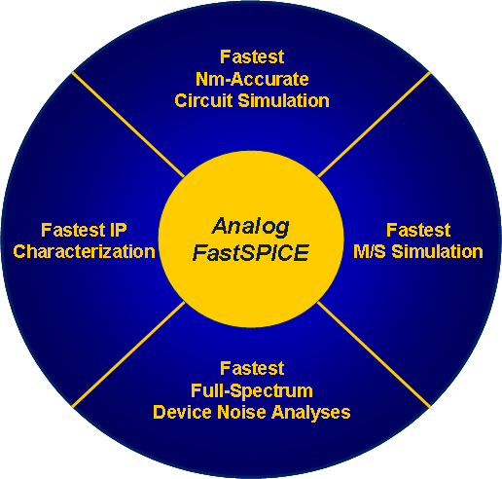
The Verification Platform
Analog Bits Selects Analog FastSPICE™ (AFS) Platform

Slide 7
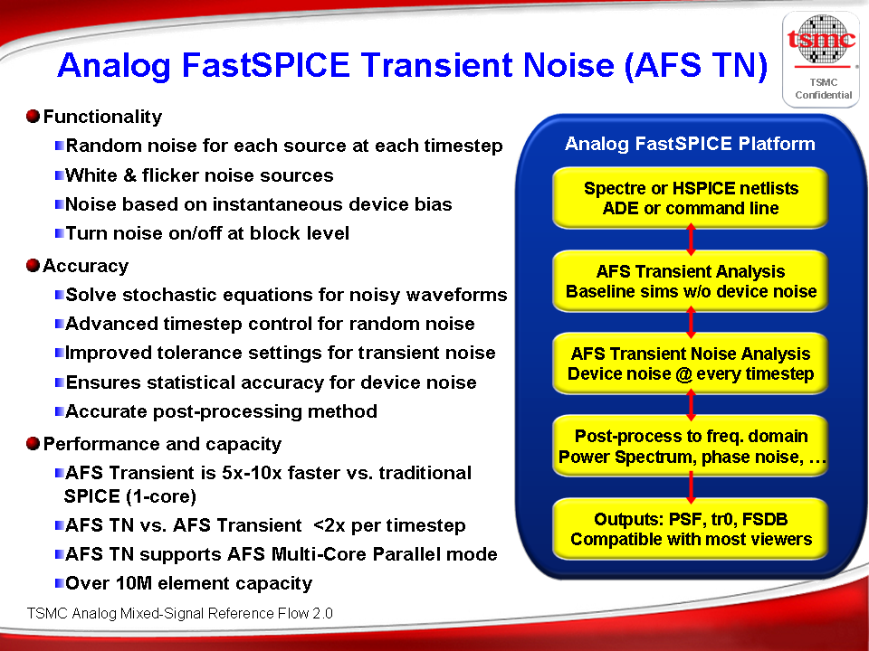
AFS in TSMC AMS Reference Flow

Slide 8
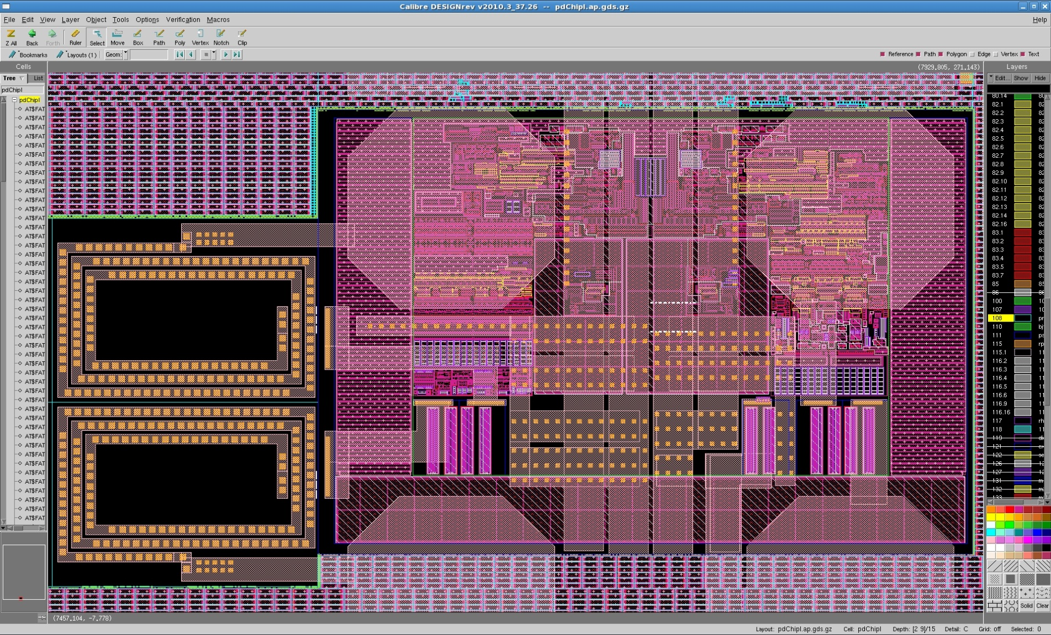
SERDES under a Bump Pitch
Analog Bits SERDES

Slide 9
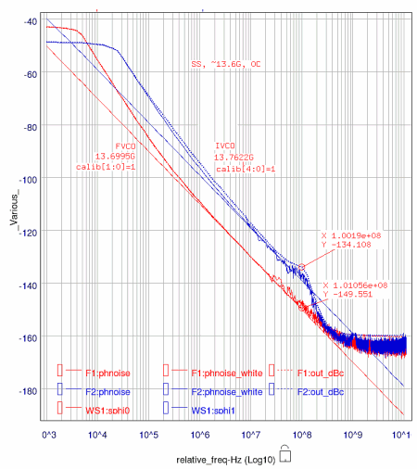
Block Level AFS + TF Aggregation Example of Block Level Extraction for VCO
Circuit Inventory
Analysis Conditions
Simulation Runtime
23 mins on 4 Xeon X5460 @3.16GHz CPUs
Good OSCNOISE and AFS TN correlation
bsim4v5_0 280
bsource_c 257
bsource_i 187
capacitor 203
diode 2
inductor 180
mutual inductor 6
resistor 6
vsource 50
Phase Noise dBc/Hz
 | VCO 1 | VCO 2
VDD | 1.8V | 1.2V
FOUT | 13.7 – 13.8 GHz
Conditions | SS, Lo T (0º)
Types of Analysis | Transient Noise, OSCNOISE
Relative Frequency – Hz (log10)
Carrier = 14GHz

Slide 10
Silicon Measurements
SS | Low Amp | Med Amp | Hi Amp
Low BW | 384 |  | 373
Med BW |  | 366
Hi BW | 333 |  | 307
FF | Low Amp | Med Amp | Hi Amp
Low BW | 378 |  | 337
Med BW |  | 360
Hi BW | 303 |  | 285

Slide 11
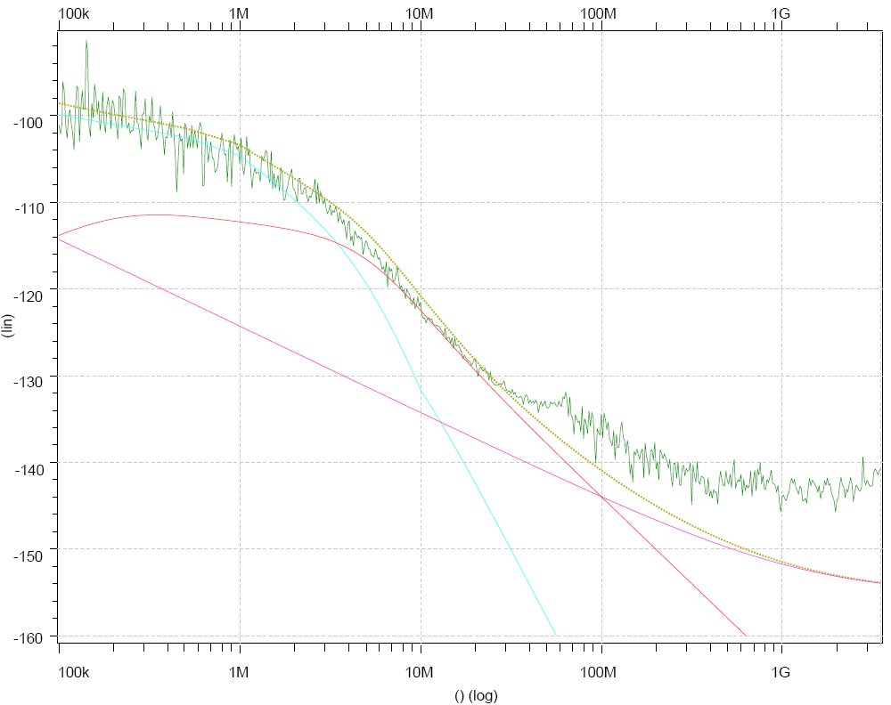
Silicon Correlation (Best Case) FF Wafers, High BW, High VCO Amp
LEGEND:
LMEAS
LSIM - Total
LSIM – REF
LSIM – VCO
LSIM - OPSTG
Refclk Dominated
VCO Dominated
Phase Noise dBc/Hz
Noise floor of Meas. Eqpt.
FF Wafers
V: 1.2V, 1V
Room Temp
BW ~ 4.2MHz
Amp ~ 0.55V
F_{out} = 7GHz
Jitter = 285 fs

Slide 12
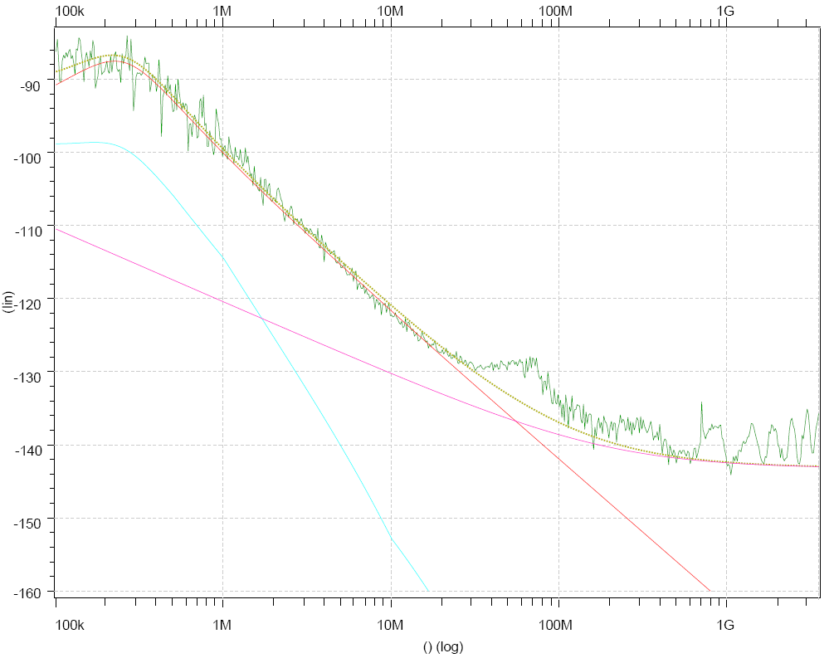
Silicon Correlation (Worst Case) SS Wafers, Low BW, Low VCO Amp
LEGEND:
LMEAS
LSIM - Total
LSIM – REF
LSIM – VCO
LSIM - OPSTG
Remember this hump ?
Amplitude Modulation
VCO Dominated
Phase Noise dBc/Hz
Output Stages Dominated
SS Wafers
V: 1.2 V, 1 V
Room Temp
BW ~ 450 KHz
Amp ~ 0.35 V
F_{out} = 7 GHz
Jitter = 384 fs

Slide 13
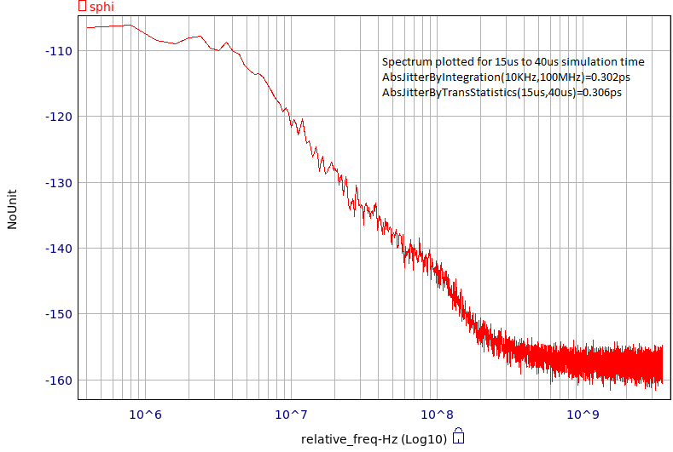
Closed- Loop PLL Transient Noise Simulation
Circuit Inventory
bsim4v5_0 1133
bsource_c 277
bsource_i 481
capacitor 429
inductor 196
mutual inductor 6
resistor 12
diode 40
vsource 78
Accuracy Settings
.option reltol=1e-5 fast=2 $ maxstep=2p delmax=2p
.tran 2p '1024*44*tper'
noisefmax='14e9' noisefmin='300e3’
Simulation Run Time
11 days on 4 Xeon X5460 @3.16GHz CPUs

Slide 14
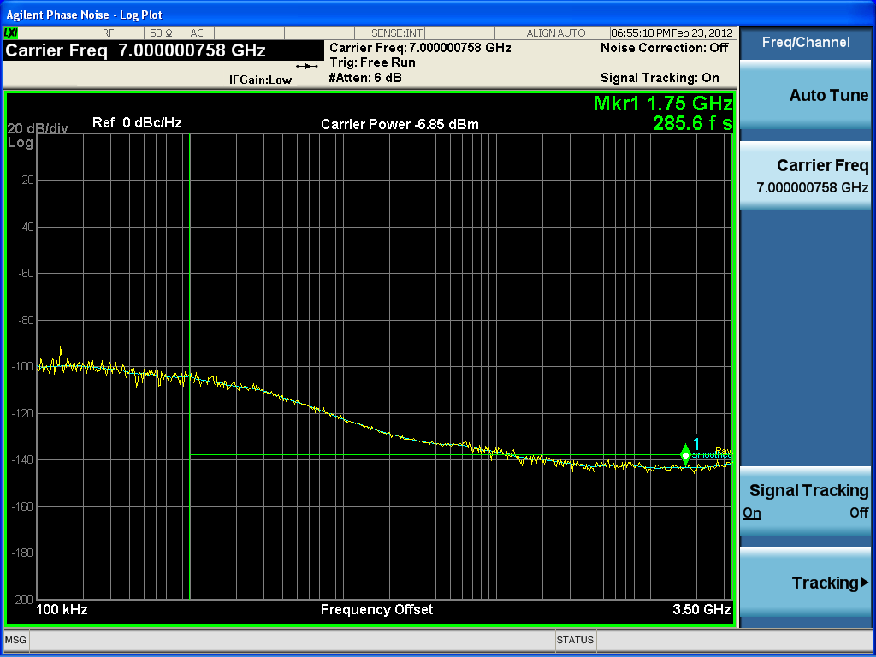

Closed-loop Transient Noise vs. Silicon
① 1M
①
1MHz
Dominated by REFCLK noise
AFS results
②
10MHz
Good match
② 10M
③
100MHz
Start seeing buffer noise
④
1GHz
Buffer noise & test equip noise floor
③ 100M
Refclk Noise (not modelled) dominates
④ 1G
Noisy REFCLK on eval board
Only real range for comparison
Driver Noise (not in Simulation) dominates
①
Noise Floor of Measurement Equipment
②
③
④
Silicon measurements

Slide 15
Conclusion
Lowest jitter PLL with 100 Gbps data transfer rates
Silicon-proven in TSMC’s 28nm process
Performance characterized with AFS Platform enabling
Rapid and accurate block-level and top-level analysis
Good simulation-to-silicon correlation
Leveraging new full-spectrum device-noise analysis technology
Improved analog SerDes sign-off flow
Increased design productivity and reduced risk
BDA-TSMC Device Noise Analysis Sub-flow provided good results in reasonable run-times

