Slide 1




TOPS
Accurate TOp Level PLL Simulator
April 14, 2007

Slide 2
Contents
Background & Motivation TOPS
TOPS Overview
User Interface
Examples
Summary
Contact info

Slide 3
Background
PLLs are complicated 3rd or higher order, non-linear, discrete-time, time-varying¹ feedback control systems
Meeting tight standards mandated goals and even tighter jitter specifications requires extensive expertise, time & compute resources
Need answers early in design process for tradeoffs and need exhaustive simulations later on for tolerance/yield analysis
There is necessity for a tool which provides circuit-simulator accurate measurements with behavioral-simulator speeds.
PLL loop parameters will change with time domain variations in supply (noise) for example, hence these parameters can be considered time-dependent. Also, in some applications like Fractional N synthesizers, the divider counts could be varied in time making the PLL loop parameters time-dependent.

Slide 4
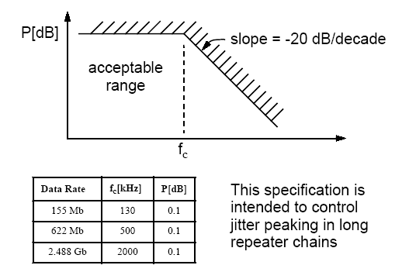
Standards Requirements
PCI Express
  2MHz < 3dB_BW < 22MHz
  0.54 < ζ
  Peak Jitter Transfer < 3dB
Sonet (OC xxx)
  f_{c} < Jitter Transfer Rolloff
  Peak Jitter Transfer < 0.1 dB
DVI/HDMI
  Jitter transfer amplitude shall not deviate from ideal (single pole 4MHz roll off) by ± 0.2dB from DC to 10MHz

Slide 5
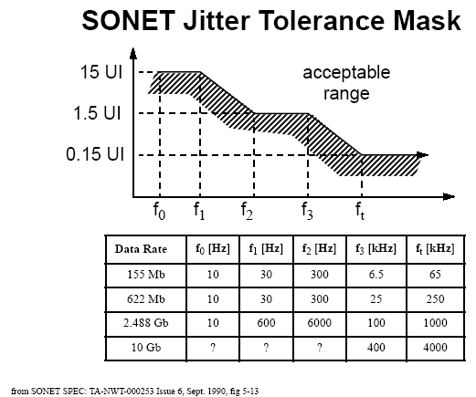
Jitter Requirements
Every standard has tight jitter specifications (TX) and lose jitter tolerances (RX) which are getting tighter/loser with advance in communication speeds
For example, 10Gigabit Ethernet requires RMS jitter to be < 5.5ps

Slide 6
Design to Standards Compliance Traditional Methods
Rely on “Classical” theory/formulae which erroneously force fits the design to possibly 2nd order or continuous time domain ?
Rely on in-house developed behavioral code (such as Matlab etc) ?
Run very time consuming transient simulations ?
After running out of time, Rely on “thumb-rules” and “gut-calls” ?
In summary, either “shoot in the dark and hope to hit the target” or expend incredible amounts time and compute resources

Slide 7
Solution
TOPS: circuit-simulator accurate behavioral simulator with 3-4 orders of magnitude improvement in speed.
Use TOPS in the architecture phase to determine PLL parameters to meet specifications
Implement circuits per design parameters
Use Circuit Simulator to verify functionality and a few step/impulse response closed loop simulations just to verify TOPS accuracy
Use TOPS with extracted non-linear sub-circuit characteristics for exhaustive tolerance/margin/yield analysis
Use TOPS with time-varying models and noise-scenarios for exhaustive jitter analysis
Get the confidence that circuit will meet specifications pre-tapeout and simultaneously reap the benefits of time-savings to tapeout.

Slide 8
TOp level PLL Simulator
Overview
A Top Level PLL simulator
  ACCURACY: Within a few % accuracy of circuit simulator, with 3-4 orders of magnitude speed improvement
  MODELING: Ability model sub-blocks as linear, non-linear or time-varying circuit extracts
  PARAMETER EXTRACTION: Push button extraction of critical closed loop parameters (ω_{3dB}, Jitter Peak, ζ, ω_{n}, Phase-margin)
  JITTER ANALYSIS: Comprehensive jitter analysis based on user defined noise vectors

Slide 9
TOPS
User Interface

Slide 10
TOPS User Interface
Simulator settings tab to select type of analysis
PLL settings tab to specify linear/non-linear PLL parameters such as ICP, KVCO and divider ratios
Filter settings tab to specify linear/non-linear filter parametrs (active/passive, 1/2/3rd order)
Global Settings tab to select working directory, path to waveform viewers etc.
Active & 3rd order filters are under development

Slide 11
Simulator Settings – Single Simulation
User selectable types of analyses
  Reference Phase Step (frequency impulse response/phase step response)
  Reference Frequency Step (frequency step response)
  Reference STFM
  User Defined Inputs (for example, Spread Spectrum or Jitter analysis)

Slide 12
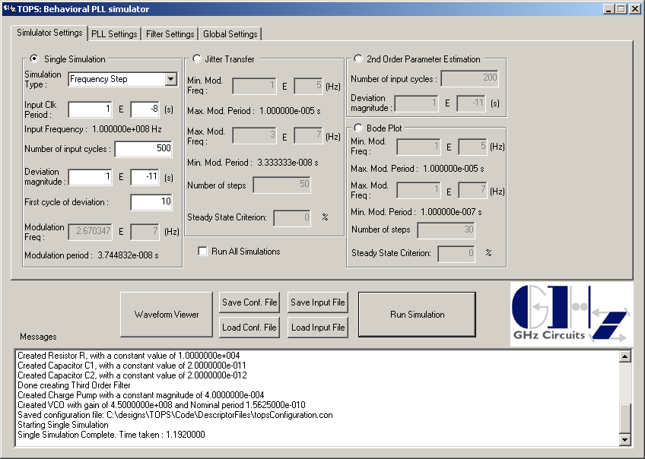
Simulator Settings – Single Simulation

Slide 13
Simulator Settings – Jitter Transfer
Jitter Transfer (Closed loop BW) measurements
  User defines start/stop of modulation frequencies and # of intermediate, logarithmically spaced, frequency points to be analyzed.
  User defines steady-state criterion, which is defined as ‘acceptable percentage variation of successive amplitudes of Feedback Clock period deviation’ to determine steady-state condition. Note that even at steady-state, at higher frequencies, successive sinusoidal amplitudes could vary due to the discrete nature of system
  TOPS simulates the frequency response in transient domain for each frequency point and outputs ω_{3dB} & Jitter Peak

Slide 14
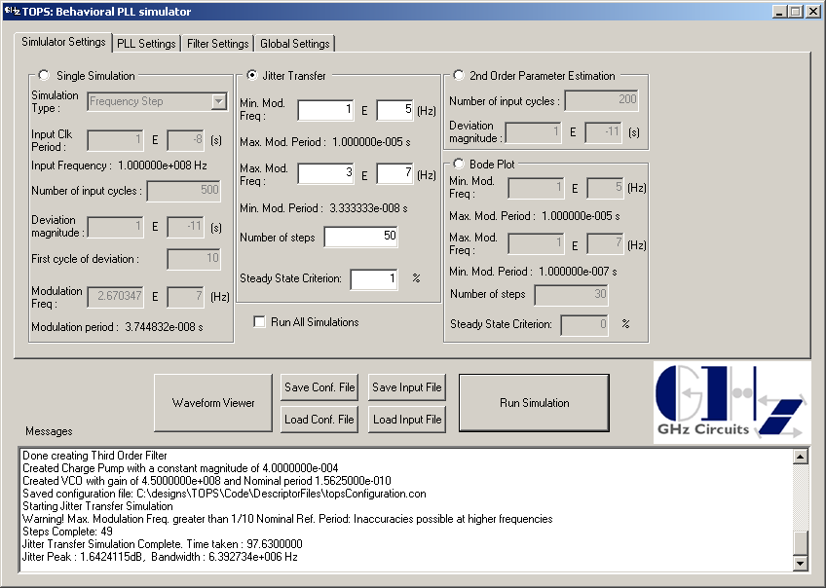
Simulator Settings – Jitter Transfer

Slide 15
Simulator Settings – Parameter Extraction
2nd order Parameter measurements
  User defines # of Reference Clock cycles to be simulated
  User defines amplitude of Reference frequency step
  TOPS simulates the step response, best fits the “classical” 2nd order response to actual response per two different algorithms and reports, ζ & ω_{n} for each.

Slide 16
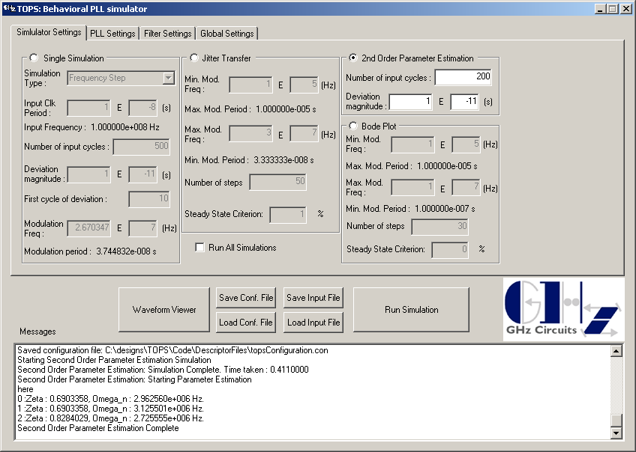
Simulator Settings – Parameter Extraction

Slide 17
Simulator Settings – Bode Plot
Bode Plot (Phase Margin measurements)
  User defines start/stop of phase modulation frequencies and # of intermediate, logarithmically spaced, frequency points in between
  User defines steady-state criterion, which is defined as ‘acceptable percentage variation of successive amplitudes of output phase deviation’ to determine steady-state condition. Note that even at steady-state, at higher frequencies, successive sinusoidal amplitudes could vary due to the discrete nature of system
  TOPS simulates the open loop frequency response in transient domain for each frequency point and outputs the Bode Plot & Phase Margin

Slide 18
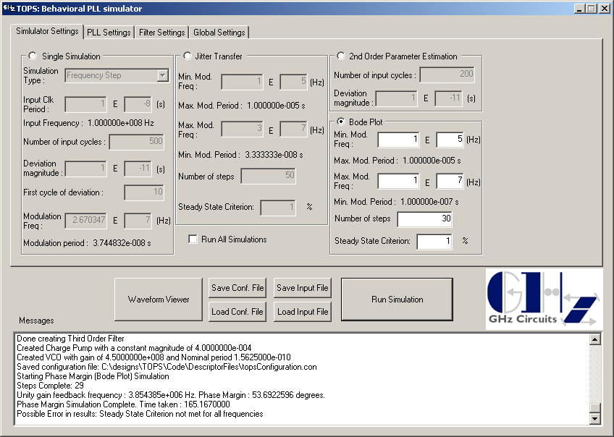
Simulator Settings – Bode Plot

Slide 19
Simulator Settings – All Simulations
Check this button and click Run to report results for all the below analyses
  Jitter transfer (ω_{3db} & Jitter Peak)
  2nd order Parameter Estimation (ζ & ω_{n})
  Bode Plot (Phase Margin)

Slide 20
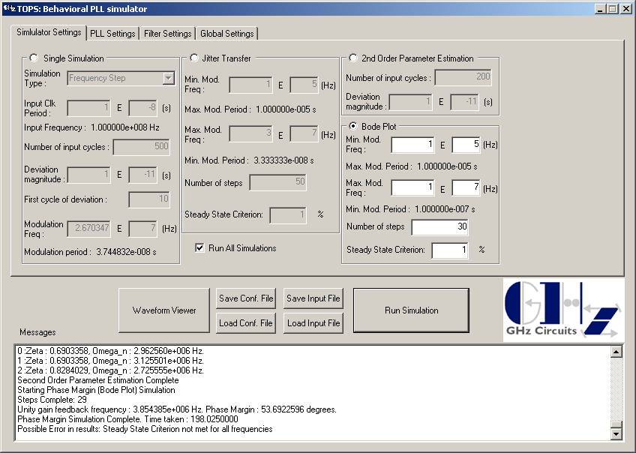
Simulator Settings – All Simulations

Slide 21
PLL Settings
KVCO and ICP can either be set linear, non-linear or time-varying. Non-linear or time-varying characteristics should be specified in an ASCII file and appropriately loaded.
Dividers can either be time-invariant or time-varying (ex: for Fractional-N synthesizers)
TPVCO(Nom) is the frequency of the VCO at nominal control voltage. This allows the PLL to either be started from lock, or be allowed to acquire lock.

Slide 22
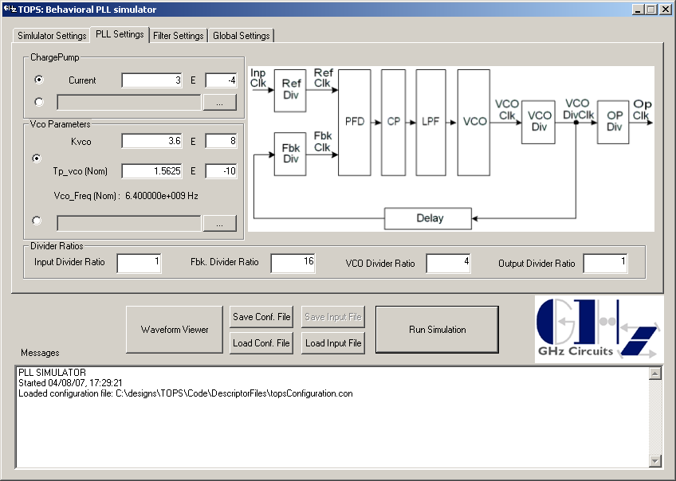
PLL Settings
LIN
NL/
TV

Slide 23
Filter Settings
Filter parameters can either be set linear or non-linear. Non-linear characteristics should be specified in an ASCII file and appropriately loaded.
3rd order Filter and capacitor leakage models are not yet implemented in this release

Slide 24
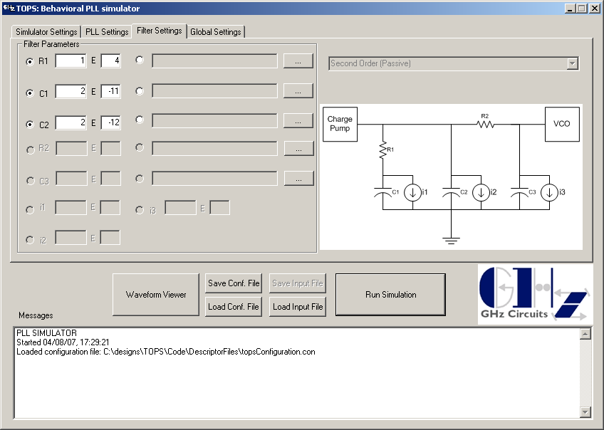
Filter Settings
NL/
TV
LIN

Slide 25
Global Settings
Working directory can be specified by user. This is where the configuration file and simulation outputs are placed
User can specify his/her choice of waveform viewer. Currently the results are output in the following formats
  Synopsys Awaves
  Cadence
  BDA
  Plain Text

Slide 26
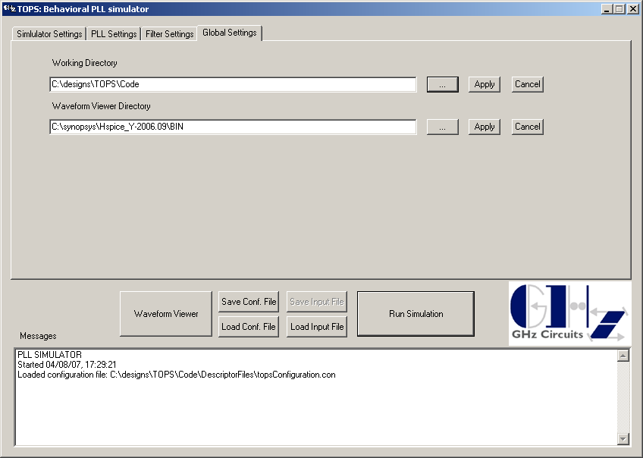
Global Settings

Slide 27
Examples

Slide 28
Application Examples
10 GbE: PLL Phase step response and verification of accuracy against Cadence Spectre results
SATA: PLL acquisition characteristics
SATA: PLL spread spectrum response
PCI-Express: Jitter Transfer characteristics
PCI-Express: 2nd Order parameter (ζ & ω_{n}) estimation
10GbE: Bode-Plot & Phase Margin measurement

Slide 29
Ex 1: Single Simulation –
Impulse Response
Impulse response for a fully differential 6.4GHz LC oscillator is simulated in Circuit Simulator (Cadence Spectre) & TOPS
PLL is allowed to lock in Circuit simulator and a Reference Clock phase step of 200ps is applied at 2uS
PLL is modeled as a linear system in TOPS with circuit extracted parameters. See Ex 6 for parameter listing
Next page shows superposition of the phase tracking error & instantaneous VCO frequency for both Circuit Simulator & TOPS
Output is viewed with Synopsys AWAVES waveform viewer

Slide 30
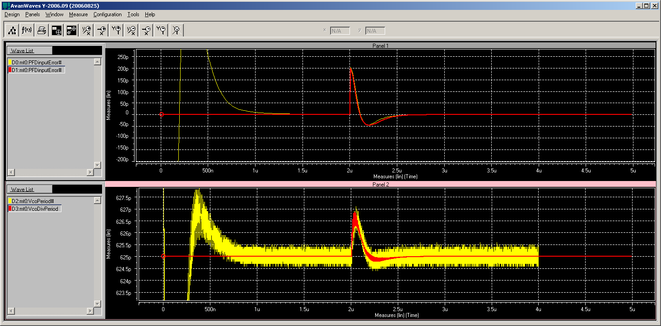
Ex 1: Impulse Response
Spectre
TOPS
Spectre
TOPS

Slide 31
Ex 1: Impulse Response
Summary of Results
ACCURACY: The superimposed plots show TOPS step response very closely matches Circuit Simulator phase step response, even using linearized models for TOPS simulation.
Zero Crossing (ω_{n} indicator) | -3.4%
Peak Undershoot (ζ indicator) | 2.2%
Difference in integrated error is within a few % and difference in instantaneous VCO frequency is negligible
Circuit Simulator shows numerical noise in instantaneous frequency plot which is dependent on timestep resolution.
Circuit Simulator run time ~ 10 h
TOPS run time ~ 1.2s

Slide 32
Ex 2: Single Simulation
- Acquisition
The acquisition behavior of a SATA PLL is simulated. See Ex 3 for PLL parameter listing
The next page shows acquisition plots of PFD input tracking error and instantaneous VCO frequency
The model is accurate for small and large signal
Simulation for 10us takes < 1s

Slide 33
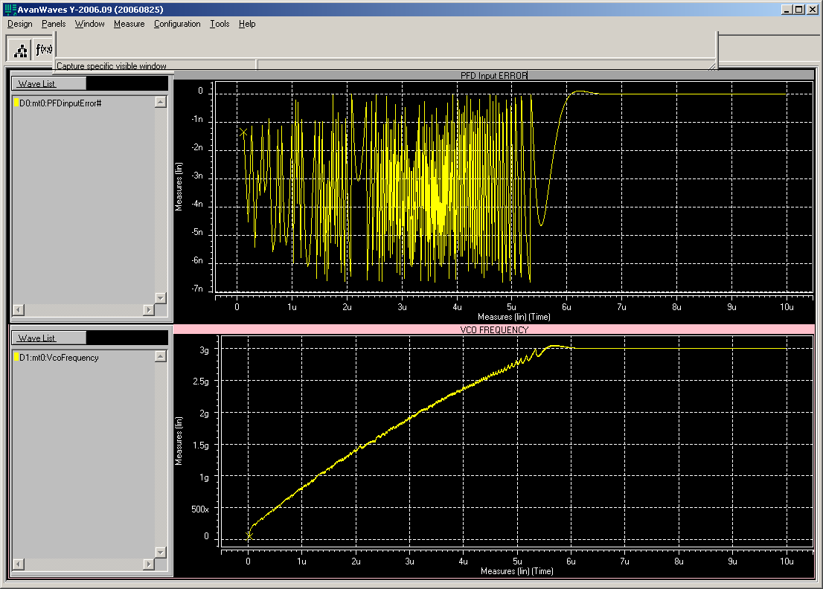
Ex 2: Acquisition

Slide 34
Ex 3: Single Simulation – UDI
(User Defined Input)
The spread spectrum response of a SATA PLL is analyzed
The filter capacitor is varied to observe variations in tracking error

Slide 35
Ex 3: Spread Spectrum Tracking
Reference: Serial ATA specifications
  Spreading reference spectrum is defined as +0 / -0.5% reference clock period/frequency variation over a 33.33us up/down (15KHz) triangular wave period
Assume SS input clock at 150MHz and 3GHz transmitter clock
PLL parameters are as shown in next slide
Tracking is analyzed for 3 different values of main filter capacitor

Slide 36
Ex 3: Spread Spectrum Tracking
PLL parameters
Parameter | Value
Fin | 150MHz
Fout | 3GHz (x 20)
KVCO | 4GHz/V (Ring Osc)
ICP | 10uA
Rzero | 5KΩ
Cpole | 25pF, 50pF, 100pF
Cspur | 5pF

Slide 37
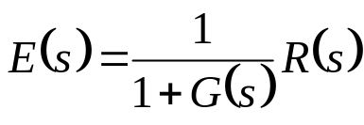

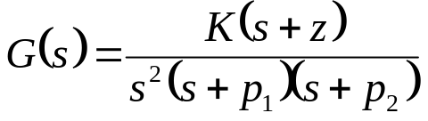
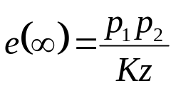
Ex 3: Spread Spectrum Tracking
Expectations from Theory
R(s)
+
E(s)
C(s)
G(s)
_
Final value theorem states
For an input frequency ramp (parabolic in phase), R_{fr}(s) = 1/s³.
Simplifying, it can be shown that the steady state error for this input is a constant given by

Slide 38
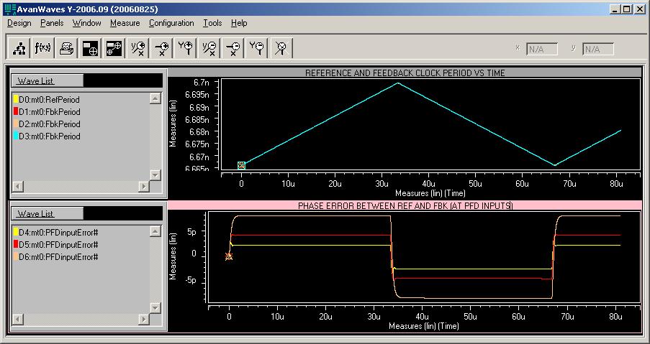
Ex 3: Spread Spectrum Tracking

Slide 39
Ex 3: Spread Spectrum Tracking
Summary & Run time statistics
As expected from theory, tracking error increases with P1 (i.e. as Cpole increases, tracking error increases)
Each simulation run was for ~ 80us
  About 12K 150MHz cycles
  About 240K 3GHz VCO cycles
  Simulation time < 5s

Slide 40
Ex 4: Jitter Transfer
The Jitter Transfer (closed loop BW) of a PCI-Express PLL is analyzed
The parameters for the PLL is shown in the next slide
The zero-resistor is varied to see effect on the Jitter Peaking

Slide 41
Ex 4: Jitter Transfer
PLL parameters
Parameter | Value
Fin | 100MHz
Fout | 2.5GHz (x 25)
KVCO | 5GHz/V (Ring Osc)
ICP | 20uA
Rzero | 1, 2, 4, 8 KΩ
Cpole | 50pF
Cspur | 5pF

Slide 42
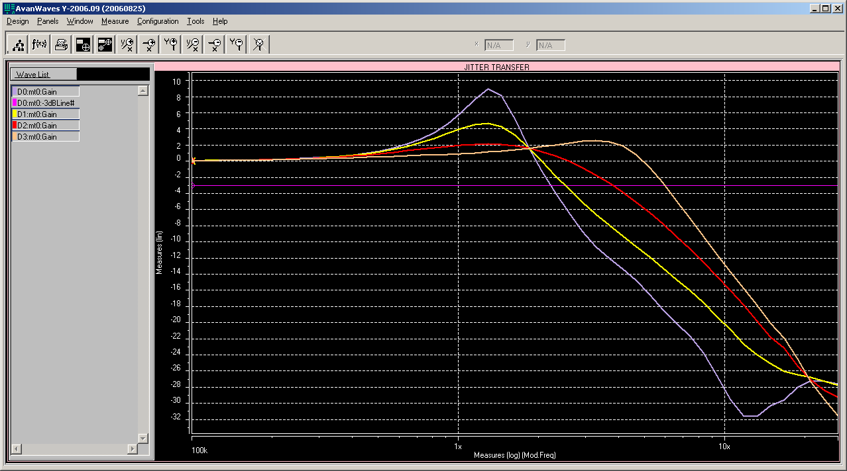
Ex 4: Jitter Transfer

Slide 43
Ex 4: Jitter Transfer
Summary of results
R (KΩ) | ω_{3db} (MHz) | Jitter Peak (dB)
1 | 2.23 | 8.9
2 | 2.52 | 4.7
4 | 3.8 | 2.13
8 | 5.9 | 2.58
Note Jitter Peak increase from Rz = 4K to 8K due to 3rd order effects

Slide 44
Ex 4: Jitter Transfer
Run time statistics
Each BW simulation run was for
  Fmod start = 100K
  Fmod stop = 30MHz
  50 logarithamically spaced points inbetween
  Simulation duration ~ 660us or 2e6 VCO cycles inclusive of time for FFBK to stabilize in transient domain
  Simulation time ~ 30s

Slide 45
Ex 5: 2nd order Parameter Estimation
The 2nd order parameters (ζ & ω_{n}) of the previous PCI-Express PLL is analyzed
The analysis is for the same variation of zero-resistor as mentioned previously
The next 4 graphs show the actual response of the PLL to a freq step vs. the best fit per 2 algorithms
  Notice the 3rd order effects manifesting in the step response as Rspur increases.
Which of the 2 algorithms better fits the PLL response is dependent on many factors and it is left to the user to select best fit

Slide 46
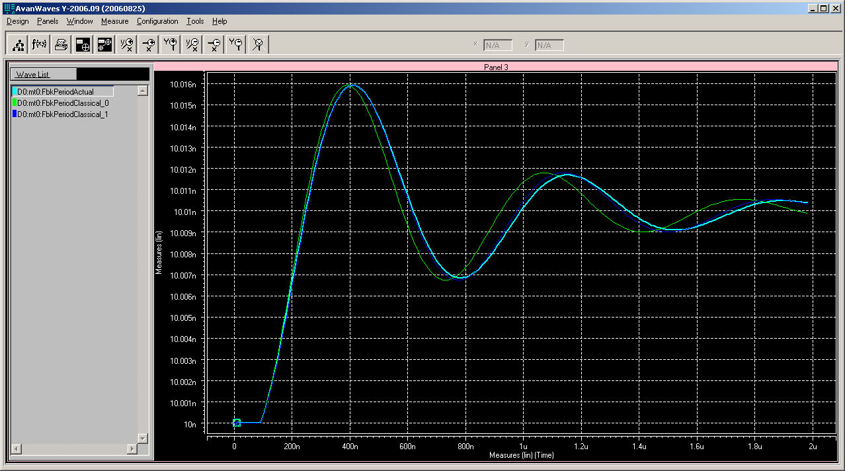
Ex 5: Parameter Estimitation
Rz = 1k

Slide 47
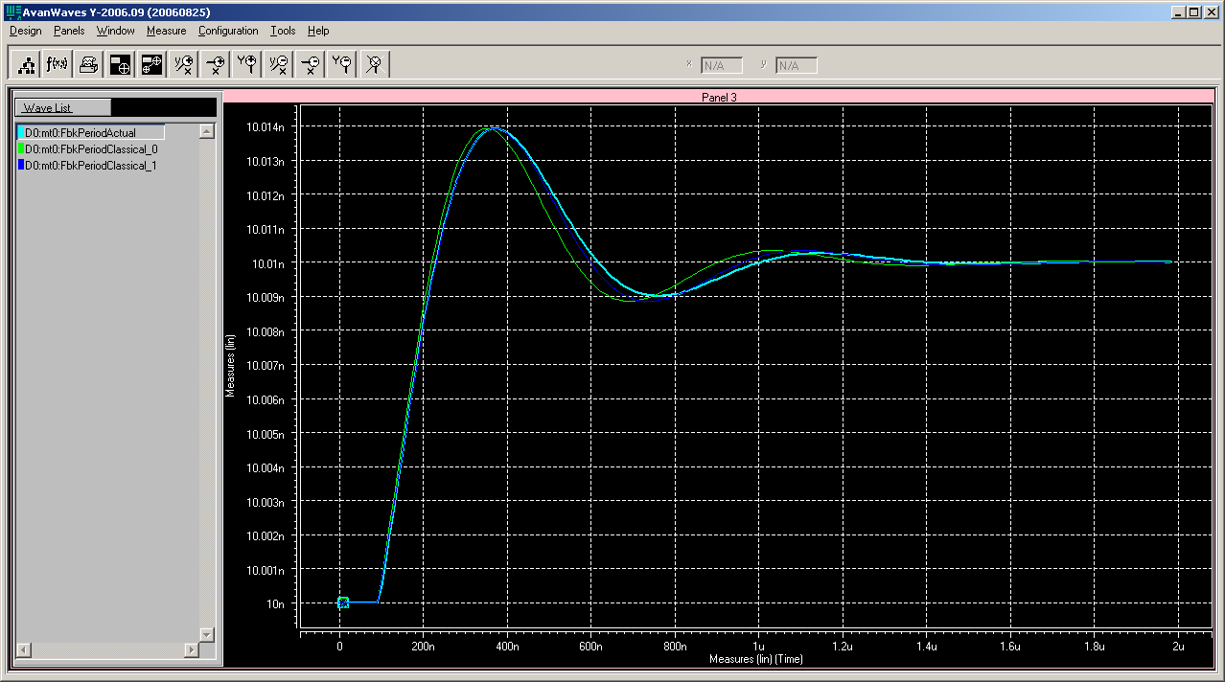
Ex 5: Parameter Estimimation
Rz=2k

Slide 48
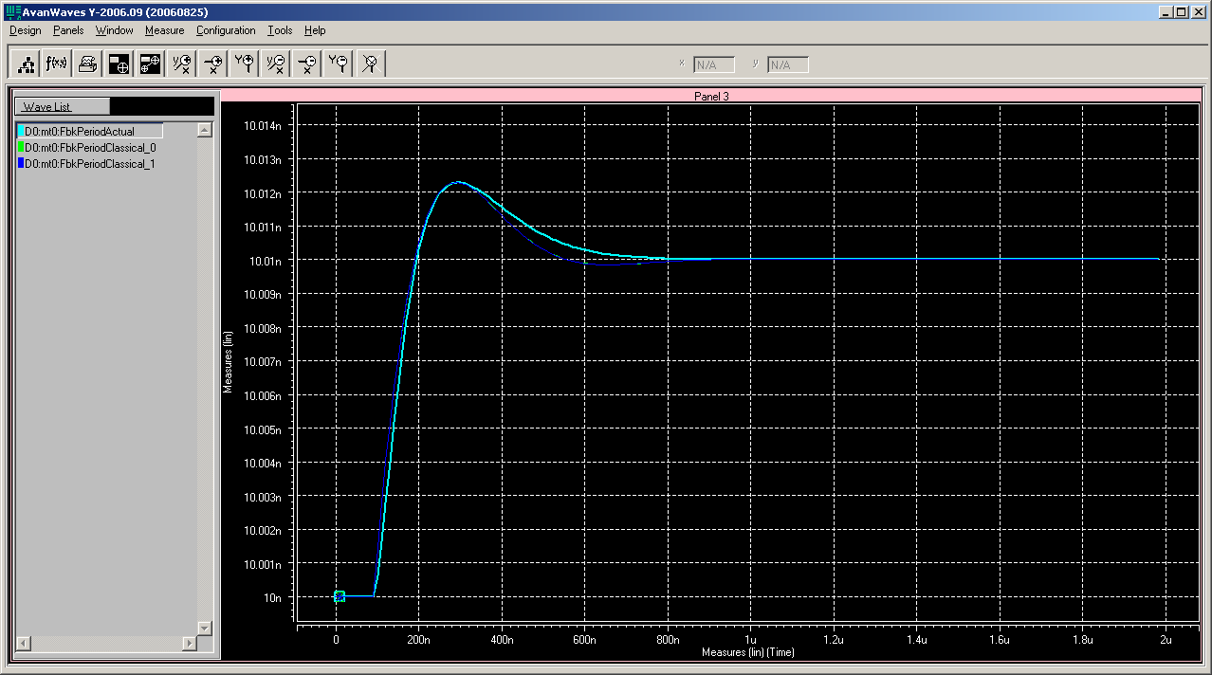
Ex 5: Parameter Estimation
Rz=4k

Slide 49
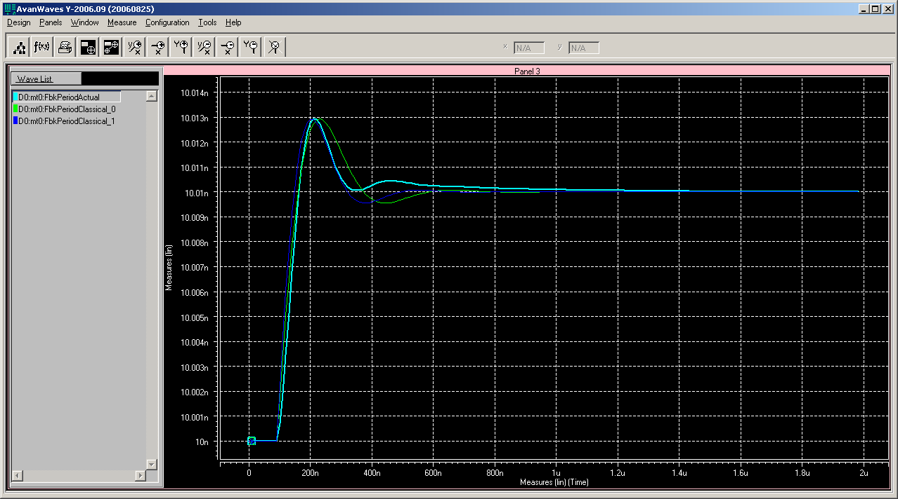
Ex 5: Parameter Estimitation
Rz=8k

Slide 50
Ex 5: Param Estimation
Summary of results
R (KΩ) | ζ |  | ω_{n}(MHz)
1 | 0.186 | 0.192 | 1.4 | 1.402
2 | 0.364 | 0.385 | 1.46 | 1.45
4 | 0.65 | 0.77 | 1.81 | 1.57
8 | 0.51 | 0.53 | 3.35 | 3.33
Note ζ reduction from Rz = 4K to 8K due to 3rd order effects

Slide 51
Ex 5: Parameter Estimation
Run time statistics
Each Param estimation simulation
  Was for 200 FREF cycles
  Simulation time < 1s
  2nd order curve fit time 1.2s

Slide 52
Ex 6: Bode Plot
The Bode plot for a 6.4GHz 10GBE LC oscillator based Differential PLL is plotted through open loop transient simulations
Bi-section theorem is applied to convert Differential parameters to Single Ended
The loop parameters are as shown in the next slide
Charge pump current (which directly affects loop gain) is varied for 3 values

Slide 53
Ex 6: Bode Plot
PLL parameters
Parameter | Value
Fin | 100MHz
Fout | 6.4 GHz (x 64)
KVCO | 450 MHz/V (LC Osc)
ICP | 100, 200, 400 uA
Rzero | 10 KΩ
Cpole | 20pF
Cspur | 2pF

Slide 54
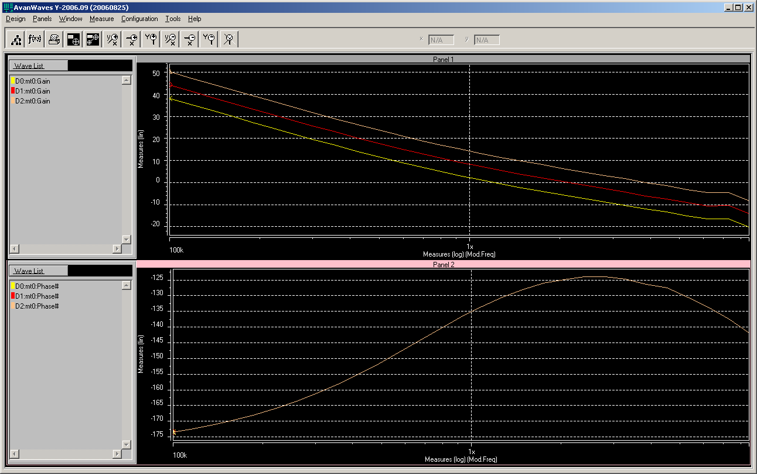
Ex 6: Bode Plot

Slide 55
Ex 6: Bode Plot
Summary of results
ICP | Phase Margin
100u | 48.6°
200u | 55.4 °
400u | 53.7 °
Note the phase roll-off due to the 3rd pole
Increasing or decreasing open loop gain from ICP=200u worsens Phase margin due to the phase roll-off

Slide 56
Ex 6: Bode Plot
Run time statistics
Each PM simulation run was for
  Fmod start = 100K
  Fmod stop = 100MHz
  30 logarithamically spaced points inbetween
  Simulation duration ~ 1.5ms or 10e6 VCO cycles, inclusive of time for FFBK to stabilize in transient domain
  Simulation time ~ 2m 44s

Slide 57
Summary
Demonstrated examples from 4 real world examples
  Spread Spectrum tracking response for SATA PLL
  Jitter Transfer characteristics for PCI-Express PLL
  2nd Order parameter (ζ & ω_{n}) estimation for PCI-Express PLL
  Bode-Plot & Phase Margin measurement for 10GbE PLL

Slide 58
Contact Info
Nandu Bhagwan
  GHz Circuits, Inc
  1030 E. El Camino Real, PMB 232
  Sunnyvale, CA 94087
  (408)\7/8/1\0/9/8/9/
  www.ghzcircuits.com
  Nandu_at_ghzcircuits_dot_com

Slide 59
Backups

Slide 60
Planned Enhancements
Add 3rd order Filters (with leakage models) and active Filter library
Add hooks to apply user defined jitter at different points (VCO, delay path etc)
Add jitter generation & visualization tools
Add optimization core
Add formal-verification core

Slide 61
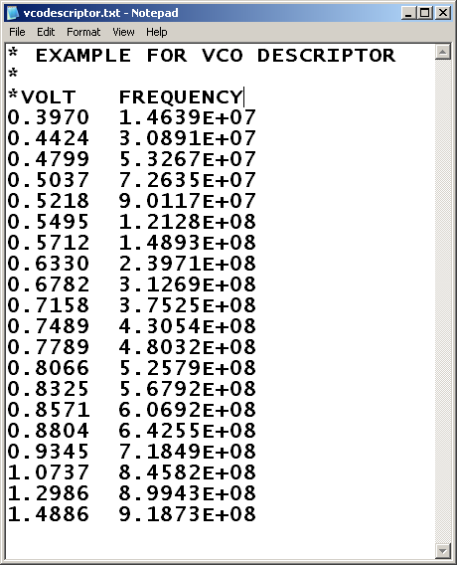
Example Descriptor File
Non-linear VCO Transfer Characteristic

Slide 62
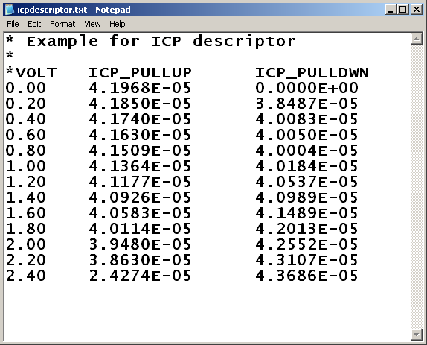
Example Descriptor File
Non-linear Charge Pump Current

Slide 63
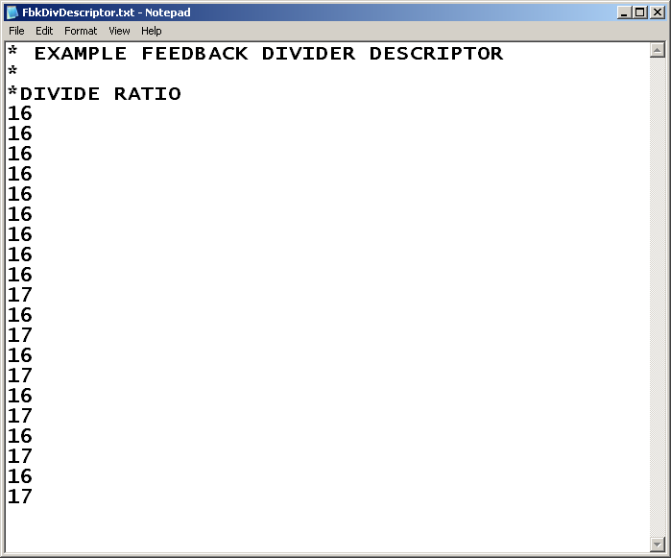
Example Descriptor File
Time Varying Divider Count

Slide 64
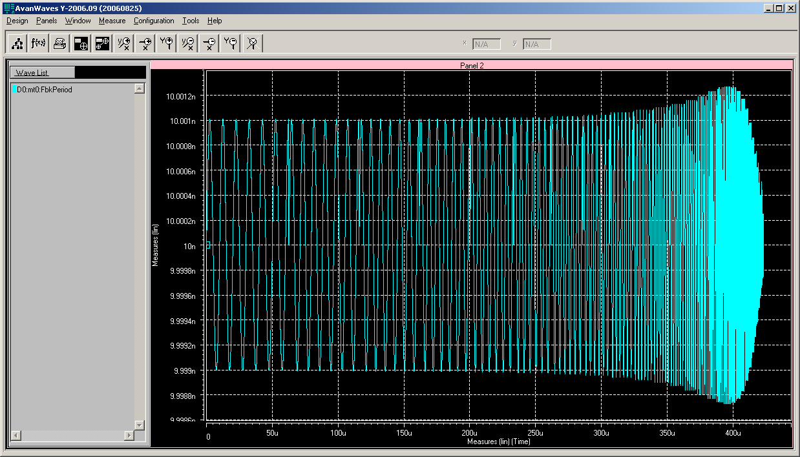
Jitter Transfer Simulation
The transient run (feedback clock period)

Slide 65
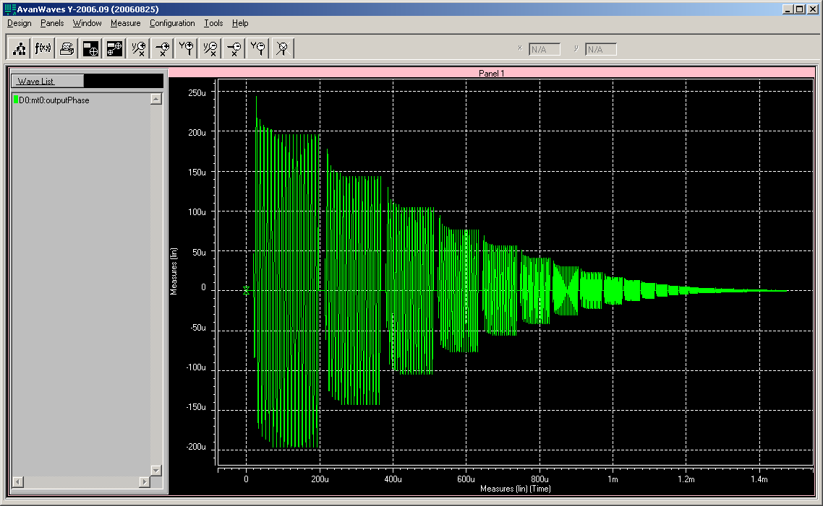
Bode Plot Simulation
The transient run (output phase deviation)

