Slide 1




TOPS
Accurate TOp Level PLL Simulator
April 13, 2007

Slide 2
Contents
Background & Motivation
    Traditional Solutions
    Proposed Solution
TOPS Overview
    User Interface
    Example
Summary
    Benefits
    Extensions
    Market Segments
Contact info

Slide 3
Background
PLLs are complicated 3rd or higher order, non-linear, discrete-time, time-varying¹ feedback control systems
Meeting tight standards mandated goals and even tighter jitter specifications requires extensive expertise, time & compute resources
Need answers early in design process for tradeoffs and need exhaustive simulations later on for tolerance/margin/yield analysis
There is necessity for a tool which provides circuit-simulator accurate measurements with behavioral-simulator speeds.
PLL loop parameters will change with time domain variations in supply (noise) for example, hence these parameters can be considered time-dependent. Also, in some applications like Fractional N synthesizers, the divider counts could be varied in time making the PLL loop parameters time-dependent.

Slide 4
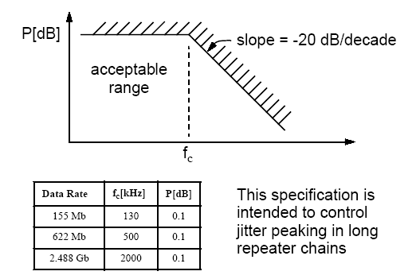
Standards Mandates
PCI Express
  2MHz < 3dB_BW < 22MHz
  0.54 < ζ
  Peak Jitter Transfer < 3dB
Sonet (OC xxx)
  f_{c} < Jitter Transfer Rolloff
  Peak Jitter Transfer < 0.1 dB
DVI/HDMI
  Jitter transfer amplitude shall not deviate from ideal (single pole 4MHz roll off) by ± 0.2dB from DC to 10MHz
Communications: Jitter performance
  Advances in signaling speeds continuously tightens jitter specifications (TX) and losens jitter tolerances (RX)

Slide 5
Design to Standards Compliance Traditional Methods
Rely on “Classical” theory/formulae which erroneously force fits the design to possibly 2nd order or continuous time domain
Rely on in-house developed behavioral code (such as Matlab etc)
Run very time consuming transient simulations
After running out of time, Rely on “thumb-rules” and “gut-calls”
In summary, either “shoot in the dark and hope to hit the target” or expend incredible amounts time and compute resources

Slide 6
Solution
TOPS: circuit-simulator accurate behavioral simulator with 3-4 orders of magnitude improvement in speed.
Use TOPS in the architecture phase to determine PLL parameters to meet specifications
Implement circuits per design parameters
Use Circuit Simulator to verify functionality and a few step/impulse response closed loop simulations just to verify TOPS accuracy
Use TOPS with extracted non-linear sub-circuit characteristics for exhaustive tolerance/margin/yield analysis
Use TOPS with time-varying models and noise-scenarios for exhaustive jitter analysis
Get the confidence that circuit will meet specifications pre-tapeout and simultaneously reap the benefits of time-savings to tapeout.

Slide 7
TOp level PLL Simulator
Overview
A Top Level PLL simulator
  ACCURACY: Within a few % accuracy of circuit simulator, with 3-4 orders of magnitude speed improvement
  MODELING: Ability model sub-blocks as linear, non-linear or time-varying circuit extracts
  PARAMETER EXTRACTION: Push button extraction of critical closed loop parameters (ω_{3dB}, Jitter Peak, ζ, ω_{n}, Phase-margin)
  JITTER ANALYSIS: Comprehensive jitter analysis based on user defined noise vectors

Slide 8
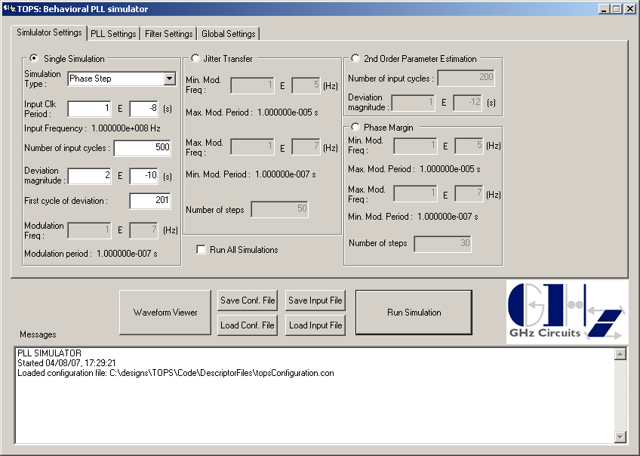
TOPS: User Interface (i)

Slide 9
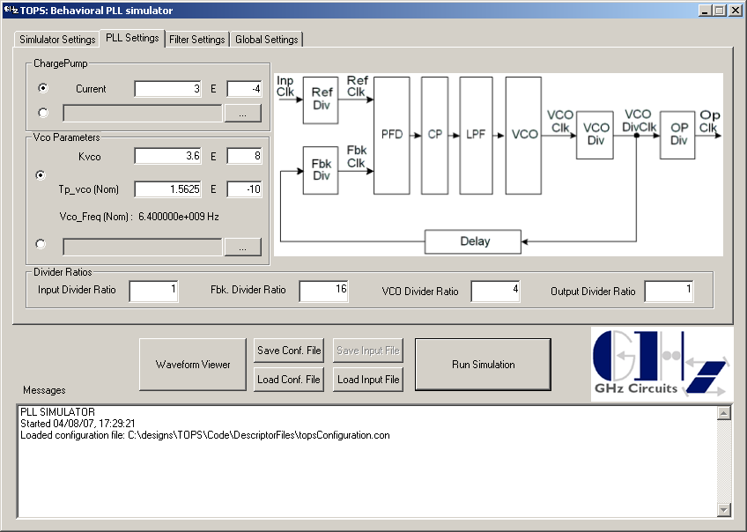
TOPS: User Interface (ii)

Slide 10
Case Study: Impulse Response
Comparison with Cadence Spectre
Impulse response for a fully differential 6.4GHz LC oscillator is simulated in Circuit Simulator (Cadence Spectre) & TOPS
PLL is allowed to lock in Circuit simulator and a Reference Clock phase step of 200ps is applied at 2uS
PLL is modeled as a linear system in TOPS with circuit extracted parameters.
Next page shows superposition of the phase tracking error & instantaneous VCO frequency for both Circuit Simulator & TOPS
Output is viewed with Synopsys AWAVES waveform viewer

Slide 11
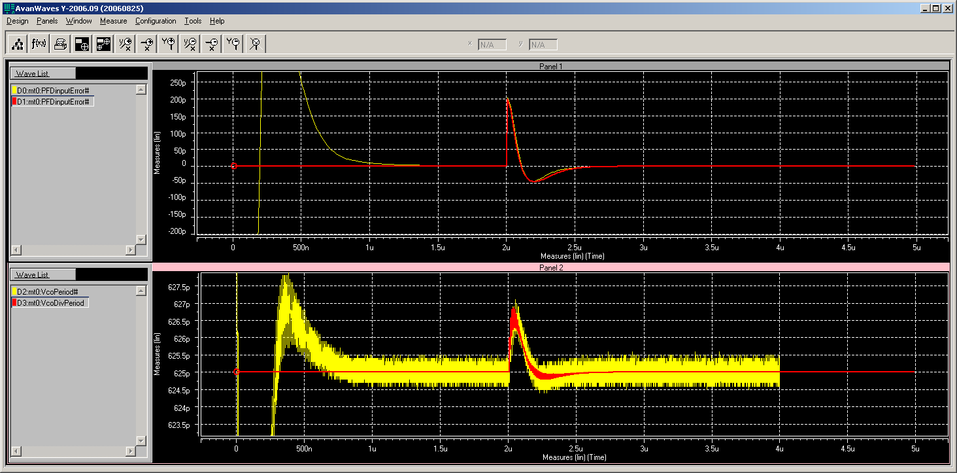
Case Study: Impulse Response
Simulation Results Overlay
Spectre
TOPS
Spectre
TOPS

Slide 12
Case Study: Impulse Response
Summary of Results
ACCURACY: The superimposed plots show TOPS step response very closely matches Circuit Simulator phase step response, even using linearized models for TOPS simulation.
Zero Crossing (ω_{n} indicator) | -3.4%
Peak Undershoot (ζ indicator) | 2.2%
Difference in integrated error is within a few % and difference in instantaneous VCO frequency is negligible
Circuit Simulator shows numerical noise in instantaneous frequency plot which is dependent on timestep resolution.
Circuit Simulator run time ~ 10 h
TOPS run time ~ 1.2 s

Slide 13
Summary
Accurate to Circuit Simulator within a few %
Speed improvement of 3-4 orders of magnitude
Intuitive & User friendly GUI
Push-button extraction of critical design-to parameters

Slide 14
Benefits
Accuracy and significant simulation time savings enable
Exhaustive what-if analysis & optimization at architecture level
Exhaustive tolerance/margin/yield analysis at post circuit design/layout level
Exhaustive Jitter analysis for user specified noise scenarios
Formal analog-verification
Ability to run bench test measurements prior to tapeout

Slide 15
Cost Benefits
Reduction in simulation/verification time and time to tape-out
Reduction in simulator licenses
Reduction in Hardware to run simulators
Reduction in Silicon spins

Slide 16
Extensions to different
Market Segments
The engine can be extended to benefit other continuous-time systems with discrete-time control
  SERDES (CDR)
  RF (Fractional-N synthesizer)

Slide 17
Verticals
Analog/Mixed-Signal/SOC
  Chip Design Companies
  IP design Companies
  IP purchaser Companies
  System Companies

Slide 18
Known Competition
Agilent Eagleware Genesys
  Agilent purchased Eagleware for a few million
  This however is does not have circuit-accurate modeling of sub-blocks
  We believe TOPS is significantly faster
  This does not have post processing engines for optimization/formal-verification etc.
Freeware
  There are a few freely available software but quality, support, verification w.r.t. industrial designs/silicon is unproven
WaveCrest
  This is not exactly competition as Wavecrest has tools to measure similar results post-silicon.
  One of our goals is to provide WaveCrest type measurements pre-silicon

Slide 19
Contact Info
Nandu Bhagwan
  GHz Circuits, Inc
  1030 E. El Camino Real, PMB 232
  Sunnyvale, CA 94087
  1\(408)\7/8/1\0/9/8/9/
  www.ghzcircuits.com
  Nandu_at_ghzcircuits_dot_com

