Slide 1


Project Title -
Seasonal Agriculture Performance Analysis
Name: RAYANA MALLIKARJUNA DURGA SAI
College Name: Raghu Engineering College
AICTE STU ID : STU69c38045ede4b1774420037
9/8/2026
Annual Review
‹#›

Slide 2

PROBLEM STATEMENT
Agricultural activities are influenced by seasonal variations in environmental conditions, farming practices, resource availability and market conditions. As a result, agricultural performance may differ from one season to another.
However, raw agricultural data does not clearly explain how agricultural performance changes across seasons or what patterns can be observed in different seasonal conditions. The project analyzes the given agricultural dataset to identify meaningful seasonal patterns, trends, relationships and variations.
9/8/2026
Annual Review
‹#›

Slide 3
Project Description
Seasonal Agriculture Performance Analysis studies farm-level agricultural records across Kharif, Rabi and Zaid seasons. The analysis examines environmental conditions, farming practices, resource usage, production, profitability and irrigation.
The notebook performs data exploration and cleaning, descriptive statistics, univariate, bivariate and multivariate analysis, outlier review, seasonal comparisons, group comparisons and a Kruskal-Wallis test. The purpose is to understand how agricultural performance changes across seasons and to communicate evidence-based findings.
9/8/2026
Annual Review
‹#›

Slide 4

WHO ARE THE END USERS?
Farmers and farm managers – for comparing seasonal performance.
Agricultural analysts and planners – for identifying seasonal patterns and differences.
Irrigation and resource managers – for reviewing water use and efficiency.
Agricultural researchers and students – for evidence-based seasonal analysis.
Decision-makers – for using data-driven seasonal insights in planning.
9/8/2026
Annual Review
‹#›

Slide 5

Technology Used
Python
Pandas and NumPy
Matplotlib and Seaborn
SciPy (Kruskal-Wallis test)
Google Colab / Jupyter Notebook
9/8/2026
Annual Review
‹#›
Notes:
5

Slide 6
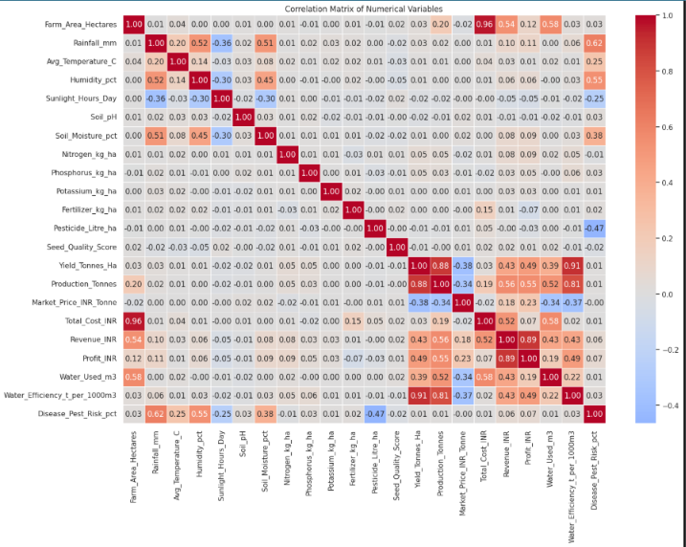
RESULTS
9/8/2026
Annual Review
‹#›

Slide 7
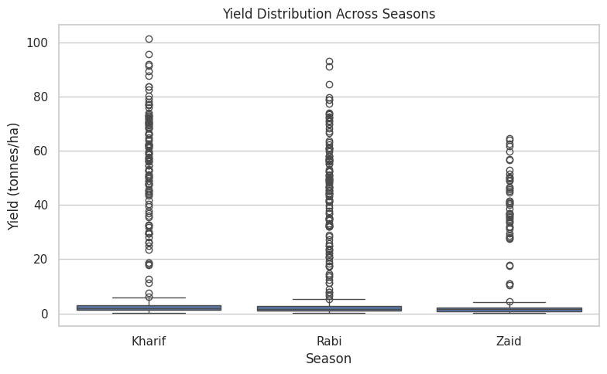
RESULTS
Yield is highest on average in Kharif, followed by Rabi and Zaid.
9/8/2026
Annual Review
‹#›

Slide 8
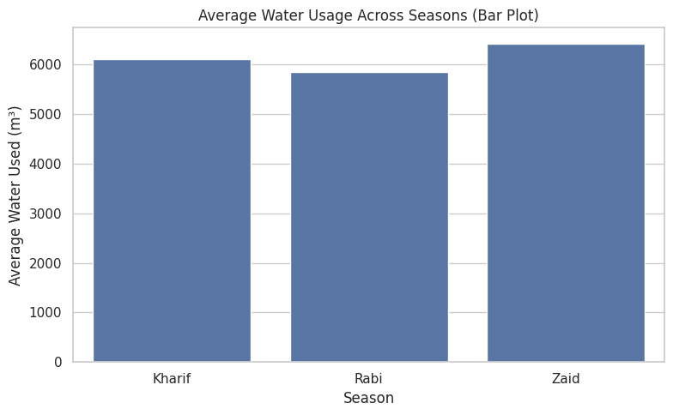
RESULTS
Rabi uses the least water on average, while Zaid has the highest average water use.
9/8/2026
Annual Review
‹#›

Slide 9
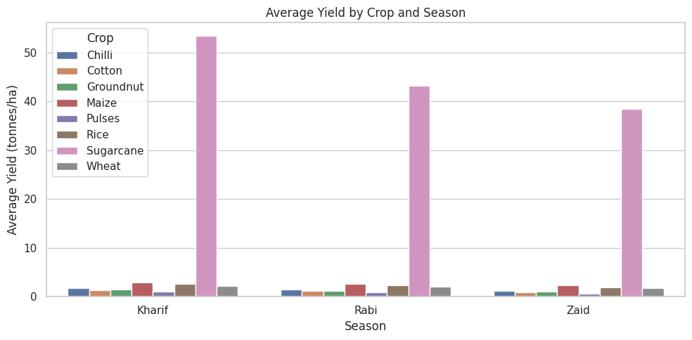
RESULTS
Sugarcane is the highest-yielding crop in all three seasons in the executed analysis.
9/8/2026
Annual Review
‹#›

Slide 10
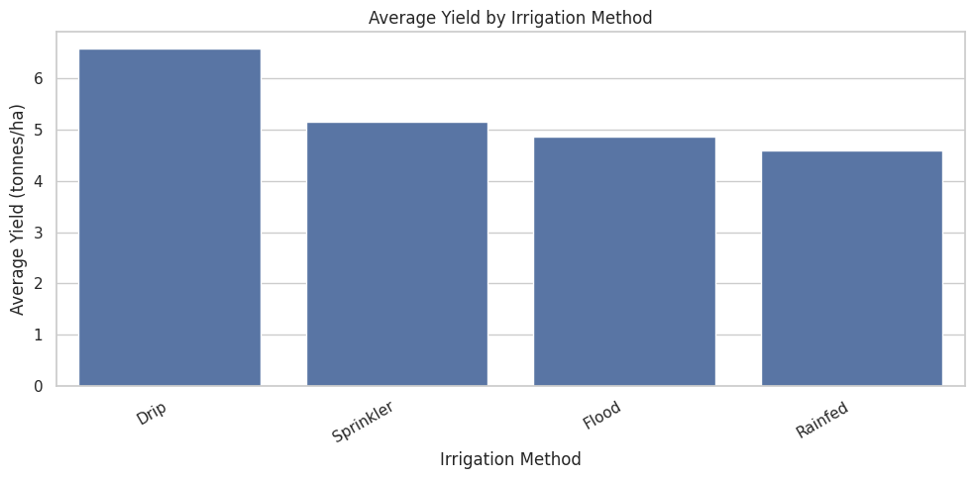
RESULTS
Rainfed has the highest average water efficiency, while Drip has the highest average yield among irrigation methods.
9/8/2026
Annual Review
‹#›

Slide 11
Future scope
Include additional years and wider regional coverage for stronger seasonal comparisons.
Add weather and soil observations from external sources for deeper seasonal analysis.
Extend the analysis with forecasting or predictive models when suitable data is available.
Develop an interactive dashboard to present seasonal indicators and comparisons.
Automate seasonal reports for regular agricultural planning and resource monitoring.
9/8/2026
Annual Review
‹#›

Slide 12
GitHub Link
https://github.com/Mallikarjuna6126/Agriculture-
9/8/2026
Annual Review
‹#›

Slide 13
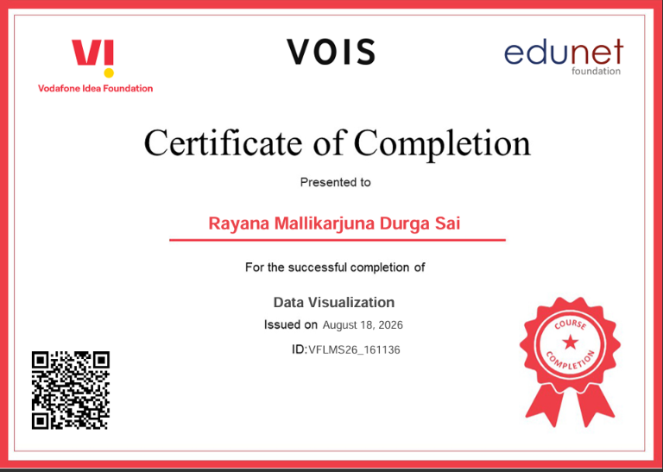
VOIS Course completion certificate -
Course name- Data Visualization
9/8/2026
Annual Review
‹#›

Slide 14
Thank you
Seasonal Agriculture Performance Analysis
Understanding seasonal patterns, agricultural performance,
resource usage and data-driven insights
Presented by:
Rayana Mallikarjuna Durga Sai
Raghu Engineering College
.
.
9/8/2026
Annual Review
‹#›

