Slide 1







Capstone Project
Mallikarjuna YC
21 Feb 2023

Slide 2



OUTLINE
Executive Summary
Introduction
Methodology
Results
Visualization – Charts
Dashboard
Discussion
Findings & Implications
Conclusion
Appendix

Slide 3

EXECUTIVE SUMMARY
This project is done to predict if the Falcon 9 first stage will land successfully.
The objectives of the project are
Write Python code to manipulate data in a Pandas data frame
Use data analysis tools to load a dataset, clean it, and find out interesting insights from it

Slide 4

INTRODUCTION
Satellite launches are relatively less expensive. SpaceX advertises saying they are the cheapest as they can re-use the first stage. If we can determine the landing of the first stage, we can determine the launch cost.
The data available is accesses, cleaned, analyzed with
Python libraries and plotted to gain new insights.

Slide 5

METHODOLOGY
Data Collection and wrangling
Exploring and preparing data
Analyzing with python and its libraries
Plotting to draw insights

Slide 6
SpaceX Falcon 9 first stage Landing Prediction
In this capstone, we will predict if the Falcon 9 first stage will land successfully.
Steps:
Data Collection and Wrangling
Data Collection through web scraping
Data analysis with Python and SQL
Data Visualization with Python Libraries like Folium
Predictive analysis

Slide 7
Data collection and Data Wrangling
In this step, collect the data required and will also do some basic data wrangling and formatting.
First step that is required in any project is to import the necessary libraries
Define the functions that are required: getBoosterVersion, getLaunchSite. GetPayloadData, getCoreData
Get the data using the get request - response = requests.get(spacex_url)
Using the above functions, get the data required
Convert the data in lists to a dataframe
The first step is to filter 'Falcon 9' data
The next one is to remove the null data (replace the null with the mean)

Slide 8
Data collection and Data Wrangling

Slide 9
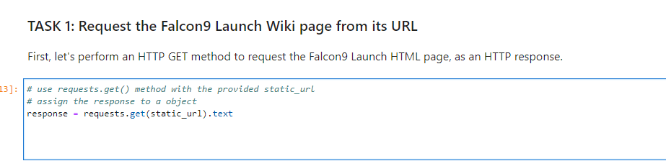
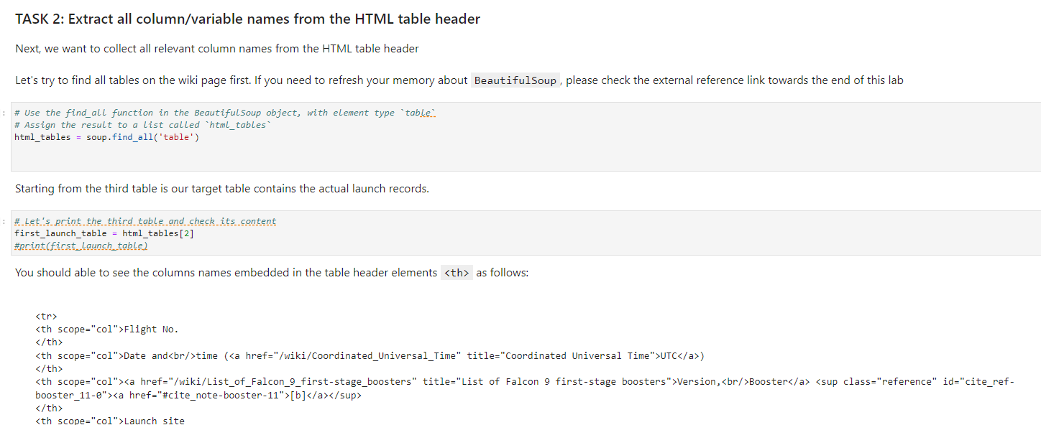

Slide 10
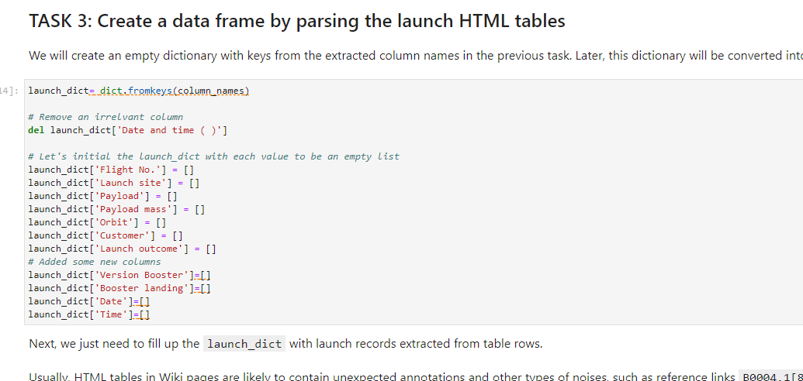

Slide 11
Data Wrangling
In this step,
First step that is required in any project is to import the necessary libraries
Define the functions that are required: getBoosterVersion, getLaunchSite. GetPayloadData, getCoreData
Get the data using the get request - response = requests.get(spacex_url)
Using the above functions, get the data required
Convert the data in lists to a dataframe
The first step is to filter 'Falcon 9' data
The next one is to remove the null data (replace the null with the mean)

Slide 12
Data Wrangling
In this step, we will perform some Exploratory Data Analysis (EDA) to find some patterns in the data and determine what would be the label for training supervised models.
Import the necessary libraries
Do the data analysis
Load the dataset
Calculate the number of launches on each site
Calculate the number and occurrence of each orbit
Calculate the number and occurrence of mission outcome per orbit type
Create a landing outcome label from Outcome column

Slide 13
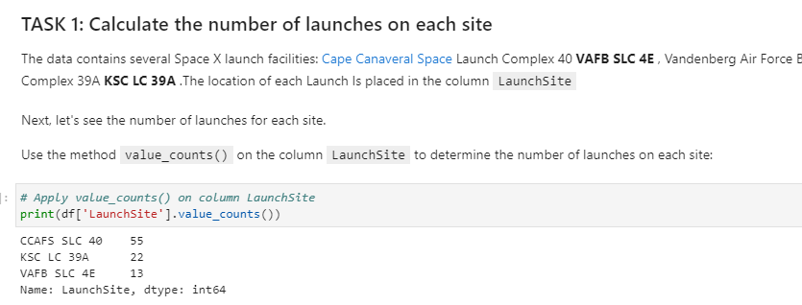
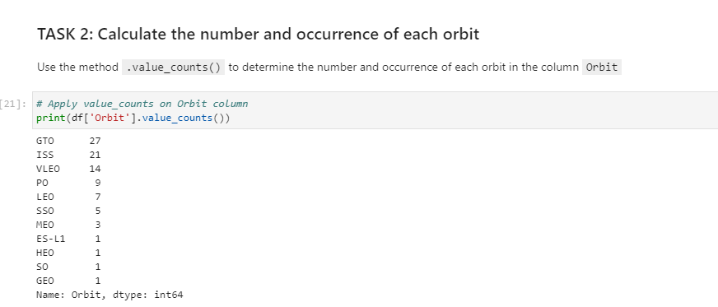

Slide 14
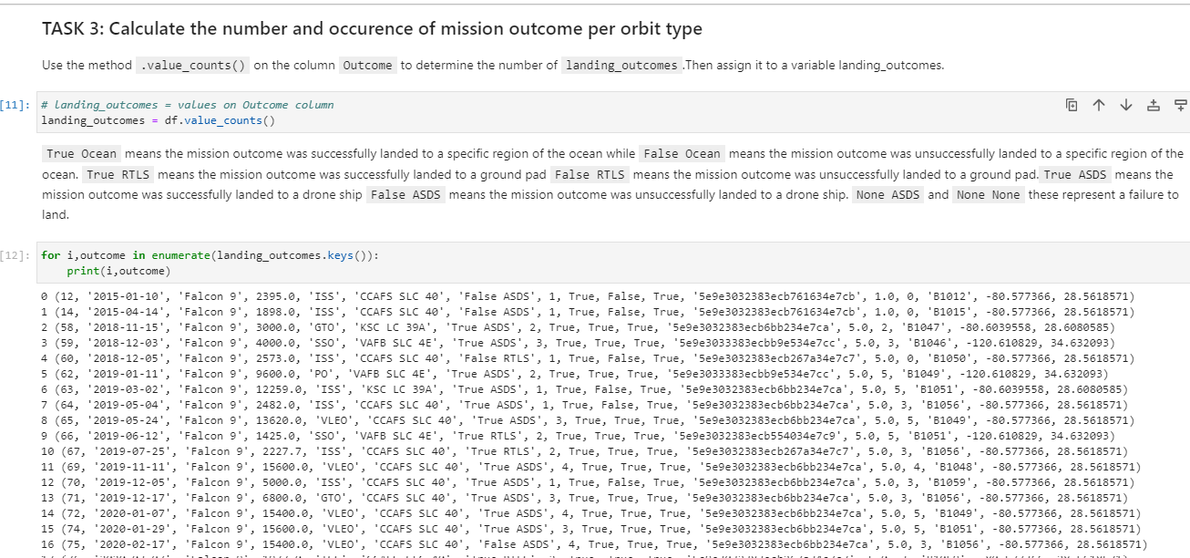
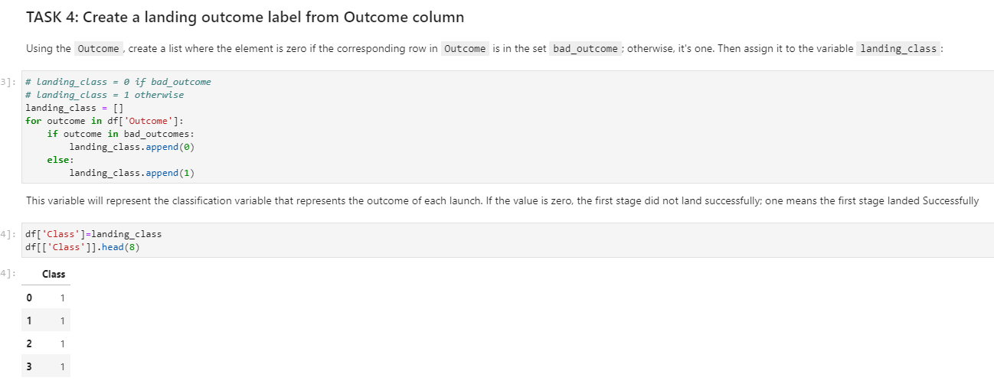

Slide 15
Data Analysis with SQL
In this step, we will perform some Data Analysis (EDA) using SQL.
Import the necessary libraries, Do the data analysis, Load the dataset
The following data was got from the data extrated
Display the names of the unique launch sites in the space mission
Display 5 records where launch sites begin with the string 'CCA'
Display the total payload mass carried by boosters launched by NASA (CRS)
Display average payload mass carried by booster version F9 v1.1
List the date when the first successful landing outcome in ground pad was acheived.
List the names of the boosters which have success in drone ship and have payload mass greater than 4000 but less than 6000
List the total number of successful and failure mission outcomes
List the names of the booster_versions which have carried the maximum payload mass
List the records which will display the month names, failure landing_outcomes in drone ship ,booster versions, launch_site for the months in year 2015.
Rank the count of successful landing_outcomes between the date 04-06-2010 and 20-03-2017 in descending order.

Slide 16
Exploring and Preparing Data
Import the necessary libraries, Do the data analysis, Load the dataset
With the data available, we found the relationship between using the libraries in the matplot lib.
Visualize the relationship between FlightNumber vs. PayloadMass
Visualize the relationship between FlightNumber vs LaunchSite
Visualize the relationship between launch sites and their payload mass
Visualize the relationship between success rate of each orbit type
bar chart for the success rate of each orbit
Visualize the relationship between FlightNumber and Orbit type
Visualize the relationship between Payload and Orbit type
Visualize the launch success yearly trend

Slide 17
Launch Sites Locations Analysis with Folium
Perform interactive visual analytics using Folium
Mark all launch sites on a map
Mark the success/failed launches for each site on the map
Calculate the distances between a launch site to its proximities

Slide 18
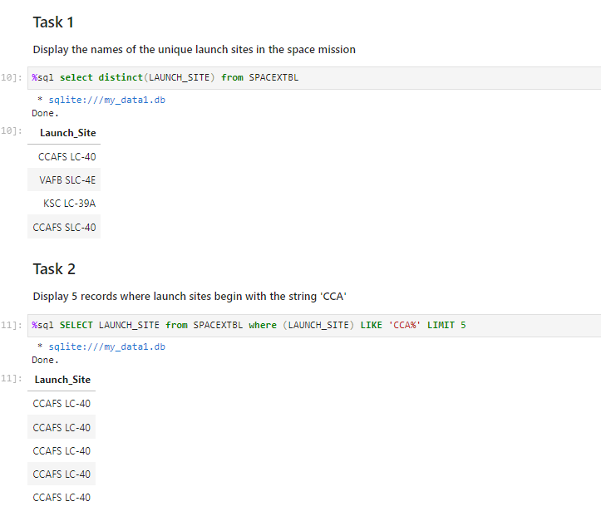

Slide 19
Dashboard Application with Plotly Dash
Perform interactive visual analytics using Folium
Mark all launch sites on a map
Mark the success/failed launches for each site on the map
Calculate the distances between a launch site to its proximities

Slide 20
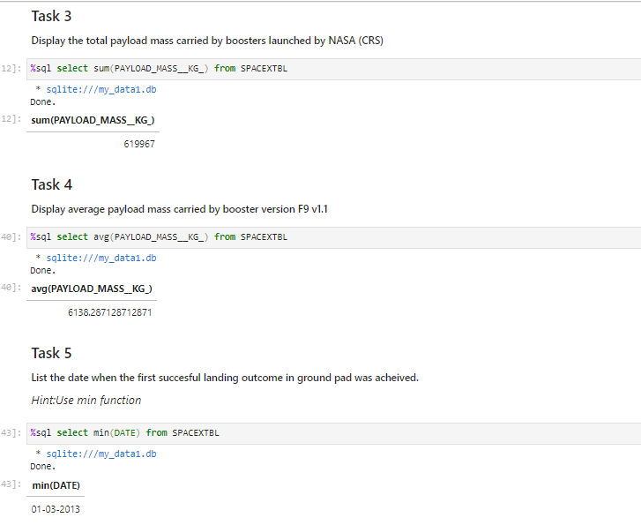
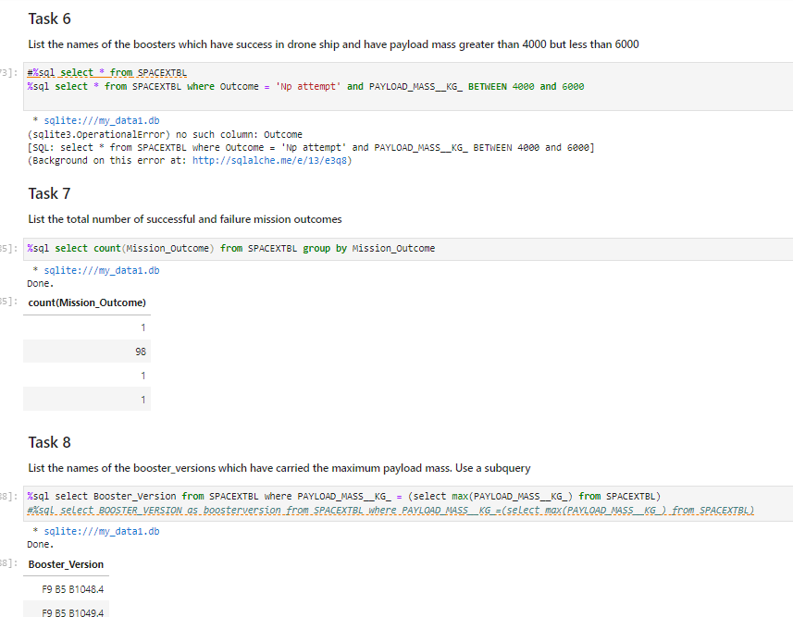

Slide 21
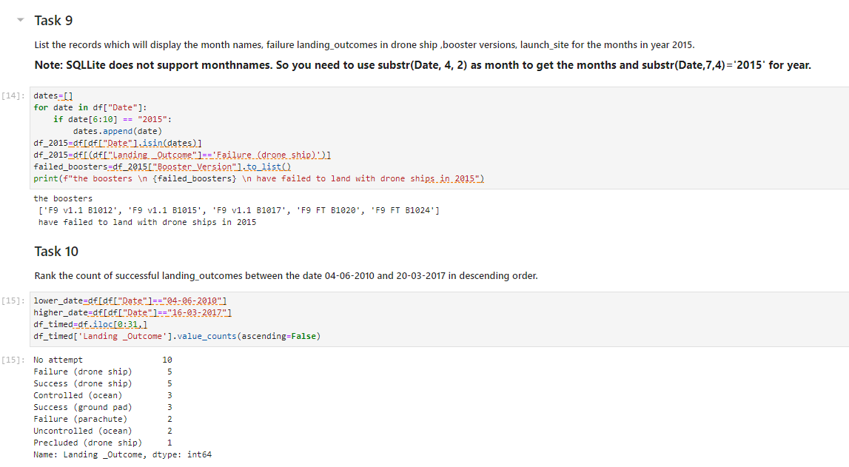

Slide 22
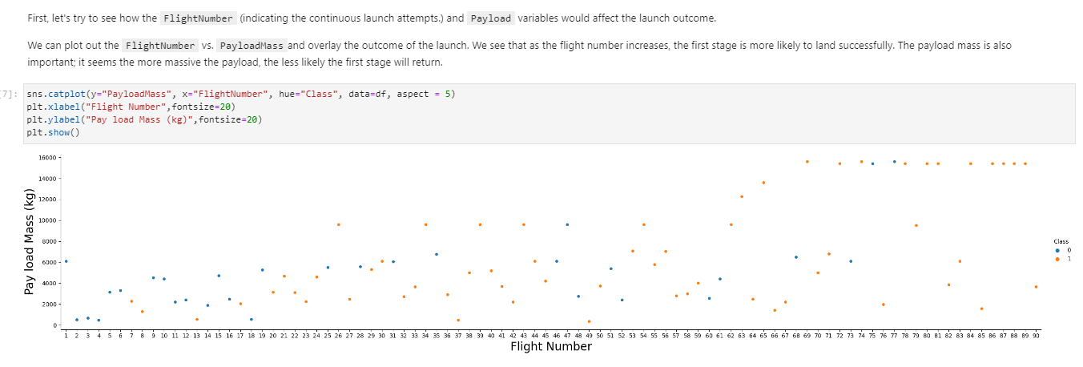
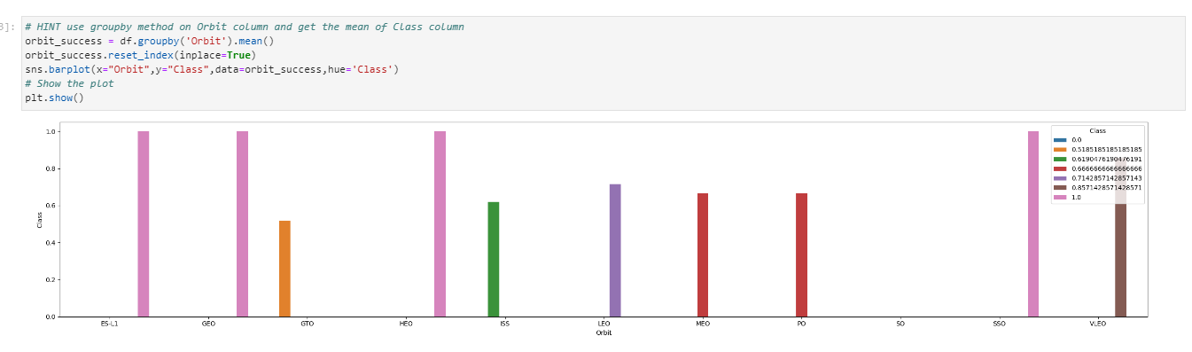

Slide 23
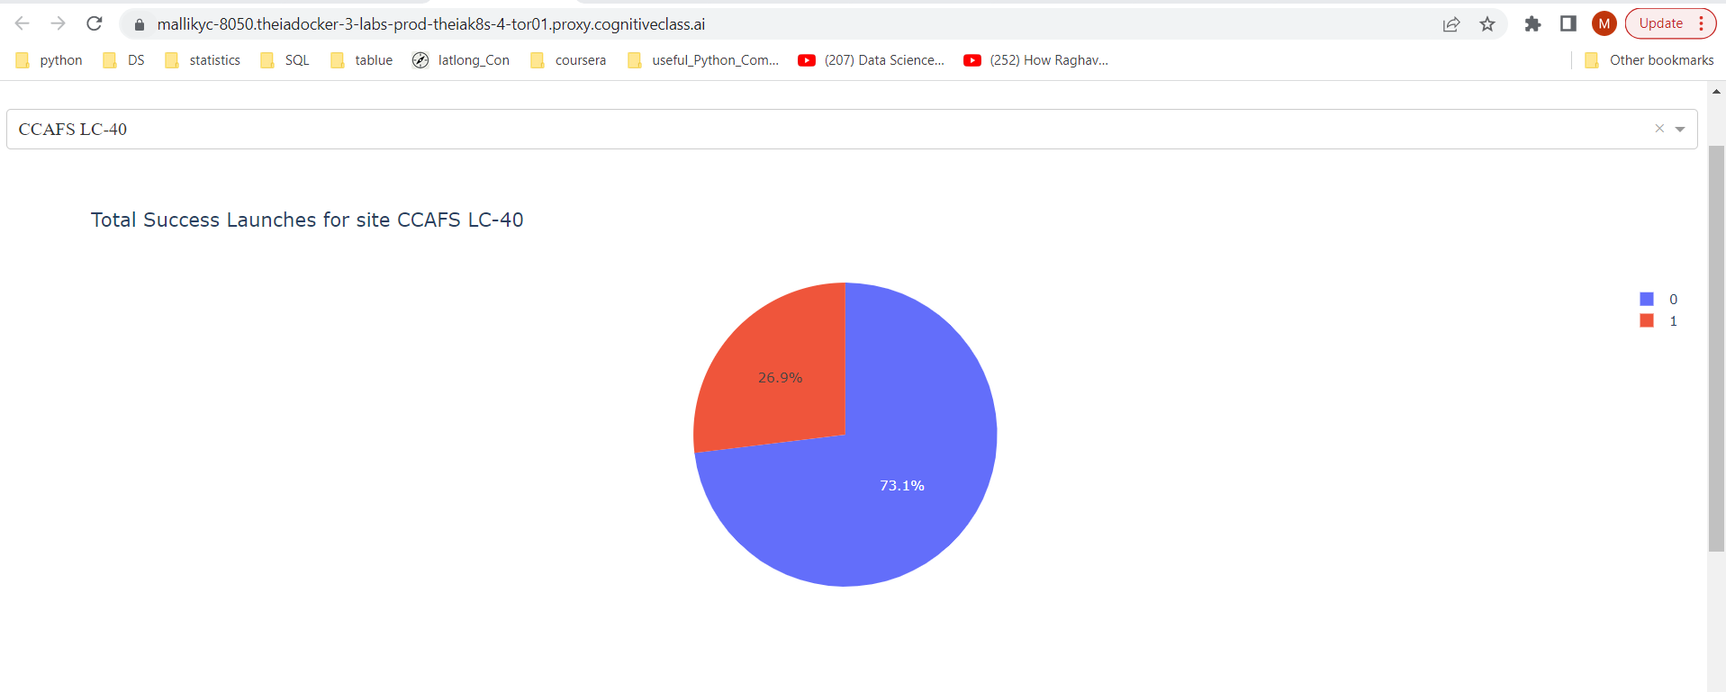
Dashboard Application with Plotly Dash

Slide 24
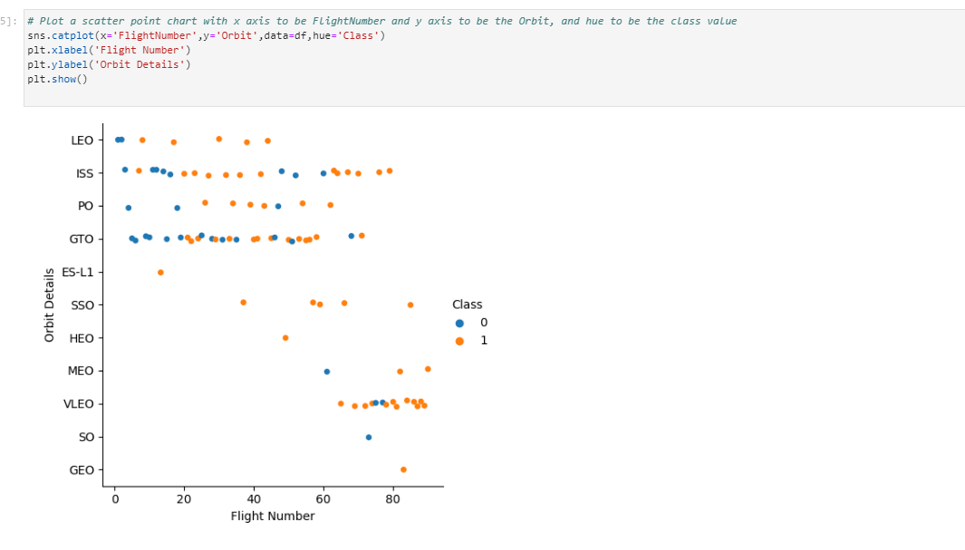
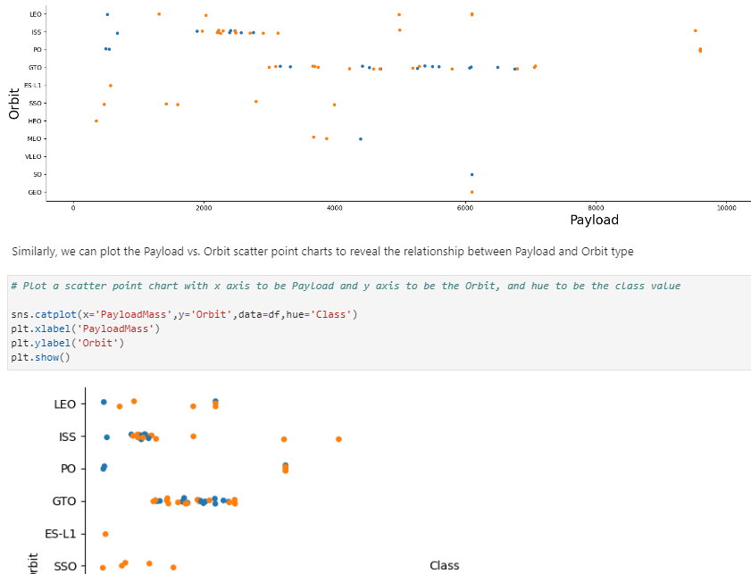

Slide 25
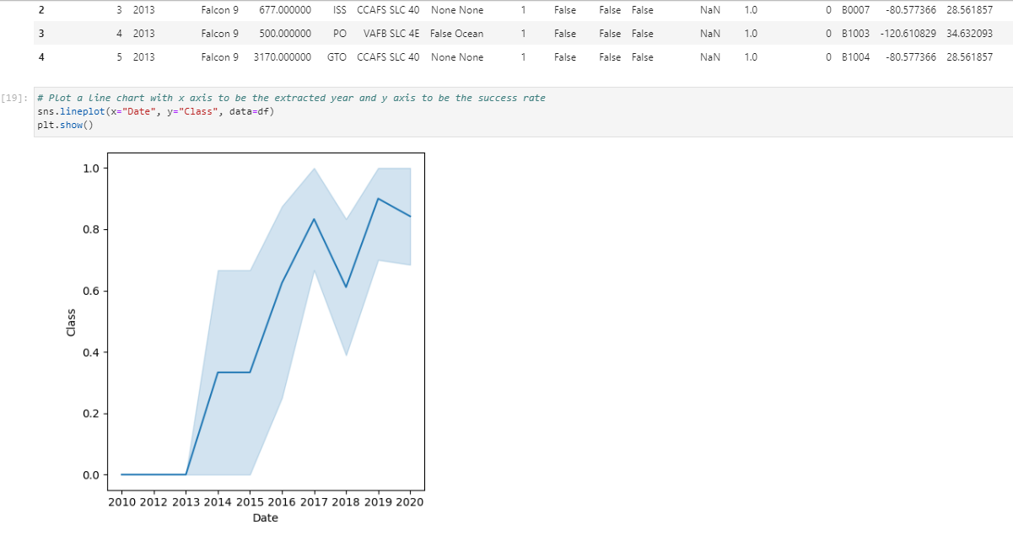

Slide 26
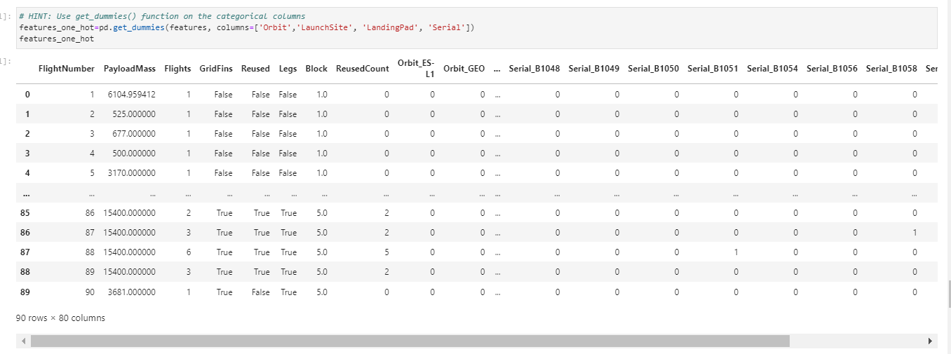

Slide 27
RESULTS

Slide 28
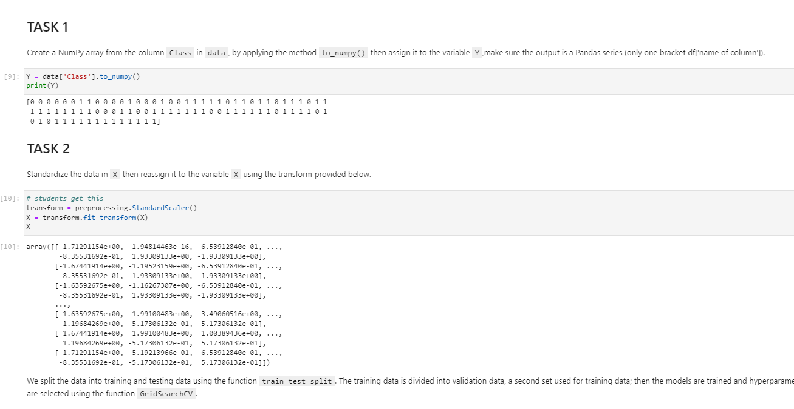

Slide 29
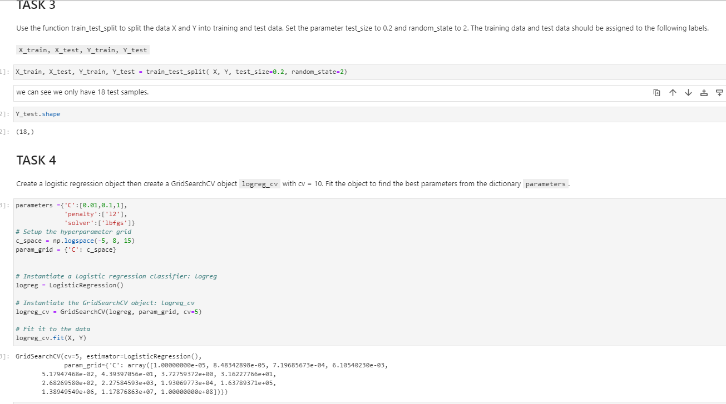

Slide 30
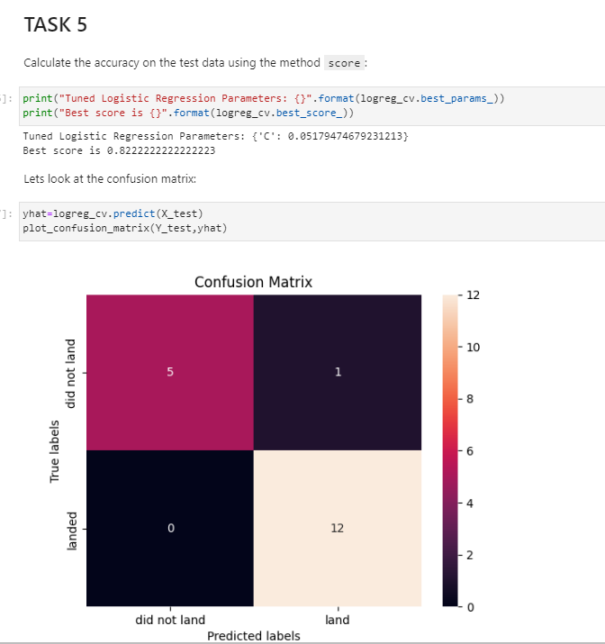

Slide 31
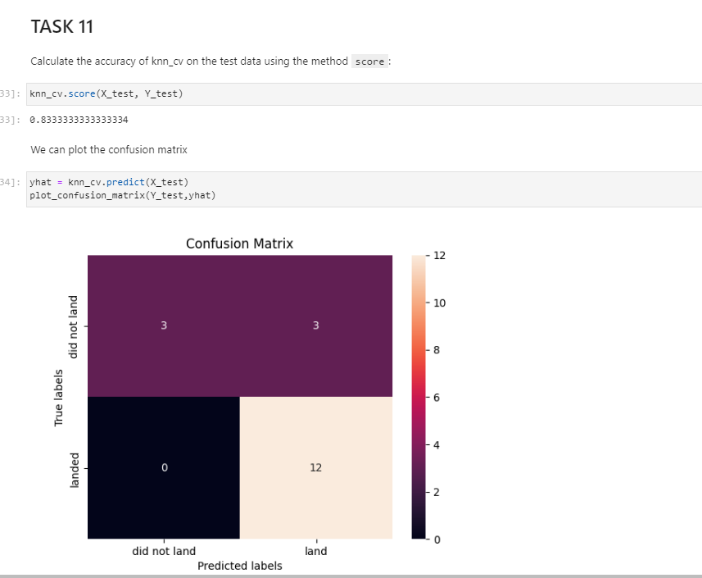

Slide 32
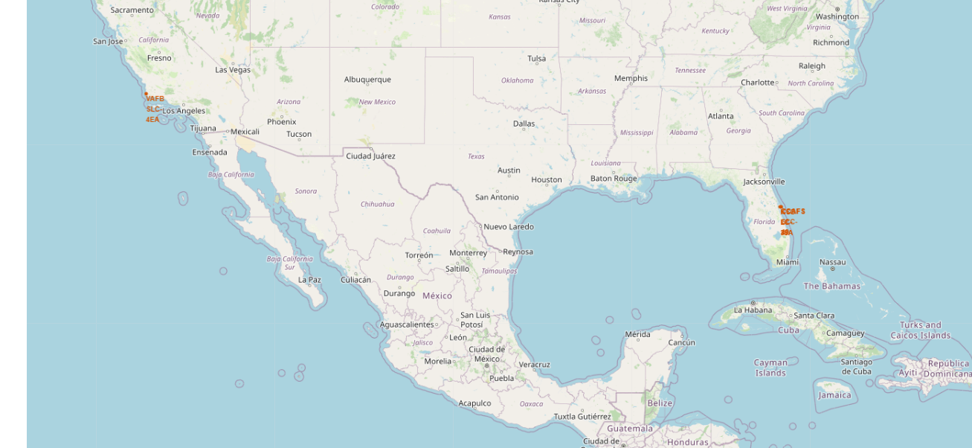

Slide 33
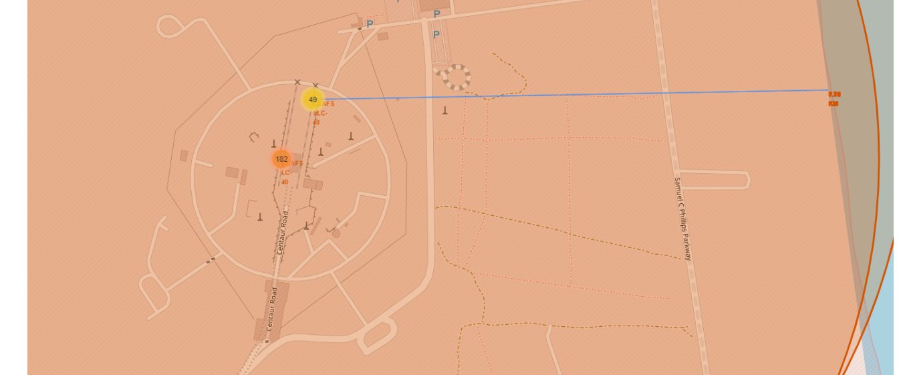

Slide 34
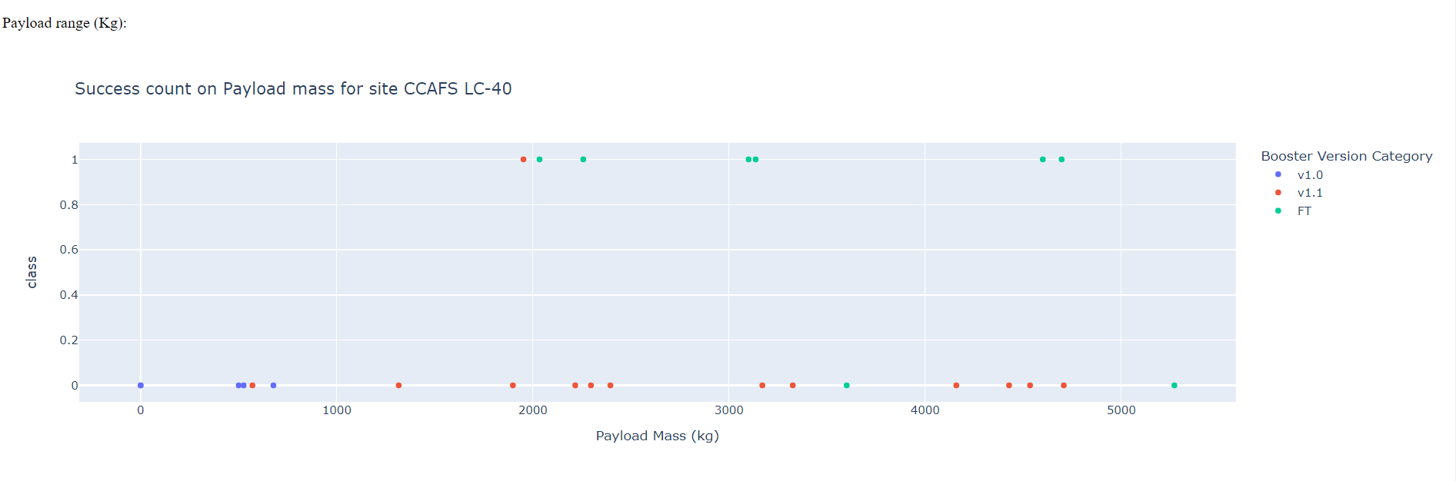
Dashboard Application with Plotly Dash

Slide 35

DISCUSSION

Slide 36

CONCLUSION
The project aims to accomplish the task of estimating the successful landing of the first stage using the publicly available data.
The analysis focused on find the best site to launch a satellite based on a number of factors like payload, launchsite, its proximity to the equator, orbit and payload etc

