Slide 1

HKD 2.1
TEAM VOID
Aniket ingole
Saravanaperumal
Agni paul
Lucas Eduardo
Santosh Ramachandran
Mallikharjuna Rao S
Traffic challenge

Slide 2

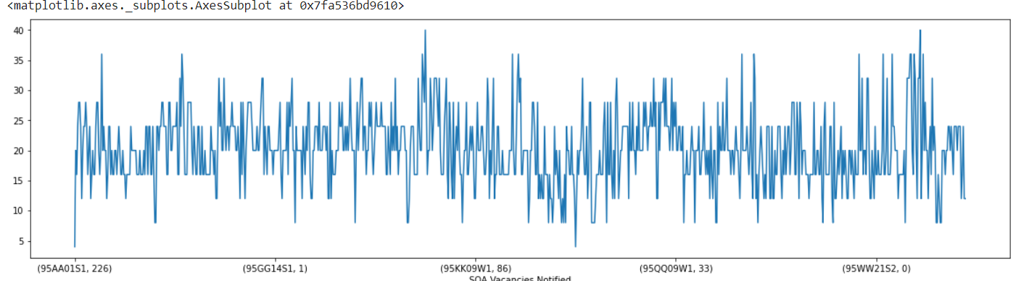





SOA Zones with multiple SA w/o P.T
SOA | Vacancies Notified | SA zones
95AA01S2 | 381 | 20
95AA01S3 | 17 | 16
95AA02W1 | 72 | 28
95ZZ14S1 | 76 | 12
95ZZ14S2 | 0 | 16
95ZZ15W1 | 22 | 24

Slide 3
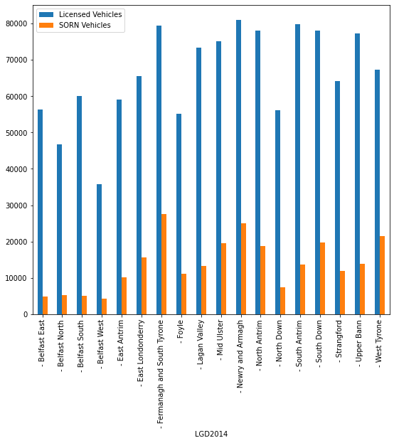
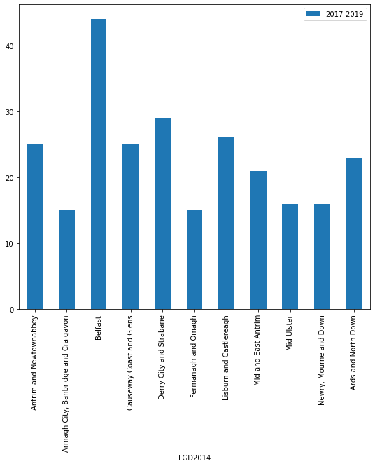
Mobility As A Service

Slide 4
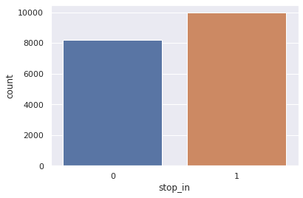
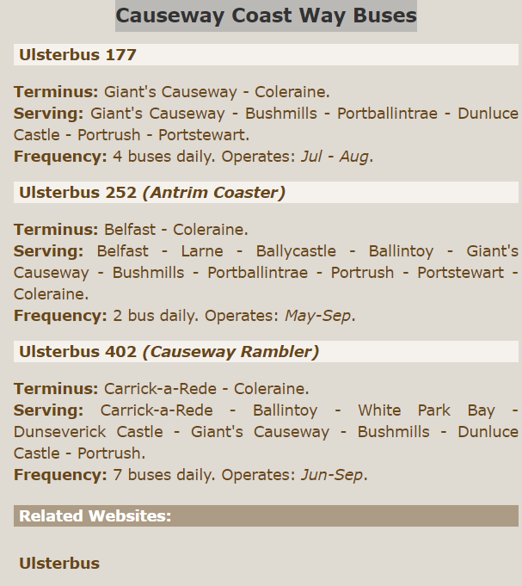
Enhancements
Google Maps API to know busy routes.
AI enables(controlled) traffic lights.
Graph models for the Geo locations (identify the weighted edges).
Tourist places transport (Ex :Causeway Coast Way Buses during the seasons).
Live tracking of the public vehicle in case of delay.
Urban and industrial areas accessibility during specific hours.
Reduced carbon footprint.
Hassel free commuting

Slide 5
THANK YOU!!

