Slide 1
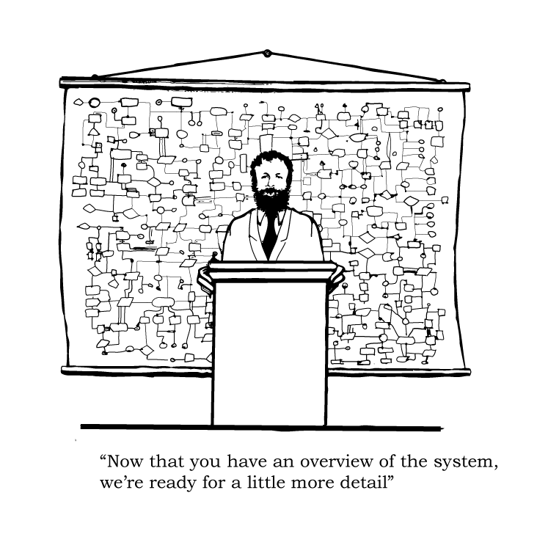
Exploring the Fullstack model

Slide 2

This is not a normal presentation

Slide 3
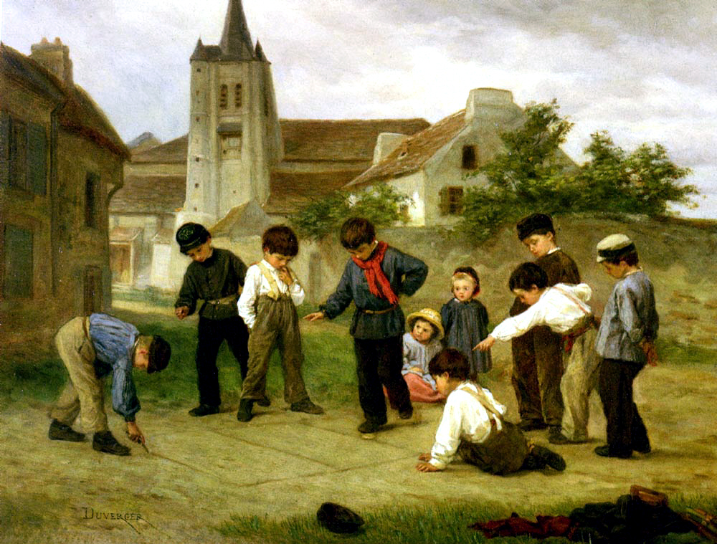
This is a game

Slide 4
Role of the game:
We will explore theory by practical exercises the fullstack model of web-applications
All practical exercises are not difficult
(no algorithms etc), everybody can solve them.

Slide 5

Role of the game
Don‘t use social media, telephone, mails, irc or do something different from the exercises.

Slide 6
01. Getting started
https://github.com/MalloZup/presentations/blob/master/2018/rails-mvc/01/01.md

Slide 7
01) The Story So Far
Gem install rubygems, which are pkg for ruby
and are stored in Gemfile
Basic html, javascript and overview of few basic components of fullstack web-application.

Slide 8
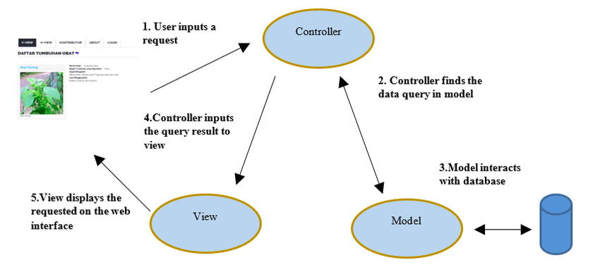
02) architecture of MVC web-application
Model view controller

Slide 9
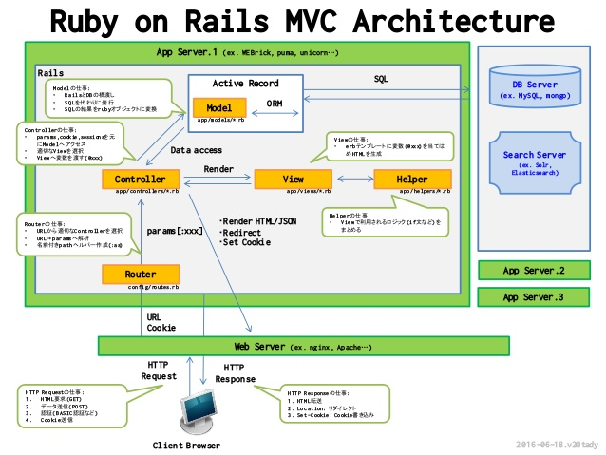

Slide 10
03)Conclusion: SUSE case Study
As an examples with rails, you can have a look at: https://github.com/kubic-project/velum
Velum: web-application using rails

Slide 11
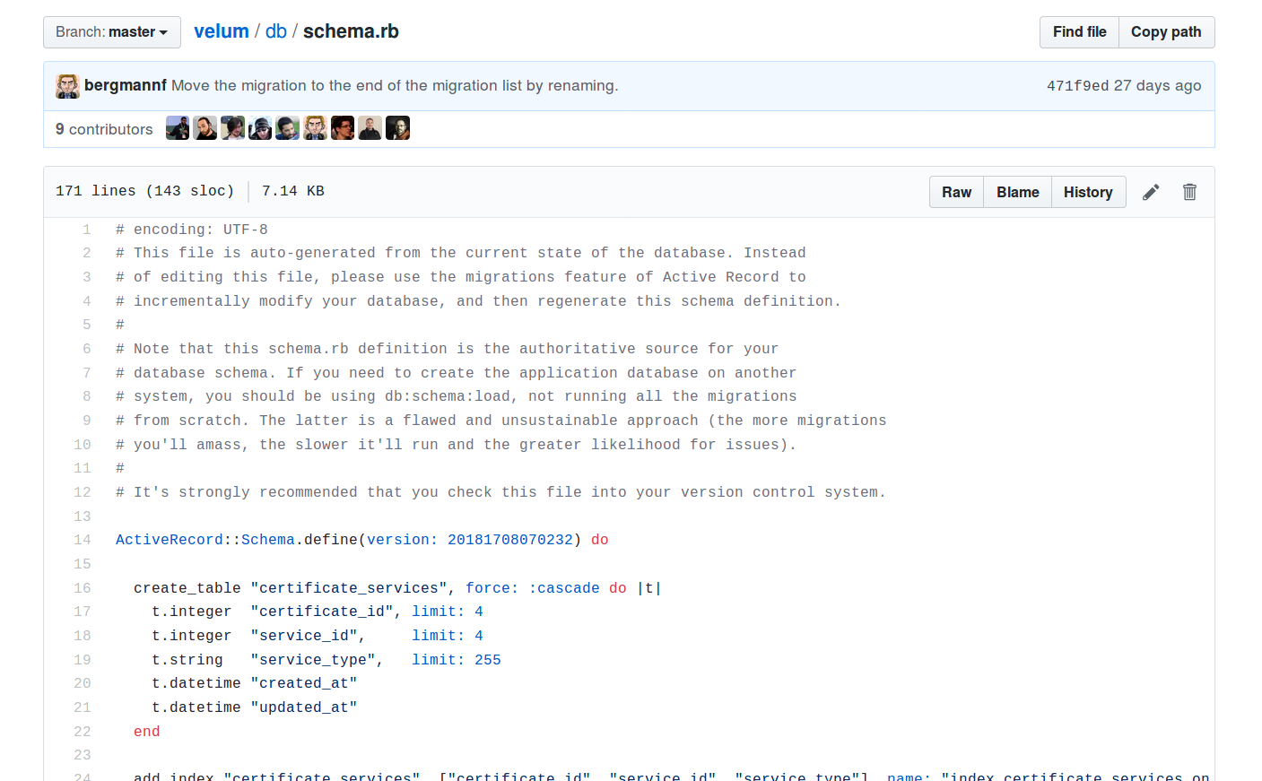
Velum details patterns (schema,db)

Slide 12
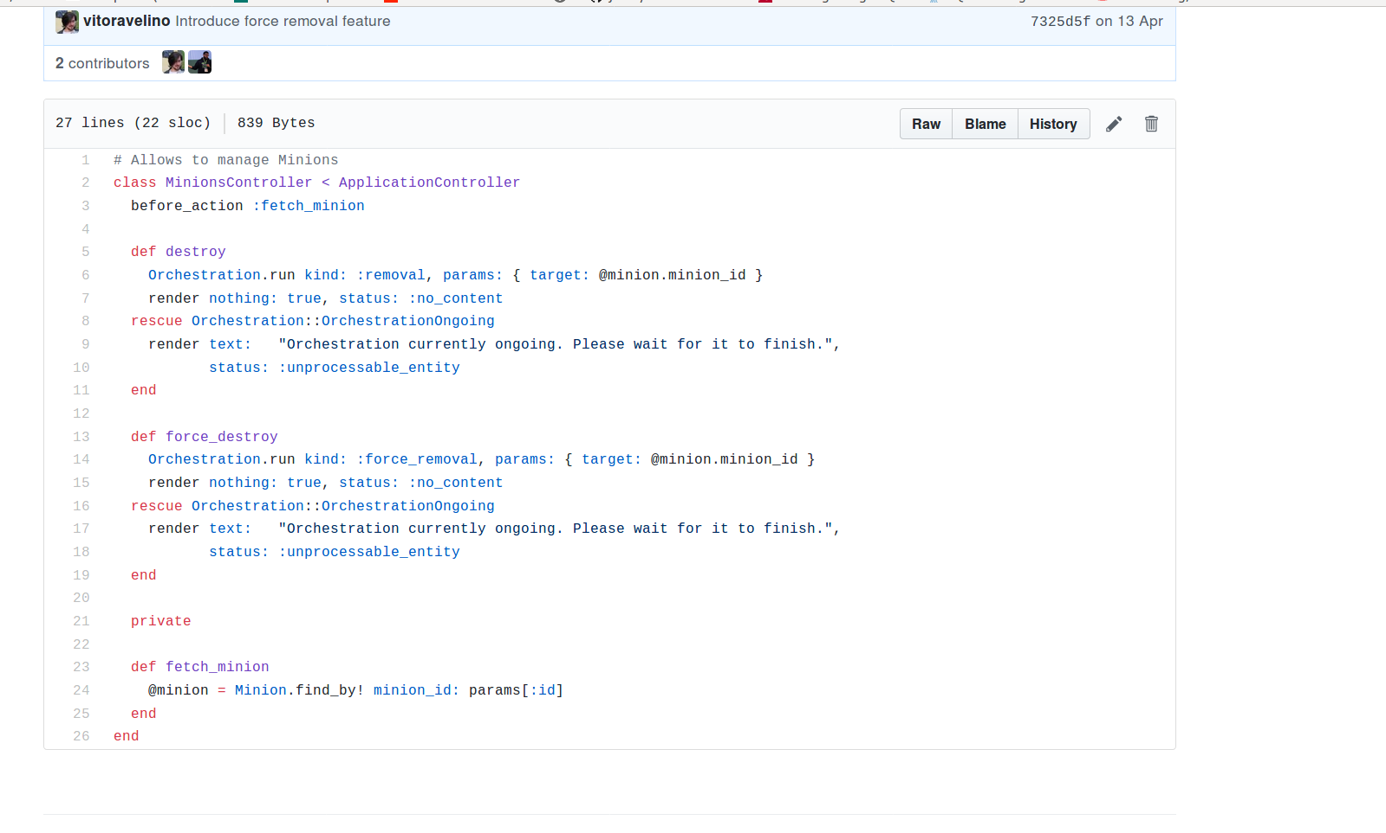
Velum controller
Active record

