Slide 1



Salt-ssh for managing complex infrastructure

Slide 2
Summary:
Salt-ssh design (high-level intro)
Some advantages using salt-ssh
Real life implementation @suse (since 2 years)
Salt-ssh demo

Slide 3
Salt-ssh quick overview
salt-ssh '*' test.ping
Roster file
kvm-servers:
Host: 10.21.3.3
user: root
Docker-server:
Host: 10.20.3.1
user: root
Your localmachine
Salt-ssh exec
Machines where state are executed
x+2
x+1
You will understand better later
NO PKG installed
No service running!

Slide 4
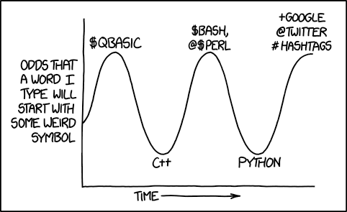
Benifits:
Simplicity
Salt is very simple to set up and maintain, regardless of the size of the project.

Slide 5

Salt vs home-made provisionining

Slide 6

stability

Slide 7
Stabililty (2)
No manual changes on server
Having code on gitlab
Review on changes per PR Review (collaboration and review)

Slide 8
What is mandatory:
1) Create project on gitlab
2) Automate state execution on CI
3) Automate states execution on ci
4) Automate states execution on ci
5) Automate states execution on ci

Slide 9

Real Life example:
https://gitlab.suse.de/galaxy/infrastructure

Slide 10
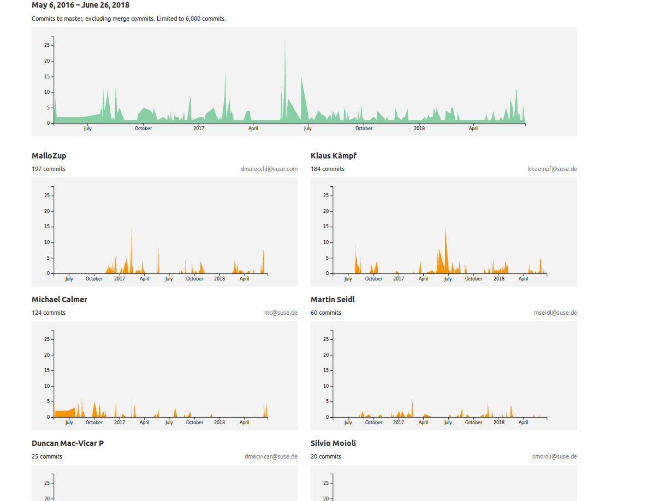
24 Contributors (collaboration)

Slide 11
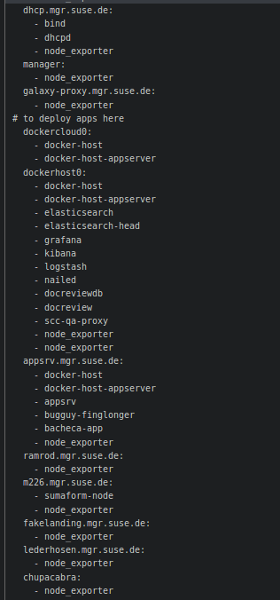
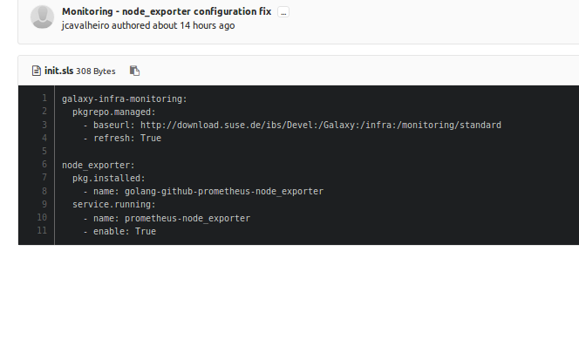
Monitoring example:

Slide 12
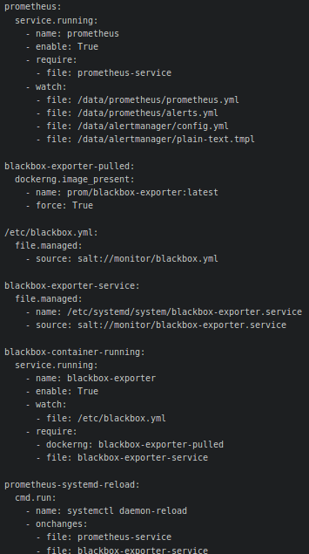
monitor(2)

Slide 13
Which salt-state could we reuse
Prometheus/grafana and monitoring
Jenkins-slave generator
Docker-hosts server
Dhcpd/bind
Kvm server init
…

Slide 14
Your turn: your demo
git clone https://github.com/MalloZup/presentations.git
cd presentations/2018/salt-ssh
follow:
https://github.com/MalloZup/presentations/blob/master/2018/salt-ssh/00.md

