Slide 1

https://github.com/MalloZup/kubeojo
Source code
This presentation:
https://github.com/MalloZup/presentations/blob/master/2018/hackweek/elixir.odp

Slide 2
Summary:
Goal of my hackweek and retro
Which problem i try to solve
What is the roadmap and actual status
If you want to contribute
Quick-intro to elixir/phoenix resources.

Slide 3
Goals of my hackweek
Learn elixir and phoenix (functional programming + MVC) in the context of CHAOSS
→ (analyzing software health metrics)
https://wiki.linuxfoundation.org/chaoss/software
Retrospective: elixir is awesome.
→ (OTP + functional programming + nice community).
→ It give you a different mindset about programming.

Slide 4
Problems:
Visualize data and testresults with longterm perspective
How to Maintain/Analyze large codebases.
Questions:
what are the weak/buggy zones of a product/codebase?
What are the flaky tests of testsuites in longterm period?

Slide 5
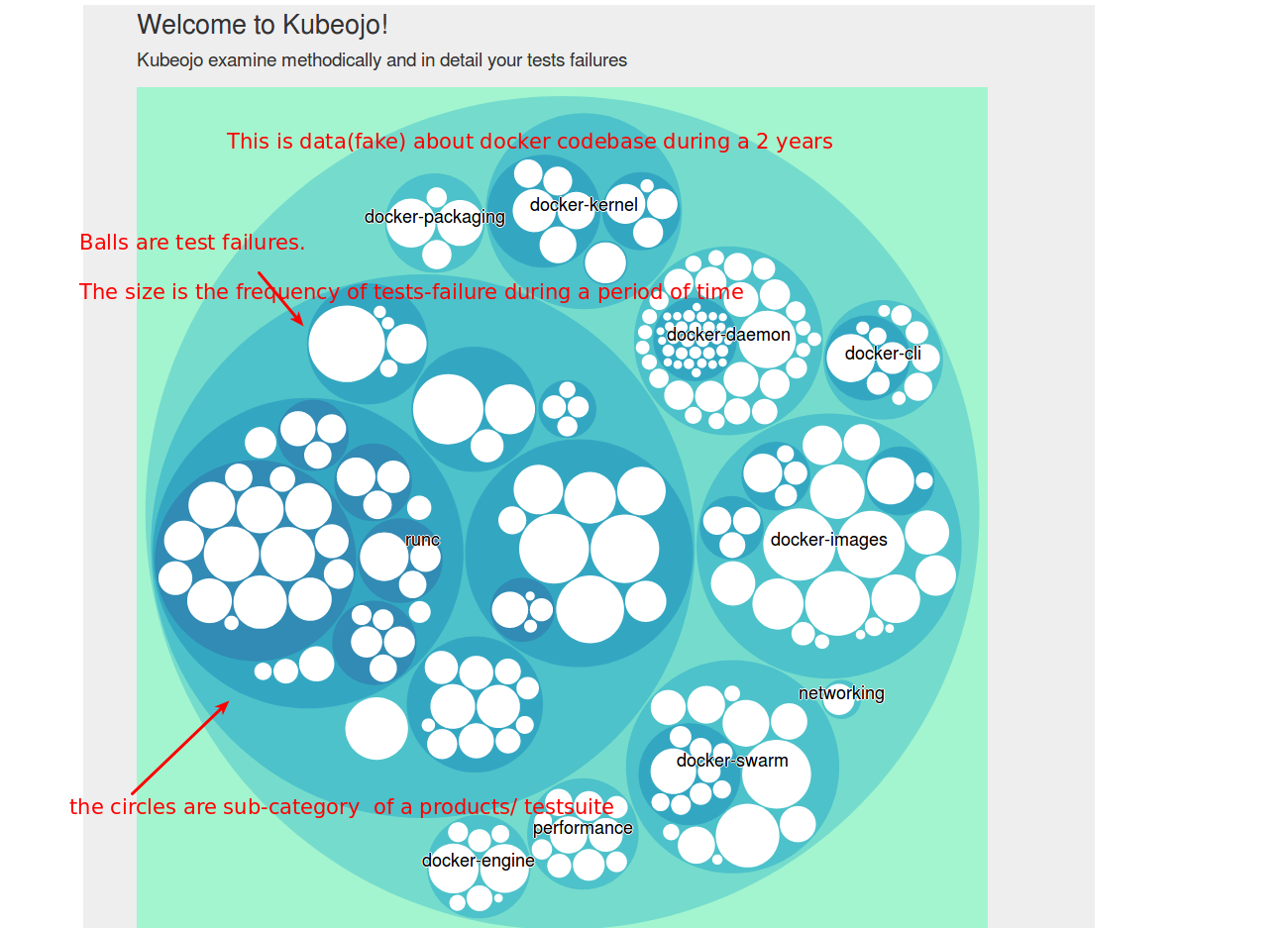
Some concepts:

Slide 6
What is the roadmap and actual status
Backend and D3.js in elixir still on WIP
What is planned:
Dockerized phoenix-app
More visualisation charts with d3.js
Improve frontend visualisation (change color of balls depending of size big red etc)
( is enough work for moment :D )

Slide 7
Contributors welcome:
If you want to contribute, feel free to send an
e-mail to: dmaiocchi@suse.de, and we can sync.

Slide 8
Quick-intro to functional program.
Pattern-matching
%{ b: value, d: value2 } = %{ a: 1, b: 2, d: 3 }
Immutability
https://gist.github.com/bmitch/a999822c164963671e3bdecd521f3653
Books Resources:
Use your safary account LUKE! (it‘s free for susers)
Programming Elixir 1.6 by Dave Thomas
The Little Elixir & OTP Guidebook by Benjamin Tan Wei Hao

