Slide 1
Cucumber on spacewalk
GitHub pull requests
(head)

Slide 2
Summary:
1) GitHub perspective and workflow
2) Global orverview or Prs status
3) Pipeline Overview
4) Pipeline deep study
5) Tools Involved
FAQ

Slide 3
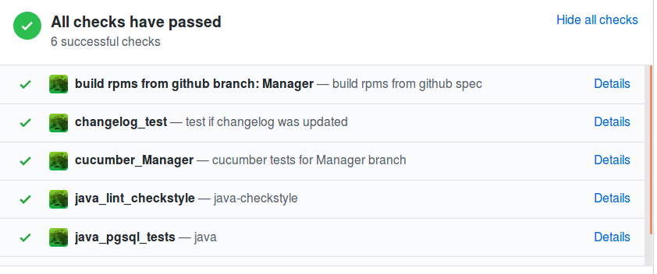
An example Pr check test
2 Checks: if 1 first fails other doesn‘t run.
1
2
Build rpms trigger cucumber branch tests only when all pkgs are builded succefully

Slide 4
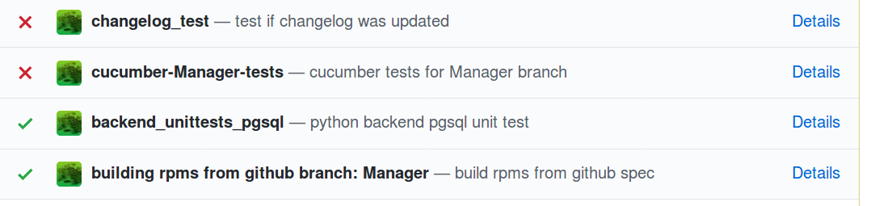
Retrigger always first if second fail
We need to build new pkgs before rerunning tests
For retrigger tests failed, always trigger first ( otherwise 2nd will not retriggered)
$ gitarro rerun building rpms from github branch: Manager !!!

Slide 5
1) Your Pr is a new spacewalk server rpm
a commit on PR trigger the obs repository
https://build.suse.de/project/show/Devel:Galaxy:Manager:Head:Pr-Automation (
This mean we know in advance if your code is going to breaking any package you changed!
If this tests packaging build fail, there is no cucumber tests triggered.
By every new commits, only the new modified pkgs will be created.
( we are using tito)

Slide 6
2) The tests run only if the pkg building on your pr is without any errors
Artifacts stored (output.html with spacewalk-debug.tgz)
As always click to details for results:

Slide 7
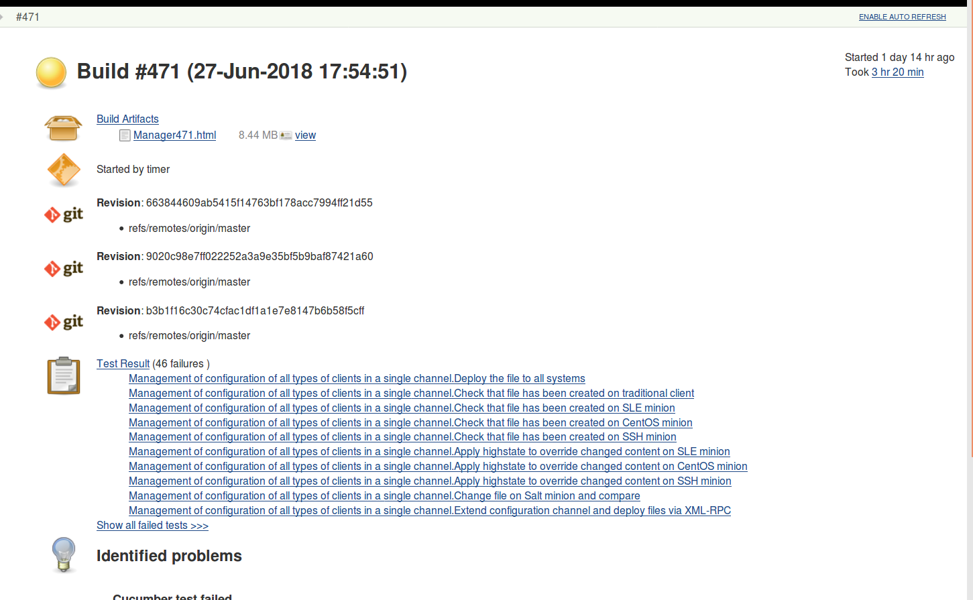
Cucumber.html results for you prs

Slide 8
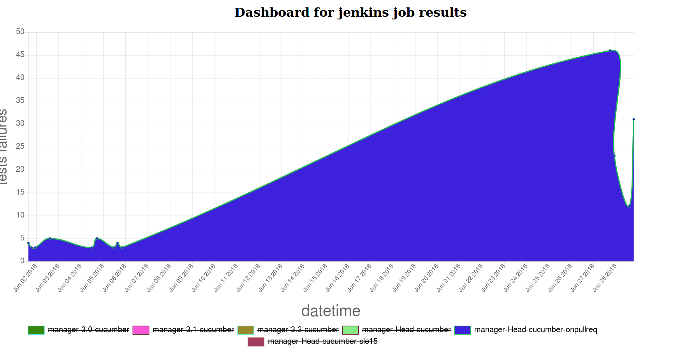
GLOBAL overview of incoming Prs failures (kind of staging)
(http://appsrv.mgr.suse.de:9000)
https://github.com/MalloZup/bacheca

Slide 9
Building Pkgs and repo
During the pipeline we are rebuilding 2 times pkgs.
- 1: build pkgs from your PR
- 2nd (at the end): to restore the HEAD pkgs into our custom repo.
( we need this to have always the same pkgs)
(Detail will follow in diagramm later)

Slide 10
Build pkgs from GitHub (head)
Check that all pkg are ok
(prbranch ==Head)
First action in pipeline
Jenkins
Pipeline
Build From github PR
Restore pkgs from HEAD
Postbuild action

Slide 11
Github Tests
Check that all pkg are ok
(prbranch ==Head)
First action in pipeline
Build From github PR
Jenkins
Pipeline
1st github test
deploy
Run cucumber
2nd github test
Restore pkgs from HEAD
Postbuild action

Slide 12
Scenario build fail
Check that all pkg are ok
(prbranch ==Head)
First action in pipeline
Build From github PR
1st github test
Jenkins
Pipeline
Need to commit a fix for retrigger tests
Restore pkgs from HEAD
Postbuild action

Slide 13
Scenario: tests fails
Check that all pkg are ok
(prbranch ==Head)
First action in pipeline
Build From github PR
Jenkins
Pipeline
1st github test
deploy
Spacewalk-debug and output.html artifacts
Run cucumber
2nd github test
Restore pkgs from HEAD
Postbuild action

Slide 14
Complete Pipeline
Rpm Head ok?
1st github test
Pr need tests?
Build From github PR
2nd github test
Deploy sumaform infra
fail
fail
Run cucumber tests
fail
fail
Post build actions (always executed)
Rebuild HEAH pkg
If needed

Slide 15
Github projects involved
https://github.com/openSUSE/gitarro
https://github.com/SUSE/susemanager-ci
https://github.com/mcalmer/tito
https://github.com/moio/sumaform/
https://gitlab.suse.de/galaxy/sumaform-test-runner (storing tf files)
https://github.com/MalloZup/bacheca

Slide 16
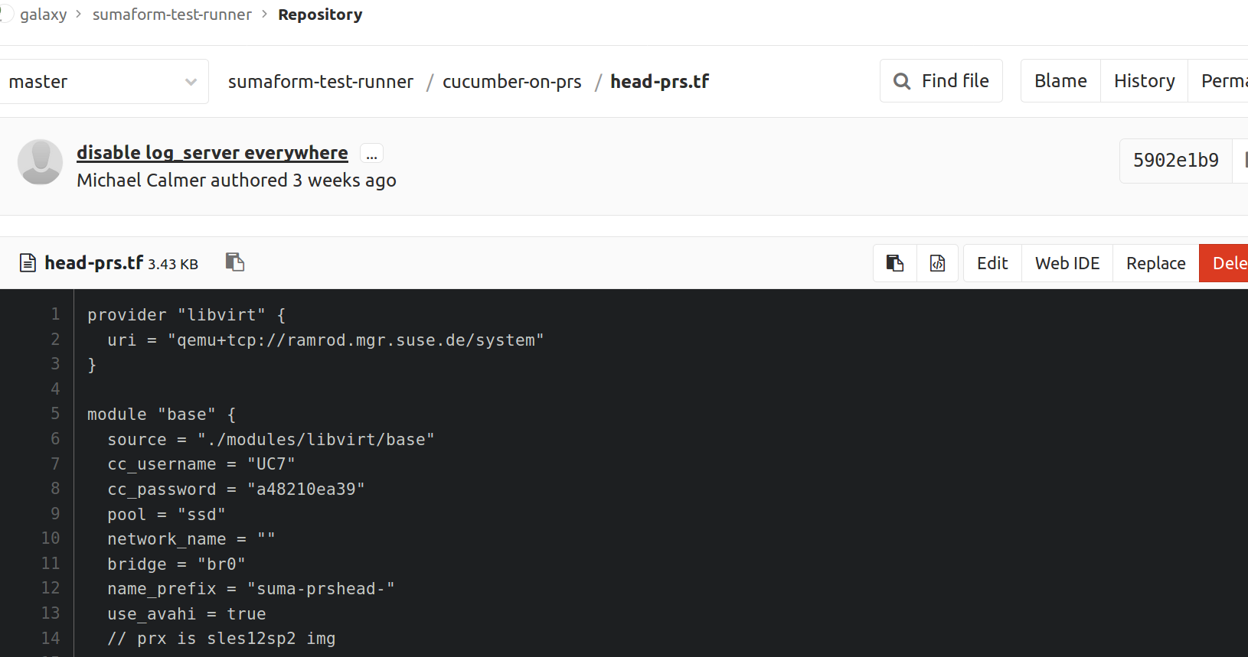
Terraform files
Jenkins slave is m226 as always.

Slide 17
Known Issues:
Forked repo problems (suse/spacewalk github hardcoded on ctl-node)
https://github.com/moio/sumaform/issues/304
For new issues/idea, comment here:
  https://github.com/SUSE/susemanager-ci/issues/20

Slide 18
FAQ

