Slide 1
Monitoring & Alerts for HA/SAP Clusters
Dario Maiocchi SUSE SHAP team

Slide 2
Agenda:
1) The monitoring architecture. Where we are, a global overview.
2) Monitoring Usecases:
- Visualization and Alerts:
* Raise alerts when some cluster resource fail
* Raise alert when there is a failover/promotion mechanism
3) Open questions:
- reflections and next steps.

Slide 3
1) The monitoring architecture in SAP/HANA Cluster context

Slide 4
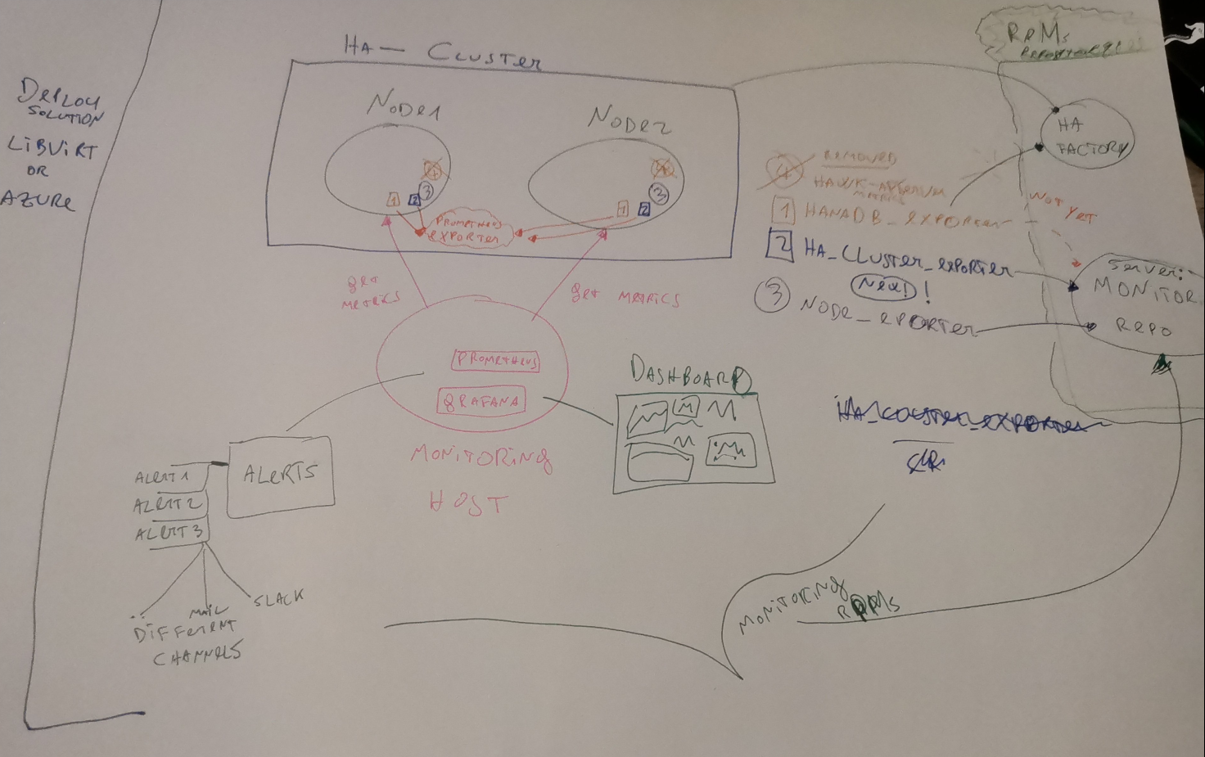
ADD HERE DESIGN PICTURE

Slide 5
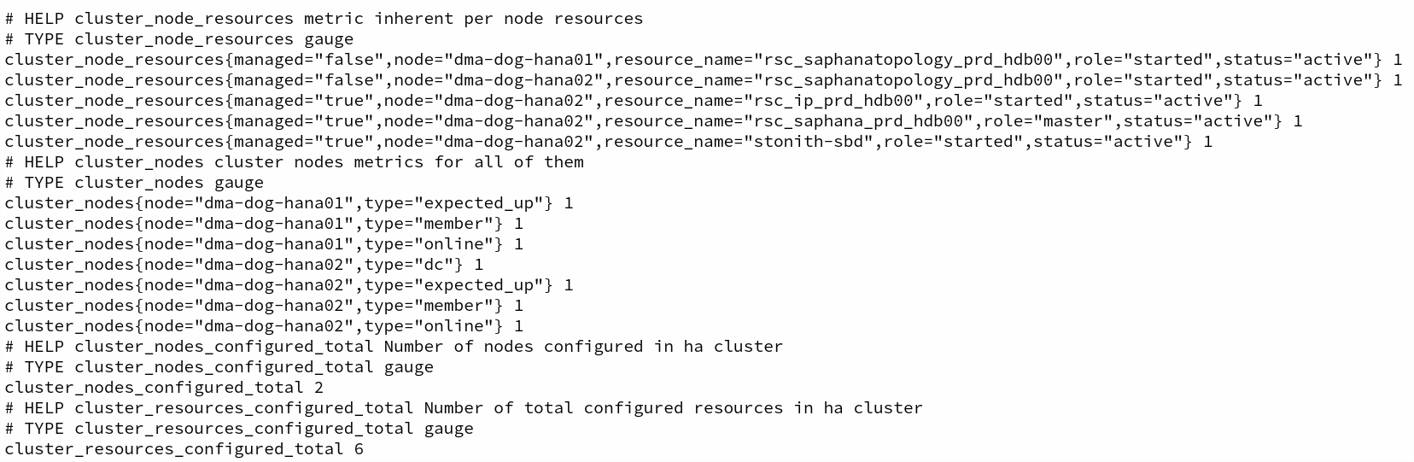

Slide 6
Monitoring: Alerts

Slide 7
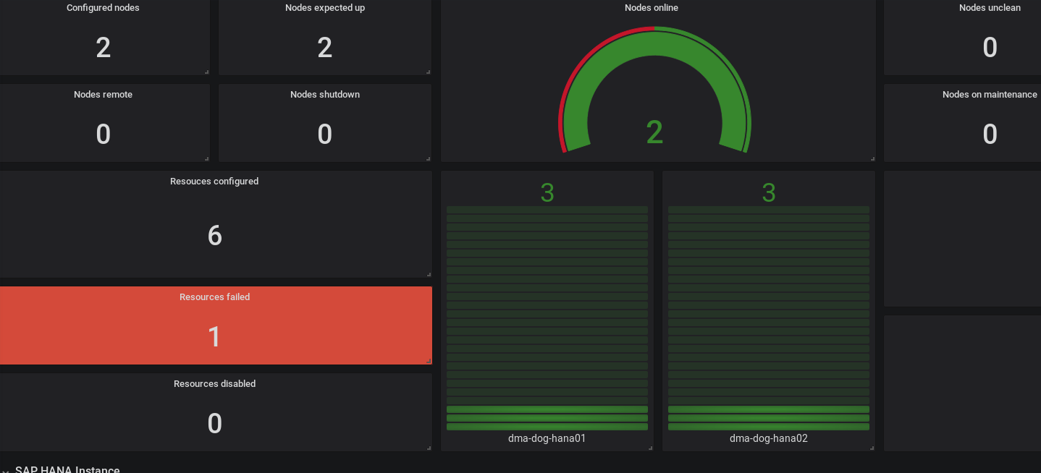
Raise alerts when some cluster resource fail
(VISUAL)

Slide 8
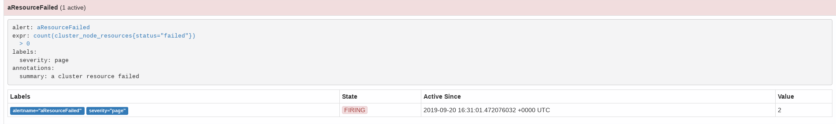
Raise alerts when some cluster resource fail
(ALERT)
This can be a slack/mail notifications etc

Slide 9
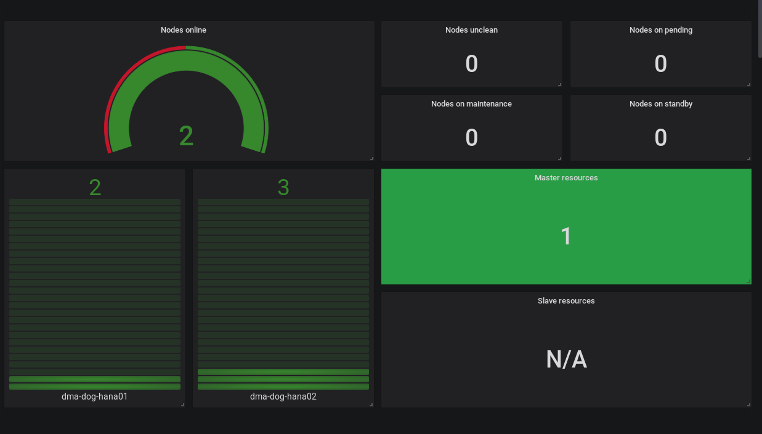
Raise alert when there is a failover/promotion mechanism (visual)

Slide 10
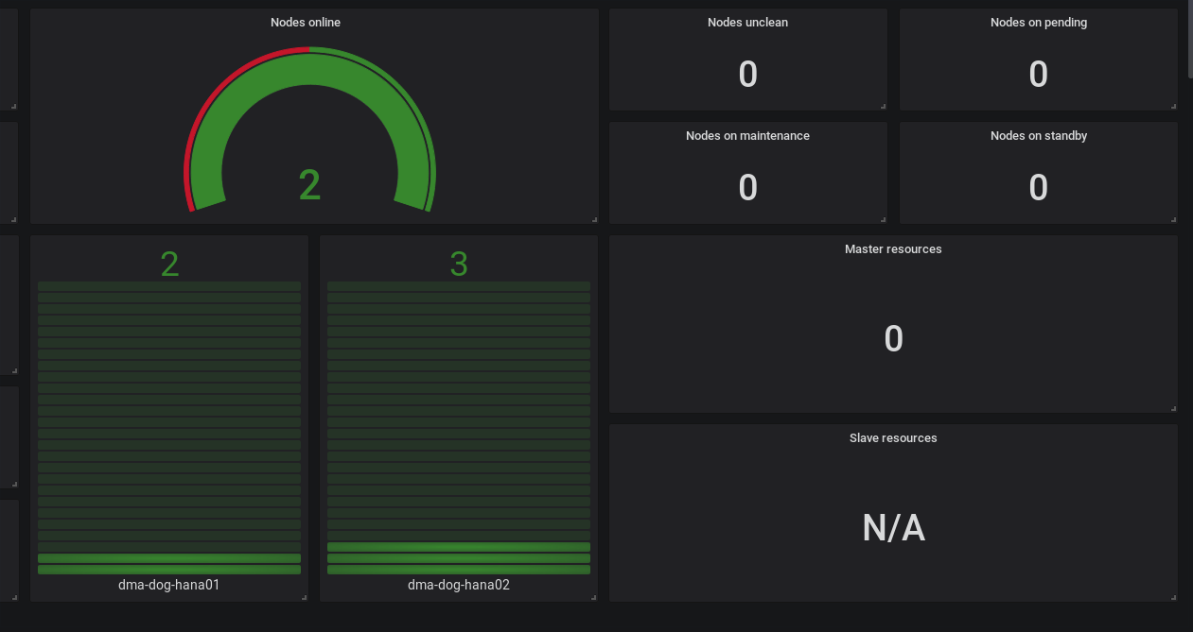
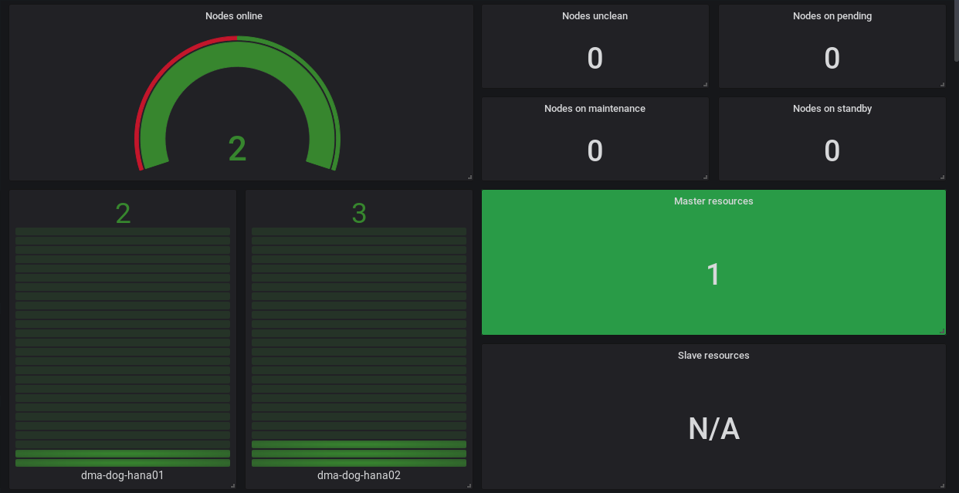
TRANSITION, master resource from node1 to node2
MASTER RESOURCE UP AGAIN
MASTER RESOURCE FAILED

Slide 11
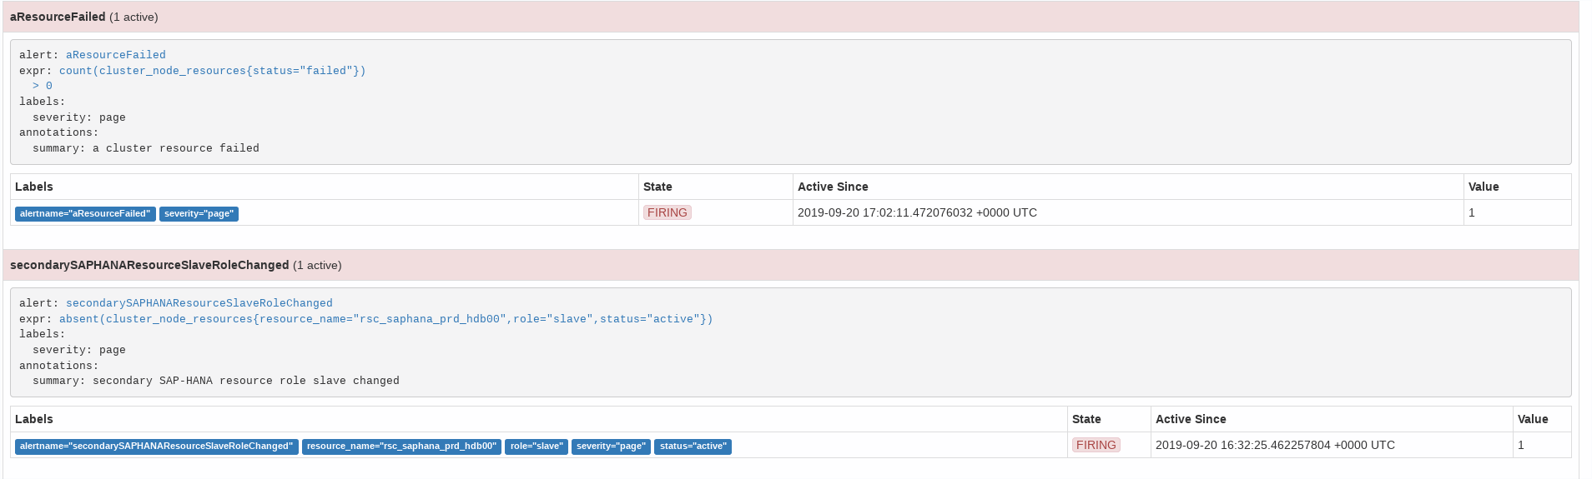
Raise alert when there is a failover/promotion mechanism (alerts/mails)

Slide 12
3) Reflections and next steps (visualisation)

Slide 13
Next sprint Investing in visualization:
Avoiding the wall of graphs
Minimalism and useful actionable metrics visualization

Slide 14
GOALS: “Provide more actionable, simple alerts/dashboards”
USE-CASE: “As admin I can react on
Red/green with a specific action to make it green again”

Slide 15
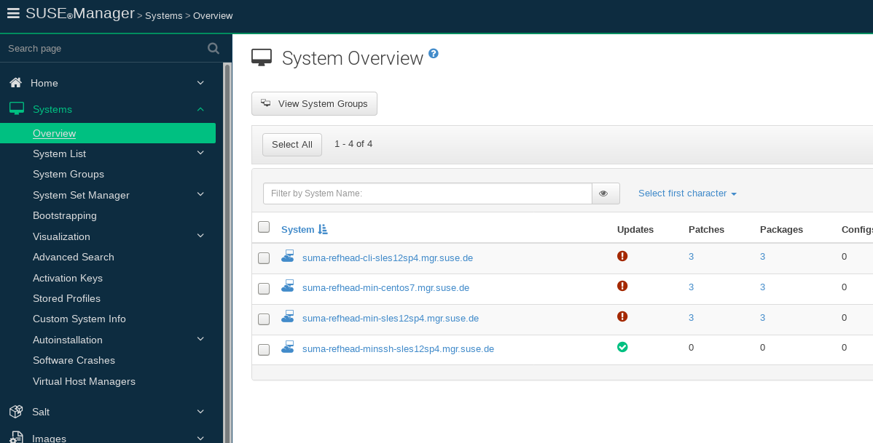
EXAMPLE: this is an actionable alert (red: need patch, green updated)

Slide 16
We need more alerts with concrete actions

Slide 17
Research/exploration: provide different dashboard, specialized on use cases

