Slide 1
DRBD Monitoring

Slide 2
Agenda:
DRBD (Distributed Replicated Block Device) Monitoring
* presentation of metrics
* possible visualizations

Slide 3
Metric 1: DRBD local disk state
High-level Use case: disks shall always be Primary/Secondary and in SYNCED state
ha_cluster_drbd_resource{disk_state="uptodate",resource_name="1-single-0",role="Secondary",volume="0"} 1
ha_cluster_drbd_resource{disk_state="uptodate",resource_name="1-single-1",role="Secondary",volume="0"} 1
ha_cluster_drbd_resource{disk_state="uptodate",resource_name="vg1",role="Secondary",volume="0"} 1
ha_cluster_drbd_resource{disk_state="uptodate",resource_name="vg2",role="Secondary",volume="0"} 1
ha_cluster_drbd_resource{disk_state="uptodate",resource_name="vg3",role="Secondary",volume="0"} 1

Slide 4
Details:
ha_cluster_drbd_resource{disk_state="uptodate",resource_name="1-single-0",role="Secondary",volume="0"} 1
ha_cluster_drbd_resource{disk_state="uptodate",resource_name="1-single-1",role="Secondary",volume="0"} 1
ha_cluster_drbd_resource{disk_state="uptodate",resource_name="vg1",role="Secondary",volume="0"} 1
ha_cluster_drbd_resource{disk_state="uptodate",resource_name="vg2",role="Secondary",volume="0"} 1
ha_cluster_drbd_resource{disk_state="uptodate",resource_name="vg3",role="Secondary",volume="0"} 1
disk_state= drbd diskstate like also Dunknown etc
Resource name = drbd resource
Role= drbd role
Volume= volume ID
Metric is always 1 or absent since it is a atomic snapshot of cluster

Slide 5
Metric 2: DRBD remote disk state
High-level Use case: remote disks shall always be Primary/Secondary and in SYNCED state
ha_cluster_drbd_resources_remote_connection{peer_disk_state="dunknown",peer_node_id="0",peer_role="Unknown",
resource_name="drbd_passive",volume="0"}

Slide 6
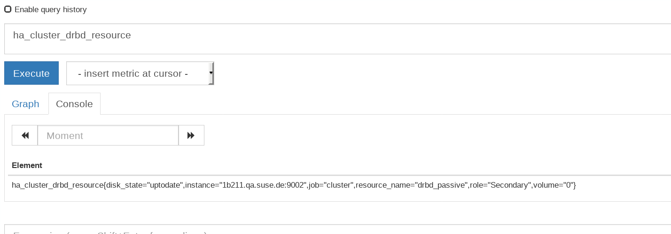
DRBD Metric: 1)Local disk state monitoring

Slide 7
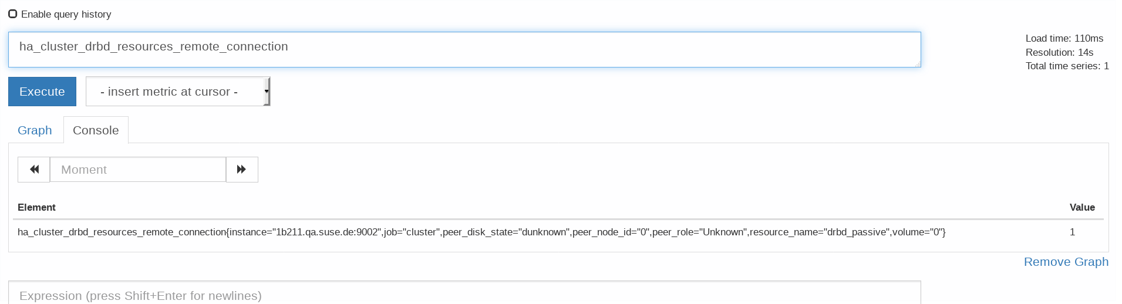
DRBD Monitoring: 2) Remote disk state

Slide 8
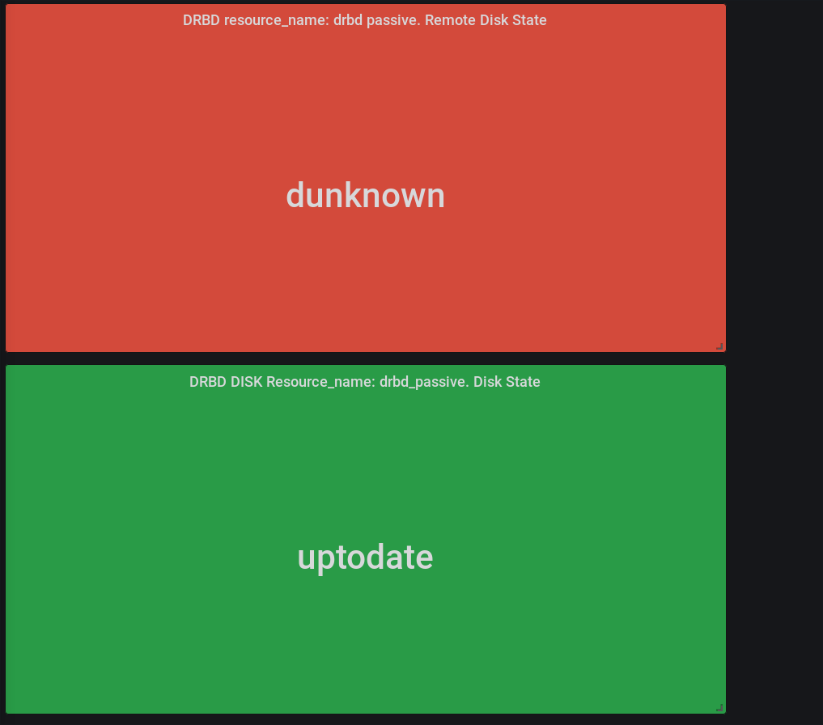
A 1 of a lot possible visualisation (remote/local)

Slide 9
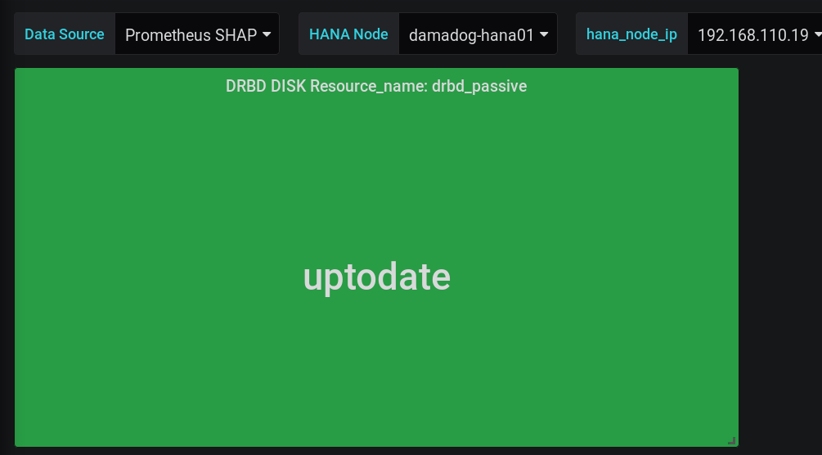
Visualize and monitor a specific local disk

