Slide 1
Logs HA/SAP Monitoring
(Loki from @grafana)

Slide 2
Agenda:
Warning: this is a high development presentation which might change
1) Architecture of loki in our HA cluster
2) What has be done so far
3) some short term plan:

Slide 3
Monitor logs with LOKI/Grafana
1) Loki: receive logs from agents and serve them to grafana
1) promtail: agent which gather logs
promtail
Ha node1
Monitoring server
Ha node2
Grafana
promtail
loki

Slide 4
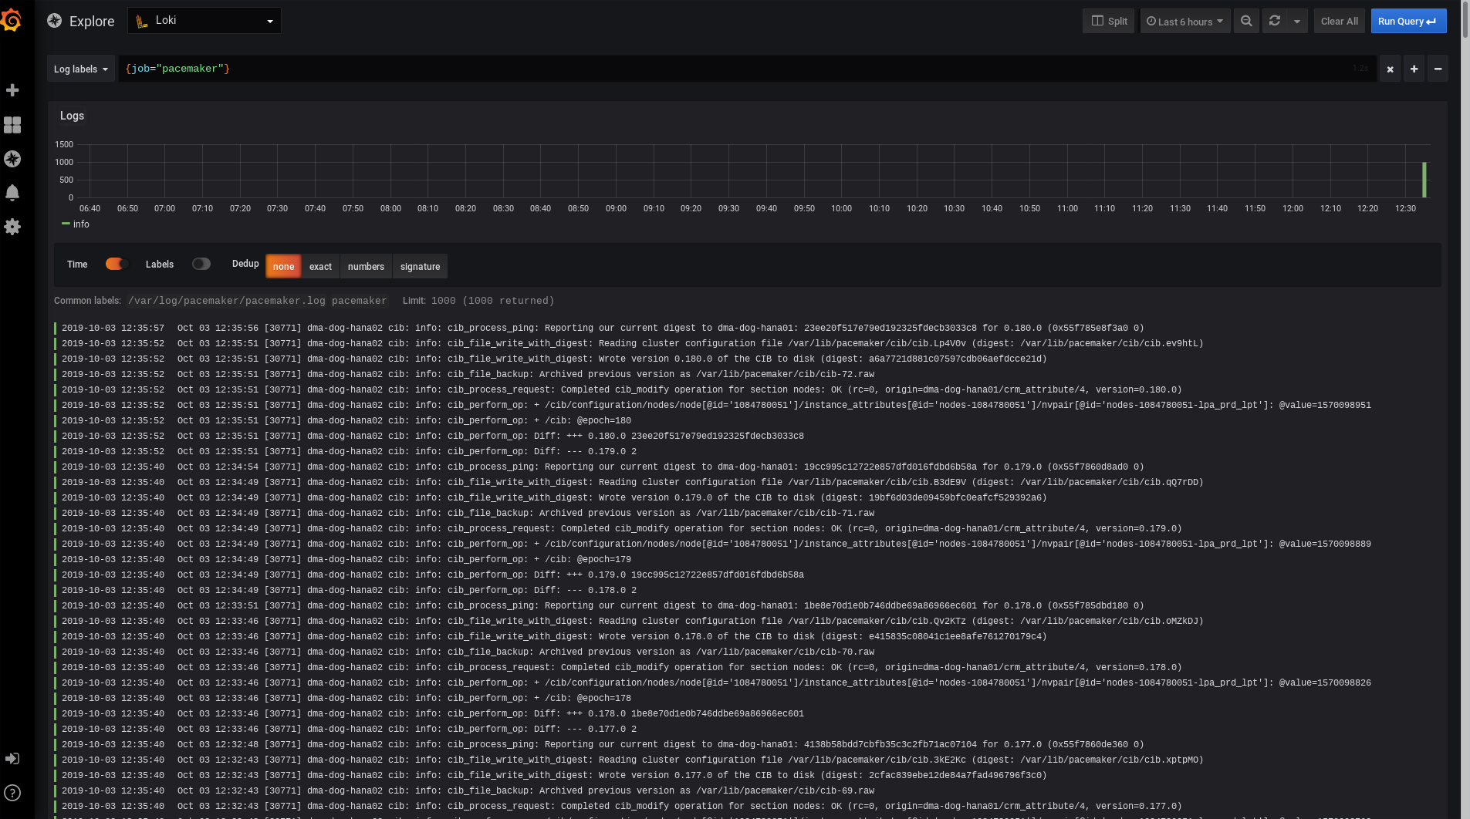
Monitor Cluster HA logs with LOKI/Grafana

Slide 5
What has been done sofar:
0) Initial RFC
1) latest version of loki into RPMs pkg at monitoring repo:
https://build.opensuse.org/package/show/server:monitoring/loki
2) Effort to make them visible upstream at grafana upstream documentation (ongoing):
https://github.com/grafana/loki/issues/52

Slide 6
Possible features
* add loki/promtail by default into monitoring project and make them monitor the pacemaker etc logs by default
* Visualize logs in grafana dashboard ( possible in 0.4 devel version)

