Slide 1
HA Cluster exporter Release 0.1.0

Slide 2
Agenda:
1) What’s new on the 0.1.0 Release of HA-Cluster exporter
2) Presentation of new metrics:
High-level usage and metric details
Note: visualization and alerts of some metrics are work in progress

Slide 3
What are we monitoring right now?
SBD
pacemaker
ha-cluster-exporter
Corosync
drbd

Slide 4
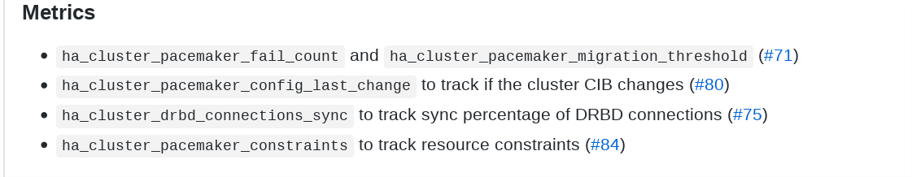
New metrics:
pacemaker
drbd

Slide 5
1)Failcount and threshold metric:
Use-case:
When the failcount exceeds the migration threshold, pacemaker will stop to try actions to reestablish the cluster until the sysadm intervention. As much it is a normal behavior, it is very common that sysadms don't know that manual interventions are expected.
An warning should be raise and presented on the dashboard in such a situation guiding the sysadm that the cluster will not react until it is health and a resource clean-up is done.

Slide 6
ha_cluster_pacemaker_fail_count
ha_cluster_pacemaker_fail_count{node="hana01",resource="rsc_SAPHanaTopology_PRD_HDB00"} 0 1234
ha_cluster_pacemaker_fail_count{node="hana01",resource="rsc_SAPHana_PRD_HDB00"} +Inf 1234
ha_cluster_pacemaker_fail_count{node="hana02",resource="rsc_ip_PRD_HDB00"} 2 1234
ha_cluster_pacemaker_migration_threshold
ha_cluster_pacemaker_migration_threshold{node="hana01",resource="rsc_SAPHanaTopology_PRD_HDB00"} 1 1234
ha_cluster_pacemaker_migration_threshold{node="hana01",resource="rsc_SAPHana_PRD_HDB00"} 5000 1234
ha_cluster_pacemaker_migration_threshold{node="hana02",resource="rsc_SAPHanaTopology_PRD_HDB00"} 3 1234
ha_cluster_pacemaker_migration_threshold{node="hana02",resource="rsc_SAPHana_PRD_HDB00"} 50 1234

Slide 7
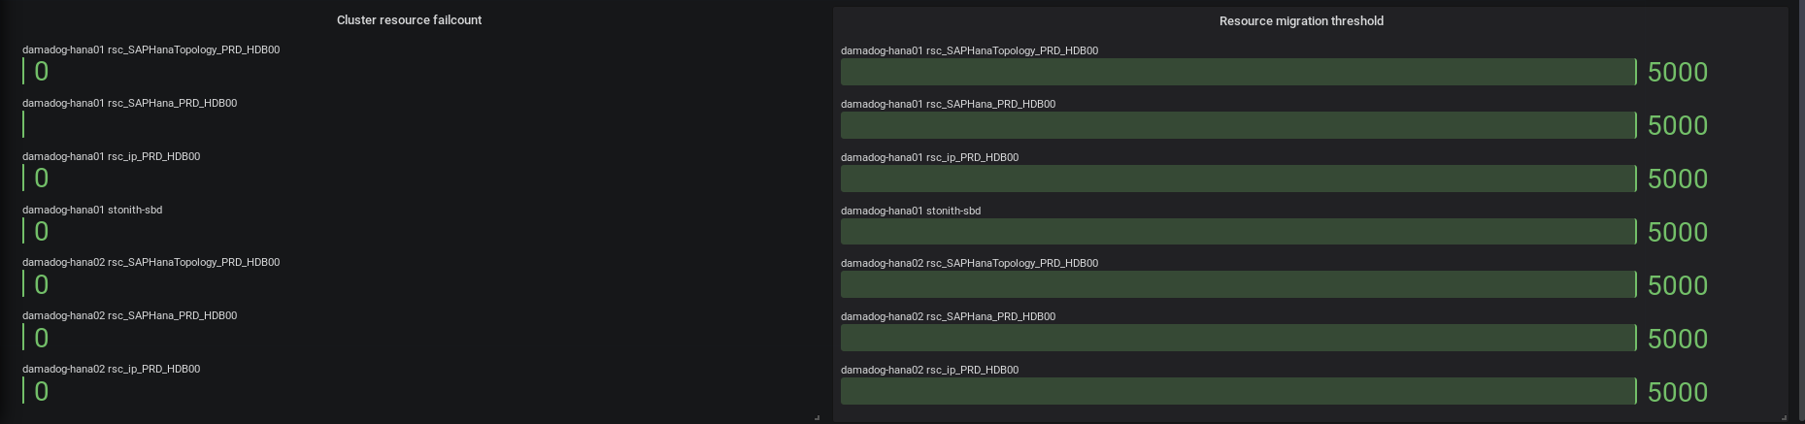
Possible visualisation

Slide 8
2) Config last change
The monitoring solution should raise a warning when the configuration of resource changes. Even that it can be intentional, it is not common that the configuration changes that often, and it can be changed by mistake, so raising a warning can help the user to identify undesired changes.

Slide 9
ha_cluster_pacemaker_config_last_change 1 1571399302000
This is a timestamp which will updated when the config changes.
An admin should use this metric with delta or other function to check if they have changed over time period
The 1 indicates it is present so it can be ignored

Slide 10
3) ha_cluster_drbd_connections_sync
ha_cluster_drbd_connections_sync{peer_node_id="2",resource="1-single-0",volume="0"} 100.00 1234
ha_cluster_drbd_connections_sync{peer_node_id="1",resource="1-single-1",volume="0"} 100.00 1234
Use-case:
Monitor the data changed on the master disk that needs to be shipped/synched on the other disks...
if this starts to grow because network bottleneck or any problem, customers can loose data in case of failure

Slide 11
pacemaker_constraints (2 types: ban/prefer)
Use-case:
The command `crm resource move` creates location constraints that the sysadm needs to manually remove.
Even that the behavior is expected, it is common that the sysadm forget about that or lack the knowledge about this.
The problem occurs when a new failure occurs, and the constraint avoid pacemaker to take correct actions.

Slide 12
Pacemaker constraints(metric)
ha_cluster_pacemaker_constraints{id="cli-ban-msl_SAPHana_PRD_HDB00-hana01",resource="msl_SAPHana_PRD_HDB00",type="ban"} 1 1234
ha_cluster_pacemaker_constraints{id="cliprefercln_SAPHanaTopology_PRD_HDB00",resource="cln_SAPHanaTopology",type="prefer"} 1 1234
ha_cluster_pacemaker_constraints{id="cli-prefer-msl_SAPHana_PRD_HDB00",resource="msl_SAPHana_PRD_HDB00",type="prefer"} 1 1234

