Slide 1
AD integration OS-layer with SAP/HA solutions
<Dario Maiocchi dmaiocchi@suse.com>

Slide 2
RATIONALE:
Install, manage SAP/HA cluster components with AD users

Slide 3
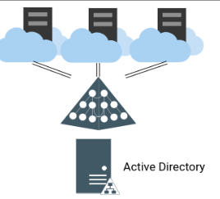
The AD administrator create user and groups into AD.
hacluster , <sid>adm user and others groups.
The groups/user must have POSIX attributes with right number of SID and GID

Slide 4
Which Users needs to be managed from AD:
- 1) HA cluster user/hawk: hacluster, <<SID>>adm for RA
- 2) SAP HANA: <<SID>>adm
- 3) Netweaver: <<SID>>adm

Slide 5
Ad configuration must occur before the installation

Slide 6
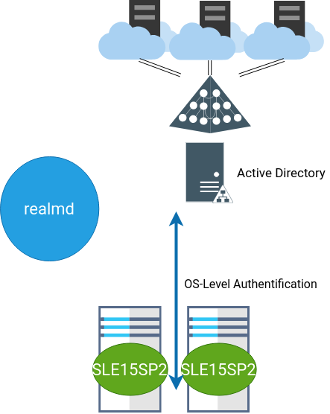
REALM configure Linux machines for AD
(sssd, pam etc)

Slide 7
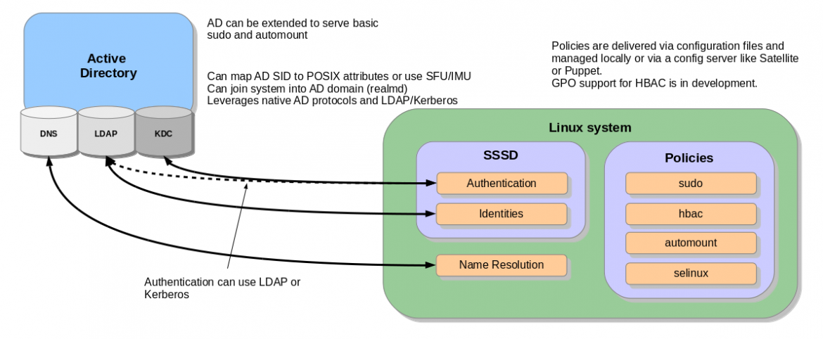

Slide 8
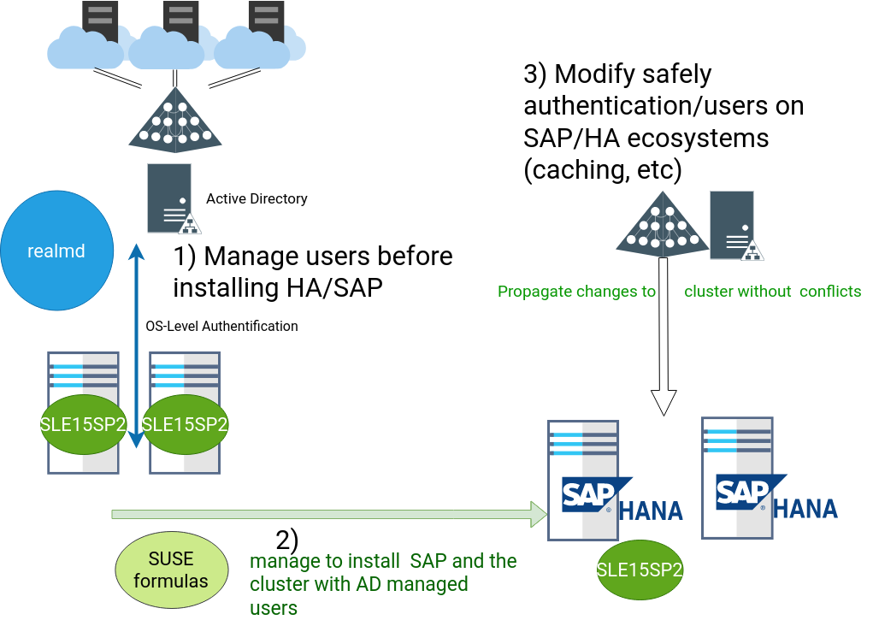

Slide 9
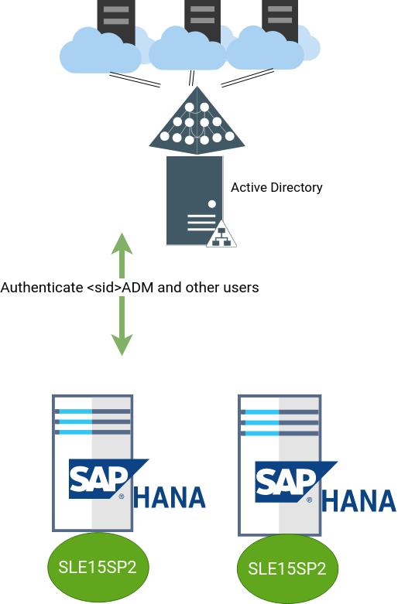
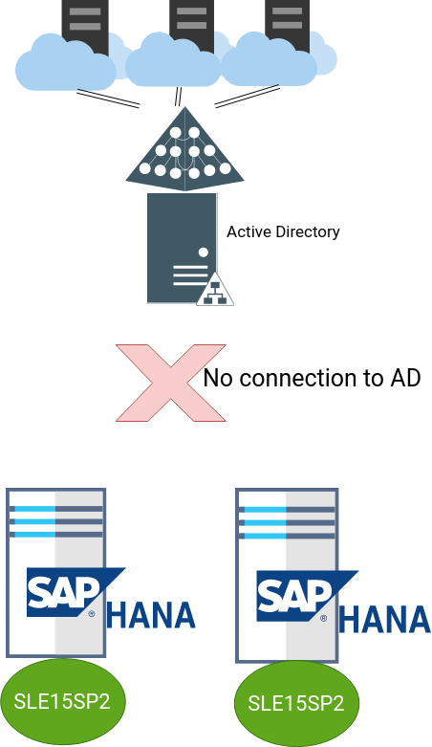

Slide 10
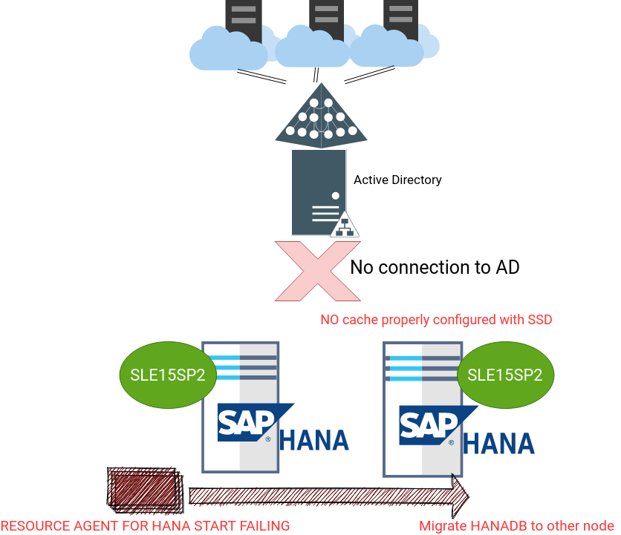

Slide 11
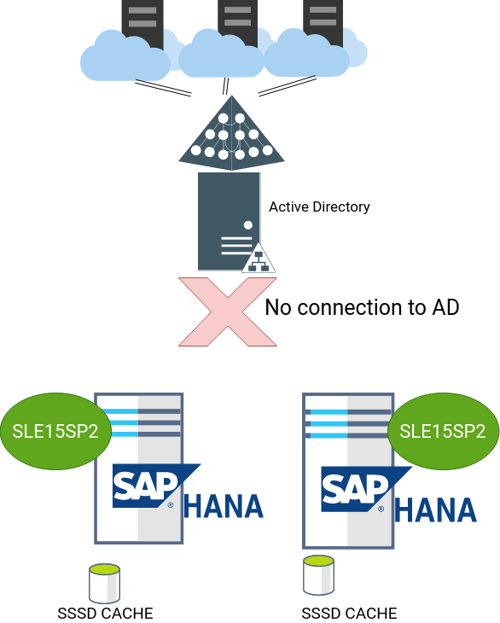

Slide 12
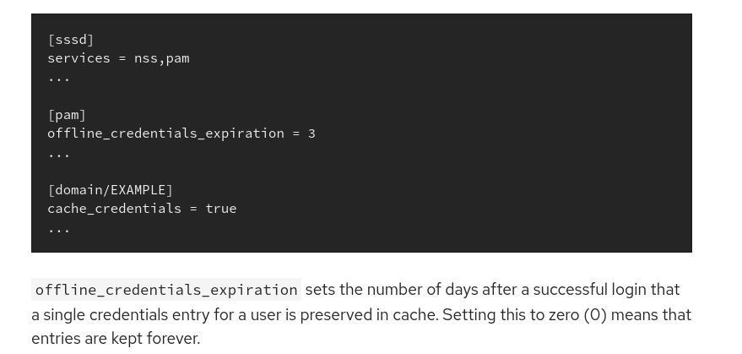
SSSD.conf file * solving the sudo problem for RA

Slide 13
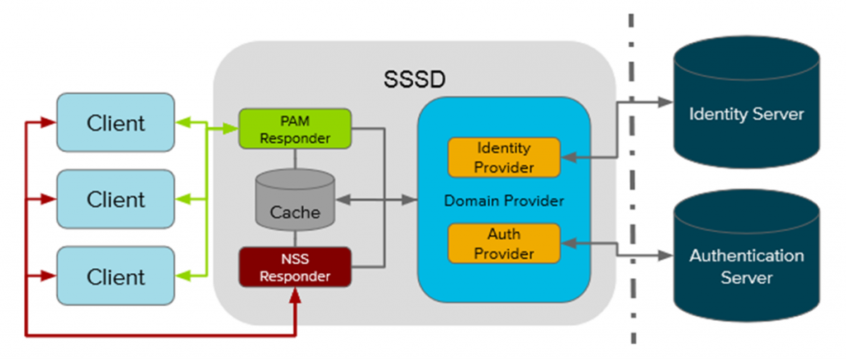

Slide 14
DEMO

