Slide 1
Research preview:
Self-healing clusters based on prometheus alerts
<Dario Maiocchi>

Slide 2
Warning:
This is a research topic, so nothing is yet already shipped and implemented on the products.
Things can changed/improved.

Slide 3
Highlevel usage:
SBD timeout is to low.
Systems detect and fix automatically.

Slide 4
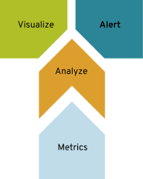

Slide 5
Alerts events can create self-healing systems

Slide 6
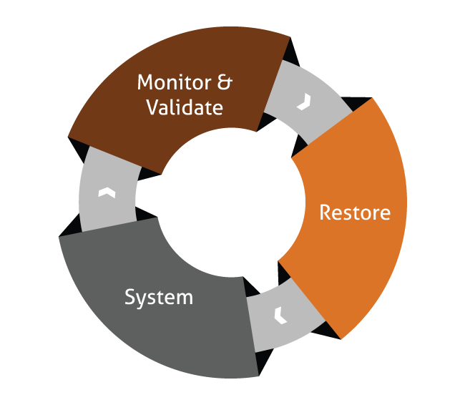

Slide 7
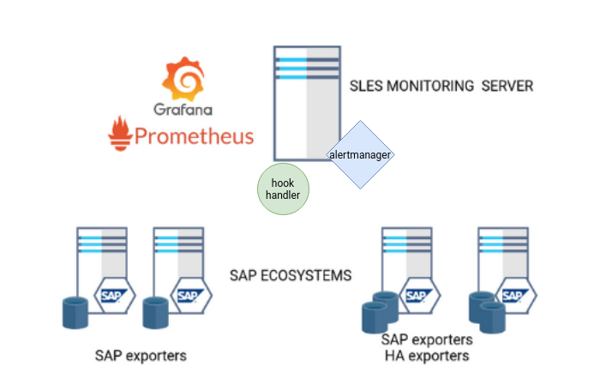
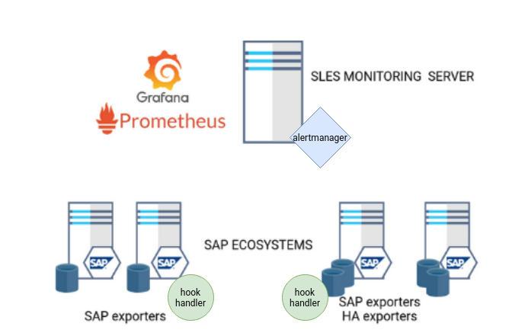

Slide 8
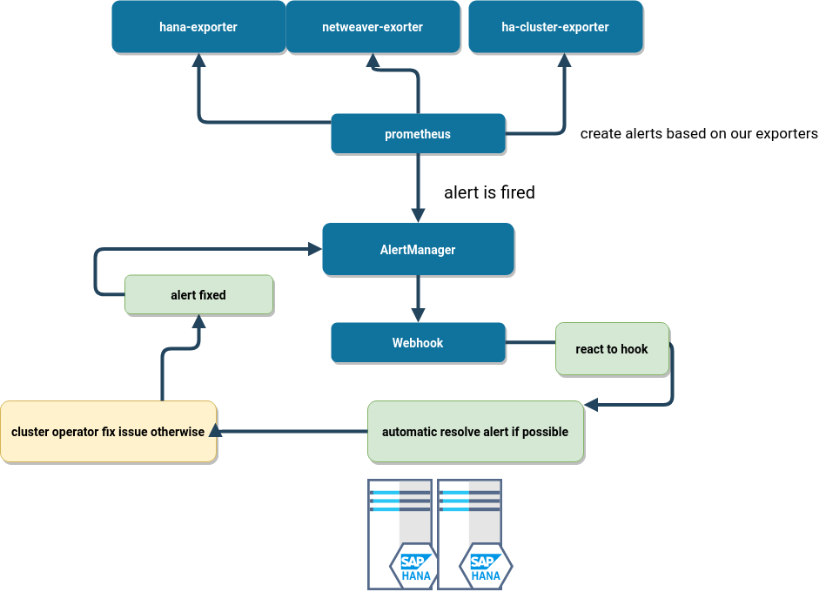

Slide 9
implementation
Use alertmanager and use golang mux route handler for implementing custom handler of alerts.
(https://github.com/gorilla/mux)

Slide 10
Consideration:
We do have already all needed components (execpt of the minimal binary handler)

Slide 11
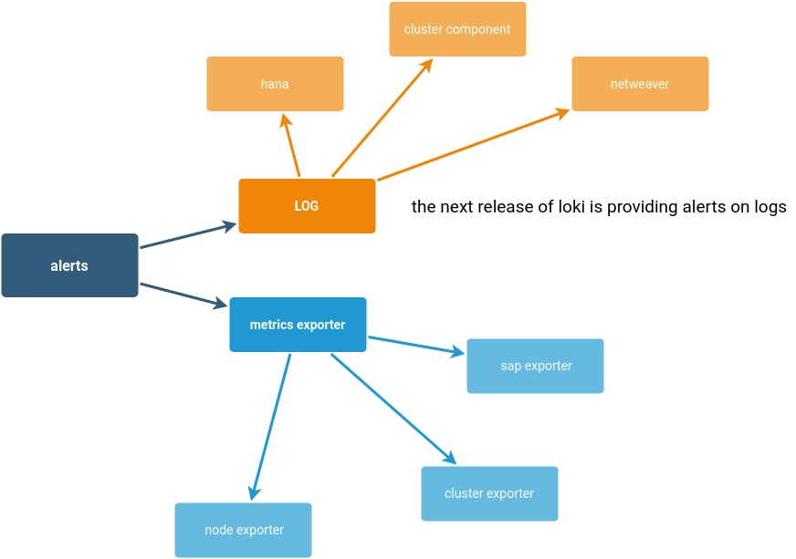

Slide 12
