Slide 1
Standalone salt-formulas and solutions based on it.
Dario Maiocchi <dmaiocchi@suse.com>

Slide 2
Problem(1):
Salt formulas are not easy to install/deploy for non salt user

Slide 3
Problem(2): an user need to know which pillar need to set and how

Slide 4
Problem(3): susemanager ships formulas as standalone

Slide 5
problem(4): standalone monitoring deployment

Slide 6
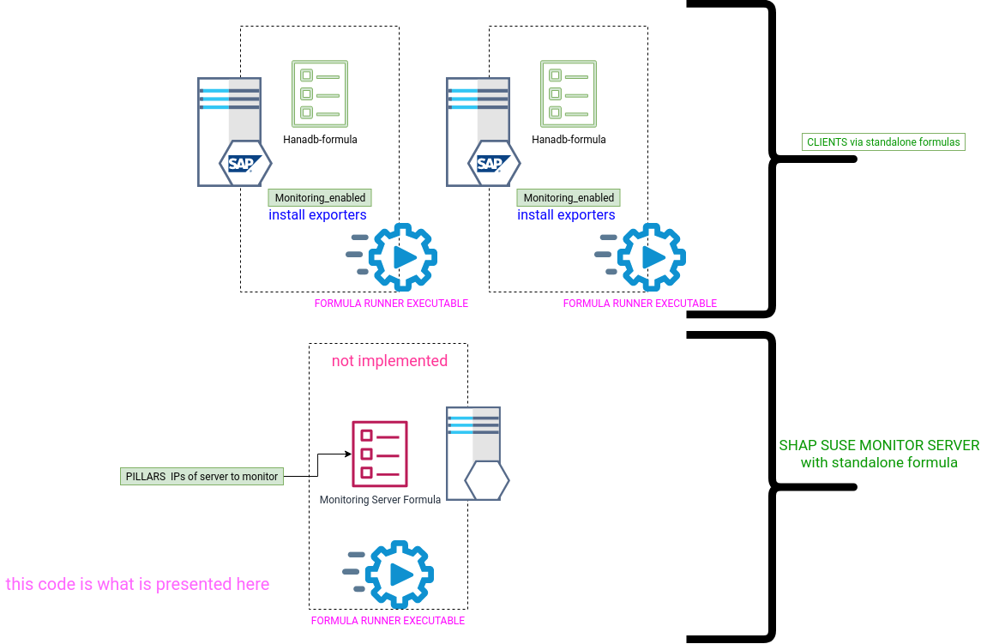

Slide 7
Standalone formulas are the condition for idempotency

Slide 8
The deployment project will then execute the executables

Slide 9
What is needed to make formula standalone?

Slide 10
1) minor changes how we package our formulas
( add pillars, minion config)

Slide 11
2) small compact self-contained executable shipped to each formula ( golang)

Slide 12
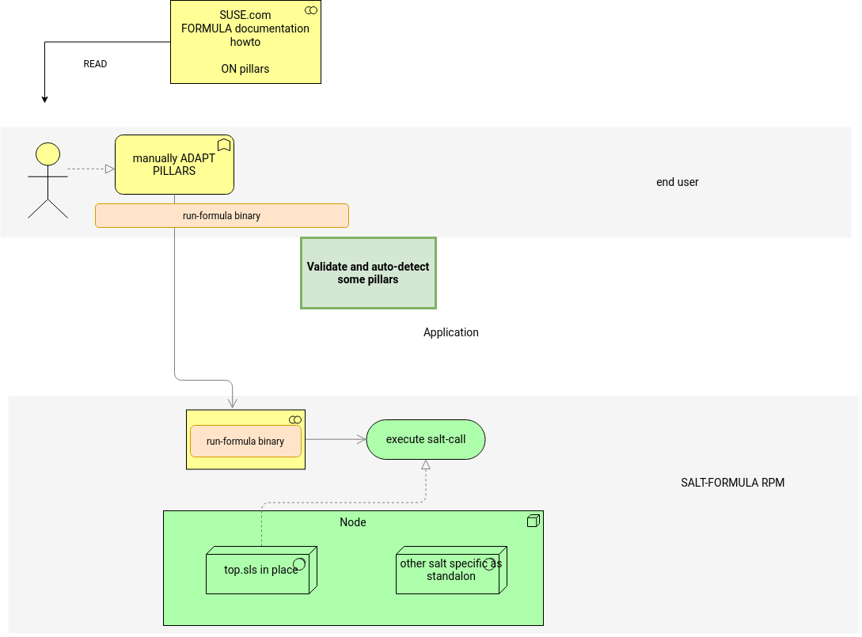

Slide 13
DEMO

