Slide 1
Self-healing with prometheus alerts
Dario Maiocchi <dmaiocchi@suse.com>

Slide 2
Warning: the implementation here is for POC purposes.

Slide 3
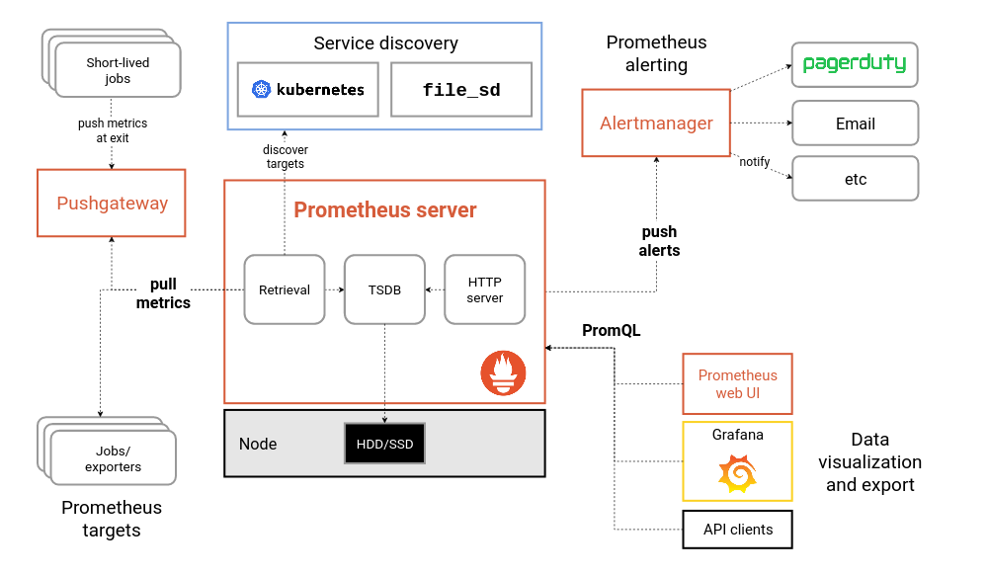

Slide 4
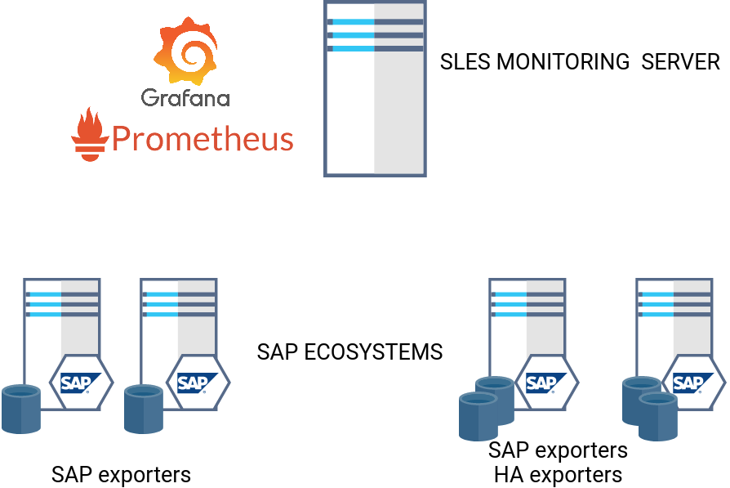
This is a possible architecture. (simplest)
Alertmanager
h
h
h
h
h
h
h
h
h
H= handler. Each server has a new binary, the handler which will handle the alerts

Slide 5
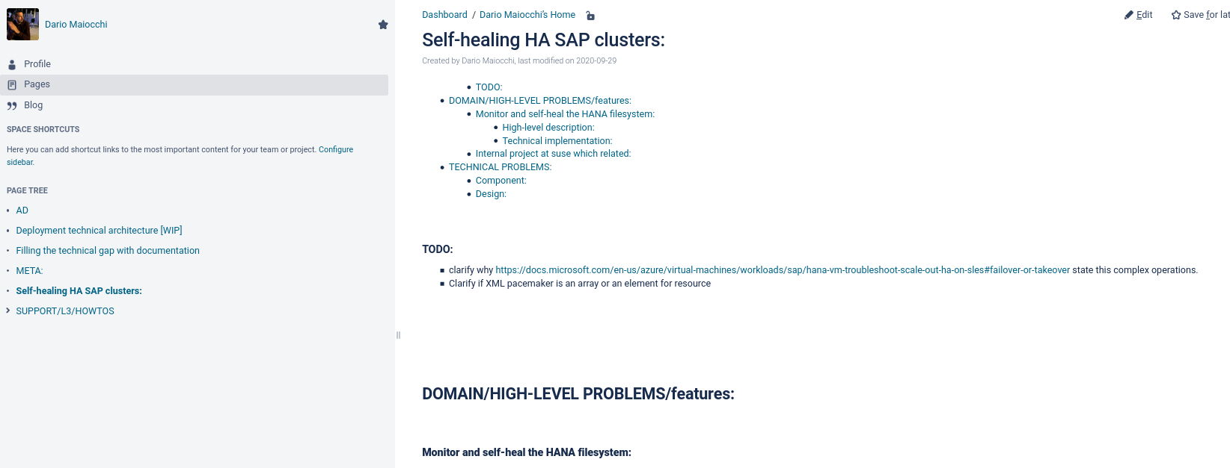
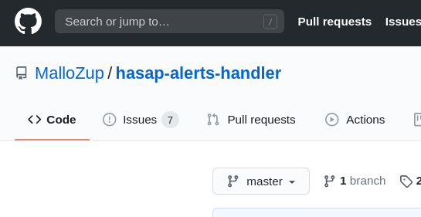
For technical details, infos check my confluence page
RFC will come later. (didn’t had time)

Slide 6
Features:
- Secure (https) possible.
- Self-heal on specific alerts, based on declarative API
- Raise alerts back to alertmanager in case selfheal fail
(can be used for other purposes, like monitor config file etc)

Slide 7
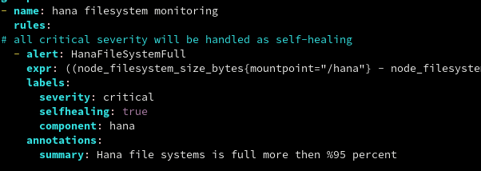
Declarative api

Slide 8
Declarative api labels play a role on the handler this will be documented clearly

Slide 9
severity: define how severe is an alert.

Slide 10
selfhealing:
Disable selfhealing or enable it.
If omitted is disabled on that alert.

Slide 11
component:
Infuence routing of alerts

Slide 12
Alertermanager
Route and filter alert, send them to various handlers

Slide 13
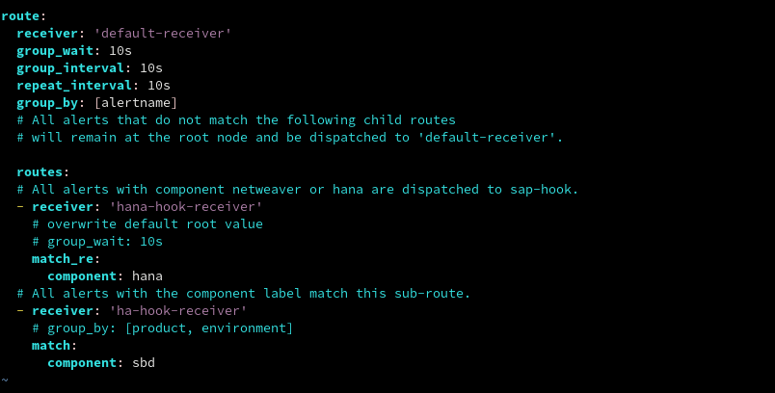

Slide 14
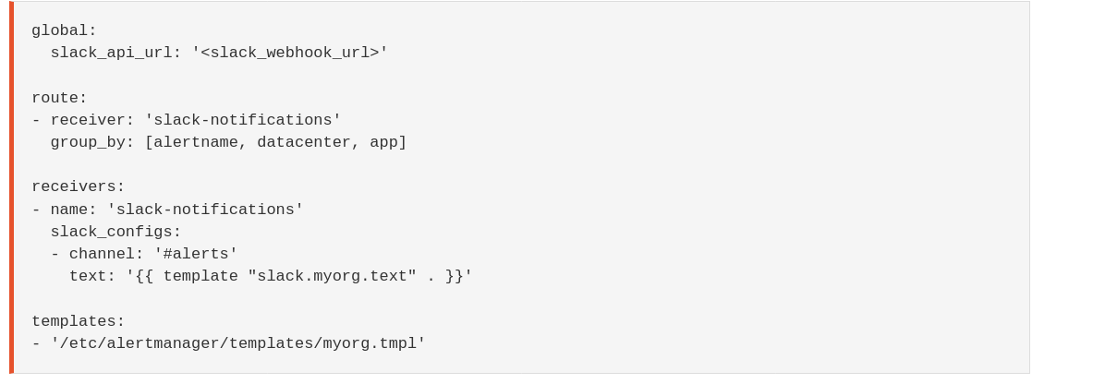
Templates are possible
https://prometheus.io/blog/2016/03/03/custom-alertmanager-templates/

Slide 15
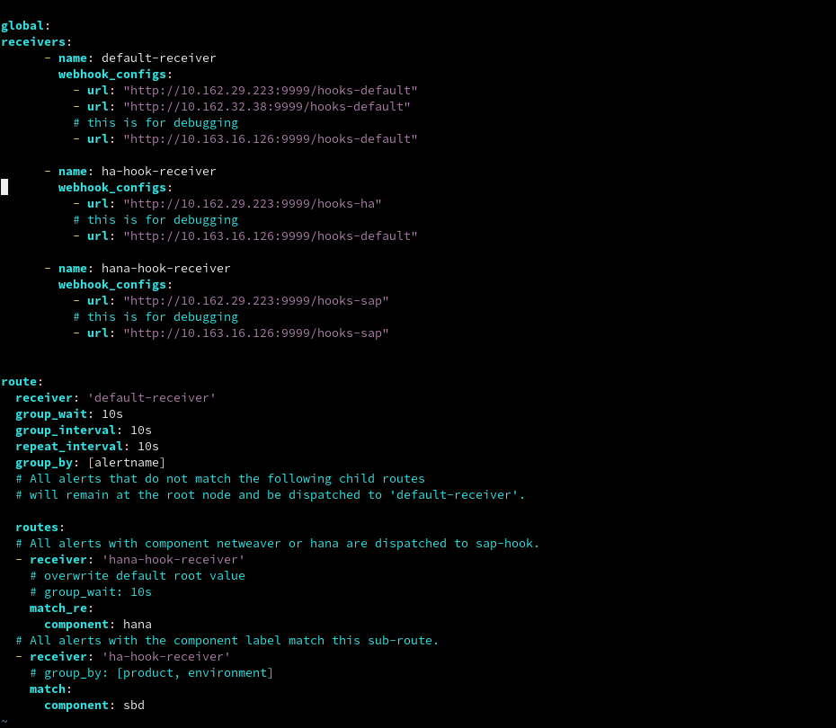

Slide 16
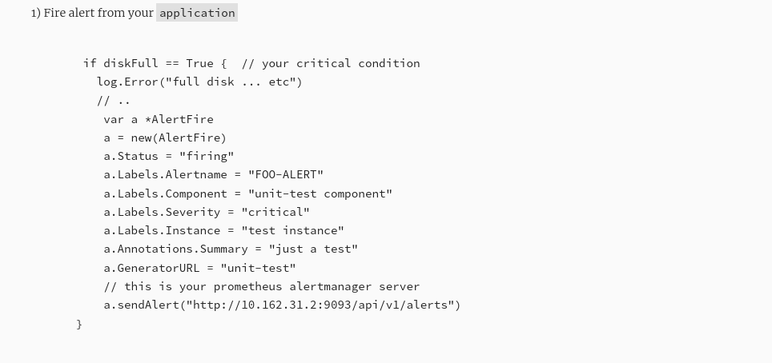
From an application codebase we can fire alerts.
This is needed for the handlers when they cannot selfhealf
but it can be reused for other purposes, like monitoring configuration files change etc..

Slide 17
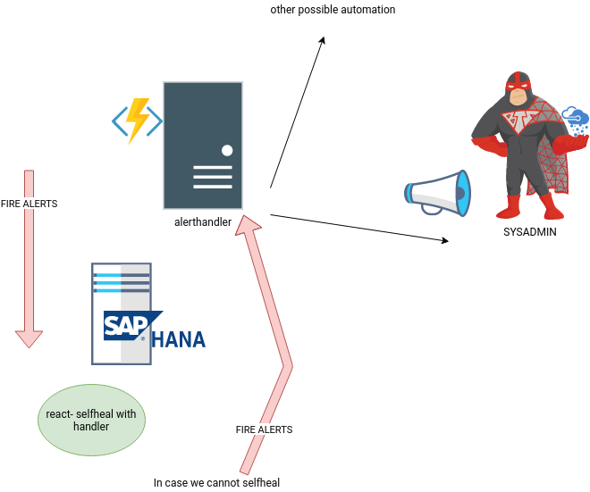
Firing alerts from application codebase.
(This is the inverse of reacting on alerts)

Slide 18
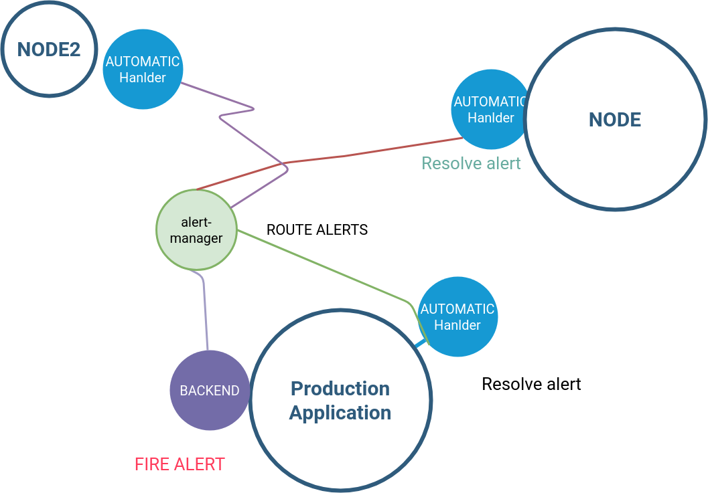
For details:
https://mallozup.github.io/posts/selfhealing-systems-part2/

Slide 19
DEMO

Slide 20
Thank you.

