Slide 1
Hawk: Operating HA cluster(s)
HA-SAP devel team
Dario Maiocchi <dmaiocchi@suse.com>
https://github.com/MalloZup

Slide 2
Index:
1) PAST: brief demo on hawk history
2) PRESENT: problem solved for the hawk maintainability problem, and security etc.
3) FUTURE: futuare of hawk. Short open discussion with follow-up actions

Slide 3
What Is hawk? released since 2010.
for more historical point of view visit:
https://confluence.suse.com/display/haslesforsap/Cluster+Stack+Introduction+by+Kristoffer?preview=/251594913/251599322/hawk-apiserver.pdf

Slide 4
DEMO

Slide 5
Current Maintenance updates
(status: not already released on all channels, on review)

Slide 6
Highlights:
* CVEs fixes on puma rubygem (webserver used by hawk )

Slide 7
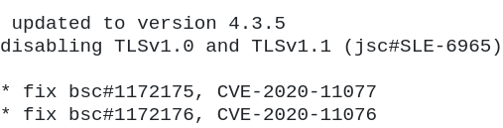
Highlights:
* security: allow disabling of TLS 1.0 and 1.1 for web-server (jira: PM-220)
SLE12: lower version of puma 2.16

Slide 8
Highlights:
* hawk is running on rails 6.1 on opensuse TW Factory (bsc#1172840) where on sle15 is rails 5.1

Slide 9
2nd MU for hawk
Status: code mostly implemented, SR need to be done

Slide 10
Highlights:
* fix bug bsc#1163381
Hawk2 returns "Low level server error occurred"

Slide 11
Highlights:
* allow user belong to haclient group to access history explorer ( #PM-51)

Slide 12
Highlights: (contained in 1 MU)
* the maintainance process improvements

Slide 13

Maintainance Process of hawk highlights: more CI/Automation:
* QA tests are now merged upstream
And documented here:
https://github.com/ClusterLabs/hawk/blob/master/e2e_test/README.md
And can be run manually executed
This are executed automatically and maintained by QA CI systems (thx to Rbranco, Alvaro and team)

Slide 14
Maintainance Process of hawk highlights: faster Release process
Maintaince process for SLE12SP3 and SLE12sp4 was not simple or compact
PROBLEM
* SLE12sp3 and SLE12sp4 codebase are using only 1 codebase branch instead of 2 confusing
*SLE12SP3 and SLE12sp4 don’t have any patches since code has been refactored and patches merged in code
SOLUTION

Slide 15
Maintainance Process of hawk highlights:
Documentation on hawk maintainance
The release processs on HAWK was obscure.
Lot of difference on SLE12 and SLE15.
PROBLEM
SOLUTION
Added new documentation on confluence regarding release process
* added related jira cards for tech-debts

Slide 16
Feature preview: disable tls 1.0/1.1

Slide 17
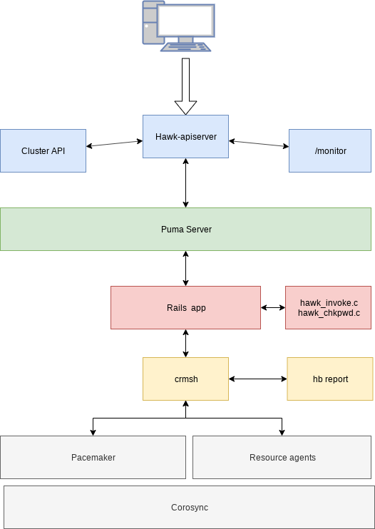
SLE15 and higher:
Status: not implemented hawk-api-server handle this differently and customer req on SLE12 codebase first

Slide 18
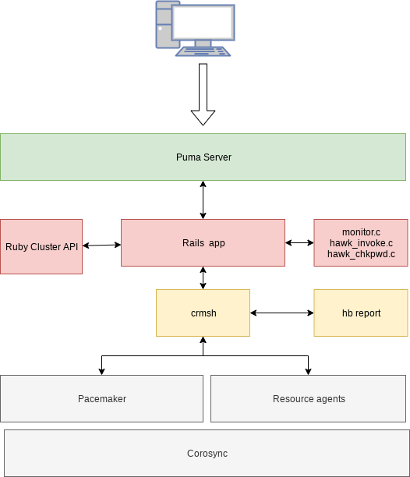
SLE12 and higher
Maintanance update Status: under review

Slide 19
SLE12: how to disable TLS 1.0 or TLS 1.1

Slide 20
Easy to configure manually
(1line change)

Slide 21
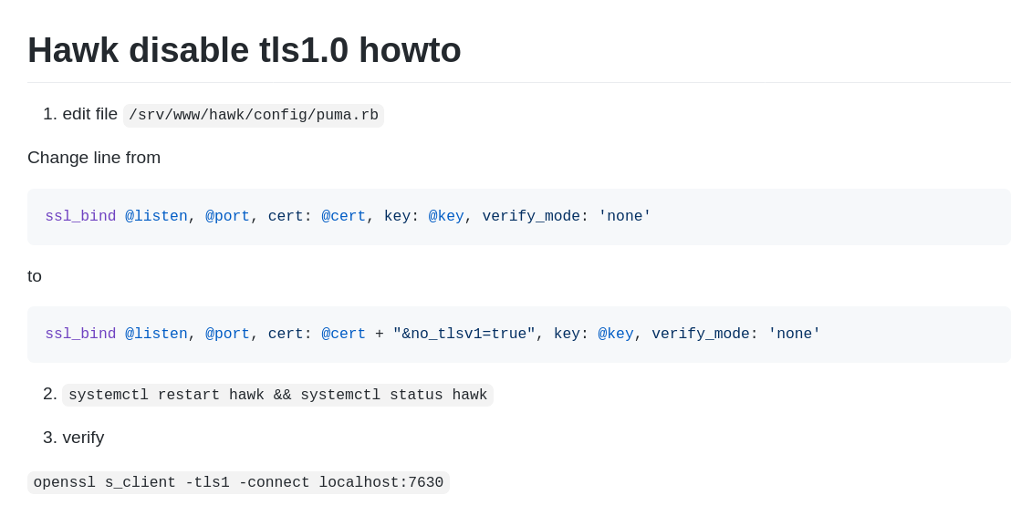
Operating HA clusters

Slide 22
Where can HAWK help the SAP future (? open question)
1) SAP Windows users transition to Linux (?)
2) ..
* we need to think about the new shape in high-level manner

Slide 23
Thank you.

