Slide 1
Operating HA clusters
Dario Maiocchi <dmaiocchi@suse.com>

Slide 2
HAWK:
(https://hawk-ui.github.io/)
Configure the HA cluster, with API-backend or GUI; configure resources and advanced Pacemaker features.

Slide 3
History:
First release on 2010, operational since 10 years.
opensource for HA cluster. (!= SAP) https://clusterlabs.org/ opensource organisation.
(SUSE, Redhat and others)

Slide 4
* Hawk is a GUI and an API-server.
The gui is a rails app
The api-server/web-server is golang project.
* it doesn’t have any DB ( the cluster has the state)

Slide 5
* despite all the years, and change of maintainers is still wide used and works without major problems

Slide 6
What hawk is:
* backend: mostly written in ruby, but has components written in C, other in golang. (see later)
* frontend: erb + javascript (no complex framework)

Slide 7
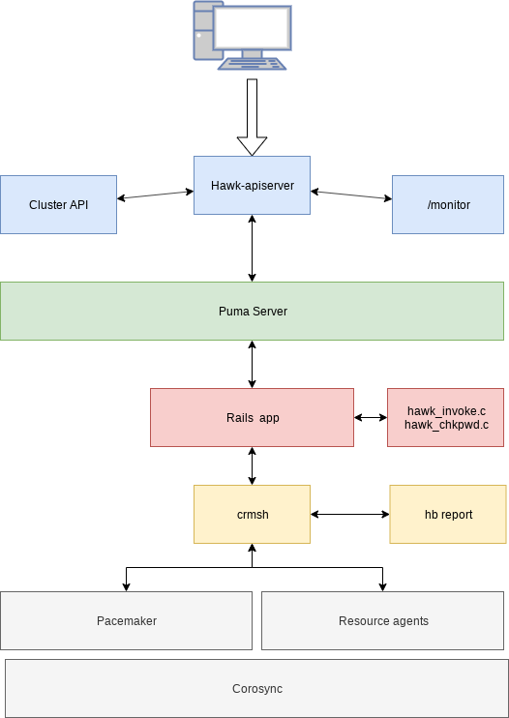
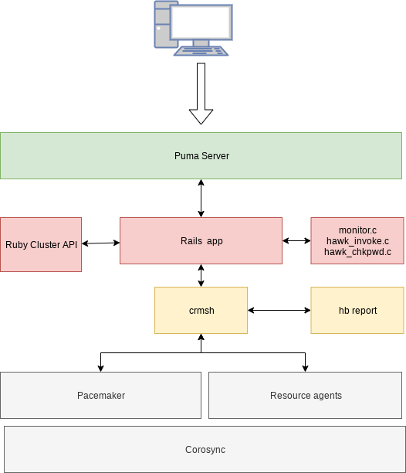
SLE15
SLE12

Slide 8
DEMO

Slide 9
Thank you.

