Slide 1
HA cluster exporter:
DRBD split-brain metric

Slide 2
Usecase:
Detect when the splitbrain mechanism occurs pro node and pro resource and volume.
The Ha-cluster exporter will then signal this.
The sysadmin need to resolve splitbrain situation manually

Slide 3
How it works?

Slide 4
High-level Picture:
Drbd node1
Drbd node2
SUSE Custom spilitbrain hook
1)
Splitbrain res1 volume02
2)
The hook react to event splitbrain

Slide 5
Configure drbd to react the hook (done automatically by salt)

Slide 6
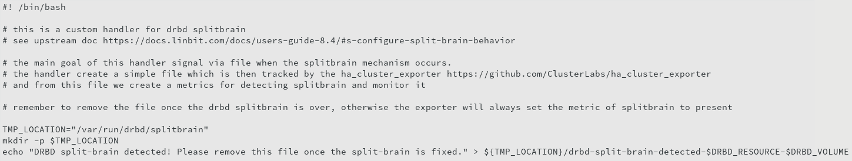
"/usr/lib/drbd/notify-split-brain-haclusterexporter-suse-metric.sh"

Slide 7
High-level Picture:
Drbd node1
Drbd node2
SUSE Custom spilitbrain hook
file
1)
3)
Splitbrain res1 volume02
2)
hook create special file
The hook react to event splitbrain

Slide 8
High-level Picture:
4)
metric
ha-exporter convert it to metric
Drbd node1
Drbd node2
ha-cluster-exporter
SUSE Custom spilitbrain hook
file
1)
3)
Splitbrain res1 volume02
2)
hook create special file
The hook react to event splitbrain

Slide 9
High-level Picture:
5) Sysadmin need to resolve split brain and remove file.
4)
metric
Drbd node1
Drbd node2
ha-exporter convert it to metric
ha-cluster-exporter
SUSE Custom spilitbrain hook
file
1)
3)
Splitbrain res1 volume02
2)
hook create special file
The hook react to event splitbrain

Slide 10
How it looks like the metric:

Slide 11
The complete documentation is avail at:
https://github.com/ClusterLabs/ha_cluster_exporter/blob/master/doc/metric_spec.md#ha_cluster_drbd_split_brain

