Slide 1
Monitoring & Alerts for HA/SAP Clusters

Slide 2
Summary:
1) Ha Dashboard highlights
2) Ha alerts highlights
3) ha-exporter highlights of 0.2.0 release

Slide 3
HA Dashboard

Slide 4
Enable multi-clusters on a single dashboard

Slide 5
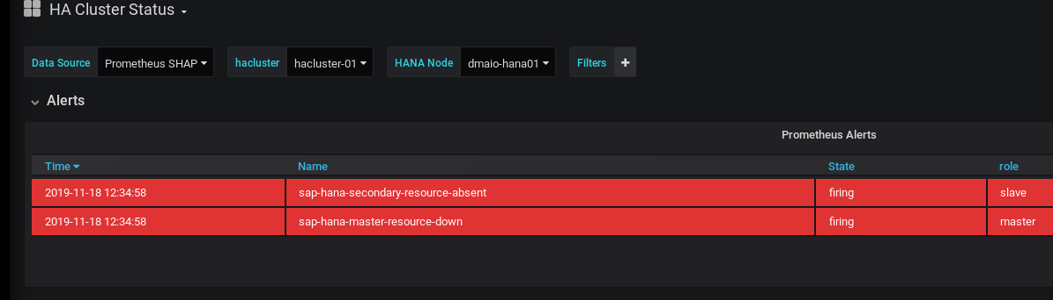

Slide 6
Drbd disk status visualization

Slide 7
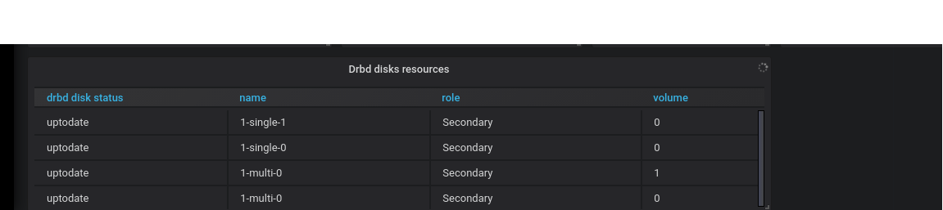
NEW visualisation added: DRBD disks resources state

Slide 8
Alerts

Slide 9
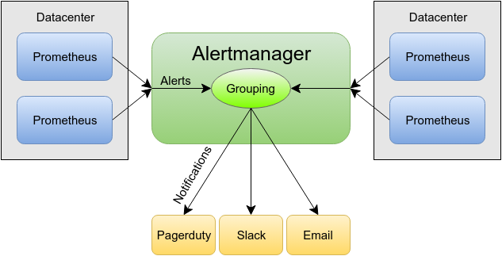
Recap: what is alertmanager in hacluster
hacluster1
hacluster2

Slide 10
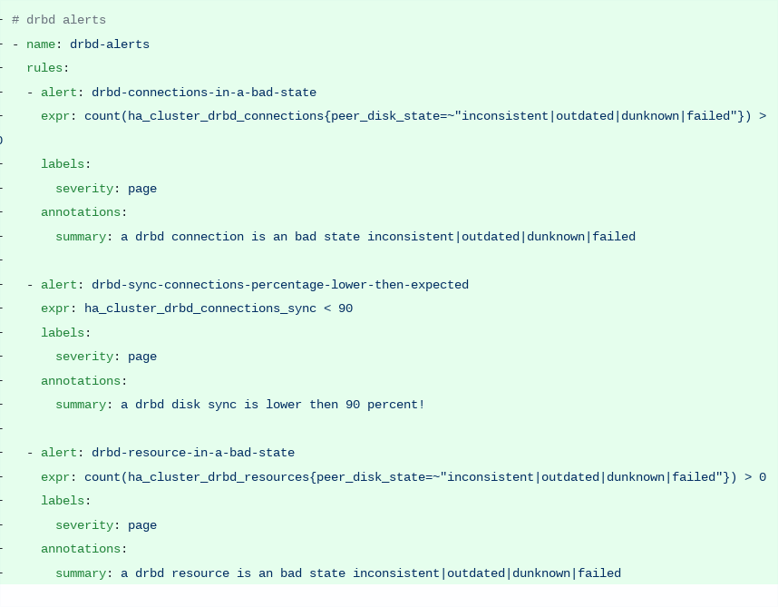
New DRBD alerts
1) drdb remote resource
2) drbd sync percentage
3) drbd local resource

Slide 11
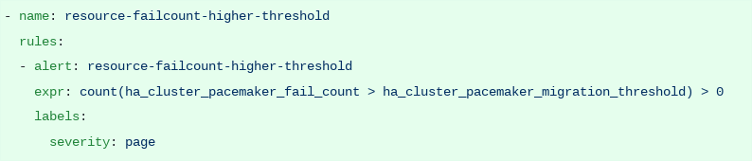
Combine threshold and failcount metric to an alert

Slide 12
Hacluster exporter 0.2.0

