Slide 1
Windows Active Directory authentication with SUSE
HANA Solutions (RFC)
<Dario Maiocchi>

Slide 2
WHY SAP and Active Directory (LDAP)?

Slide 3
Scenario
1. Users are assigned to Windows AD groups by the company

Slide 4
Scenario
2. Users logs into HANA using Windows AD
No new user needs to be created in HANA.

Slide 5
Scenario
3. A new employee joins the org and is tagged to a Windows AD group.
He/she automatically gains access no new user ID created.

Slide 6
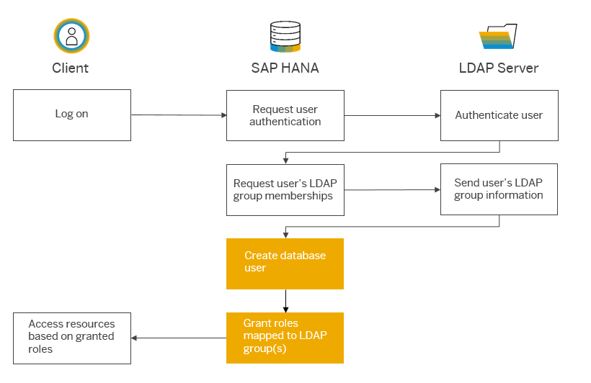

Slide 7
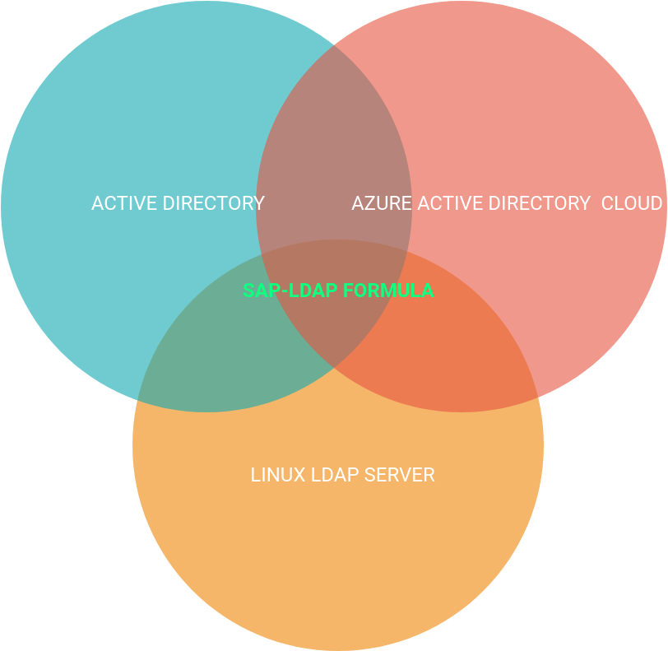
ECOSYSTEM
INTEGRATION

Slide 8
Integration on SUSE solutions:
1) Deployment
2) Webui (SUSE-Manager)

Slide 9
SAP-LDAP-FORMULA
It is intended to be executed on already existing SAP HANA db (netweaver in future)

Slide 10
1) Deployment a) Deploy from scratch

Slide 11
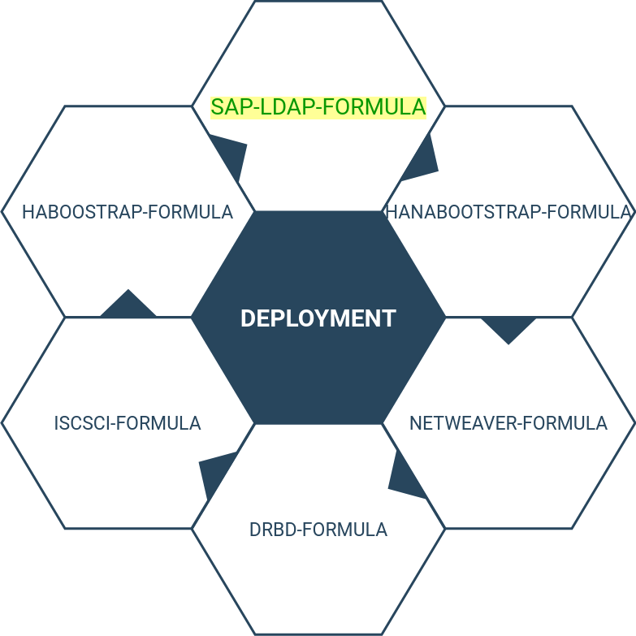
1) Deployment
2) require an already LDAP server running

Slide 12
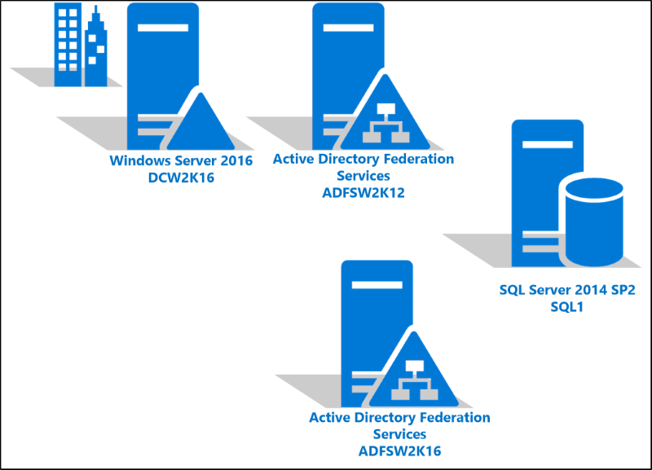
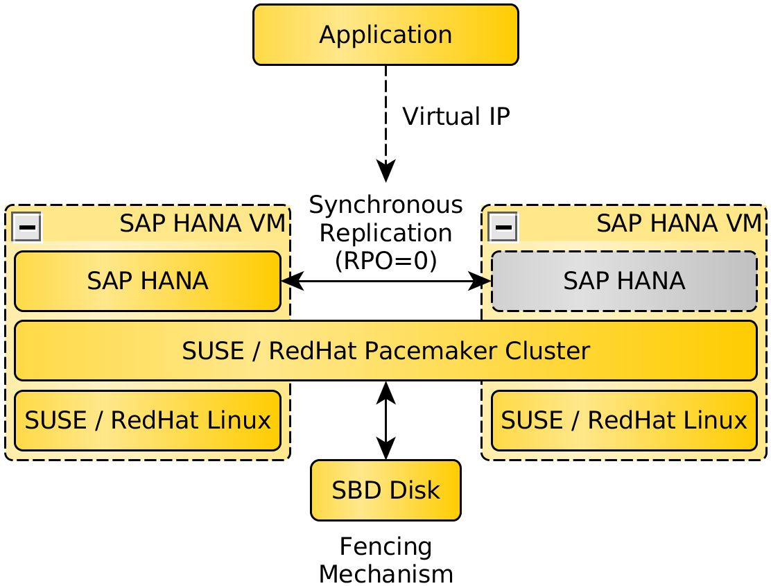


Slide 13
b) Run the formula on already existing clusters

Slide 14
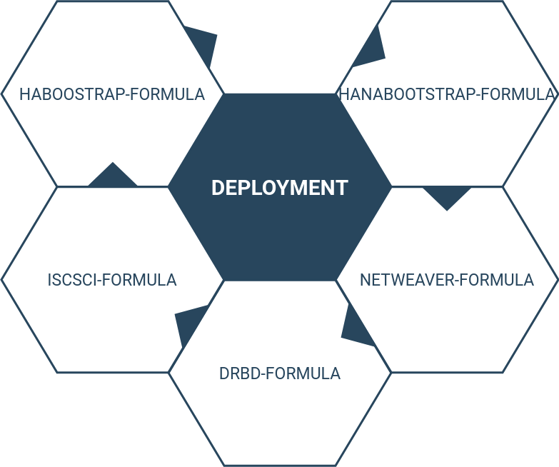

Slide 15
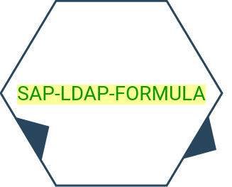

Slide 17
SAP-LDAP-FORMULA
It executes mostly sql statement supported by SAP HANA to configure LDAP functionalities
https://github.com/saphanaacademy/ldap#create-ldap-provider

Slide 18
WEBUI-INTEGRATION

Slide 19
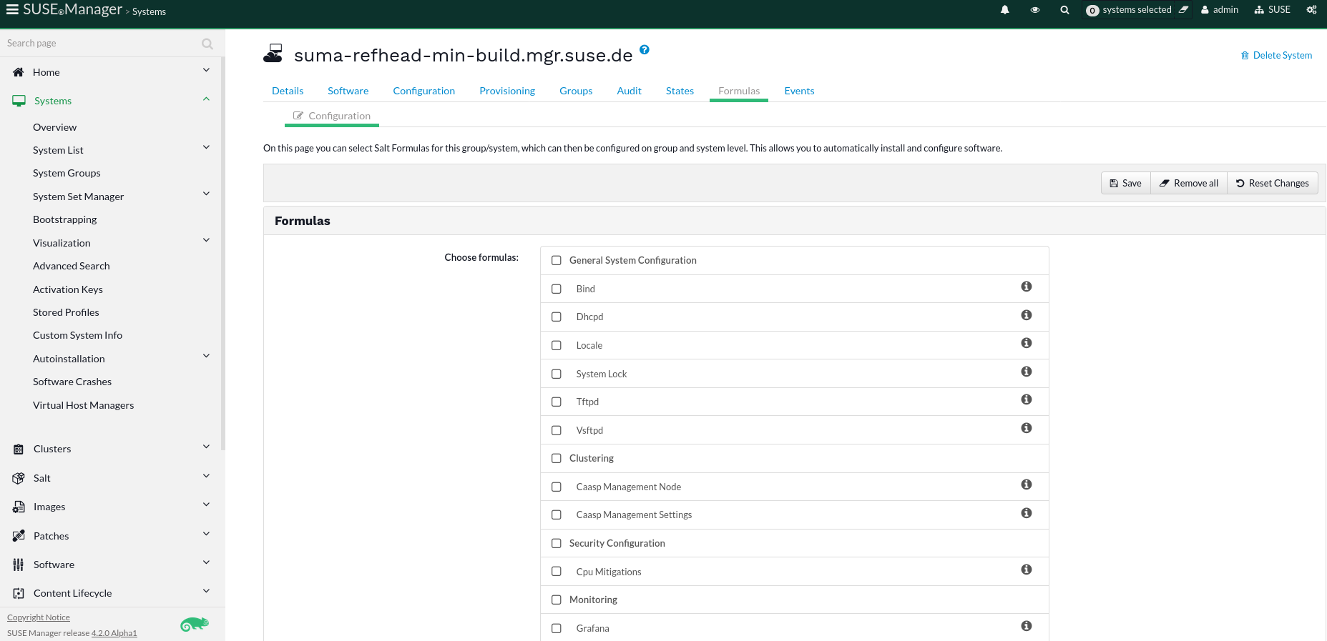
Here the new forumula can be installed

Slide 20
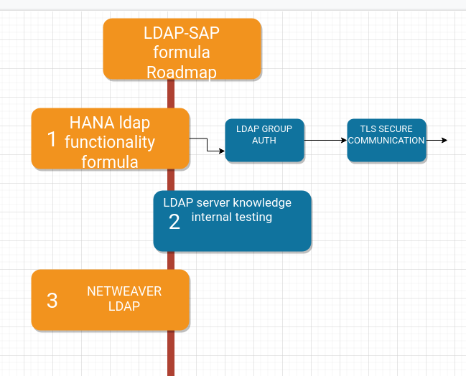

Slide 21
© 2020 SUSE LLC. All Rights Reserved. SUSE and the SUSE logo are registered trademarks of SUSE LLC in the United States and other countries. All third-party trademarks are the property of their respective owners.
For more information, contact SUSE at:
+1 800 796 3700 (U.S./Canada)
+49 (0)911-740 53-0 (Worldwide)
SUSE
Maxfeldstrasse 5
90409 Nuremberg www.suse.com
Thank you.

