Slide 1
HAWK and puma update
<Dario Maiocchi dmaiocchi@suse.com>

Slide 2
RATIONALE:
Update needed for supporting disabling TLS feature for puma/HAWK.

Slide 3
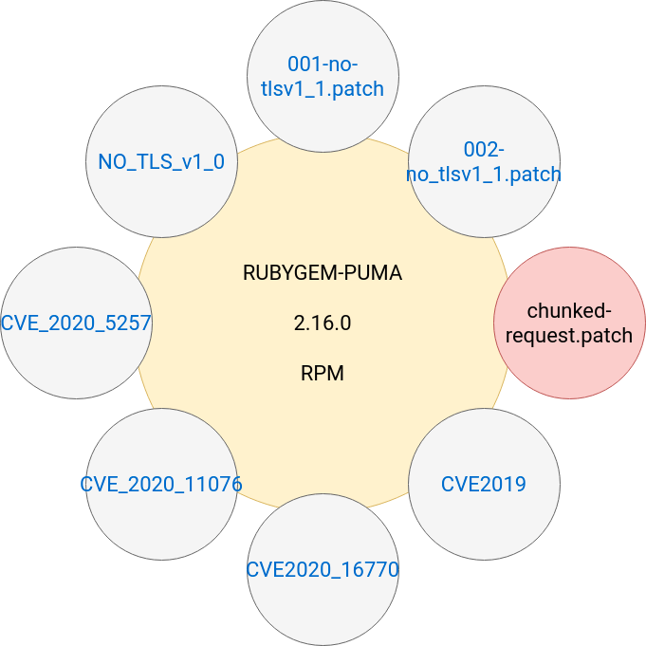
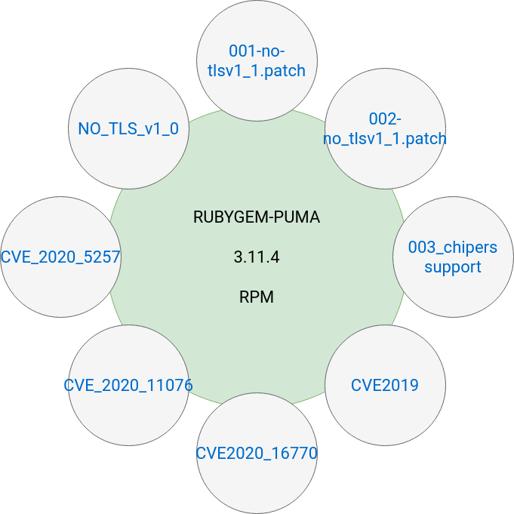
All Patches reworked

Slide 4
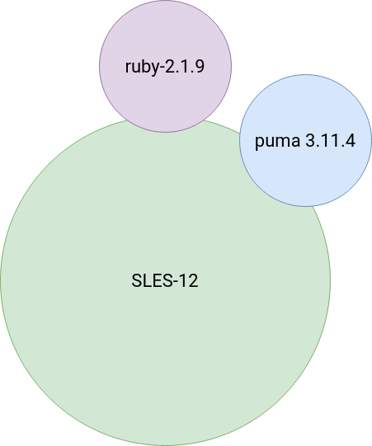
The 3.11.4 version is the latest who support ruby 2.1.9p490

Slide 5
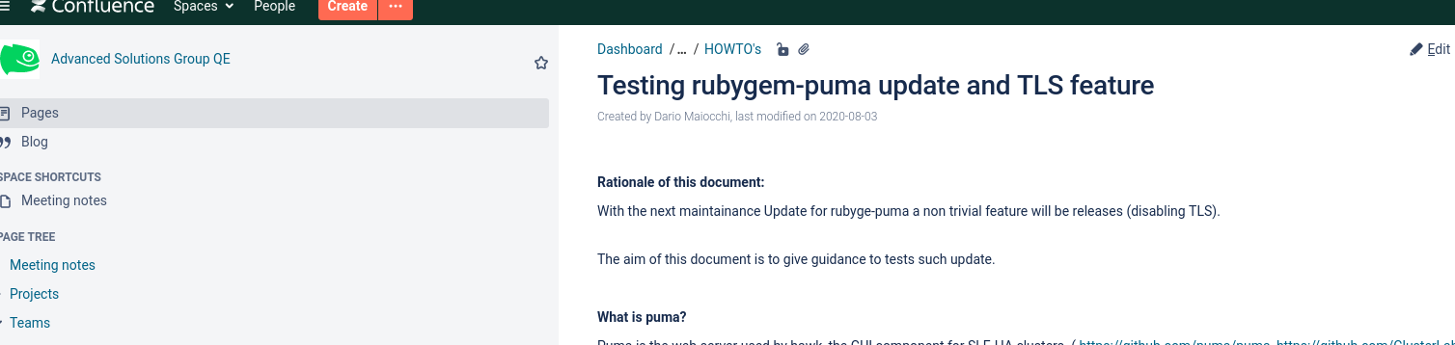
HOW TO TEST the Maintainance UPDATE:
https://confluence.suse.com/display/ASGQE/Testing+rubygem-puma+update+and+TLS+feature

Slide 6
STATUS: not merged in SLES codebase. update sent , under review.

Slide 7
DEMO

