Slide 1
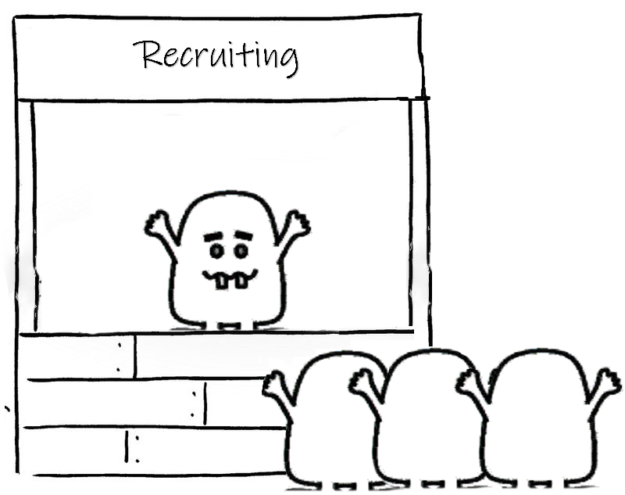
Wombus World – Analysis of NelNet Applicants and Scoring Predictions
Tony Nguyen

Slide 2
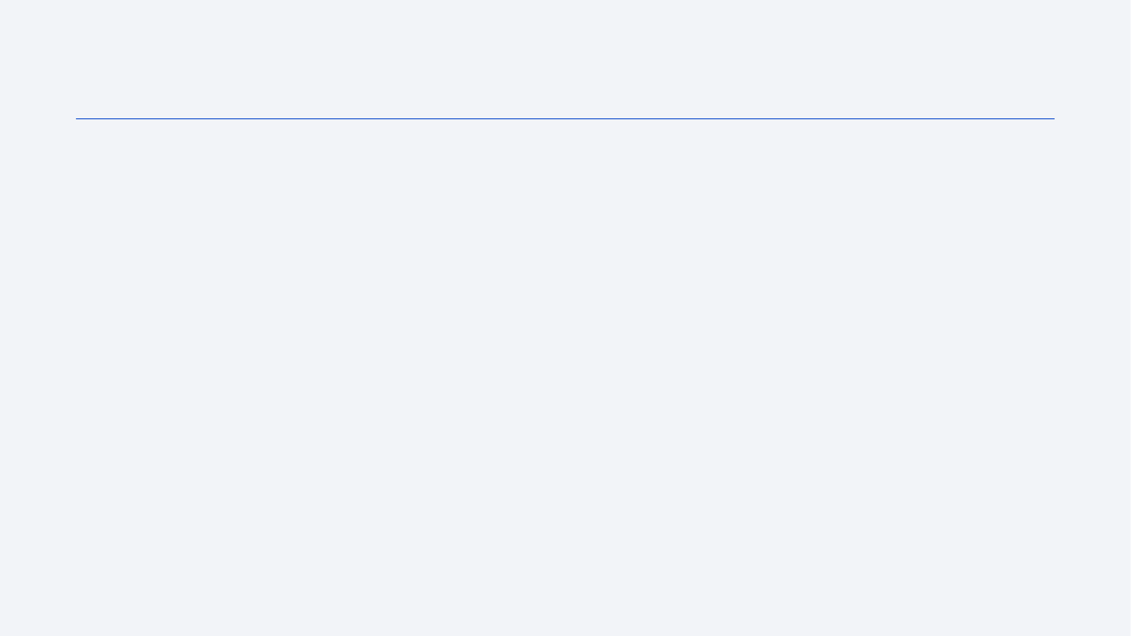
Outline
Introduction and Background
Exploratory Data Analysis
Data Preprocessing
Model Selection using Supervised Learning and Optimization
Performance Measurement
Finalizing the Machine Learning Pipeline
Decision Boundary Analysis
Conclusion

Slide 3
Introduction
Background:
Wumpus has evolved into Wombus, where they are extremely data-oriented and highly intelligent creature that can bypass the accuracy of traditional resumes.
They have sensed a great opportunity at NelNet and flooded their career websites across numerous industries NelNet currently operates in.
Problem Statement:
NelNet’s recruitment team is overwhelmed with Wombus’ applications and cannot process many requests.
They require assistance in the screening process to automate scoring of all applicants that applied for the position.
Constraints:
NelNet only has enough resources to screen 100 candidates
Data loss during transferring process due to some internal problems

Slide 4
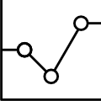
Exploratory Data Analysis

Slide 5
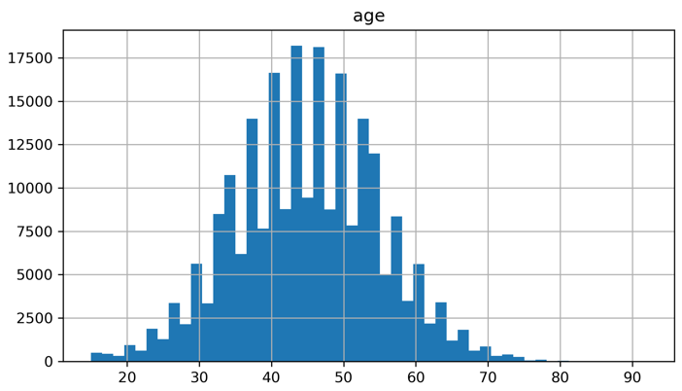
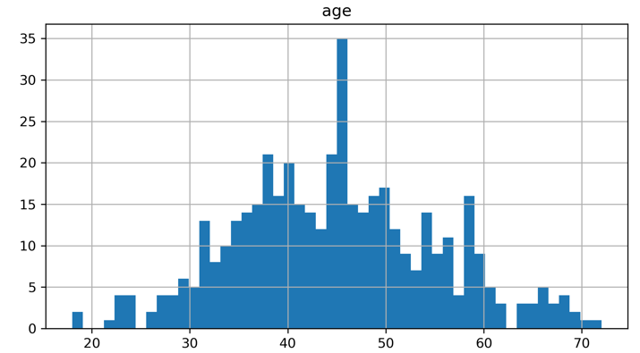
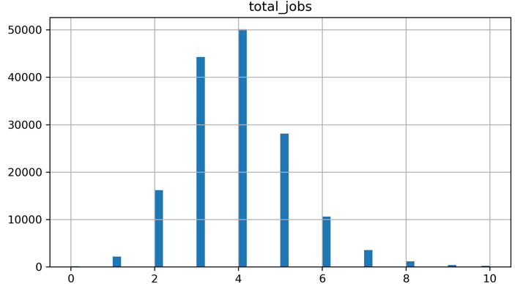
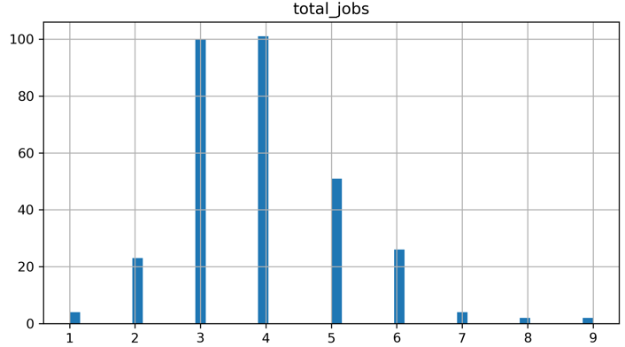
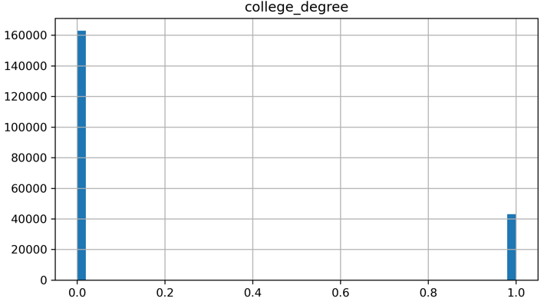
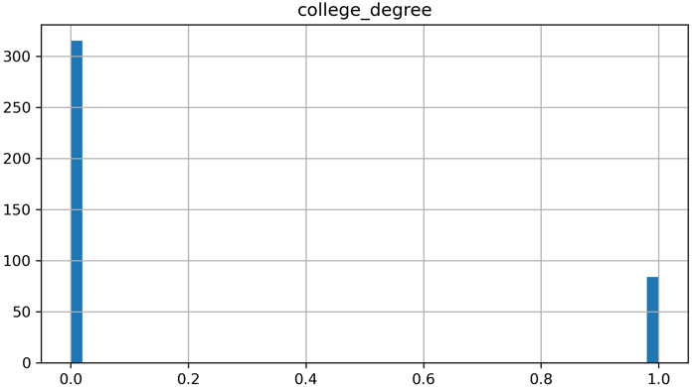
Histogram of Employees’ and Candidates’ profile
Employee
Profile
Candidates
Profile
Notes:
Age and total jobs prior to screening seems normally distributed
More people don’t have college degrees compared to with college degree
Average Age = 45
Average Total jobs = 3-4
~20% of Wombus applicants who applied had college degree, compared to those without college degree 80%.

Slide 6
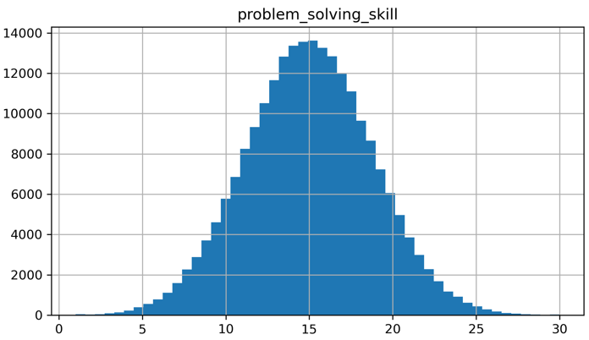
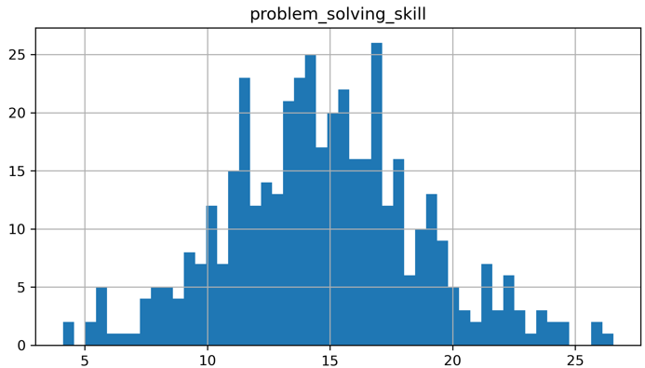
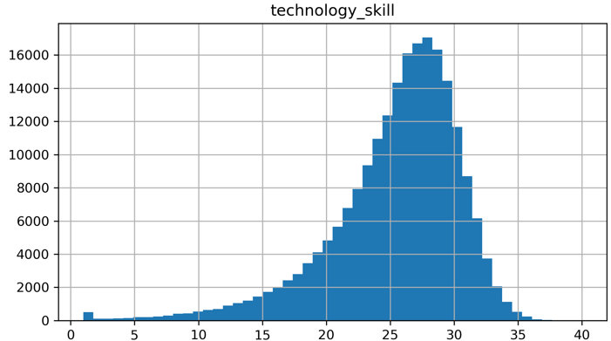
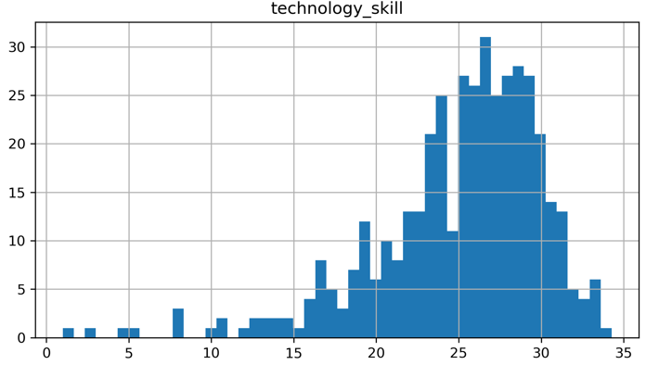
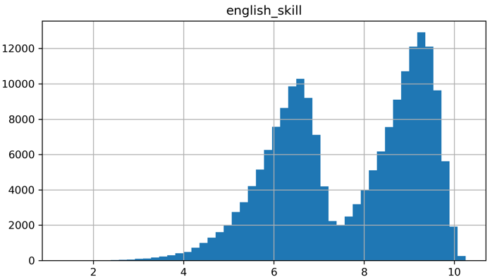
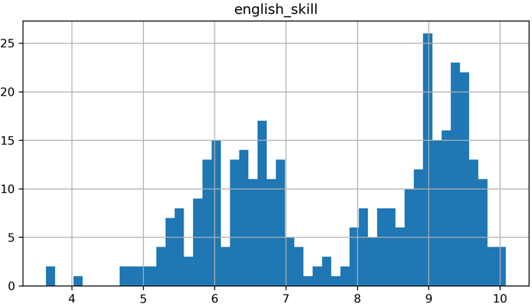
Histogram of Employees’ and Candidates’ skillsets
Employee
Skillsets
Candidates
Skillsets
Notes:
Problems Solving skills have normal distribution – mean average of 14.7
Technology skill has a slightly left skew distribution – mean average of 25.1
English skill is bimodal distribution – one peaks at 6.3 and 8.5

Slide 7
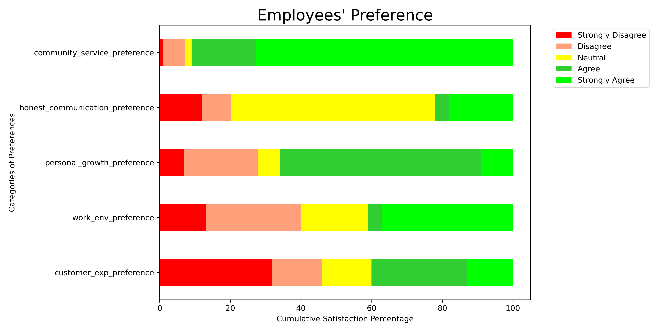
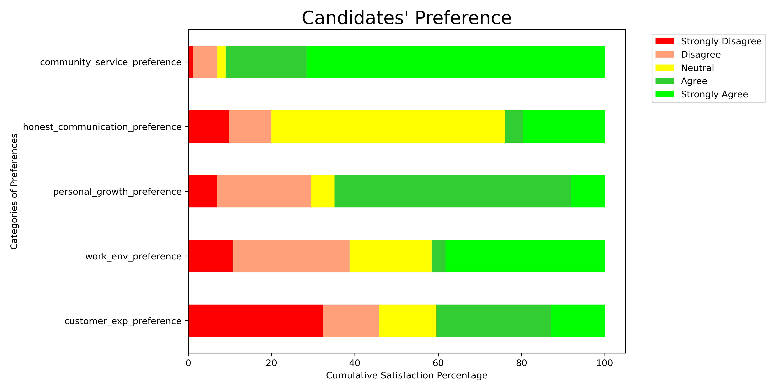
Comparison of Employees’ and Candidates’ preferences
Similar rankings amongst both Employee and Candidate preferences.
‘Strongly Agree’ to providing community services
‘Neutral’ feelings about communicating openly and honestly
‘Agree’ upon the continuation of individual growth

Slide 8
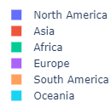



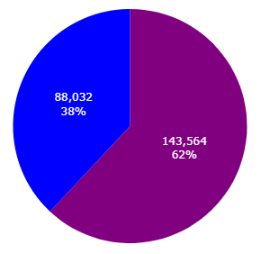
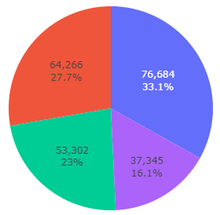
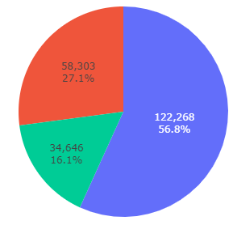
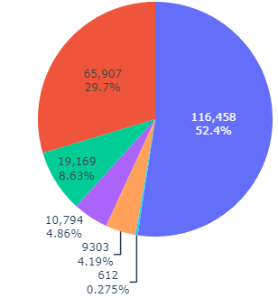
Employee Profiles/Preferences
Company Swag Color
preference
Industry Field
preference
Work Style
preference
Birthplace

Slide 9
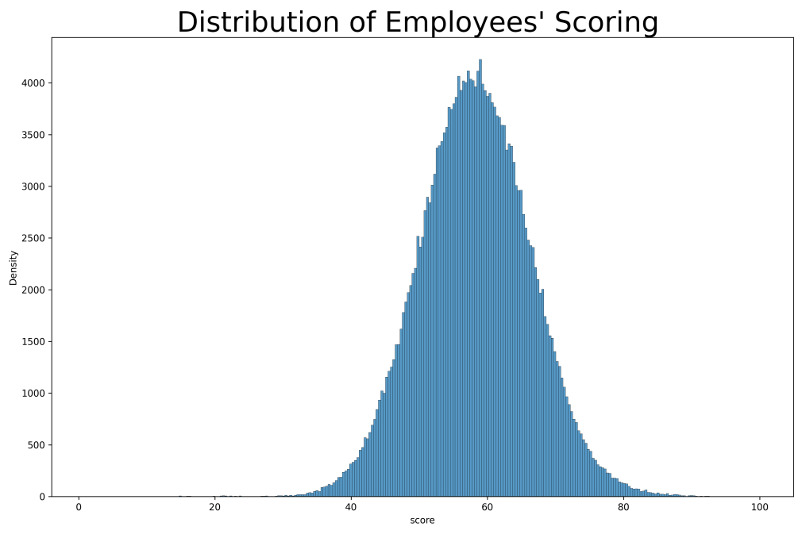
Distribution of our Target Variable: Score
Normal distribution with mean value of 58.2 and median value of 58.15

Slide 10
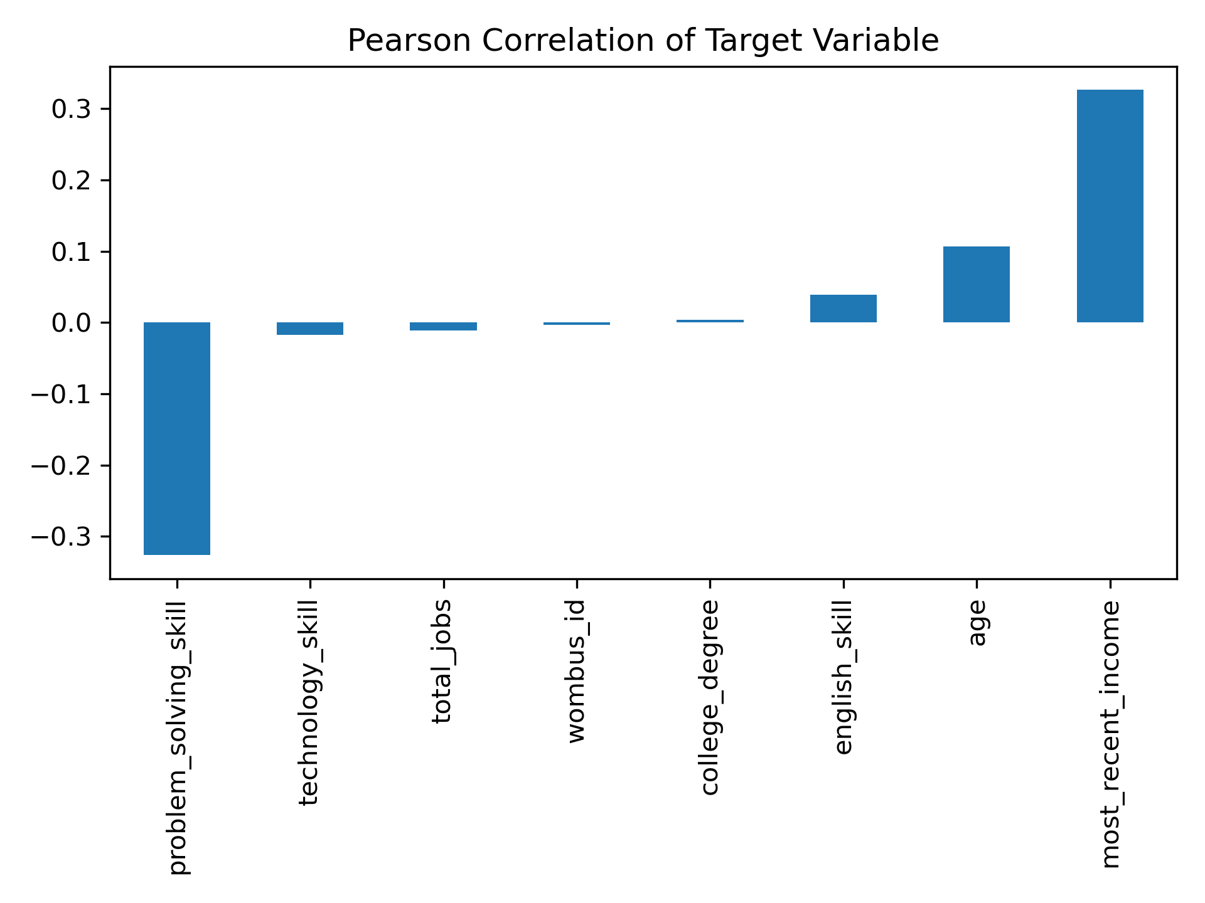
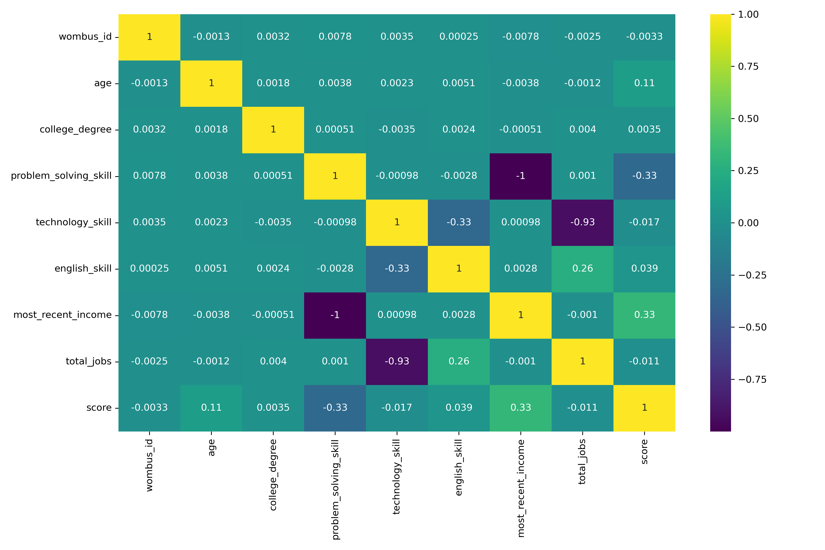
Correlation Matrix
Correlation Matrix of Employees
Notes:
Multicollinearity exists between problem solving skill and most recent income
Problem solving skill, age, and English skill seems very correlated with our target variable

Slide 11
Multicollinearity
The following independent variables were highly correlated with each other:
Problem Solving skill and Most Recent Income
Technology skill and Total Jobs
Using threshold value of 0.6, we removed most recent income and total jobs
After removing, VIF score is normalized and continue to the preprocessing step
Notes:
From the previous slide, we saw that there were several independent features that were highly correlated with one another. This will lead to overfitting, as these features will not help our model prediction because they have the same relationship with the target variable as any other variable. So it’s the best decision to remove it from our model.

Slide 12
Data Preprocessing

Slide 13
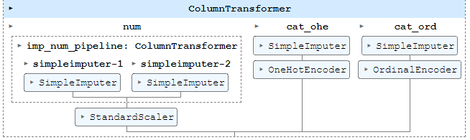
Flowchart of the Supervised Learning for Regression model
Flowchart of the data preprocessing approach
Preprocessing Pipeline using Sklearn pipeline module
Helps us chain our processes together in a ‘container’ and introduce our dataset before our regression model
We split our dataset into the predictor attributes (X) and our target variable (y)
Raw data
Data processing
Cleaned datasets
Feature engineering
ML pipeline

Slide 14
Sklearn Preprocessing Pipeline
Numerical Attributes:
Simple imputed with the following methods:
mean for continuous values
most frequent for binary or integer values
Remaining features gets eliminated:
Multicollinear features
Unique identifiers
StandardScaler to normalize our numeric attribute
Categorical Attributes:
Simple imputed with the following method:
Most frequent for string values
OneHotEncoder:
String values that do not have order
OrdinalEncoder:
String values that do have order (preferences)

Slide 15
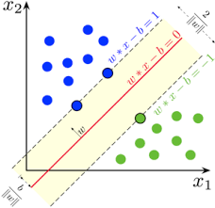
Model Selection using Supervised Learning and Optimization

Slide 16
Model Selection: Compare the performance of K-Fold CV
Random Forest, Gradient Boost, and Extra Tree Regressor seems to perform decently
Best model is the MLP Regressor (NN)
Notes:
Median value of the ‘score’ variable is 58.15

Slide 17
Optimization of the ML algorithm of Interest: MLP Regressor
Grid Search CV was used to further optimize our MLP Regressor algorithm
Best parameter score: RMSE value of 3.71
Best parameter are:
hidden_layers_sizes = 150
activation = relu
solver = adam
batch_size = 128
The inconvenience is that it took 215 minutes total with the combination in the notebook, but the information is worth it when fine tuning our model.
Notes:
Relu = prevents neurons from having weights extremely high and low values
Adam = optimization algorithm for sgd… adaptive learning rate
Batch size controls number of training samples to wrk through for each iterations

Slide 18
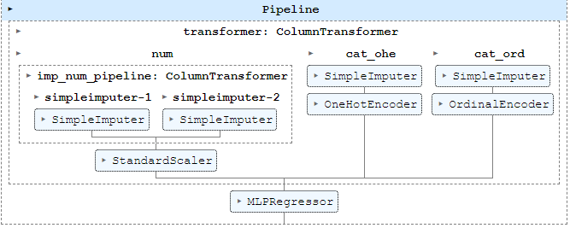
Finalizing our Machine Learning pipeline
Two methods were used to view comparison of our performance metrics:
Imputing missing values with mean and most frequent
R² value of 0.769
dropna() method
R² value of 0.863
Notes:
The R2 value is higher if we dropped null values compared to imputing the null values with their respective mean/freq. That's impressive; unfortunately, we have to remember that our candidates dataset has some data loss, so our pipeline accommodates for the transformation of our X, so all we have to do is pass the data with null values into the pipeline and predict. Since this is a scenario of file corruption, this ML pipeline should be used. And even if the file wasn't corrupted, I'm sure that this pipeline would still yield even higher result because SimpleImputer wouldn't have any NaN values to impute and would continue through the other standardization/normalization/transformation.

Slide 19
Decision Boundary Analysis

Slide 20
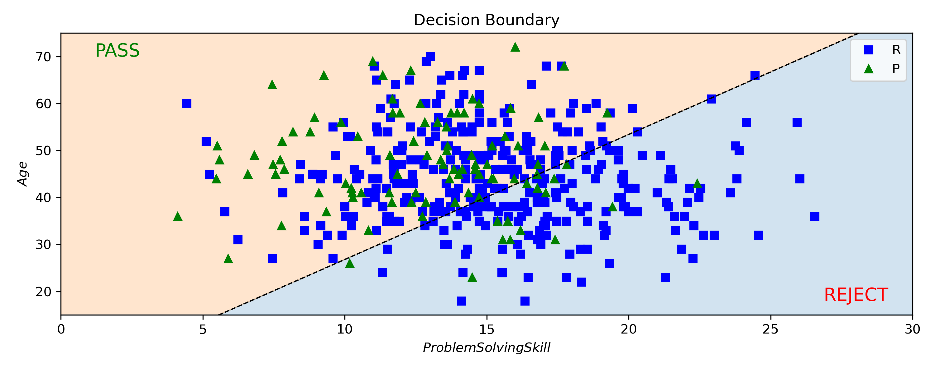
Decision Boundary using Logistic Regression
Determinate factor of the threshold value was based the minimum score value in the top_100_candidates profile
Value set at 64
Problem Solving and Age had fairy decent correlation with ‘Scoring’ set to be 0 for reject candidates and 1 for pass candidates

Slide 21
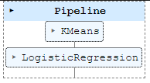
Performance Metrics of Logistic Regression
My initial hypothesis:
If I use K-Means Clustering in conjunct with Logistic Regression, it would improve the accuracy of the model
After performing Grid Search CV, our best parameter were:
K-Means
Number of cluster = 12
Logistic Regression:
Solver = lbfgs
C = 10**10
Result:
Accuracy of 85.5% on test set without K-Means
Accuracy of 84.4% on test set with K-Means
Notes:
C = high value means trust the data a lot as though it’s a representative of the population, low is not representative… don’t listen to it
Lbfgs = Limited Memory Broyden Fletcher Goldfarb Shanno = sotes only last few updates to save memory, default solver

Slide 22
Conclusions
Main drivers of our prediction model were: Age, Problem Solving Skills, and English Skills
Multicollinearity exists, so it’s a good idea to remove total jobs and most recent income for future datasets
MLP Regressor outperformed all other ML algorithm using KFold CV on default parameters
Best parameters after optimization are:
hidden_layers_sizes = 150
activation = relu
solver = adam
batch_size = 128
RMSE value of 3.7
Minimum ‘Score’ value of our top 100 candidates was 64 and was used as our threshold value for our Decision Boundary analysis
Accuracy score of 85.5%

Slide 23
Appendix
Github link:
https://github.com/MallowATN/ml_projects/tree/main/NelNetAsset
Includes more images not shown on presentation
Not all images of the notebook will be shown on github, would have to use Jupyter or VSC

Slide 24
Thanks!

