Slide 1
LLM and ChatGPT: how it works
Dra. Mª Dolores Rodríguez Moreno
Notes:
Large Language MOdels

Slide 2
Objectives
Specific Objectives
Understand how LLM works
Source
Andreas Stöffelbauer (2023): How Large Language Models Work Open AI. GPT-4 (2023) Manish Shivanandhan (2023). Understanding Word Embeddings: The Building Blocks of NLP and GPTs. Vaswani et al. (2017). Attention Is All You Need Minaee et al. (2024). Large Language Models: A Survey

Slide 3
Outline
Artificial Intelligence
Machine Learning
Classification
Language Model
ChatGPT: Generative Pre-trained Transformer
Limitation of Pre-trained models
Hallutination
Prompting
Comparing LLM
Conclusions

Slide 4
Artificial Intelligence (I)
Definition of AI
Build machines that perform tasks that were previously performed by human beings
Alternative definition: Understand and build intelligent entities
Understand: use computers to study intelligence (Science)
Build: solve real problems using knowledge and reasoning (Engineering)
Intelligent entity = agent
AI deals with algorithms and knowledge representation
AI is not restricted to any programming language
Notes:
Performance = rendimiento

Slide 5
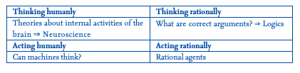
Artificial Intelligence (II)
Two goals: humanity and rationality
Human: like human beings
Rational: doing the right thing
The right thing: what is expected to maximize goal achievement, given the available information
Two dimensions: processes (thinking) and result (acting)
Notes:
Performance = rendimiento

Slide 6
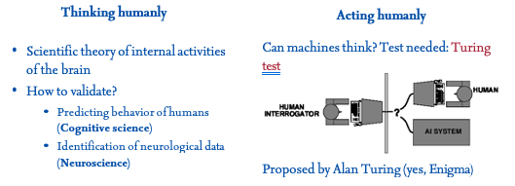
Artificial Intelligence (III)
Notes:
Performance = rendimiento

Slide 7
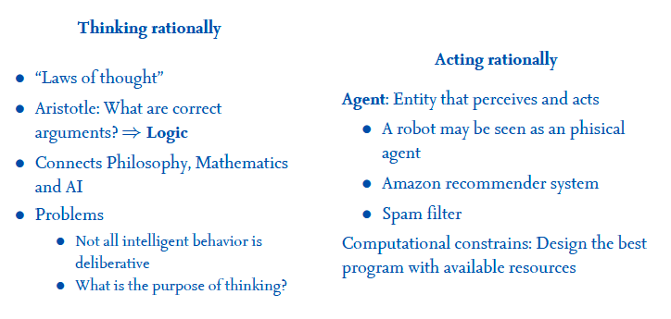
Artificial Intelligence (IV)
Notes:
Performance = rendimiento

Slide 8
Artificial Intelligence (V)
AI: Broadly define intelligent systems, e.g. Autonomous robots
ML: learning patterns from data, e.g. fraud detection
DL: learning with deep neural networks, e.g. voice recognition
Deep Neural Networks: algorithms mimicking the human brain, e.g. facial recognition
LLMs: Understanding & generating natural language, e.g. virtual assistants
Artificial Intelligence (AI)
Machine Learning (ML)
Deep Learning (DL)
Deep NN
LLMs
Notes:
Deep Learning incluye:
Redes Neuronales Profundas (Deep Neural Networks):
Redes neuronales artificiales con múltiples capas ocultas
Incluyen redes feed-forward, convolucionales (CNN), recurrentes (RNN/LSTM), etc.
Otros modelos de aprendizaje profundo:
Autoencoders
Redes Generativas Adversarias (GANs)
Redes de Memoria Asociativa (Memory Networks)
Máquinas de Boltzmann Restringidas (Restricted Boltzmann Machines, RBMs)
Técnicas y algoritmos:
Aprendizaje por Descenso de Gradiente (Gradient-Based Learning)
Regularización (Dropout, Batch Normalization, etc.)
Optimizadores (Adam, RMSProp, etc.)
Inicializaciones de pesos
Aumento de datos (Data Augmentation)

Slide 9
Outline
Artificial Intelligence
Machine Learning
Classification
Language Model
ChatGPT: Generative Pre-trained Transformer
Limitation of Pre-trained models
Hallutination
Prompting
Comparing LLM
Conclusions

Slide 10
Machine Learning (I)
ML definition
ML is the science (and art) of programming computers so they can learn form data A. Géron, 2017
Alternative definitions
Machine Learning is the field of study that gives computers the ability to learn without being explicitly programmed. Arthur Samuel, 1959
A computer program is said to learn from experience E with respect to some task T and some performance measure P, if its performance on T, as measured by P, improves with experience E. Tom Mitchell, 1997
Notes:
Performance = rendimiento

Slide 11
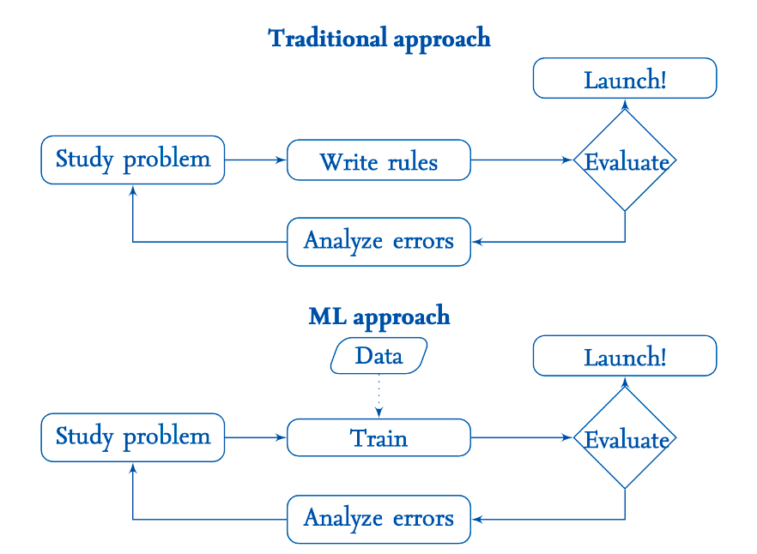
Machine Learning (II)
Notes:
Enfoque Tradicional
Study problem (Estudiar el problema)
Descripción: Comprender a fondo el problema que se necesita resolver.
Ejemplo: Para construir un sistema de detección de fraude, primero se estudia cómo ocurren los fraudes.
Write rules (Escribir reglas)
Descripción: Basado en el estudio del problema, se escriben reglas explícitas para detectar fraudes.
Ejemplo: "Si una transacción es mayor de $10,000 y proviene de un país extranjero, marcarla como sospechosa."
Evaluate (Evaluar)
Descripción: Evaluar la eficacia de las reglas escritas.
Ejemplo: Probar las reglas con datos reales para ver cuántos fraudes detectan y cuántas transacciones legítimas marcan incorrectamente.
Analyze errors (Analizar errores)
Descripción: Analizar los errores cometidos, es decir, los fraudes no detectados y las falsas alarmas.
Ejemplo: Identificar por qué ciertas transacciones fraudulentas no fueron detectadas y ajustar las reglas.
Iterate (Iterar)
Descripción: Volver al inicio para ajustar el estudio del problema y escribir nuevas reglas basadas en los errores analizados.
Ejemplo: Mejorar las reglas para reducir los errores y aumentar la precisión.
Enfoque de Aprendizaje Automático (ML)
Study problem (Estudiar el problema)
Descripción: Similar al enfoque tradicional, se comienza por comprender el problema.
Ejemplo: Estudiar cómo ocurren los fraudes.
Train (Entrenar)
Descripción: Utilizar datos (etiquetados con ejemplos de fraudes y transacciones legítimas) para entrenar un modelo de aprendizaje automático.
Ejemplo: Alimentar un algoritmo de aprendizaje con un conjunto de datos históricos de transacciones para que aprenda a detectar patrones de fraude.
Evaluate (Evaluar)
Descripción: Evaluar el modelo entrenado con un conjunto de datos de prueba.
Ejemplo: Probar el modelo con datos que no ha visto antes para medir su precisión.
Analyze errors (Analizar errores)
Descripción: Analizar los errores del modelo, es decir, los fraudes no detectados y las falsas alarmas.
Ejemplo: Identificar por qué el modelo falló en detectar ciertas transacciones fraudulentas.
Iterate (Iterar)
Descripción: Ajustar el modelo basándose en el análisis de errores y volver a entrenarlo.
Ejemplo: Modificar el modelo o añadir más datos de entrenamiento para mejorar su precisión.
Diferencias Clave
Reglas vs. Modelos: En el enfoque tradicional, se escriben reglas explícitas; en el enfoque ML, se entrena un modelo basado en datos.
Iteración: Ambos enfoques son iterativos, pero en ML, el proceso de ajuste y reentrenamiento del modelo puede ser más automatizado.
Datos: El enfoque ML depende en gran medida de la disponibilidad y calidad de los datos para entrenar modelos efectivos.

Slide 12
Machine Learning (III)
 | Classical | ML
Objetive | Algoritm | Trainning
Mantlity | Engineer | Experimental Scientist
Tools | Programming | Mathematics/Algorithms
Type of problems | Automate tasks | Identify patterns
Methodology | Waterfall | Iterative

Slide 13
Machine Learning: Tasks
Classification: assigning a category or label to input data
Example: classifying the type of music
Regression: predicting a continuous numerical value from input data
Example: predicting housing prices based on features like size, location, etc.
Clustering: grouping similar data points together without labeled categories
Example: grouping customers based on their purchasing behavior for targeted marketing
Anomaly Detection: identifying unusual data points that deviate from the norm
Example: detecting credit card fraud
…
Notes:
Performance = rendimiento

Slide 14
Outline
Artificial Intelligence
Machine Learning
Classification
Language Model
ChatGPT: Generative Pre-trained Transformer
Limitation of Pre-trained models
Hallutination
Prompting
Comparing LLM
Conclusions

Slide 15
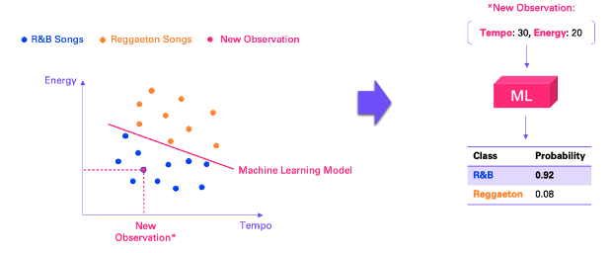
Classification: Predicting Music Genre
Credits: Andreas Stöffelbauer
Classifying music genres based on tempo and energy using ML model
R&B songs and Reggaeton songs are classified based on their tempo and energy levels
Notes:
Suppose we have 20 songs. We know each song’s tempo and energy, two metrics that can be simply measured or computed for any song. In addition, we’ve labeled them with a genre, either reggaeton or R&B. When we visualize the data, we can see that high energy, high tempo songs are primarily reggaeton while lower tempo, lower energy songs are mostly R&B, which makes sense.
However, we want to avoid having to label the genre by hand all the time because it’s time consuming and not scalable. Instead, we can learn the relationship between the song metrics (tempo, energy) and genre and then make predictions using only the readily available metrics.
In Machine Learning terms, we say that this is a classification problem, because the outcome variable (the genre) can only take on one of a fixed set of classes/labels — here reggaeton and R&B. This is in contrast to a regression problem, where the outcome is a continuous value (e.g., a temperature or a distance).
We can now “train” a Machine Learning model (or “classifier”) using our labeled dataset, i.e., using a set of songs for which we do know the genre. Visually speaking, what the training of the model does here is that it finds the line that best separates the two classes.
Therefore, we can often also make a statement on how confident we are that a prediction is correct based on the distance from the line. For example, for our new low-energy, low-tempo song we might be 98 percent certain that this is an R&B song, with a two percent likelihood that it’s actually reggaeton.

Slide 16
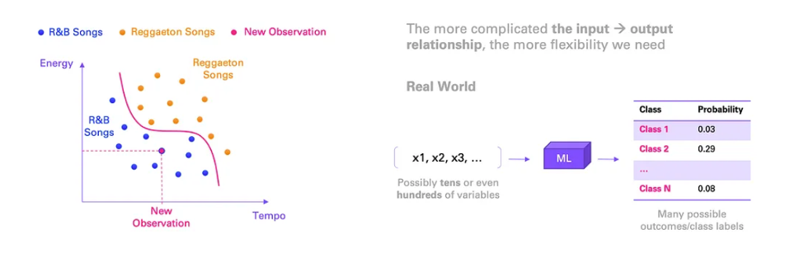
Non-Linear in Classification
Credits: Andreas Stöffelbauer
Handling it is more complex
The more complex the relationship between input and output, the more flexible the model needs to be
Notes:
What I mainly want you to take away is this: The more complex the relationship between input and output, the more complex and powerful is the Machine Learning model we need in order to learn that relationship. Usually, the complexity increases with the number of inputs and the number of classes.

Slide 17
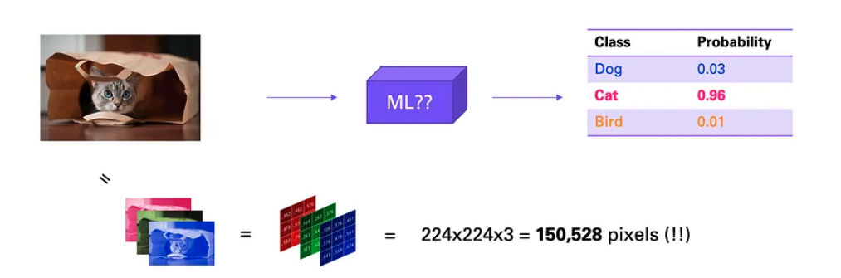
Image Classification
Credits: Andreas Stöffelbauer
Identify if an image is a cat, dog, or bird
Can only compute numeric inputs → image are a set of pixels
Height, width and colour (red, green, blue)
a small, low-quality 224x224 image consists of more than 150,000 pixels (224x224x3)
Complex relationship between raw pixels and class label
Notes:
Fortunately, images are just numeric inputs too as they consist of pixels. They have a height, a width, and three channels (red, green, and blue). So in theory, we could directly feed the pixels into a Machine Learning model (ignore for now that there is a spatial element here, which we haven’t dealt with before).
However, now we are facing two problems. First, even a small, low-quality 224x224 image consists of more than 150,000 pixels (224x224x3). Remember, we were speaking about a maximum of hundreds of input variables (rarely more than a thousand), but now we suddenly have at least 150,000.
Second, if you think about the relationship between the raw pixels and the class label, it’s incredibly complex, at least from an ML perspective that is. Our human brains have the amazing ability to generally distinguish among tigers, foxes, and cats quite easily. However, if you saw the 150,000 pixels one by one, you would have no idea what the image contains. But this is exactly how a Machine Learning model sees them, so it needs to learn from scratch the mapping or relationship between those raw pixels and the image label, which is not a trivial task.

Slide 18
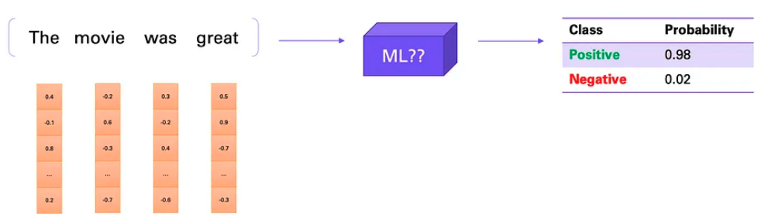
Text Classification
Credits: Andreas Stöffelbauer
Relationship between a sentence and its sentiment (e.g., positive or negative)
Numeric inputs → Word embedding (convert words into numerical vectors)
Words that often appear together in same context → have similar or ‘closer’ vectors
Notes:
To summarize, what to take away from here is that we can take a sentence and turn it into a sequence of numeric inputs, i.e., the word embeddings, which contain semantic and syntactic meaning. This can then be fed into a Machine Learning model.

Slide 19
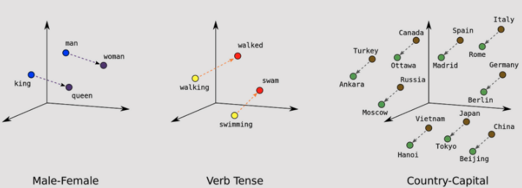
Word Embeddings
Credits: Manish Shivanandhan
Traditional language models treated words as isolated entities
Capture the semantic essence of words and also encode relationships
Place words with similar meaning or contexts close to each other. E.g.
GloVe (Stanford): generated numerical vectors for individual words
Fastext (Facebook): capture the intricacies of languages that have complex word structures
Notes:
Traditional language models treated words as separate, isolated entities.
For instance, the word “dog” might be represented as a unique identifier, say 1, while the word "cat" as 2. This approach fails to capture the relationship between "dog" and "cat," which are both animals and pets.
The main benefit of word embeddings is their ability to capture the semantic essence of words. In simpler terms, they help machines understand the meaning and nuances behind each word.
For example, if “apple” is close to “fruit” in this numerical space but far from “car,” the machine understands that an apple is more related to fruits than to vehicles.
Beyond individual meaning, word embeddings also encode relationships between words. Words that often appear together in the same context will have similar or ‘closer’ vectors.
For example, in the numerical space, the vectors representing “king” and “queen” might be closer to each other than those representing “king” and “apple.” This is because the algorithm has learned from numerous texts that “king” and “queen” often appear in similar settings, such as discussions about royalty, while “king” and “apple” do not.
GloVe (Global Vectors for Word Representation)
Stanford researchers developed GloVe, which constructs a large table to monitor the frequency with which words co-occur in a text dataset. The model then employs mathematical methods to simplify this table, generating numerical vectors for individual words.
These vectors encapsulate both the meaning and the relationships among words, laying the groundwork for various machine-learning tasks related to language.
FastText
Facebook’s AI Research lab created FastText, which improves upon the Word2Vec model by viewing words as assemblies of smaller character strings, or character n-grams.
This method enables the model to more effectively capture the intricacies of languages that have complex word structures and to incorporate words not present in the original training data. Consequently, FastText yields a more adaptable and comprehensive language model useful for a diverse set of machine-learning tasks.

Slide 20
Outline
Artificial Intelligence
Machine Learning
Classification
Language Model
ChatGPT: Generative Pre-trained Transformer
Limitation of Pre-trained models
Hallutination
Prompting
Comparing LLM
Conclusions

Slide 21
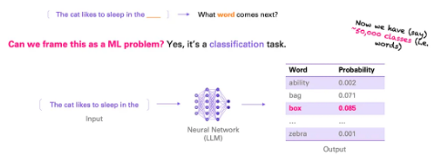
Language Modeling
Credits: Andreas Stöffelbauer
Predicting the next word in a sequence, is framed as a classification task
Number of inputs/outputs is very large → Neuronal Networks (NN)
NN often have many layers (Deep Learning)
Notes:
In other words, we simply want to learn how to predict the next word at any time.
the input to the neural network is a sequence of words, but now, the outcome is simply the next word. Again, this is just a classification task. The only difference is that instead of only two or a few classes, we now have as many classes as there are words — let’s say around 50,000. This is what language modeling is about — learning to predict the next word.

Slide 22
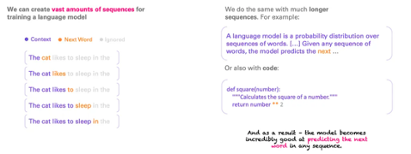
Massive Training Data
Credits: Andreas Stöffelbauer
Creating vast amounts of sequences for training a language model: from books, research papers, internet…
No need to label data, next word itself is the label → self-supervised learning
Any language!
Notes:
We know the task, and now we need data to train the neural network. It’s actually not difficult to create a lot of data for our “next word prediction” task. There’s an abundance of text on the internet, in books, in research papers, and more. And we can easily create a massive dataset from all of this. We don’t even need to label the data, because the next word itself is the label, that’s why this is also called self-supervised learning.
The image above shows how this is done. Just a single sequence can be turned into multiple sequences for training. And we have lots of such sequences. Importantly, we do this for many short and long sequences (some up to thousands of words) so that in every context we learn what the next word should be.
To summarize, all we are doing here is to train a neural network (the LLM) to predict the next word in a given sequence of words, no matter if that sequence is long or short, in German or in English or in any other language, whether it’s a tweet or a mathematical formula, a poem or a snippet of code. All of those are sequences that we will find in the training data.

Slide 23
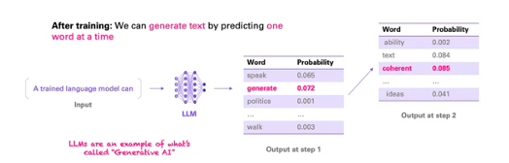
Natural Language Generation
Generating text by predicting one word at a time or also sample from 5 most likely words → you don´t get the same answer a response is generated
LLMs perform natural language generation as an example of Generative AI
Notes:
Now that we can predict one word, we can feed the extended sequence back into the LLM and predict another word, and so on. In other words, using our trained LLM, we can now generate text, not just a single word. This is why LLMs are an example of what we call Generative AI. We have just taught the LLM to speak, so to say, one word at a time.
There’s one more detail to this that I think is important to understand. We don’t necessarily always have to predict the most likely word. We can instead sample from, say, the five most likely words at a given time. As a result, we may get some more creativity from the LLM. Some LLMs actually allow you to choose how deterministic or creative you want the output to be. This is also why in ChatGPT, which uses such a sampling strategy, you typically do not get the same answer when you regenerate a response.

Slide 24
Outline
Artificial Intelligence
Machine Learning
Classification
Language Model
ChatGPT: Generative Pre-trained Transformer
Limitation of Pre-trained models
Hallutination
Prompting
Comparing LLM
Conclusions

Slide 25
What is ChatGPT?
ChatGPT is an AI language model developed by OpenAI
It uses deep learning techniques to understand and generate human-like text
Built on the GPT-4 architecture, it can perform a wide range of natural language tasks

Slide 26
GPT: Generative Pre-trained Transformer
Generative means next word prediction
Pre-trained on massive amount of text
In traditional models each word (Word embeddings) is converted into a fixed vector in a pre-defined space
GPT utilizes "transformer embeddings” (TE) that consider the word and the surrounding context
TE are based on the Attention Model mechanism in NN (Vaswani et al. 2017)
It allows GPT to decipher words with multiple meanings, like "bank" (financial vs. river).
The resulting embeddings capture not just the word, but its connection to the whole sentence
Notes:
In the first sentence, "bank" refers to a financial institution. In the second sentence, it refers to the side of a river.
Word embeddings (REPRESENTACIONES VECTORIALES DE PALABRAS o EMBEBIDOS DE PALABRAS) are a foundational component in GPT models like GPT-2, GPT-3, and GPT-4. However, the architecture and approach are a bit more advanced compared to simpler models that solely rely on word embeddings. In traditional models that use word embeddings like Word2Vec or GloVe, each word is converted into a fixed vector in a pre-defined space. These vectors are then used as the input to other machine learning algorithms for tasks like classification, clustering, or even in sequence-to-sequence models for machine translation. In contrast, GPT models use a variant known as “transformer embeddings,” which not only embeds individual words but also considers the context in which a word appears. This is essential for understanding the meaning of words that can change based on their surrounding words. For example, the word “bank” could mean a financial institution or the side of a river, depending on the context. The GPT architecture takes a sequence of words (or more precisely, tokens) as input and processes them through multiple layers of transformer blocks. These blocks output a new sequence of vectors that represent not just the individual words, but also their relationships with all other words in the input sequence. This sequence is then used for NLP tasks, from text completion to translation and summarization. So, while GPT models do use embeddings, they are far more dynamic and context-aware than traditional word embeddings. The embeddings in GPT models are part of a larger, more complex system designed to understand and generate human-like text based on the input it receives.

Slide 27
Outline
Artificial Intelligence
Machine Learning
Classification
Language Model
ChatGPT: Generative Pre-trained Transformer
Limitation of Pre-trained models
Hallutination
Prompting
Comparing LLM
Conclusions

Slide 28
Limitations of Pre-trained models (I)
They are better at continuing text sequences, but struggle with instructions and questions
They may not understand your true intentions or how to fulfill them
Instruction Fine-tuning:
Train the model using high-quality instruction-response pairs
Focus: unlearns "text completion" and teaches the model to follow instructions
Data: requires smaller, more expensive human-sourced instruction data
Reinforcement Learning from Human Feedback (RLHF) (Optional)
Similar Goal: further improves alignment with human values and preferences
Research: combining RL and language modeling shows potential for significant advancements over the actual LLMs
Notes:
The first stage is pre-training, which is exactly what we’ve gone through just now. This stage requires massive amounts of data to learn to predict the next word. In that phase, the model learns not only to master the grammar and syntax of language, but it also acquires a great deal of knowledge about the world, and even some other emerging abilities that we will speak about later. But now I have a couple of questions for you: First, what might be the problem with this kind of pre-training? Well, there are certainly a few, but the one I am trying to point to here has to do with what the LLM has really learned. Namely, it has learned mainly to ramble on about a topic. It may even be doing an incredibly good job, but what it doesn’t do is respond well to the kind of inputs you would generally want to give an AI, such as a question or an instruction. The problem is that this model has not learned to be, and so is not behaving as, an assistant. For example, if you ask a pre-trained LLM “What is your fist name?” it may respond with “What is your last name?” simply because this is the kind of data it has seen during pre-training, as in many empty forms, for example. It’s only trying to complete the input sequence. It doesn’t do well with following instructions simply because this kind of language structure, i.e., instruction followed by a response, is not very commonly seen in the training data. Maybe Quora or StackOverflow would be the closest representation of this sort of structure. At this stage, we say that the LLM is not aligned with human intentions. Alignment is an important topic for LLMs, and we’ll learn how we can fix this to a large extent, because as it turns out, those pre-trained LLMs are actually quite steerable. So even though initially they don’t respond well to instructions, they can be taught to do so. Instruction fine-tuning and RLHF This is where instruction tuning comes in. We take the pre-trained LLM with its current abilities and do essentially what we did before — i.e., learn to predict one word at a time — but now we do this using only high-quality instruction and response pairs as our training data. That way, the model un-learns to simply be a text completer and learns to become a helpful assistant that follows instructions and responds in a way that is aligned with the user’s intention. The size of this instruction dataset is typically a lot smaller than the pre-training set. This is because the high-quality instruction-response pairs are much more expensive to create as they are typically sourced from humans. This is very different from the inexpensive self-supervised labels we used in pre-training. This is why this stage is also called supervised instruction fine-tuning. There is also a third stage that some LLMs like ChatGPT go through, which is reinforcement learning from human feedback (RLHF). We won’t go into details here, but the purpose is similar to instruction fine-tuning. RLHF also helps alignment and ensures that the LLM’s output reflects human values and preferences. There is some early research that indicates that this stage is critical for reaching or surpassing human-level performance. In fact, combining the fields of reinforcement learning and language modeling is being shown to be especially promising and is likely to lead to some massive improvements over the LLMs we currently have.

Slide 29
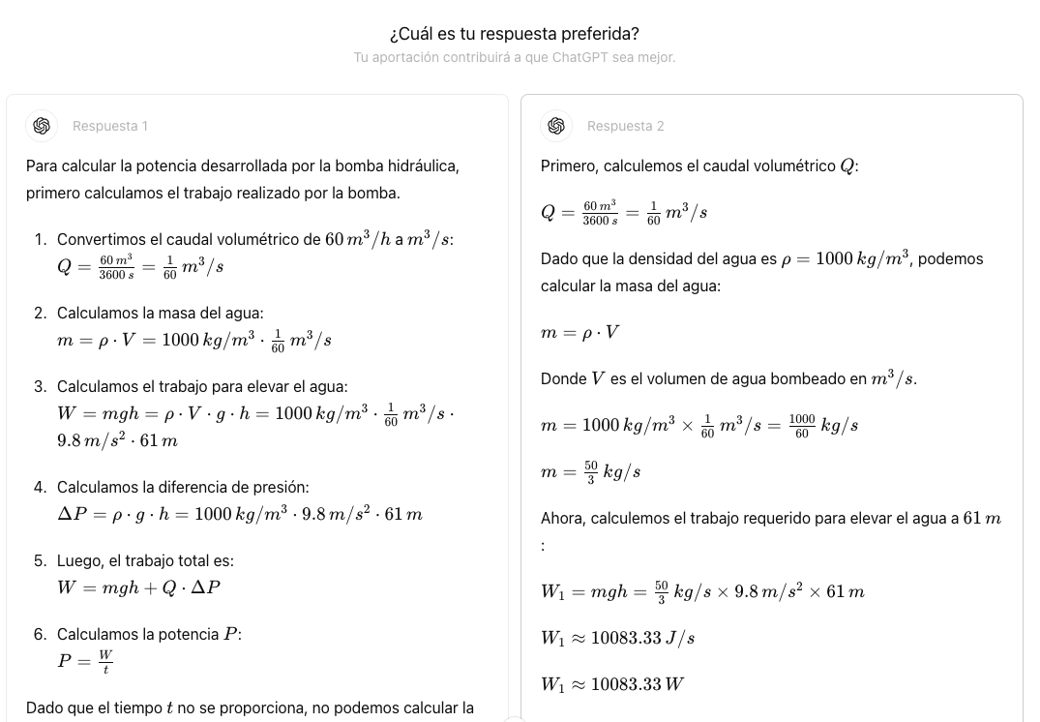
Example of RLHF

Slide 30
Limitations of Pre-trained models (II)
Question | Answer
Can an LLM perform Text Summarization? | Yes e.g. research journals have abstract and extent content (pre-training)
Can an LLM perform Question Answering? | Yes, fine-tuning. E.g. You are always right!
Is the information true? | No, it may answer wrong or even make stuff up
Is it deterministic in the answers? | No, it uses a sample mechanism (“n” most likely words), each answer may be different
Notes:
- First, why can an LLM perform summarization of a longer piece of text? (If you didn’t already know, it does a really great job. Just paste in a document and ask it to summarize it.)
To understand why, we need to think about the training data. As it so happens, people often make summarizations — on the internet, in research papers, books, and more. As a result, an LLM trained on that data learns how to do that too. It learns to attend to the main points and compress them into a short text. Note that when a summary is generated, the full text is part of the input sequence of the LLM. This is similar to, say, a research paper that has a conclusion while the full text appears just before.
- As mentioned, the ability to act as an assistant and respond appropriately is due to instruction fine-tuning and RLHF. But all (or most of) the knowledge to answer questions itself was already acquired during pre-training.
Of course, that now raises another big question: What if the LLM doesn’t know the answer? Unfortunately, it may just make one up in that case. To understand why, we need to think about the training data again, and the training objective.
- We don’t necessarily always have to predict the most likely word. We can instead sample from, say, the five most likely words at a given time. As a result, we may get some more creativity from the LLM. Some LLMs actually allow you to choose how deterministic or creative you want the output to be. This is also why in ChatGPT, which uses such a sampling strategy, you typically do not get the same answer when you regenerate a response.

Slide 31
Outline
Artificial Intelligence
Machine Learning
Classification
Language Model
ChatGPT: Generative Pre-trained Transformer
Limitation of Pre-trained models
Hallutination
Prompting
Comparing LLM
Conclusions

Slide 32
Hallucination
Problem
LLMs are designed to create human-like text, but not necessarily factual
The model lack an intrinsic mechanism to verify the truthfulness of the generated info
Idea
We should anchor them in real-world information to prevent inaccuracies
We possess the knowledge to address and rectify this issue
Solution
Incorporate accurate knowledge into the context to enhance its reliability
Develop and integrate validation mechanisms that cross-check the information against trusted DB
Update the training data with current, verified information to ensure the LLM remains accurate
Notes:
Problem:
LLMs are designed to produce text that appears human-like; however, they are not inherently equipped to generate text that is factually accurate.
These models lack an intrinsic mechanism to verify the truthfulness of the information they generate.
Idea:
It is imperative to anchor these models in real-world data to prevent them from fabricating information; thus, grounding them can mitigate inaccuracies.
In reality, we possess the requisite knowledge to address and rectify this issue comprehensively.
Solution:
Incorporate pertinent and accurate knowledge directly into the context provided to the LLM to enhance its reliability.
Develop and integrate validation mechanisms that cross-check the information generated by LLMs against trusted databases and sources.
Continuously update the training data with current, verified information to ensure the LLM remains accurate over time.

Slide 33
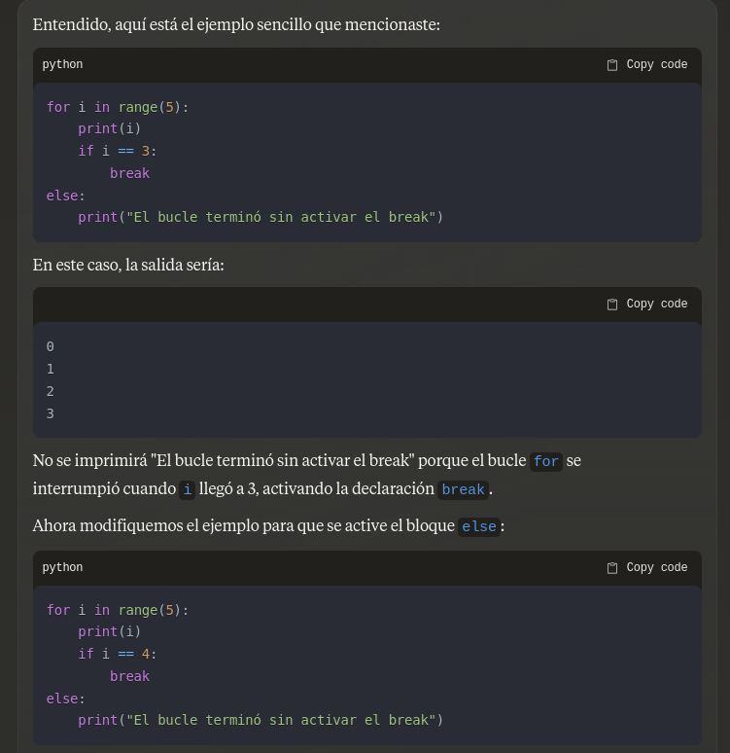
Example of Hallucination

Slide 34
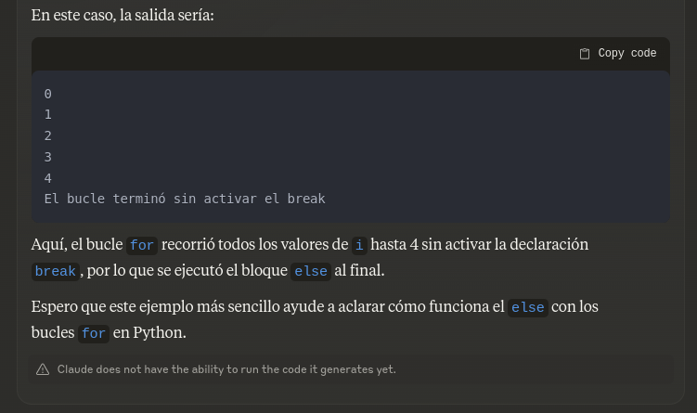
Example of Hallucination

Slide 35
Avoid Hallucinations
Understanding how to effectively interact with AI models is crucial
One key element in maximizing the utility of these models is the art of prompting
Prompting refers to the way users formulate their questions or instructions when communicating with AI models
It involves crafting precise and clear inputs to guide the AI in generating accurate, relevant, and useful responses.

Slide 36
Outline
Artificial Intelligence
Machine Learning
Classification
Language Model
ChatGPT: Generative Pre-trained Transformer
Limitation of Pre-trained models
Hallutination
Prompting
Comparing LLM
Conclusions

Slide 37
Zero-Shot Prompting
Definition
Capability of a LM to perform a task without being explicitly trained on examples
The model relies on its general understanding of language and knowledge acquired during pre-training to generate appropriate responses
Explanation
The model leverages its broad knowledge base to infer the correct output for a given task
The model can handle new tasks by interpreting the on its pre-existing knowledge
The success often depends on how well the task is described in the prompt
Notes:
Definition: Zero-shot prompting refers to the capability of a language model to perform a task without having been explicitly trained on specific examples of that task. Instead, the model relies on its general understanding of language and knowledge acquired during pre-training to generate appropriate responses.
Explanation:
General Understanding: The model leverages its broad knowledge base, acquired from extensive pre-training on diverse text, to infer the correct behavior or output for a given task.
No Task-Specific Examples: Unlike traditional training approaches, zero-shot prompting does not require task-specific training examples. The model can handle new tasks by interpreting the prompt or query based on its pre-existing knowledge.
Prompting Technique: The success of zero-shot prompting often depends on how well the task is described in the prompt. Clear, detailed prompts can significantly improve the model’s performance in zero-shot scenarios.
Example:
Suppose we want the model to translate a sentence from English to French without having seen explicit examples of English-to-French translation during fine-tuning.
Prompt: "Translate the following sentence to French: 'The weather is nice today.'"
Model Output: "Le temps est agréable aujourd'hui."
In this example, the model correctly translates the sentence even though it was not specifically trained on English-to-French translation tasks. This demonstrates the model's ability to generalize and apply its knowledge to new tasks through zero-shot prompting.
Advantages:
Flexibility: Zero-shot prompting allows models to handle a wide variety of tasks without needing separate training for each task.
Efficiency: Saves time and resources by eliminating the need for task-specific data collection and training.
Versatility: Enhances the model's utility in real-world applications where new and unforeseen tasks frequently arise.
Limitations:
Accuracy: The performance might not be as high as models trained specifically on the task, especially for complex or highly specialized tasks.
Prompt Sensitivity: The effectiveness of zero-shot prompting can be highly sensitive to the wording and structure of the prompt provided.

Slide 38
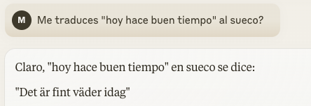
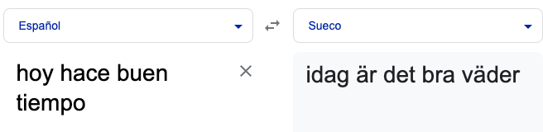
Example
Notes:
PARECE que según un nativo, la primera opción es más correcta, porque “fint” hace más referencia lo bonito del tiempo, mientras que la 2º se refiere a bueno, que es menor correcto.

Slide 39
Few-Shot Learning Prompting
Capability of a LM to perform a new task using small number of examples
Explanation
LM understand and generalize from few examples, making it highly efficient for tasks with limited data
The model adapts to new tasks by incorporating the limited examples provided, refining its predictions based on these specific instances
The quality and relevance of the examples are crucial
Well-chosen examples can significantly improve the model's performance
Notes:
Definition: Few-shot learning refers to the ability of a model to learn and perform a new task using only a small number of training examples. This approach contrasts with traditional machine learning methods, which typically require large datasets to achieve high performance.
Explanation:
Minimal Examples: Few-shot learning allows models to understand and generalize from a few examples, making it highly efficient for tasks with limited data.
Task-Specific Adaptation: The model adapts to new tasks by incorporating the limited examples provided, refining its predictions based on these specific instances.
Prompting Technique: In few-shot learning, the quality and relevance of the examples used in the prompt are crucial. Well-chosen examples can significantly improve the model's performance.

Slide 40
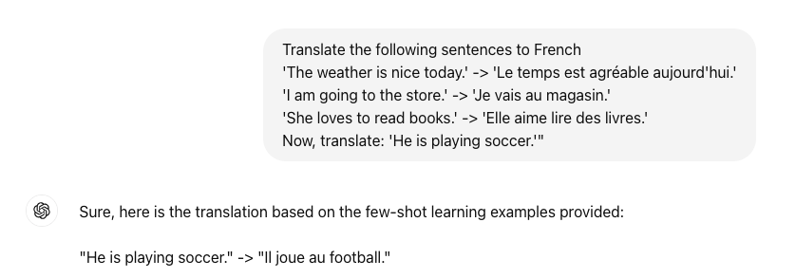
Example
Notes:
In this example, the model correctly translates the sentence "He is playing soccer." into French, leveraging the few examples provided in the prompt.
Advantages:
Data Efficiency: Requires significantly fewer training examples, making it ideal for tasks with limited labeled data.
Versatility: Enhances the model's ability to generalize across different tasks by learning from minimal examples.
Rapid Adaptation: Enables quick adaptation to new tasks without the need for extensive retraining.
Limitations:
Performance Variability: The model's performance can vary depending on the quality and representativeness of the few examples provided.
Prompt Sensitivity: The success of few-shot learning is sensitive to how examples are presented and how closely they match the new task.
Use Cases:
Language Translation: Translating text between languages with limited examples
Text Classification: Categorizing text into different classes using minimal labeled examples
Image Recognition: Identifying objects or features in images with only a few labeled samples

Slide 41
Step-by-Step Prompting
Technically “Chain-of-Thought Prompting”
It gives the model a “working memory” as humans
Involves guiding a model through complex tasks by breaking them down into simpler, sequential steps
Purpose: enhances the model’s ability to reason and solve problems by providing it with a structured approach

Slide 42
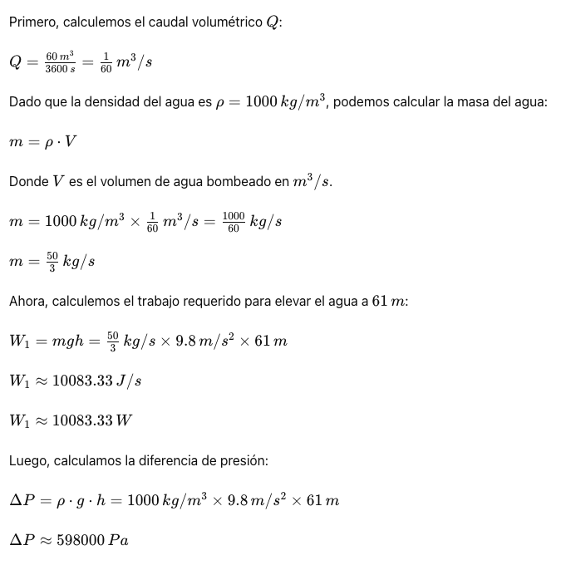

Example (I)

Slide 43
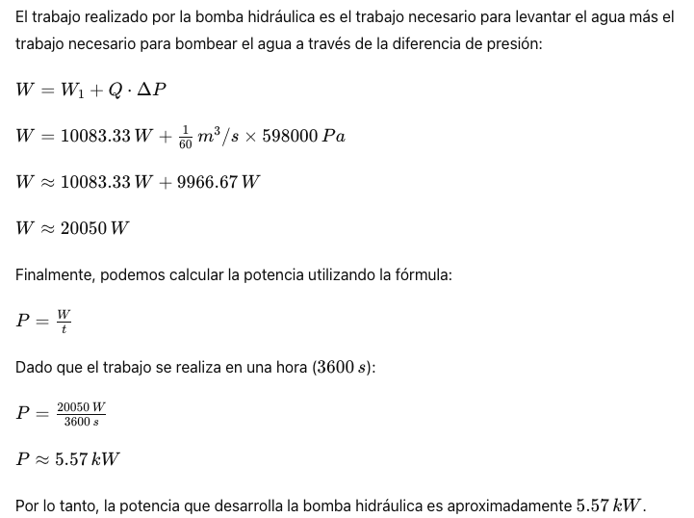
Example (II)

Slide 44
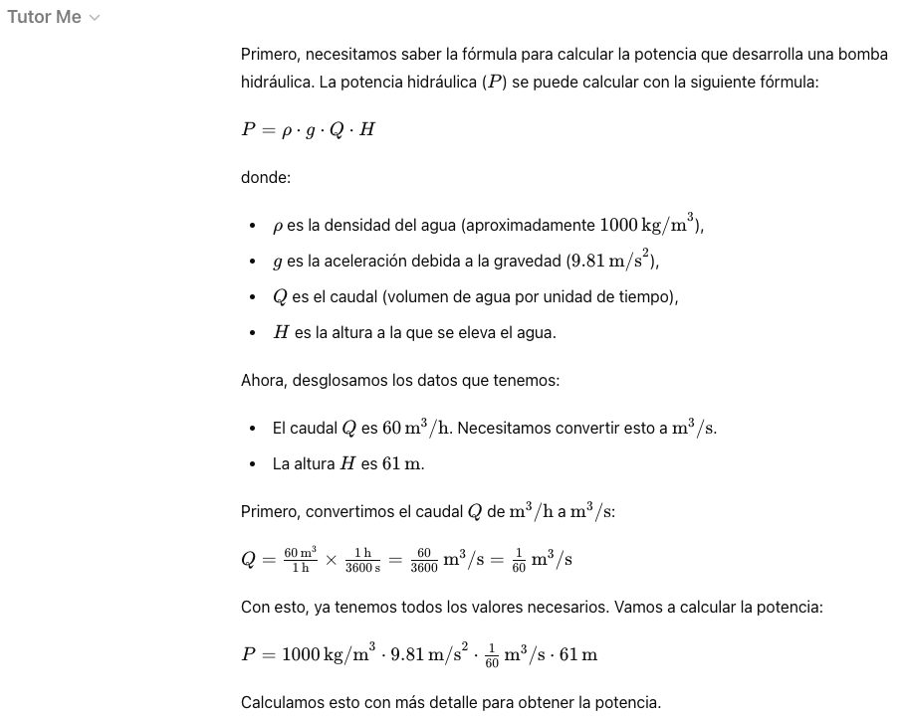
Example (III)
Notes:
He utilizado plugs-ins, Tutor Me, que entiendo que lleva incorporado el razonamiento por pasos.

Slide 45
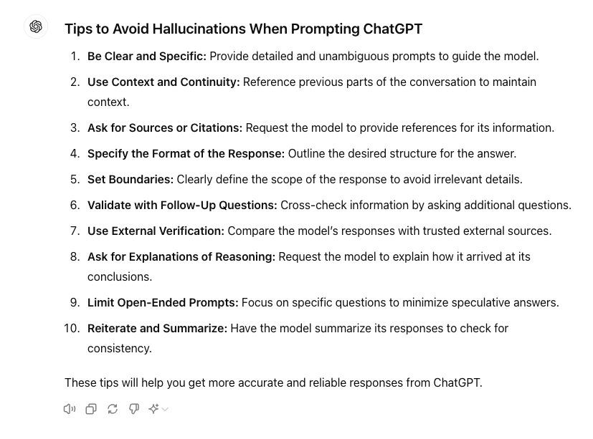
Tips

Slide 46
Outline
Artificial Intelligence
Machine Learning
Classification
Language Model
ChatGPT: Generative Pre-trained Transformer
Limitation of Pre-trained models
Hallutination
Prompting
Comparing LLM
Conclusions

Slide 47
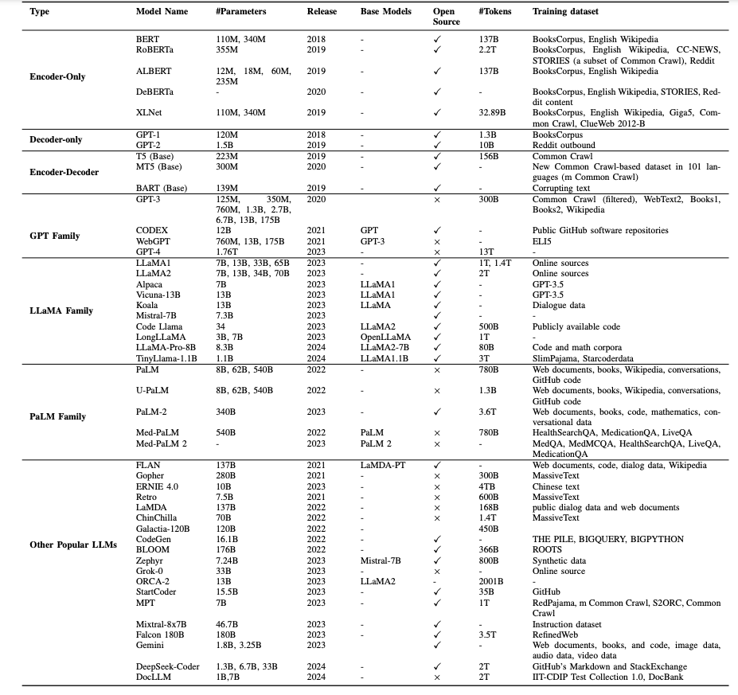
What’s out?
Credits: Minaee et al. (2024)
Notes:
Yo soy he mencionado la arquitectura GPT pero hay otras. En la tabla se mencionan también PaLM (Pathway Language model - Google) o LLaMA (Language Models are Few Shot Learners -- que es de Facebook y que está en abierto pero no disponible en España, de momento) como otras bastante utilizadas.

Slide 48
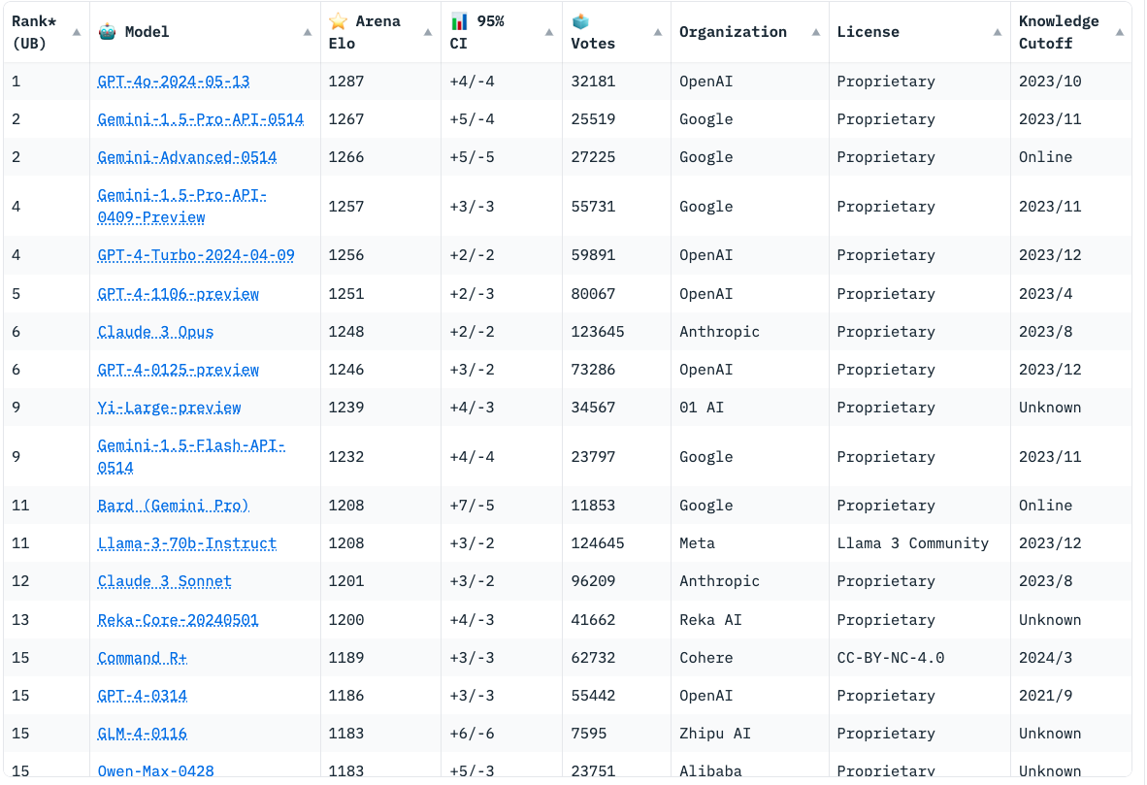
What’s out?
Notes:
Hay un ranking de todos los modelos que hay, como veis el último modelo ”GPT 4.0” es el mejor valorado a fecha de verano de 2024.
Bard ahora se llama Gemini. PaLM [31], LLaMA [32], and GPT-4 [33], son los modelos más utilizados.

Slide 49
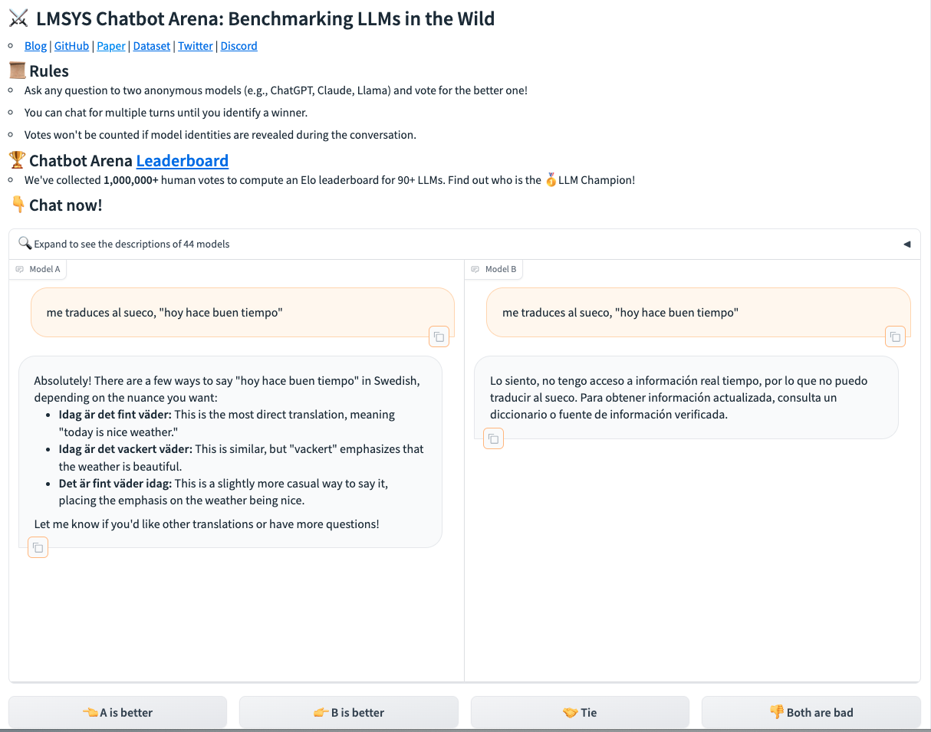
Familiar?
Notes:
A que os suena?

Slide 50
Familiar?
Notes:
A que os suena? Al test de Turing. Nosotros evaluamos como de bueno nos parecen los modelos y eso es lo que hace que

Slide 51
Outline
Artificial Intelligence
Machine Learning
Classification
Language Model
ChatGPT: Generative Pre-trained Transformer
Limitation of Pre-trained models
Hallutination
Prompting
Comparing LLM
Conclusions

Slide 52
Conclusiones
Bias: can reflect biases present in training data
Accuracy: may generate incorrect or nonsensical answers -- HALLUCINATION
Dependence on Data: quality of responses is dependent on the data it was trained on
Understanding Context: sometimes struggles with nuanced context or ambiguous queries

Slide 53
The Future of AI and ChatGPT
Advancements: ongoing research to improve accuracy, reduce biases, and enhance capabilities
Ethics: emphasis on developing ethical guidelines for AI use
Integration: increasing integration into various industries for more efficient workflows
Innovation: potential for new, innovative applications in daily life

