Slide 1
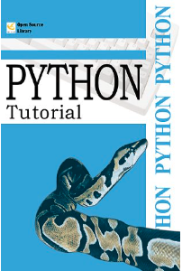
Introduction to Python
Dra. Mª Dolores Rodríguez Moreno
Notes:
Large Language Models

Slide 2
Objectives
Specific Objectives
Understand the main Python features Overview of the language components
Source
https://docs.python.org/3.10/tutorial/appetite.html https://python-textbok.readthedocs.io/en/1.0/index.html Python Tutorial - Tapa blanda. GuidoVan Rossum (2012)

Slide 3
Outline
Introduction
Why Study Python?
Python Interpreter
An informal introduction
Numbers
Strings
Lists
Functions
Variable Scope

Slide 4

Introduction (I)
Python was created by Guido van Rossum (TN)
Python 2.0: released on 2000
Python 3.0: released on 2008. Backwards‐incompatible
Python is:
General‐purpose: many applications
High‐level: abstract data structures doing more with less code
Interpreted:
No compilation needed → directly run the code
Interactive mode for testing and debugging
Emphasizes code readability and programmer’s productivity

Slide 5
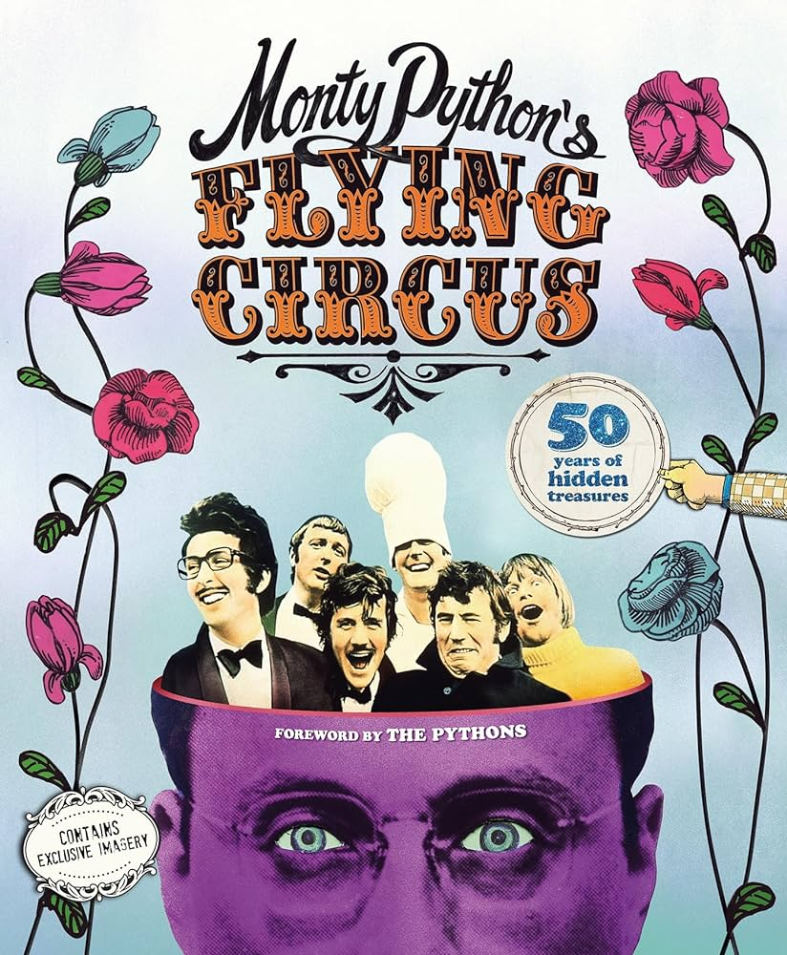
Introduction (II)
Named for the BBC show
Several paradigms: procedural, OOP, functional
Extensive Standard Library with modules for various tasks like file I/O, system calls, sockets and more
Strong Community Support: abundant resources tutorials & forums
Notes:
Named for the BBC show Monty Python… serie de humor. Podemos decir que las 2 proximas semanas vamos a ver Procedural, es decir lo básico que se hace también con C.
Programación procedural:
Se basa en la descomposición del problema en pasos o procedimientos secuenciales.
Se centra en los datos y en las operaciones que se realizan sobre ellos.
Utiliza variables y funciones para almacenar y manipular datos.
El código se organiza en bloques de instrucciones que se ejecutan uno tras otro.
Es un paradigma de programación de alto nivel, pero no tan alto como la POO o la programación funcional.
Ejemplos de lenguajes procedurales: C, Pascal, FORTRAN.
Programación orientada a objetos (POO):
Se basa en la creación de objetos que encapsulan datos (atributos) y comportamiento (métodos).
Se centra en los objetos y en las interacciones entre ellos.
Utiliza clases para definir la estructura de los objetos y objetos para instanciar las clases.
El código se organiza en clases y objetos que colaboran entre sí.
Es un paradigma de programación de alto nivel que promueve la modularidad, la reutilización del código y la mantenibilidad.
Ejemplos de lenguajes POO: Java, C++, Python, C#.
Programación funcional:
Se basa en la definición y uso de funciones puras e inmutables.
Se centra en las funciones y en los flujos de datos entre ellas.
Utiliza funciones para representar cálculos y transformaciones de datos.
El código se organiza en funciones que se componen entre sí para crear programas complejos.
Es un paradigma de programación de alto nivel que promueve la inmutabilidad, la referencialidad y la composicionalidad.
Ejemplos de lenguajes funcionales: Haskell, Lisp, Scala, Erlang.

Slide 6
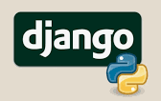


Introduction (III)
Web Development: with frameworks like Django and Flask
Data Science and Machine Learning: with libraries like Pandas NumPy SciPy TensorFlow Pytorch
Game Development: with libraries like Pygame
Embedded Systems: as MicroPython and CircuitPython

Slide 7
Outline
Introduction
Why Study Python?
Python Interpreter
An informal introduction
Numbers
Strings
Lists
Functions

Slide 8

Why Study Python?
Automate Tasks:
Perform search-and-replace over large text files
Rename and rearrange photo files
Write custom databases GUI applications or simple games
For Developers:
Faster development cycle compared to C/C++/Java
Write test suites efficiently
Use Python as an extension language
Advantages over Other Languages:
Simpler than C/C++/Java
Available on Windows macOS and Unix
Ideal for both small scripts and large programs

Slide 9
Why Study Python?
Ease of Use
Simple syntax, easy to learn and use
High-level data types (arrays & dictionaries)
Modular and Reusable
Split programs into reusable modules
Large collection of standard modules (fie I/O system calls GUI toolkits)
Readable and Compact Code
Shorter programs than C/C++/Java
Indentation for statement grouping
No variable or argument declarations needed
Extensible
Add new functions or modules in C
Link Python to binary libraries

Slide 10
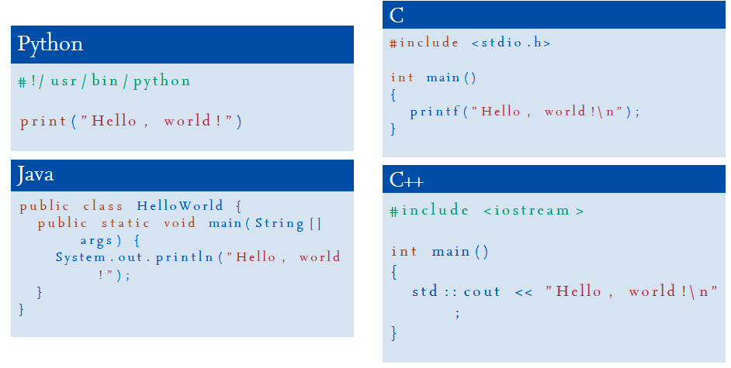
Why Study Python?

Slide 11
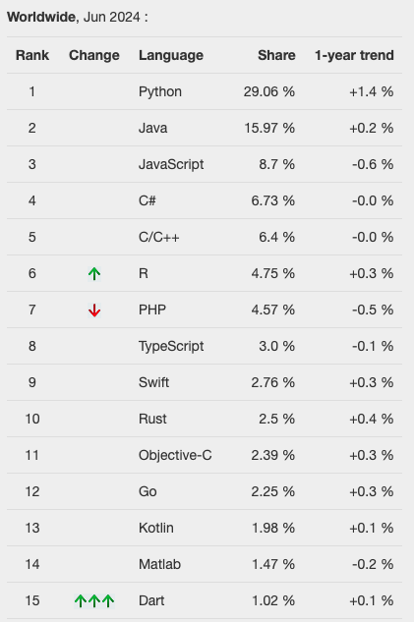
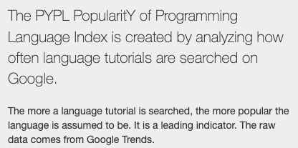
Popularity
Notes:
Segun Google el indice PYPL es decir analizar qué tutorials son los más buscandos parece que Python es el nº 1

Slide 12
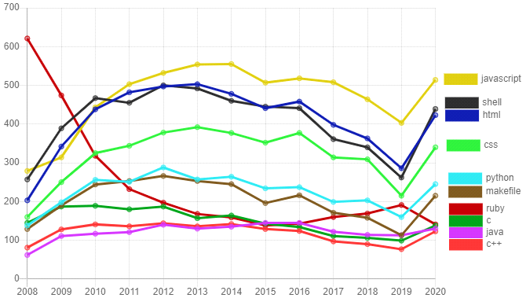
Popularity
Source: Orlowska et al (2021)
Notes:
Segun GITHUB

Slide 13
Outline
Introduction
Why Study Python?
Python Interpreter
An informal introduction
Numbers
Strings
Lists
Functions

Slide 14
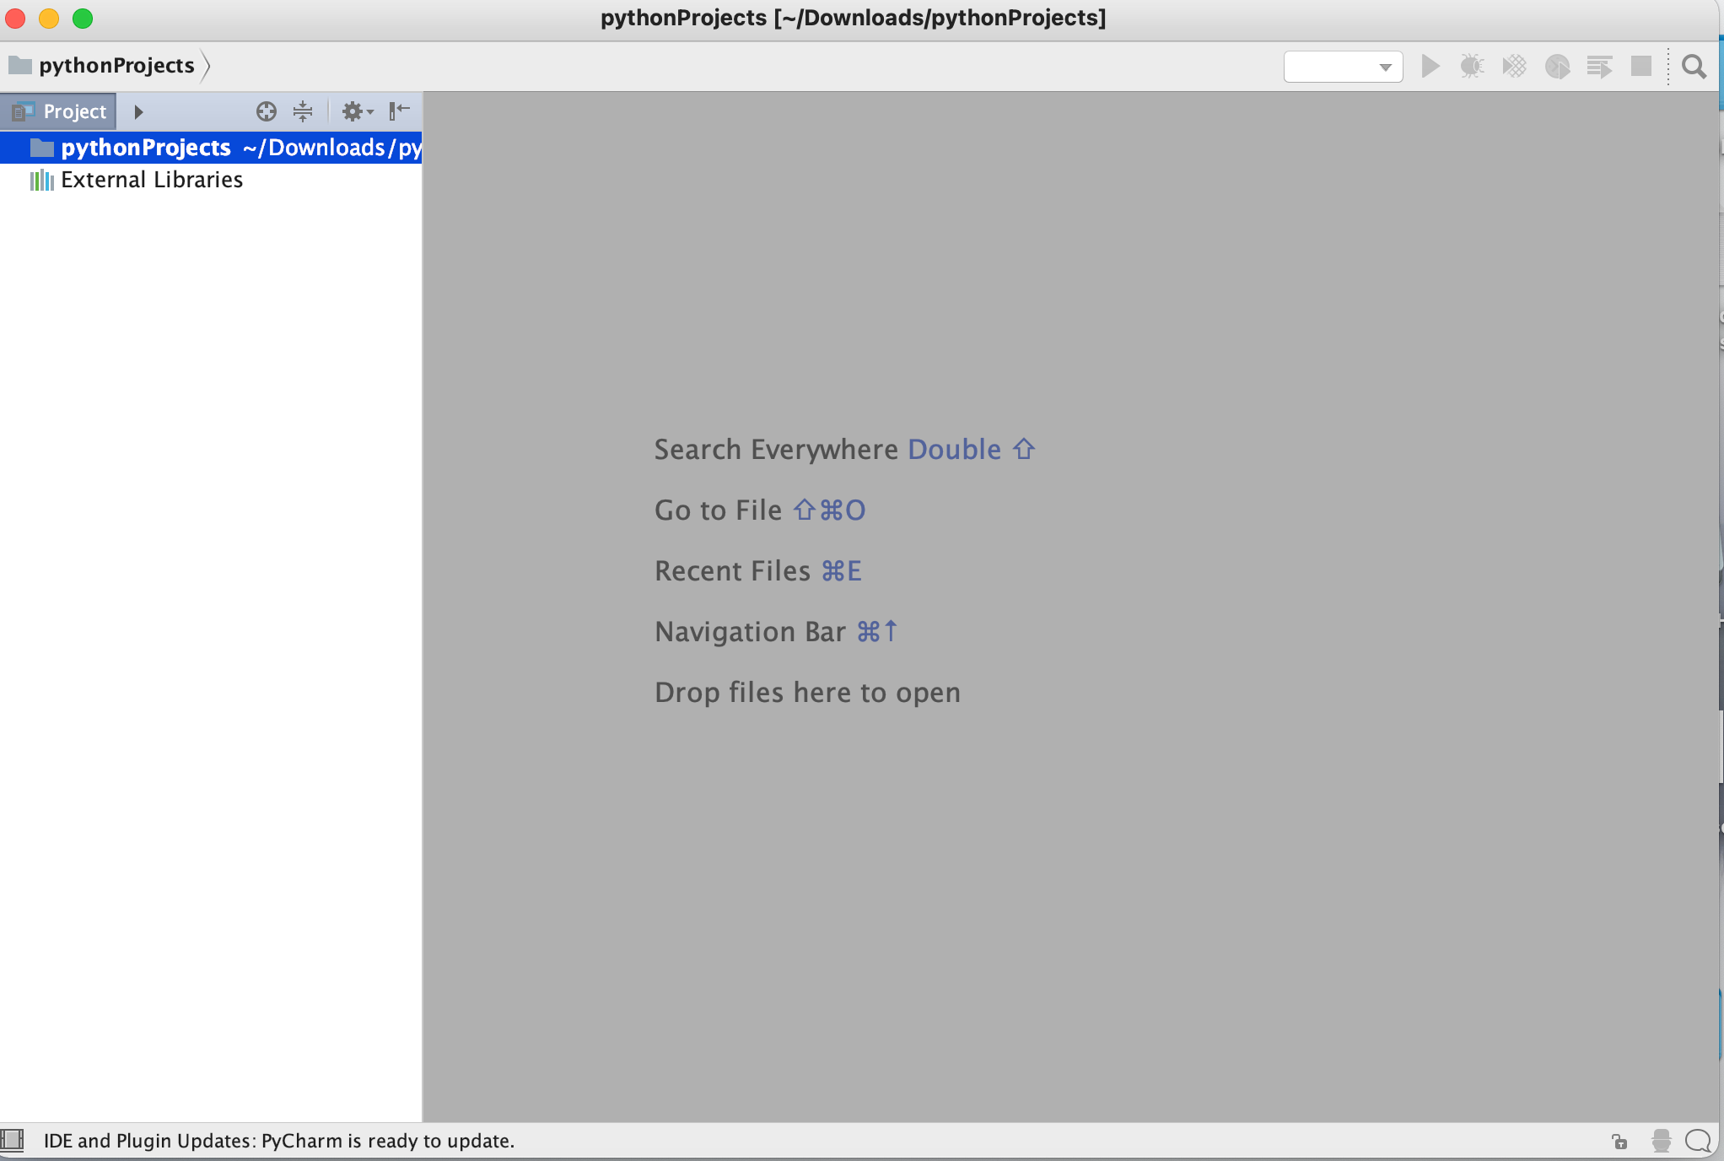
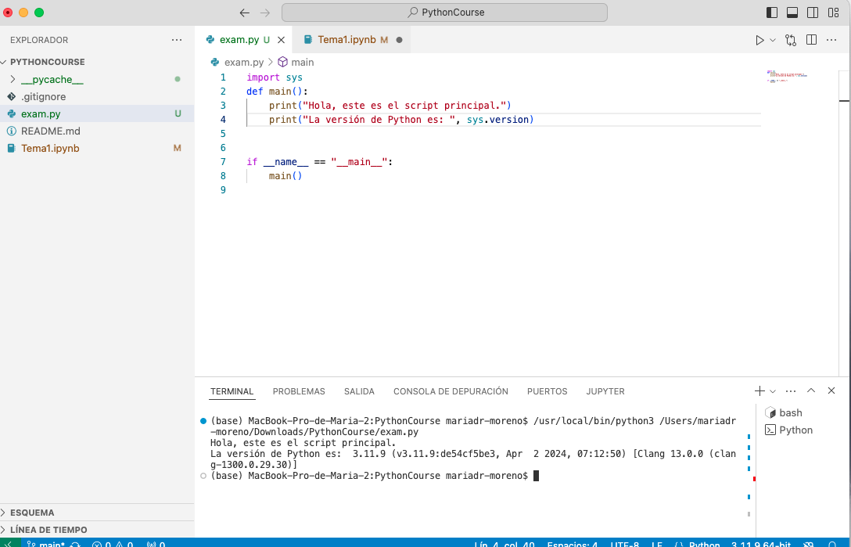


Python Interpreter (I)
If you have a Linux or Mac you already have Python!
If you have Windows you have to install it
There is no standard IDE
PyCharm
Visual Studio Code

Slide 15
Python Interpreter (II)
Python is an interpreted language, i.e. , it needs an interpreter
Interpreted = it is not complied = it needs no compilation
Faster development, slower execution
Three operation modes:
Interactive: the interpreter reads the program from the stdin . From a terminal: usually the keyboard
Non‐interactive: the interpreter reads the program from a file (.py) → Script. A python script is a sequence of python instructions stored in a .py
Mixed: from a Jupiter Notebook (.ipynb)

Slide 16
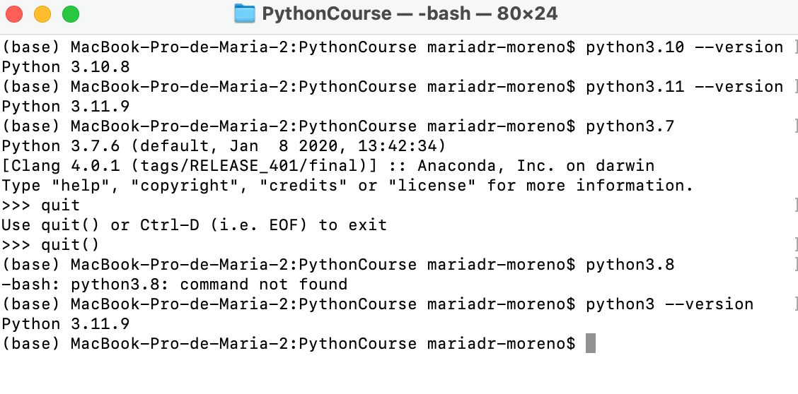
Interactive (I)
Just run Python
Different names for different versions to avoid conflicts
python python3.7 ...
> > >
The programmer executes as s/he writes code down

Slide 17
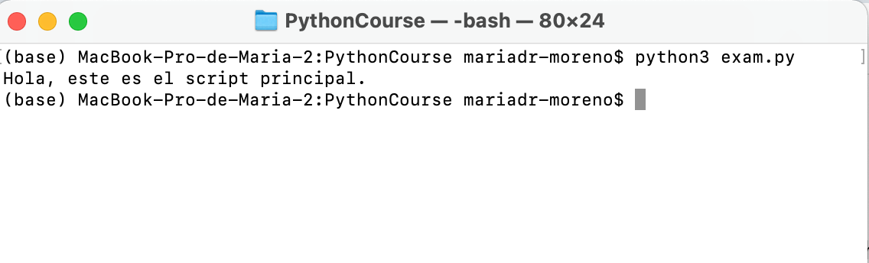
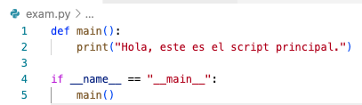
Non Interactive (I)
The program is in a plain text file
It can be edited with any text editor
Extension “.py”
By default UTF‐8 encoding

Slide 18
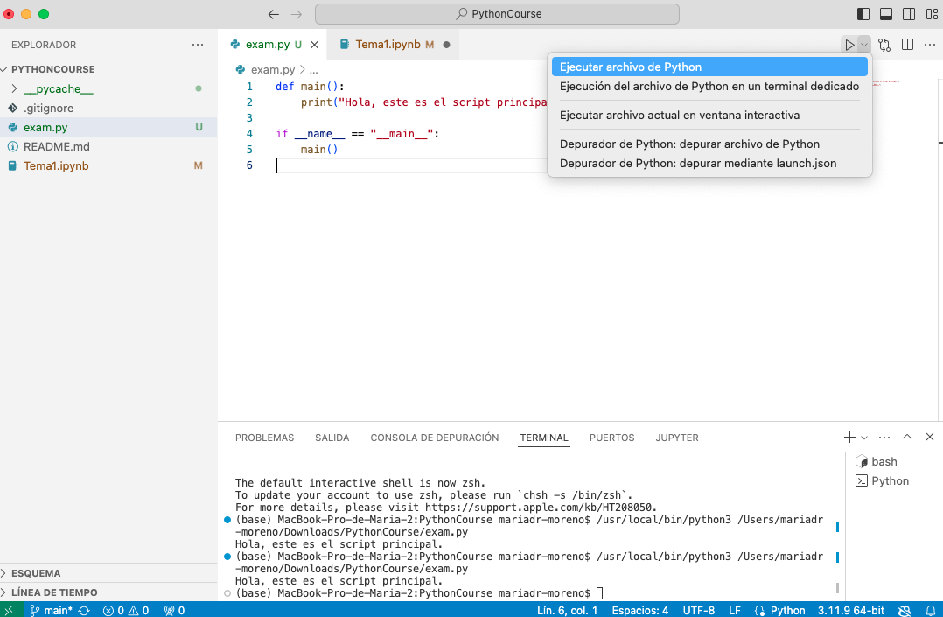
Non Interactive (II)

Slide 19
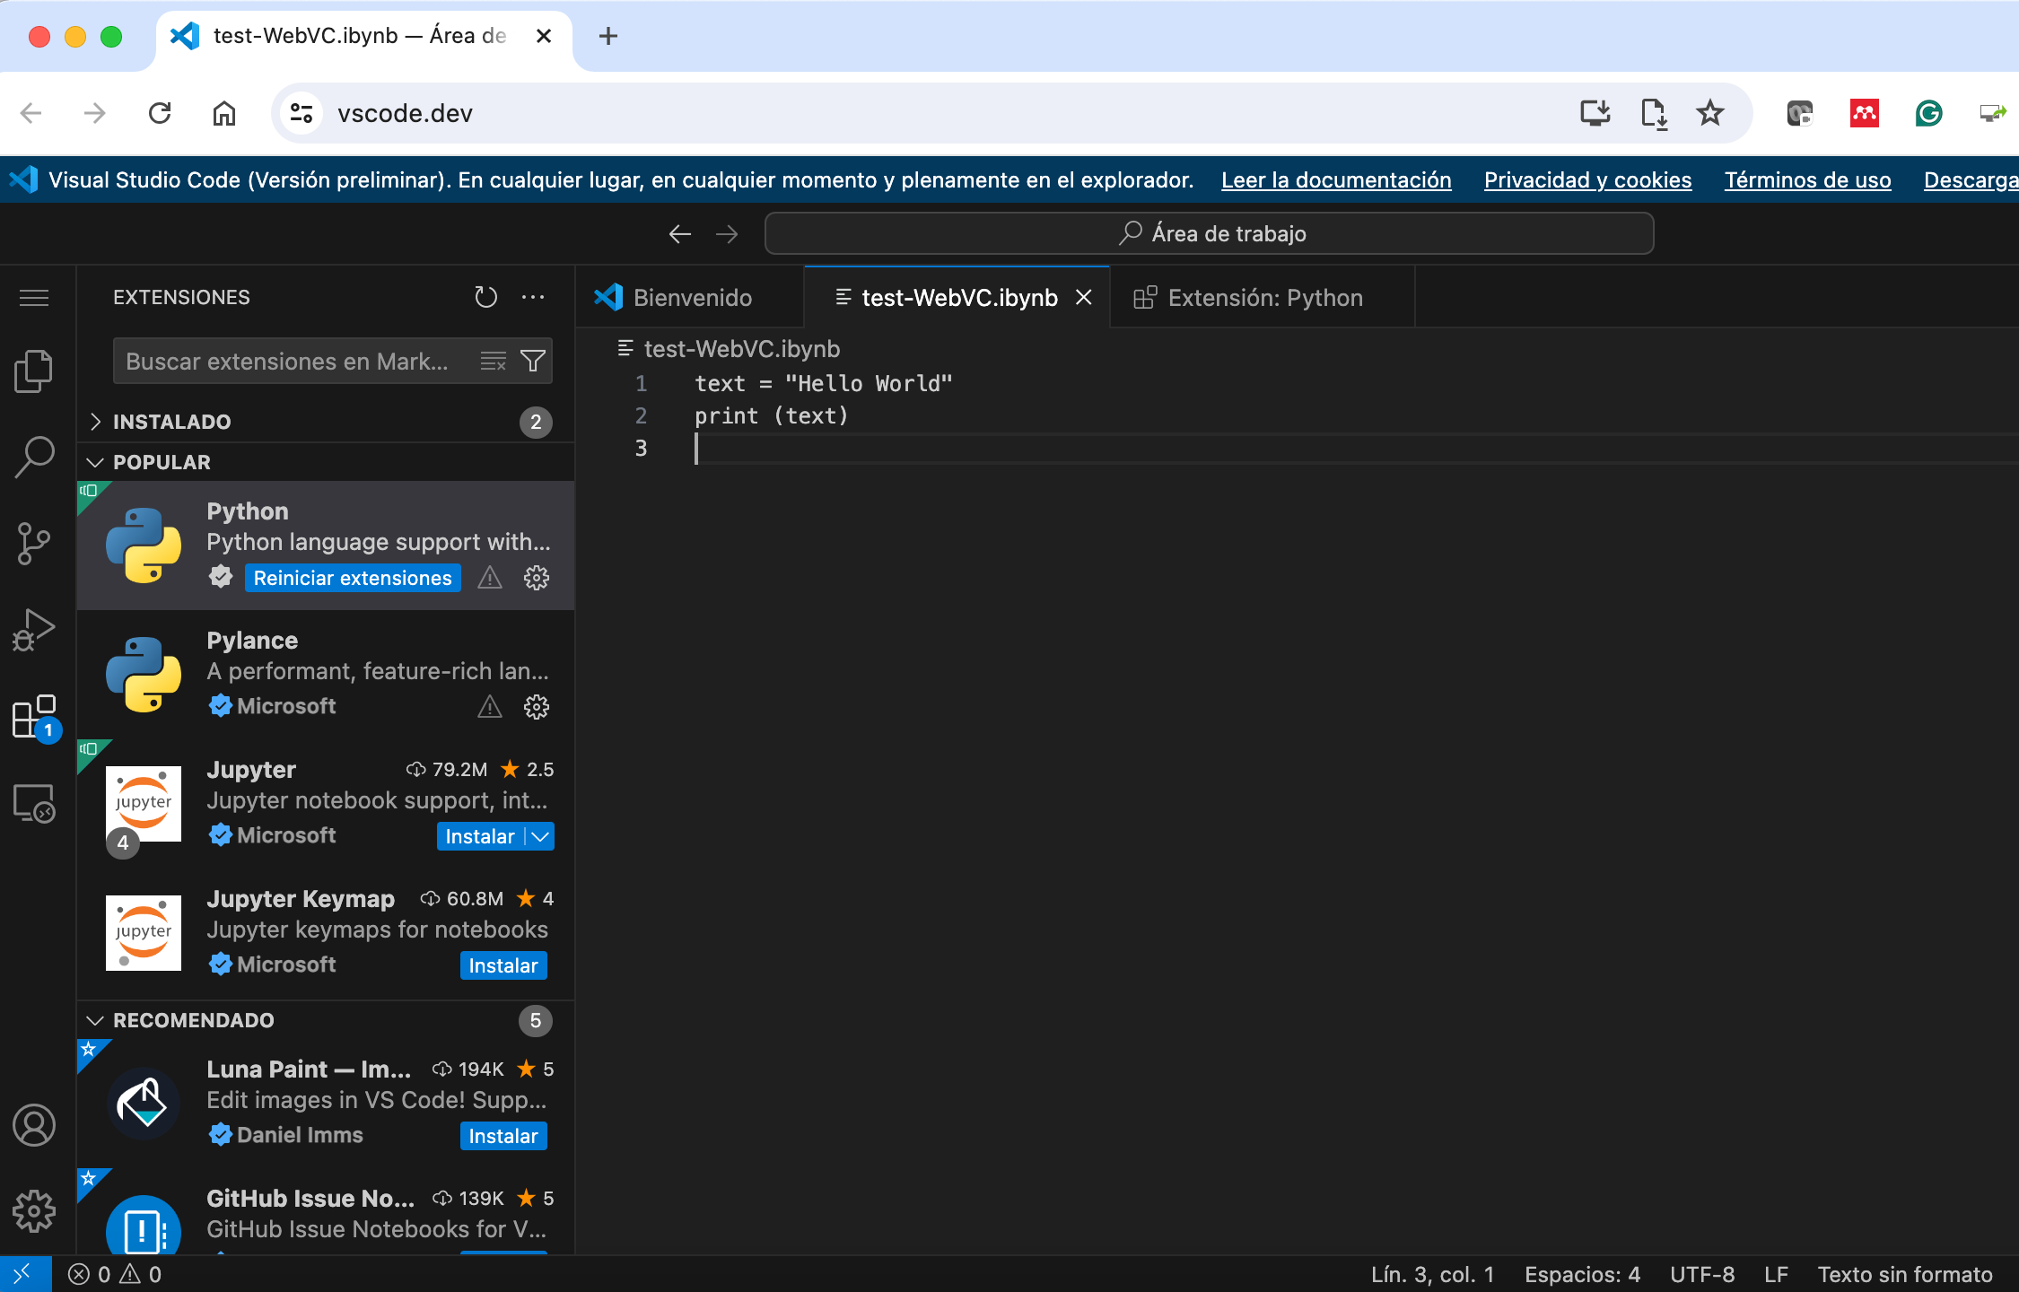
Non Interactive (III)
Visual Code Web
https://vscode.dev/
Notes:
Esta versión no la he probado pero necesitas lincarlo con un repositorio e instar extensiones

Slide 20
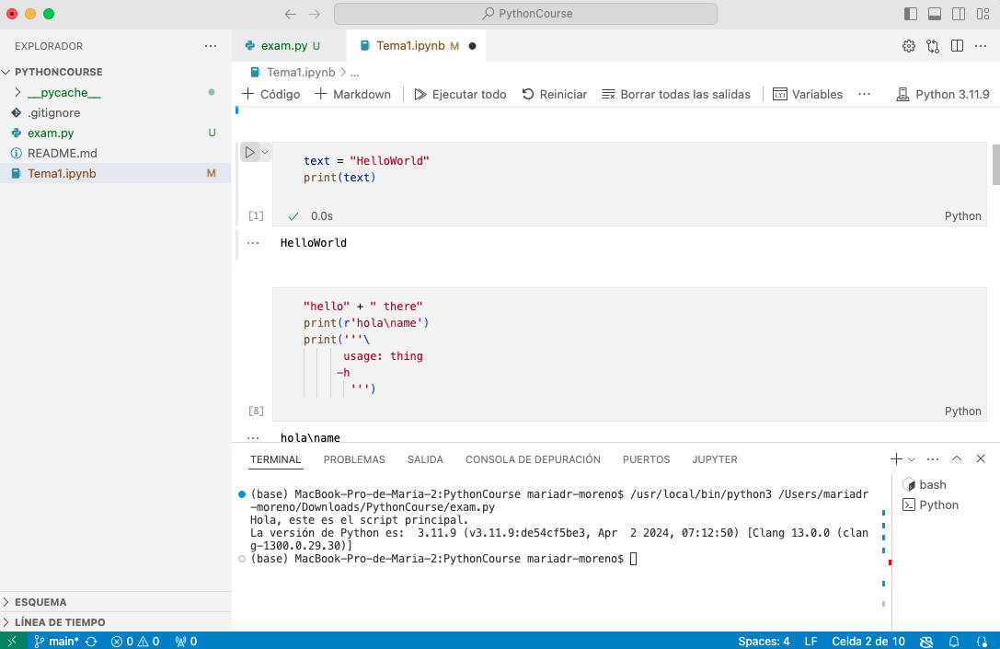
Mixed(I)
Using a Jupiter Notebook
.ipynb

Slide 21
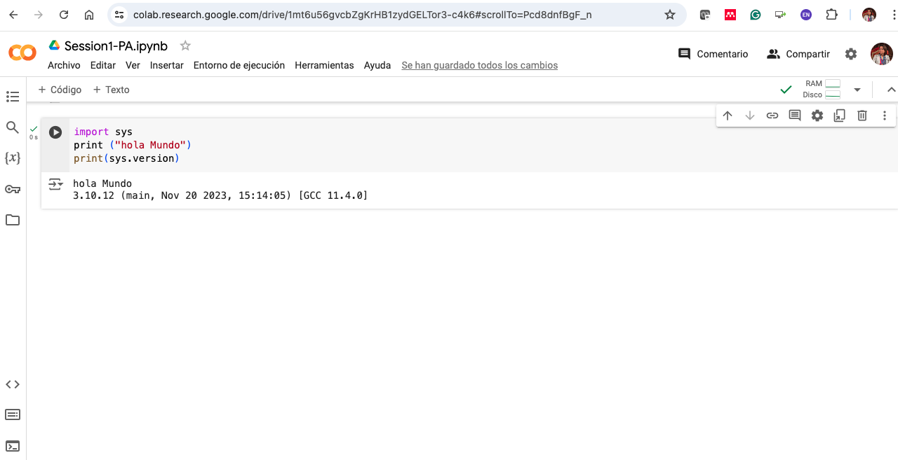
Mixed(II)
Google Collab
https://colab.research.google.com/

Slide 22
Outline
Introduction
Why Study Python?
Python Interpreter
An informal introduction
Numbers
Strings
Lists
Functions

Slide 23
Keywords
Reserved words with specific purposes and cannot be used for other purposes
Examples of Python keywords:
False class finally is return None continue for lambda try True def from nonlocal while and del global not with as elif if or yield assert else import pass break except in raise

Slide 24
Identifier Names
Names given to entities like variables functions and classes
Rules for forming identifiers:
May contain letters numbers or underscore (_)
Cannot start with a number
Cannot be a keyword
Guidelines for naming:
Be descriptive
Avoid unnecessary abbreviations
Follow naming conventions

Slide 25
Naming conventions(I)
The Python community has these recommended naming conventions
joined_lower for functions, methods and, attributes
joined_lower or ALL_CAPS for constants
StudlyCaps for classes
camelCase only to conform to pre-existing conventions
Attributes: interface, _internal, __private
Notes:
Nomenclatura "Snake Case": Se utiliza la nomenclatura "snake_case" donde las palabras se separan con guiones bajos y todas las letras son minúsculas. Por ejemplo: nombre_variable edad_persona cantidad_total.
Evitar nombres únicos o abreviaturas poco claras: Se recomienda evitar el uso de nombres de una sola letra
Usar nombres en inglés: Es una buena práctica utilizar nombres de variables en inglés ya que es el idioma más común en la comunidad de programación.
Comenzar con una letra o un guión bajo: Los nombres de las variables deben comenzar con una letra (a-z A-Z) o un guión bajo (_). No pueden comenzar con un número.
Usar nombres en minúscula para variables: Los nombres de variables se escriben completamente en minúsculas.
Usar mayúsculas para constantes: Si una variable está destinada a ser una constante (un valor que no cambia durante la ejecución del programa) se recomienda utilizar letras mayúsculas y separar las palabras con guiones bajos. Por ejemplo: CONSTANTE_PI MAXIMO_INTENTOS.

Slide 26
Naming conventions (II)
Variable Names:
Use lowercase letters
Separate words with underscores (_)
Example: my_variable, total_sum, count
Function Names:
Use lowercase letters
Separate words with underscores (_)
Example: my_function(), calculate_total(), get_user_input()
Class Names:
Use CamelCase (capitalize the first letter of each word)
Do not use underscores (_)
Example: MyClass, UserProfile, DataAnalyzer

Slide 27
Naming conventions (III)
Constant Names:
Use all uppercase letters
Separate words with underscores (_)
Example: MAX_VALUE, PI, DEFAULT_TIMEOUT
Module and Package Names:
Use lowercase letters
Can use underscores (_) if necessary to improve readability
Example: my_module.py, user_profile.py, data_analyzer.py
Method Names:
Follow the same convention as function names
Use lowercase letters and separate words with underscores (_)
Example: get_user_name(), calculate_total(), save_data()

Slide 28
Naming conventions (IV)
Private Variable and Method Names:
Prefix with a single underscore (_) to indicate they are intended for internal use
Example: _my_private_variable, _my_private_method()
Special Method Names:
Use double underscores (__) before and after the name
These are also known as "dunder" methods or magic methods
Example: __init__(), __str__(), __repr__()

Slide 29
Example of identifiers
Invalid Reason
Person Record Identifier contains a space
DEFAULT-HEIGHT Identifier contains a dash
class Identifier is a keyword
2totalweight Identifier starts with a number
Notes:
PersonRecord
DEFAULT_HEIGHTtotal_weight

Slide 30
Indentation and Semicolons
## Individual instructions -- no semicolons print("Hello!")
print("Here's a new instruction")
a = 2
# This instruction spans more than one line
b = [1 2 3
4 5 6]
# This is legal but we should NOT do it
c = 1; d = 5
print(“Here's another” c d)
Indentation to delimit blocks of code
No need of {}
No need for semicolons “;” to mark the end of instructions
Can be used to put multiple instructions on a single line (not recommended)
Notes:
Python uses identation to delimit blocks of code como {} en C.

Slide 31
Whitespace & Colons
White space matters:
Indentation must be consistent
Use tabs or white spaces (don’t mix them)
IDE can handle for you
'pass' is an empty command used for empty indentation block
Colons (“:”) start of a new block in many constructs e.g. function definitions then clauses
Notes:
Python uses identation to delimit blocks of code como {} en C.

Slide 32
Comment
# This is a multiline comment
# Each line starts with a hash (#)
# and continues until the end of the line.
print("Hello World!")
"""
This is a multiline comment.
It spans multiple lines.
However this is typically used for docstrings.
"""
print("Hello World!")
Comments start with # and continue until the end of the line
Used to describe what the program does and how it works
More than 1 line use """ … """

Slide 33
Docstrings
def greet(name):
"""
This function greets the person whose name is passed as an argument.
Parameters:
name (str): The name of the person to greet.
Returns:
None
"""
print("Hola " name "!")
# Using the help function to access the docstring
help(greet)
print(greet.__doc__)
Type of multiline comment used to document modules classes functions and methods
They are written using triple quotes (""" or ''') and can span multiple lines
Different from regular comments because they are stored as an attribute of the object they document and can be accessed programmatically using tools like help() or __doc__
Notes:
Yo puedo poner
X=[1 2 3]
Y=(2 3)
help (x) – me da información sobre las listas
Help(Y) – me da información sobre las tuplas

Slide 34
Flow of control
# this function definition starts a new block
def print_numbers(a b):
# this instruction is inside the block
print(“Numbers are:” a b)
# this if statement starts a new block
if it_is_tuesday:
# this is inside the block
print("It's Tuesday!")
# this is outside the block!
print("Print this no matter what")
The order in which the computer executes instructions
Example of flow of control

Slide 35
Exercise
def happy_day(day):
if day == "monday":
return ":("
if day != "monday":
return ":D"
print(happy_day("sunday"))
print(happy_day("monday"))
The following Python program is not indented correctly
Re-write it so that it is correct

Slide 36
Reading and Writing
For reading use “input”
It reads a string
For writing use “print”
first_number = input("Enter the first number: ")
print("The number is" first_number)

Slide 37
Assignment(I)
Binding a variable in Python means setting a name to hold a reference to some object
Assignment creates references not copies
Names in Python do not have an intrinsic type; objects have types
Python determines the type of the reference automatically based on what data is assigned to it
Basic types: numbers, strings, Booleans, complex
You create a name the first time it appears on the left side of an assignment expression: y = 5
A reference is deleted via garbage collection after any names bound to it have passed out of scope
Python uses reference semantics (more later)

Slide 38
Assignment (II)
You can assign multiple names at the same time
This makes it easy to swap values
Assignments can be chained
x, y = 2, 3
a = b = x = 2

Slide 39
Built-in Types
Types of information Python can handle:
integers
floating numbers
strings
boolean
complex
None
char is not a data-type instead is a string
print(type(1)) # <class 'int'>
print(type("a")) # <class 'str’>
print(type(2.45)) # <class 'float’>
print(type(True)) # <class bool’>
print(type(4 + 4j))#<class 'complex’>
print(type(x)) #<class 'NoneType’>
print(type(´c´)) # <class ‘str’>

Slide 40
Built-in Types
Types of information Python can handle:
integers
floating numbers
strings
boolean
complex
None
char is not a data-type instead is a string
print(type(1)) # <class 'int'>
print(type("a")) # <class 'str’>
print(type(2.45)) # <class 'float’>
print(type(True)) # <class bool’>
print(type(4 + 4j))#<class 'complex’>
print(type(x)) #<class 'NoneType’>
print(type(´c´)) # <class ‘str’>

Slide 41
Cast Types
Cannot do arithmetic operations on variables of different types
Casting: the operation of converting a variable to a different type
int()
float()
str()

Slide 42
Outline
Introduction
Why Study Python?
Python Interpreter
An informal introduction
Numbers
Strings
Lists
Functions
Variable Scope

Slide 43
Numbers
Integer numbers: e.g. 1 5 -34
Operators:
Sign Operator | Sign | Operator
= Assignment | // | Floor division
+ Add | ** | Exponent
‐ Substration | += | Assign +
* Multiplication | ‐= | Assign ‐
/ Division | *= | Assign *
% Modulus | /= | Assign /
Notes:
No existe el ++ que hay en C o C++

Slide 44
Operator Precedence
Similar rules as other languages
() (Parentheses)
** (Exponentiation)
+x -x ~x (Unary plus Unary minus Bitwise NOT)
* / // % (Multiplication Division Floor Division Modulus)
+ - (Addition Subtraction)
<< >> (Bitwise Shift Operators)
& (Bitwise AND)
^ (Bitwise XOR)
| (Bitwise OR)
Comparison operators: == != > >= < <= is is not in not in
not (Logical NOT)
and (Logical AND)
or (Logical OR)

Slide 45
Examples
# Exponentiation has the highest precedence
result = 2 ** 3 ** 2
# Equivalent to: 2 ** (3 ** 2) = 2 ** 9 = 512
# Multiplication and division have higher precedence than addition and subtraction
result = 2 + 3 * 4 # Equivalent to: 2 + (3 * 4) = 2 + 12 = 14
# Parentheses can be used to override the default precedence
result = (2 + 3) * 4 # Equivalent to: 5 * 4 = 20
a = int(input("Number: "))
b = float(input("Number: "))
d = a * b /2
d += 1
C = d **2
print("Result c y d" c d)

Slide 46
Exercise
Which of the following numbers are valid Python integers?
110 1.0 17.5 -39 -2.3
Explain the results of the following operations:
15 + 20 * 3
13 // 2 + 3
31 + 10 // 3
20 % 7 // 3
3 ** 3 ** 2
Notes:
15 + 20 * 3
75
>>> 13 // 2 + 3
9
>>> 31 + 10 // 3
34
>>> 20 % 7 // 3
2
>>> 3 ** 3 ** 2
19683

Slide 47
Outline
Introduction
Why Study Python?
Python Interpreter
An informal introduction
Numbers
Strings
Lists
Functions
Variable Scope

Slide 48
Strings (I)
Can enclose in double or single quote
‘ ’ # a string with a single quote
” “ # a string with a double quote
Triple quotes can cross end of line boundaries
>>>''' a two line
string'''
Strings are immutable
Strings are objects of the “str” class
Notes:
El dir me da un resumen.
Help me da mas detalle de los atributos y metodos. “dir” solo los numera
Adding strings concatenates them
>>>'this' + ' ' + 'that’ # 'this that'
>>>dir(' ') # to see summay on strings

Slide 49
String Operations
Concatenation: combining strings using the + operator
Repetition: repeating a string using the * operator
Indexing: accessing individual characters using indices []
Slicing: extracting substrings using slice notation [:]

Slide 50
Examples
## Concatenation
hello = "Hello"
world = "World"
greet = hello + " " + world # "Hello World"
# Repetition
laugh = "Ha"
repeated_laugh = laugh * 3 # "HaHaHa"

Slide 51
Indexing Operations
Index starts with CERO (0)
Index can be negative
If -1 starts from the end until the length is reached
Control you don´t overpass the limit → error

Slide 52
Examples
greet = "hola" + " " + "Spain"
# Indexing
char = greet[1] # ‘o’
char1 = greet[-1] # ‘n’
char2 = greet[-11] # Error
greet[0] = "H" # Error
Notes:
Son 10 la longitude de la lista, si accedo al 11 da error
No puedo modificar la cadena porque el objeto es inmutable

Slide 53
Slicing Operations
Strings can be used as a sequence of characters
greet = "hola" + " " + ”Spain"
# Slicing
greet[2:] #'la Spain'
greet[:2] #'ho'
greet[2:] + greet[:2] #'la Spainho'
greet[2:4] #'la'

Slide 54
String Methods
Strings have built-in methods for various operations
Function: len()
Common methods:
upper()
lower()
strip()
replace()
split()
join()
find()
count()

Slide 55
Examples of methods
s = " Hello, World! "
# Convert to uppercase
upper_s = s.upper() # " HELLO, WORLD! "
# Convert to lowercase
lower_s = s.lower() # " hello, world! "
# Strip whitespace
stripped_s = s.strip() # "Hello, World!”
# Replace substring
replaced_s = s.replace("World", "Python")#” Hello, Python! "
# Split into a list
split_s = s.split(",") # [" Hello", " World! "]
# Join list into a string
joined_s = " ".join(["Hello", "World"]) # "Hello World"
# Find substring
index = s.find("World") # 8
# Count occurrences
count = s.count("l") # 3
Notes:
LEN es una función, por tanto no se llama con el nombre del objeto seguido de ., se le pasa como parametro. De hecho LEN admite otros parametros como la tupla, etc

Slide 56
Examples of len
# Length of an empty string
empty_string = ""
print(len(empty_string)) # Output: 0
# Length of a string with spaces
string_with_spaces = "Hello, World! "
print(len(string_with_spaces)) # Output: 14
# Using len() with other data types
my_list = [1, 2, 3, 4, 5]
print(len(my_list)) # Output: 5
Notes:
LEN es una función, por tanto no se llama con el nombre del objeto seguido de ., se le pasa como parametro. De hecho LEN admite otros parametros como la tupla, diccionario, etc
Cuando se realizan operaciones que parecen modificar una cadena, como la concatenación usando +=, en realidad no se modifica la cadena original inmutable. En cambio, se crea una nueva cadena con el resultado de la operación. La referencia a la cadena original permanece sin cambios, mientras que la nueva cadena con el valor modificado se almacena en una nueva ubicación en memoria

Slide 57
String Formatting
Formatting strings use placeholders or f-strings
Placeholders:
% operator
str.format() method
f-strings: introduced in Python 3.6, use {} to embed expressions inside string literals

Slide 58
Examples
name = "Alice"
age = 30
# Using % operator
formatted_str = "My name is %s and I am %d years old." % (name, age)
# Using str.format() method
formatted_str = "My name is {} and I am {} years old.".format(name, age)
# Using f-strings
formatted_str = f"My name is {name} and I am {age} years old."
Notes:
LEN es una función, por tanto no se llama con el nombre del objeto seguido de ., se le pasa como parametro. De hecho LEN admite otros parametros como la tupla, diccionario, etc
Cuando se realizan operaciones que parecen modificar una cadena, como la concatenación usando +=, en realidad no se modifica la cadena original inmutable. En cambio, se crea una nueva cadena con el resultado de la operación. La referencia a la cadena original permanece sin cambios, mientras que la nueva cadena con el valor modificado se almacena en una nueva ubicación en memoria

Slide 59
Escape Sequences
Special sequences in strings to represent certain characters
Common escape sequences:
Sequence | Meaning
\\ | literal backslash
\' | single quote
\" | double quote
\n | newline
\t | tab

Slide 60
Examples
# Literal backslash
backslash_str = "This is a backslash: \\"
print(backslash_str) # Output: This is a backslash: \
# Single quote
single_quote_str = 'It\'s a single quote.'
print(single_quote_str) # Output: It's a single quote.
# Double quote
double_quote_str = "He said, \"Hello!\""
print(double_quote_str) # Output: He said, "Hello!"
# Newline
newline_str = "First line\nSecond line"
print(newline_str)
# Output:
# First line
# Second line
# Tab
tab_str = "Column1\tColumn2"
print(tab_str) # Output: Column1 Column2
Notes:
LEN es una función, por tanto no se llama con el nombre del objeto seguido de ., se le pasa como parametro. De hecho LEN admite otros parametros como la tupla, diccionario, etc
Cuando se realizan operaciones que parecen modificar una cadena, como la concatenación usando +=, en realidad no se modifica la cadena original inmutable. En cambio, se crea una nueva cadena con el resultado de la operación. La referencia a la cadena original permanece sin cambios, mientras que la nueva cadena con el valor modificado se almacena en una nueva ubicación en memoria

Slide 61
Exercise (I)
# I want to visualize the following text. Create 1 string and use += operator
File path: C:\Users\Username\Documents
Quote: "Stay hungry, stay foolish." - Steve Jobs
List:
1. Item One
2. Item Two
3. Item Three
Notes:
message = "File path: C:\\Users\\Username\\Documents\n"
message += "Quote: \"Stay hungry, stay foolish.\" - Steve Jobs\n"
message += "List:\n\t1. Item One\n\t2. Item Two\n\t3. Item Three"
print(message)

Slide 62
Exercise (II)
Write a program that takes a sentence from the user, converts the entire sentence to lowercase, removes leading and trailing whitespace, counts the number of words, and replaces a specific word with another
Notes:
# Get the sentence from the user
sentence = input("Enter a sentence: ")
# Convert to lowercase
sentence = sentence.lower()
# Remove leading and trailing whitespace
sentence = sentence.strip()
# Count the number of words
words = sentence.split()
word_count = len(words)
# Replace a specific word with another
word_to_replace = "python"
new_word = "programming"
sentence = sentence.replace(word_to_replace, new_word)
# Display results
print(f"Transformed sentence: {sentence}")
print(f"Number of words: {word_count}")

Slide 63
Outline
Introduction
Why Study Python?
Python Interpreter
An informal introduction
Numbers
Strings
Lists
Functions
Variable Scope

Slide 64
Lists (I)
An ordered collection of mutable data
Ordered: data in the list have a location
Mutable: data can be modified
Data types can be different
Concatenation & Repetition
Slice & Indexing notation
a = ['spam', 'eggs', 123]
print(a)
print(a[2]) # 123
print(a[1:]) # ['eggs’, 123]
print(a + a[2:]) # ['spam’,'eggs’,123,123]
a[0] = "jam” # ['jam','eggs',123, 123]
print(a*2) # ['jam', 'eggs', 123, 123, 'jam’,
# 'eggs', 123, 123]

Slide 65
List Methods
List have built-in methods for various operations
Function: len()
Common methods:
append()
extend()
insert()
remove()
pop()
clear()
index()
count()
sort()
reverse()
Notes:
Just use two methods: append() and pop()
>>> stack = [3, 4, 5]
>>> stack.append(6)
>>> stack.append(7)
>>> stack
[3, 4, 5, 6, 7]
>>> stack.pop()
7
>>> stack
[3, 4, 5, 6]

Slide 66
Examples of methods
fruits = ["apple", "banana", "cherry"]
# Append an element
fruits.append("date") # ["apple", "banana", "cherry", "date"]
# Extend list with another list
fruits.extend(["elderberry", "fig"]) # ["apple", "banana", "cherry", "date", "elderberry", "fig"]
# Insert an element at a specific position
fruits.insert(1, "blueberry") # ["apple", "blueberry", "banana", "cherry", "date", "elderberry", "fig"]
# Remove an element
fruits.remove("banana") # ["apple", "blueberry", "cherry", "date", "elderberry", "fig"]
Notes:
LEN es una función, por tanto no se llama con el nombre del objeto seguido de ., se le pasa como parametro. De hecho LEN admite otros parametros como la tupla, etc

Slide 67
Examples of methods
# Pop an element (remove and return it)
popped_fruit = fruits.pop() # "fig", ["apple", "blueberry", "cherry", "date", "elderberry"]
# Clear the list
fruits.clear() # []
# Index of an element
index_of_cherry = fruits.index("cherry") # 2
# Count occurrences of an element
count_of_apple = fruits.count("apple") # 1
# Sort the list fruits.sort() # ["apple", "banana", "cherry", "date"]
# Reverse the list fruits.reverse() # ["date", "cherry", "banana", "apple"]
Notes:
LEN es una función, por tanto no se llama con el nombre del objeto seguido de ., se le pasa como parametro. De hecho LEN admite otros parametros como la tupla, etc

Slide 68
Outline
Introduction
Why Study Python?
Python Interpreter
An informal introduction
Numbers
Strings
Lists
Functions
Variable Scope

Slide 69
Functions
Functions are reusable blocks of code that perform a specific task
Functions help in organizing code and avoiding repetition
Define using the def followed by the function name and ()
Parameters: variables listed inside the parentheses in the function definition
Arguments: values passed to the function when it is called
Functions can have default parameters, allowing some arguments to be optional
Return a value using the return statement
You can return 1 or more values separated by “,”
If no return statement is used, the function returns None by default

Slide 70
Example
def square(number=3):
""”
This function returns the square of the given number.
"""
return number ** 2
# Function without return statement
def say_hello():
print("Hello, World!")
print(square(4)) # Output: 16
print(square()) # Output: 9
result = say_hello()
print(result) # Prints the string and print None
print(square.__doc__)
help(square)

Slide 71
Main Function
The main() function serves as the entry point for a Python program
Helps in organizing code and makes it easier to understand and maintain
Useful for defining a clear starting point for the program's execution
Why Use main()?
Readability: makes the program structure clear and logical
Modularity: encapsulates the main logic of the program in a single function
Reusability: allows for parts of the code to be reused or tested separately
Best Practices: aligns with common programming conventions and prepares for larger projects

Slide 72
Example
def main():
# Main logic of the program
# Example: Calling functions, performing tasks, etc.
pass
if __name__ == "__main__":
main()

Slide 73
Exercise
Write a function called process_text that takes a string and a list of words as arguments. The function should:
Convert the string to lowercase
Remove leading and trailing whitespace
Replace any word in the string that matches an element in the list of words with asterisks (*)
Provide default values for the text and words to replace
Return the processed string and the number of words replaced
Call the process_text from a main function
Notes:
def process_text(text="This is a default text with Python and amazing words.", words_to_replace=None):
"""
This function processes the given text:
- Converts to lowercase
- Strips leading and trailing whitespace
- Replaces specified words with asterisks (*)
"""
if words_to_replace is None:
words_to_replace = ["python", "amazing"]
# Convert to lowercase
text = text.lower()
# Strip leading and trailing whitespace
text = text.strip()
# Split text into words
words = text.split()
# Initialize the count of replaced words
replaced_count = 0
# Replace specified words
for i in range(len(words)):
if words[i] in words_to_replace:
words[i] = '*' * len(words[i])
replaced_count += 1
# Join the words back into a single string
processed_text = ' '.join(words)
return processed_text, replaced_count
# Test the function with default values
result, count = process_text()
print(f"Processed text: {result}")
print(f"Number of words replaced: {count}")
# Test the function with custom values
custom_text = " Python is an amazing programming language. Python is popular. "
custom_words_to_replace = ["python", "amazing"]
result, count = process_text(custom_text, custom_words_to_replace)
print(f"Processed text: {result}")
print(f"Number of words replaced: {count}")

Slide 74
Exercise: Output
# Function output with default values
Processed text: "this is a default text with ****** and ******* words."
Number of words replaced: 2
# User input and function output with custom values
Processed text: "python is an amazing programming language. python is popular."
Number of words replaced: 3

Slide 75
Outline
Introduction
Why Study Python?
Python Interpreter
An informal introduction
Numbers
Strings
Lists
Functions
Variable Scope

Slide 76
Variable Scope
Region of the code a variable is accessible
Variables declared in one part of the code may not be accessible in another
4 main types:
Local Scope: variables defined inside a function, only accessible within that function
Enclosing Scope: variables in the local scope of enclosing functions, often used in nested functions (nonlocal keyword)
Global Scope: variables defined at the top level of a script or module, or explicitly declared as global using the global keyword. Accessed from any part of the code
Built-in Scope: special reserved keywords and functions that are part of built-in namespace. E.g. len(“Hello”)
Notes:
A scope is a textual region of a Python program where a namespace is directly accessible

Slide 77
Example
#Enclosing Scope
def outer_function():
x = 10 # Variable in the enclosing scope
def inner_function():
nonlocal x
x += 5
print(f"Inside inner_function: {x}") # 15
inner_function()
print(f"Inside outer_function: {x}") # 15
outer_function()
#Local Scope
def my_function():
x = 10
print(x) # This will print 10
my_function()
print(x) # This will raise an error

Slide 78
Example
#Global Scope (I)
x = 30
def my_function():
print(x) # This will print 30
my_function()
print(x) # This will print 30
#Global Scope (II)
x = 20
def my_function():
global x
x+=1
print(x) # This will print 21
my_function()
x+=1
print(x) # This will print 22
Notes:
Cuidado. Cuando declare global la variable, no la puedo asignar un valor. Lo tengo que hacer en otra línea

Slide 79
Exercise…
Create a Python program that manages a to-do list using global, local, and nonlocal variables, and demonstrates the use of built-in functions. Include a main() function
Global Variable: named tasks which will be a list to store the tasks. Functions:
add_task(task): add a new task to the global tasks list
remove_task(task): remove a task from the global tasks list if it exists
list_tasks(): list all tasks stored in the global tasks list
task_manager(): manage the operations of adding, modifying, and listing tasks
Modifies the first task in the tasks list
Uses the nonlocal keyword to refer to the tasks variable defined in the task_manager scope
Notes:
def process_text(text="This is a default text with Python and amazing words.", words_to_replace=None):
"""
This function processes the given text:
- Converts to lowercase
- Strips leading and trailing whitespace
- Replaces specified words with asterisks (*)
"""
if words_to_replace is None:
words_to_replace = ["python", "amazing"]
# Convert to lowercase
text = text.lower()
# Strip leading and trailing whitespace
text = text.strip()
# Split text into words
words = text.split()
# Initialize the count of replaced words
replaced_count = 0
# Replace specified words
for i in range(len(words)):
if words[i] in words_to_replace:
words[i] = '*' * len(words[i])
replaced_count += 1
# Join the words back into a single string
processed_text = ' '.join(words)
return processed_text, replaced_count
# Test the function with default values
result, count = process_text()
print(f"Processed text: {result}")
print(f"Number of words replaced: {count}")
# Test the function with custom values
custom_text = " Python is an amazing programming language. Python is popular. "
custom_words_to_replace = ["python", "amazing"]
result, count = process_text(custom_text, custom_words_to_replace)
print(f"Processed text: {result}")
print(f"Number of words replaced: {count}")

Slide 80
…Exercise
main() Function: define a main() function that calls task_manager() to execute the main logic of the program
Use of Built-in Functions: use the built-in enumerate function in list_tasks() to number the tasks
Points to Consider:
Global variables (tasks) are accessible and modifiable from any function in the script
Local variables are defined within functions and are only accessible within those functions
The nonlocal keyword is used within modify_task() to refer to the tasks variable from the task_manager scope

Slide 81
Example of the output…
Task 'Buy milk' added.
Task 'Call the doctor' added.
Task 'Exercise' added.
Task list:
1. Buy milk
2. Call the doctor
3. Exercise
Task 'Buy milk' modified to 'Buy milk (modi)'
Task list:
1. Buy milk (modified)
2. Call the doctor
3. Exercise
Task 'Exercise' removed.
Task list:
1. Buy milk (modified)
2. Call the doctor
Notes:
# Global variable that stores tasks
tasks = []
def add_task(task):
"""Adds a new task to the task list."""
tasks.append(task)
print(f"Task '{task}' added.")
def remove_task(task):
"""Removes a task from the task list if it exists."""
if task in tasks:
tasks.remove(task)
print(f"Task '{task}' removed.")
else:
print(f"Task '{task}' not found in the list.")
def list_tasks():
"""Lists all the tasks."""
print("Task list:")
for index, task in enumerate(tasks, start=1):
print(f"{index}. {task}")
def task_manager():
"""Main function to manage tasks."""
def modify_task():
"""Modifies an existing task."""
nonlocal tasks
if tasks:
task_to_modify = tasks[0]
tasks[0] = f"{task_to_modify} (modified)"
print(f"Task '{task_to_modify}' modified to '{tasks[0]}'.")
else:
print("No tasks to modify.")
# Adding some example tasks
add_task("Buy milk")
add_task("Call the doctor")
add_task("Exercise")
# Listing tasks
list_tasks()
# Modifying the first task
modify_task()
# Listing tasks after modification
list_tasks()
# Removing a task
remove_task("Exercise")
# Listing tasks after removal
list_tasks()
def main():
"""Main function that calls the task_manager function."""
task_manager()
# Check if this script is being run directly
if __name__ == "__main__":
main()

