Slide 1
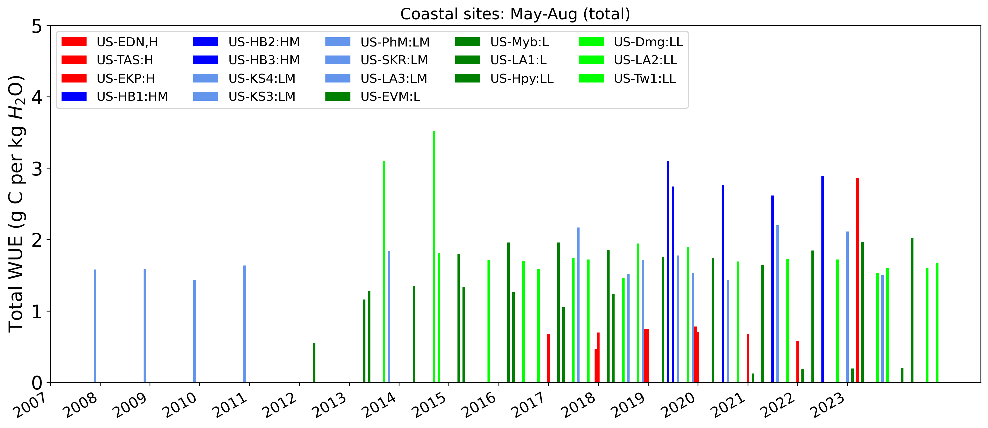
Motivation behind using ERA5 data
Previous analysis removing April and sep helped with increasing sample size
Some sites three days to 2 weeks of data missing even after ustar gap filling in growing season.
Sometimes fluxes are present and long gaps ( no September after aug) in meteorologic variables (require for GPP, reco).
US-SKR
25% of data missing
after gap filling 3% of data missing
with or without ERA5
ERA5 data is biased
Notes:
US-SKR

Slide 2
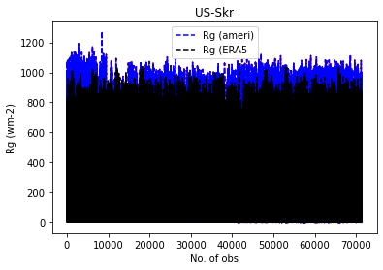
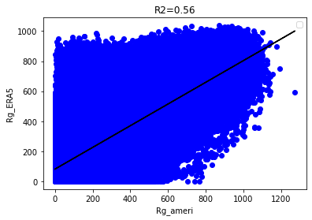
Only growing season. For whole year 0.7 R2
Notes:
Use era to predict Ameri Rg

Slide 3
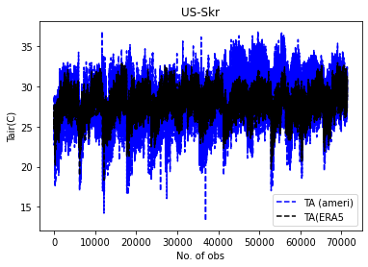
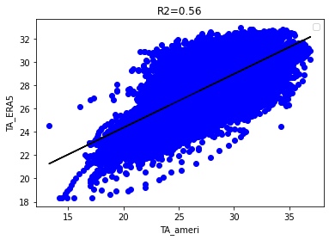

Slide 4
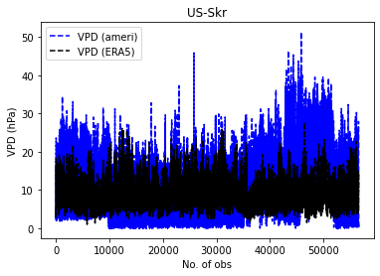
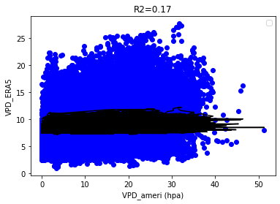
Notes:
Convert dew point to relative humidity and get relationship

Slide 5
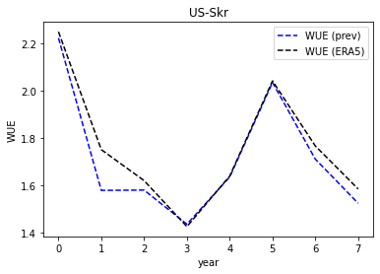
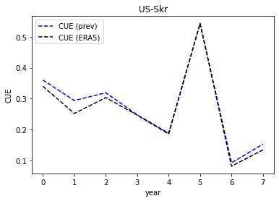

Slide 6
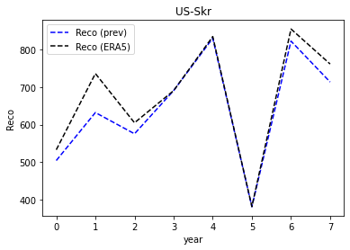
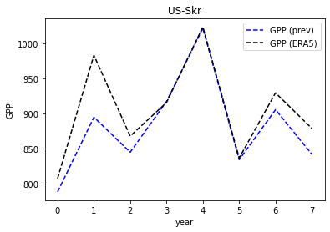

Slide 7
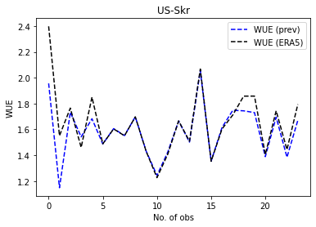
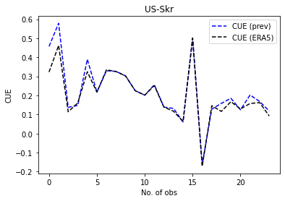
Monthly: GPP and reco converted to gCm-2

Slide 8
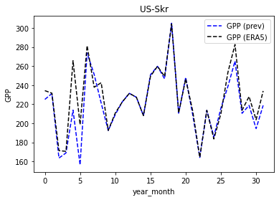
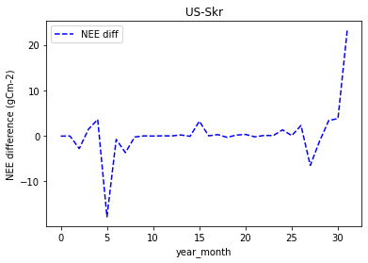

Slide 9
Don’t use ERA5 for filling three days to two weeks of gaps in data.
Because it did not help.

Slide 10
When to use ERA5 data
Data had gaps in NEE . But reddy proc calculated GPP even when NEE was missing because meteorological data has no gaps (from ERA5).
Don’t use GPP if NEE or LE is missing because can’t calculate WUE.
How to find correction factor for ERA5 data, if a variable is completely missing.

Slide 11
When to use ERA5 data
5 sites, missing atleast one meteorological variable completely so I meteorology, use ERA5 data
Sites where fluxes are present but gaps in meteorology so GPP can not be calculated, so use ERA5 data

Slide 12
Don’t use GPP is NEE was not gap filled
It does not partition NEE but estimate parameters and give NEE
For Alsaka it makes sense
How to find that correction factor.
Sites where LE and NEE present but long gaps in TA, VPD, Rg will not give us GPP. On those sites, use ERAS data
Rule about that

Slide 13
LE/Rg rule to gap fill LE
Linear model for bias correction
Rule if 50% data missing blend it after correction
Remove a year if nothing there

Slide 15
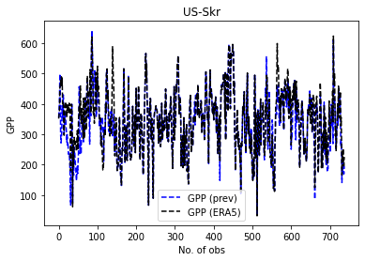
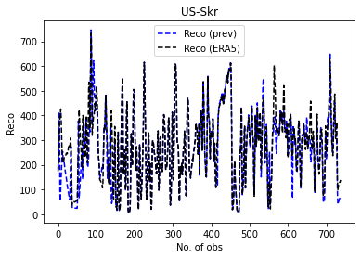
Daily , gCm-2
µmolCO2 m-2 s-1
Notes:
µmolCO2 m-2 s-1

Slide 16
NEE difference (gCm-2) half hourly

Slide 17
Quality Check
Negative Rg values at night cause negative GPP.
Replace negative nighttime Rg with zero
Era data does not negative Rg, Replace negative Rg with Era Rg
Don’t do any thing because bias effect
Reco is fine
PAR different unit umol
Calculate GPP with Rg and PAR
Tried solution 1, all GPP values are in +ve
Compare precip for all sites and compare with daymet

Slide 18
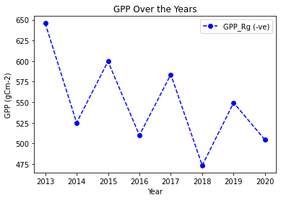
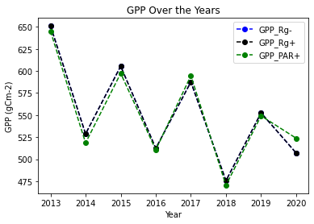
Notes:
Phm

Slide 19
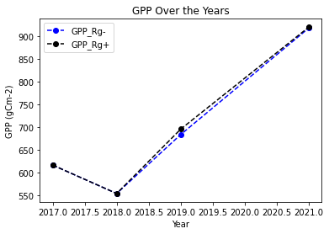

Slide 20
Quality check of gap filled data
US- Tas air temp for 2022 few days missing, so zero GPP (eras air temp), Rg is missing for 2022
Evm fix VPS and gapfill again
US-ks4 three days negative GPP (input variables are fine)
US- Myb 2013-2016 Rg is missing
US-EKP, 2023 few days of Rg is missing in may
US-phm 2017, 2020 few days of Rg is missing in may
Negative Rg values at night cause negative GPP.
Replace negative Rg with zero or era data
Era data does not negative Rg because it night time Rg is zero
Reco is fine
Make Rg negative values nan and replace then with ERA data
Do I need to convert Rg wm-2 to PPFD unit or umol / m2 / s? mutiplu
If made –ve Rg is zero only fixing night time, biasing my results. Because I am not fixing day time
Solution: ERA data
Make –ve Rg to zero
Don’t do anything
Make R hat as close to as 1
Notes:
PAR, Rg conversion
https://www.researchgate.net/post/How_to_convert_mol_m-2s-1_to_MJ_m2_day_to_calculate_accumulated_incident_PAR_of_whole_day

Slide 21
Quality check for Tair, VPD, Rg
US-EVM (Florida) VPD should be in hecta pascal but given in kpa. So multiply it with 10
SWin can be 1200 wm-2 (US-EVM)
US-EKP (California) Rg is zero for first 13 days in May. So zero GPP but respiration is present . I was using PI Rg because reddyproc code night time did not work. Solution use ERA Rg data.
If temp is below growing season, GPP zero, resco, all nee will be reco.
If GPP is zero force reco to be equal to NEE
If GPP is negative make it zero and reco equal to nee

Slide 22
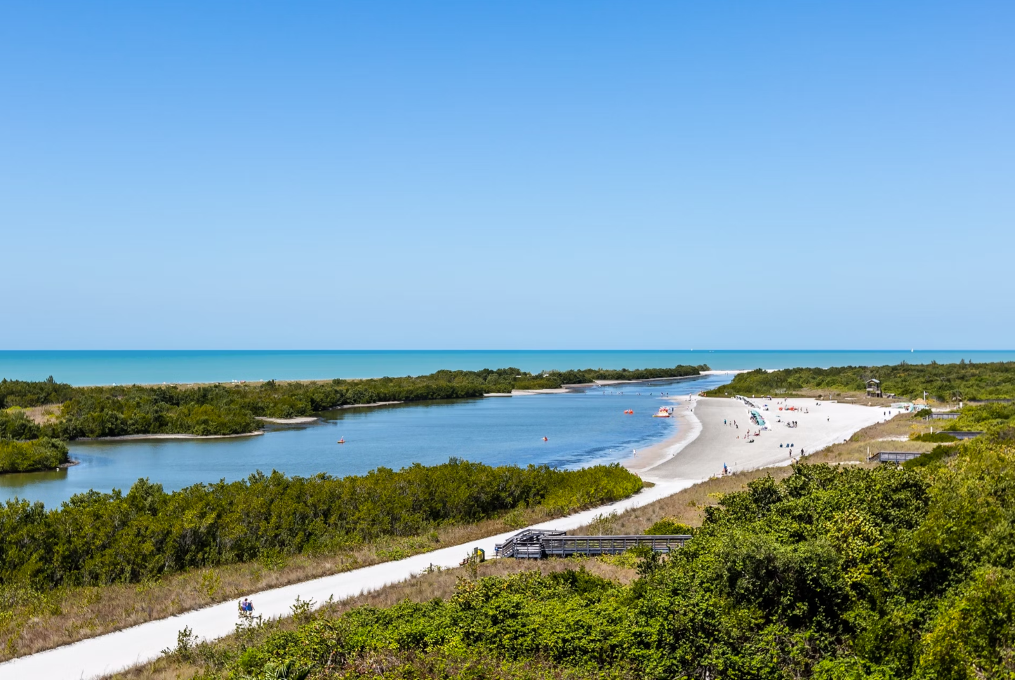
Water Use and carbon use efficiency
Ammara Talib
Sparkle Malone’s Lab
Yale School of Environment
12-20-2024
Notes:
Understand the variation in WUE within and across ecosystems.
Objectives
How much WUE changes within ecosystems
Whether differences in WUE across ecosystems resemble ecosystem variability
Determine if WUE in coastal ecosystems denotes salinity stress.

Slide 23
Objectives
How much WUE, CUE changes within ecosystems
Whether differences in WUE, CUE across ecosystems resemble ecosystem variability
Determine if WUE, CUE in coastal ecosystems denotes salinity
Notes:
Understand the variation in WUE and CUE within and across ecosystems.

Slide 24
Focused sites
US-Skr: Shark River Slough (Tower SRS-6) Everglades, 2004-present, Evergreen Broadleaf Forests, salinity range (20-30 ppt), Florida, (SRS6, SRS5 salinity data), high salinity in may June
US-Tas Taylor Slough/Panhandle. 2016-2021, wetland (Florida)
US-EvM: Everglades Saltwater intrusion marsh, 2020-present, wetland (salinity >18 psu), Florida
US-KS3: Kennedy Space Center (salt marsh), 2017-2020, wetlands (salinity<6 ppt, > 6 ppt) fluxnet (2018), Florida
US-KS4: Kennedy Space Center (Spartina marsh), 2017-present (~ 6 ppt), wetlands, Florida
US-EDN: Eden Landing Ecological Reserve, 2018-present, wetland , 30–35 ppt, mean 34 ppt (26-46 range), fluxnet (California), fluxnet
US-Dmg: Dutch Slough Marsh Gilbert Tract, wetland 2021-present, California
US-MCP: Moro Cojo Slough, PG&E Treatment Wetland, 2023-present, wetlands California
US-EKY: Elkhorn Slough Yampah Marsh, wetland 2022-present, California
US-EKP: Elkhorn Slough Porter Marsh, wetlands, 2022-present, California
US-EKN: Elkhorn Slough North Marsh, 2023-present, 2023, California
US-Myb: Mayberry Wetland, CO2, CH4, H2O, 2010-present California, little far
US-Tw1: Twitchell Wetland West Pond , Reference site to compare US-Myb, California, reference site
US-Srr, Suisun marsh - Rush Ranch, salinity 4.6 (0.25–12.3), 2014-present, wetlands fluxnet (2014-2017), wetlands (California) fluxnet
Notes:
MCP, EKY, EKN (quality control pending)
https://ameriflux.lbl.gov/sites/siteinfo/US-MCP
https://ameriflux.lbl.gov/sites/siteinfo/US-EKY
https://ameriflux.lbl.gov/sites/siteinfo/US-EKN
Going through iterative process. First looking at coordinates on google maps, literature to find salinity for particular years and then include sites back even bit far
Can include far away sites as reference

Slide 25
15. US-HRP: Herring River Phragmites, wetland, 2017-present, wetland, salinity 4–25 psu, (Cape Cod, Massachusetts)
16. US-BSM: Barnstable Great Marsh, 2017-present, wetlands, cape code, Massachusetts
17. US-PHM: Plum Island High Marsh, 2013-present, salt marsh, wetland, Massachusetts
18. US-PLM: Plum Island Low Marsh, 2015-present, 29.1 (25–33), mean (range), wetlands, Massachusetts
19. US-PLo: Plum Island Oligohaline Marsh, 2022-present , wetland, Massachusetts
20. US-HB1: North Inlet Crab Haul Creek, 2017-present, wetland, salinity 32 PSU, fluxnet (2019), South Carolina
21. US-HB2: Hobcaw Barony Mature Longleaf Pine, 2018 present South Carolina, close to coast
22. US-HB3: Hobcaw Barony Longleaf Pine Restoration, 2019-present south Carolina, close to coast
23. US-StS: Strawberry Swamp, 2015-2016, wetland, south Carolina
24. US-LA1: Pointe-aux-Chenes Brackish Marsh, wetland, (Louisiana), 2011-2012
25. US-LA2: Salvador WMA Freshwater Marsh, 2011, 2022, wetland Louisiana
26. US-LA3: Barataria Bay Saline Marsh, 2019-present , wetlands, salinity range (6-18 ppt) (Louisiana)

Slide 26
27. US-HPY, Hawk Property, 2012-2019, wetland, urban tidal, New Jersey, river near bay
28. US-MRM. Tidal marsh, salinity (1-10 ppt), 2009-2019, wetlands (New Jersey) river near bay salinity
29. US-A03: ARM-AMF3-Oliktok. Alaska tunda, BSV (Barren Sparse Vegetation: 2014-present (Alaska)
30. US-A10: ARM-NSA-Barrow, 2012-present (Barren sparse vegetation), Tundra (Alaska)
31 US-Atq: Atqasuk, wetland, 1999-present, Tundra (Alaska)
32. US-NGB: NGEE Arctic Barrow, 2012-2023, Tundra, fluxnet, wetland (Alaska), fluxnet
33. US-StJ: St Jones Reserve, 2015-present, tidal, 10 (0.3–23) mean and range, wetlands, fluxnet, long (2015-2017), Delaware
34. US-VFP, 2014-present, salt marsh, wetland (Virginia)
35. US-Tx9: Sargent Unit Salt Marsh, 2017-present, wetlands, Texas

Slide 27
High, High medium, medium low, Low, very low
High Salinity, Low WUE, exception EKP in California, exception recent years
2013: very low salinity sites has higher WUE compared to sites with low and low medium salinity
2014: very low salinity has higher WUE compared to sites with low salinity
2017: very Low salinity and low salinity sites has higher WUE compared to sites with high salinity
Very low, low and high medium switch places
Notes:
Did the salinity change

Slide 28
Mutidimentional scaling (PCI, PC2) (PC1, PC2)
Distance (mass)
Cluster (caret)
Driver pattern (caret)

Slide 29
End of January all sites (possibly) sites
Feb: cluster analysis
March: WUE, cluster, CUE
April: Analysis base of salinity, ecosystem type (forest, wetland, temp, precipitation)
Slope
Landsat, modis spectral data
Apears NDVI

Slide 30
Monthly data how to deal gaps in only one year
Add a nan column and remove that month from monthly data
Replace zero with nan

Slide 31
Processed data from MA, New Jersey, South Carolina
For one site US-PhM in MA, longer gap in Rg so replace gpp day time missing values with gpp nigh time values
2017,2020 remove for US-PhM or replace with night time GPP
Rg missing for lousiana and Delaware sites (long gaps)
Some sites no radiation data at all (remove that site)
Scale Rg to PAR
Era5 Rg

Slide 32
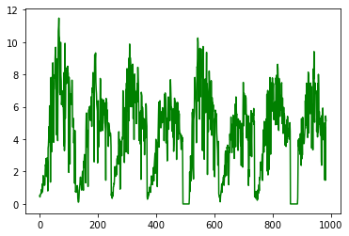
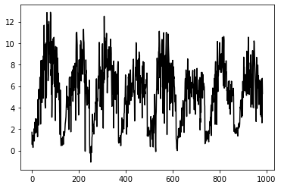
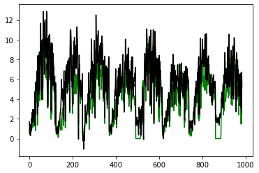
GPP_Light response curve
GPP_night time fluxes

Slide 33
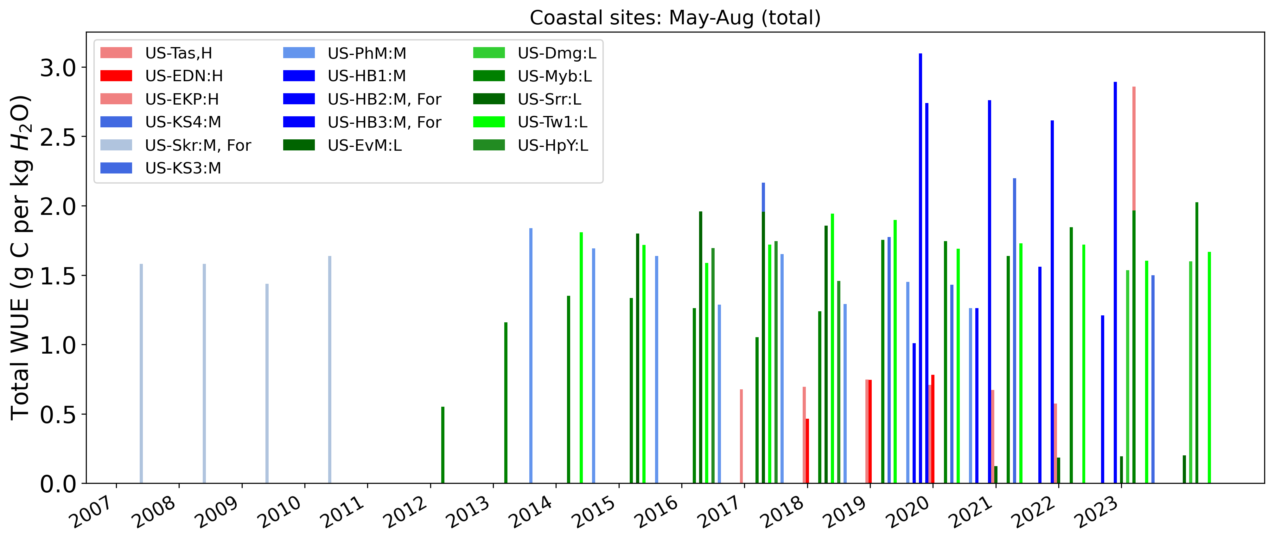
16 sites

Slide 34
Next Steps
Break down medium salinity into 2-3 categories
Data from Alaska
Slope between GPP and ET (monthly data)
CUE
Cluster analysis Mangroove issue, Salinity, MDS

Slide 35
Adina paytan, California coastal site. Graduate student working on the data new sites

Slide 36
automate
NEE_PI, NEE_1_1_1
First use data from PI, otherwise you this
Colesce function use that rule to write a code

Slide 37
Research talk
Why water or carbon accumulation while we are trying to reduce it
Your contribution to your field
Tell a story
Teaching talk……add elements that other people don’t use
Polling to do surveys students. Scale of thumb. Average of all thumbs and paired up
Different you can do this teaching. You are going to use it. Does not need to have experience of doing it
Integrate AI to teaching class

Slide 38
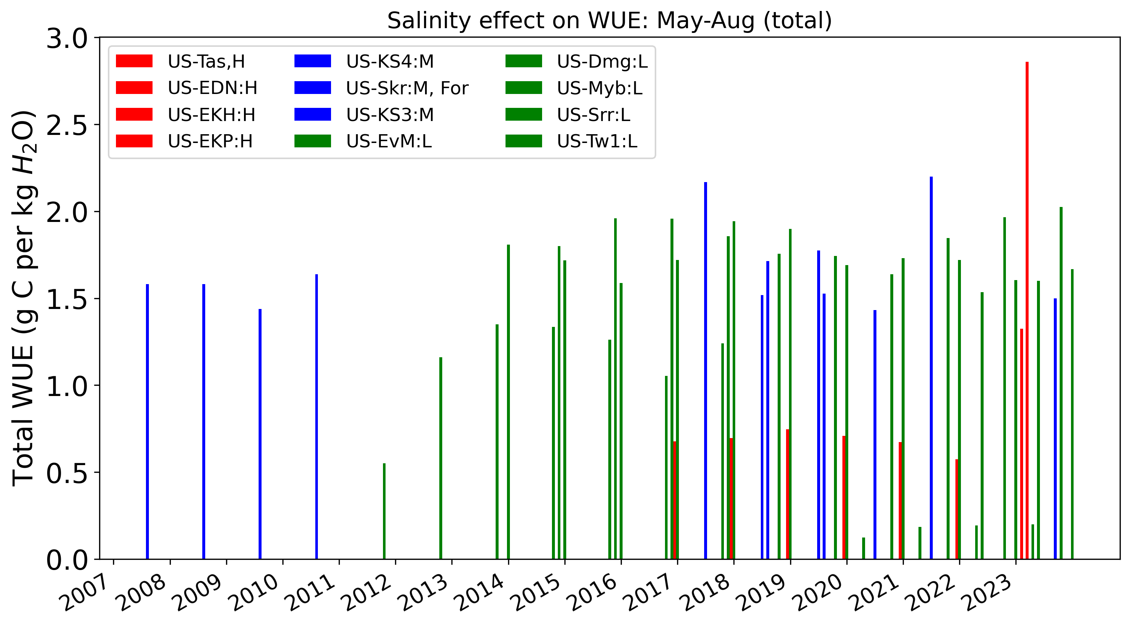
Compare red with blue: high salinity versus low salinity
2017-2020: low WUE at high salinity, high WUE at low salinity and medium salinity (2017-2020), exception US-EKP site
2023: regional differences
Notes:
Salinity effect on WUE is shown by dividing the study sites into three categories. (H: high salinity, M: medium salinity, L: low salinity). Red bars show sites with high salinity, blue bars show sites with medium salinity and green sites show sites with low salinity.
To study the effect of salinity of WUE,12 study sites were divided into three categories based on salinity, high salinity (>30 ppt), medium salinity (>10 ppt and < 30 ppt) and low salinity (<9 ppt). Based on data from 2017-2020, low WUE is observed at sites with higher salinity. On the other hand, high WUE was observed on sites with low salinity. US-EKP site from California was the exception. That could be because, on some sites plants are adapted to high salinity.

Slide 39
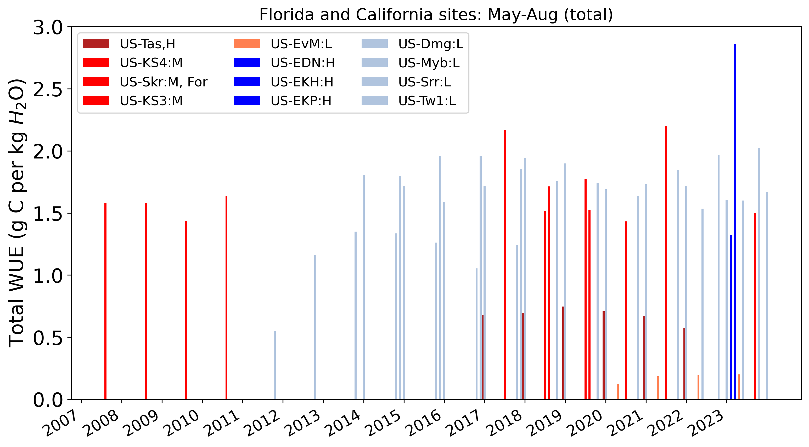
Florida sites: shades of red
California sites: shades of blue
2023: California sites higher WUE . Also because those CA sites have low salinity
Difference in WUE at medium and low salinity sites is not clear yet.
Notes:
Five siFlorida are shown in different shade of red, while seven sites in California are shown with different shade of blue. Sites in California fall under low and medium salinity, while sites in Florida fall under all three categories of salinity. Figure shows that difference in WUE can not just be attributed to salinity because there are some regional difference as well. tes from

Slide 40
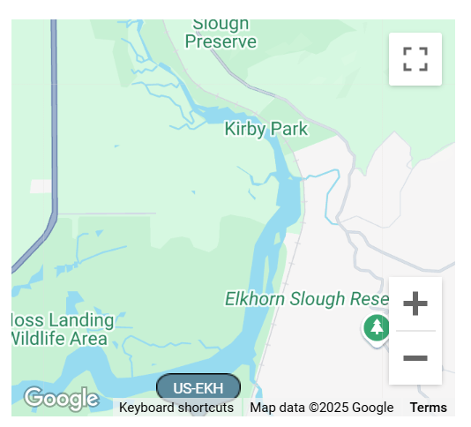
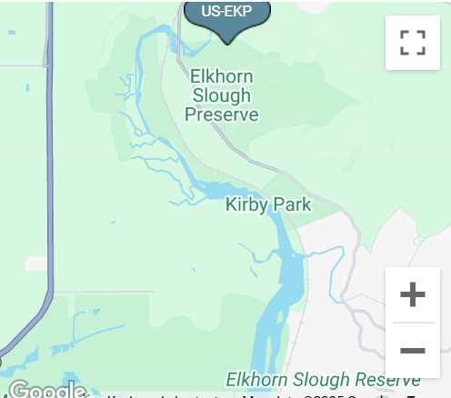
VPD, ustar and air temp in US-EKH was missing for 2023 after march so replaced by EKP
But values similar
Remove EKH
Notes:
VPD in US-EKH was missing for 2023 after march so replaced by EKP
RH is also missing , ustar is missing . But values similar

Slide 41
Notes
Even though growing season is different but months we selected seem to cover the days with high ET
Delay is growing season or growing season get longer included September, Included sept to account for late growing season but sep does not com on top, 6,7,8 come on top even for California
# initially included April because high salinity,
#remove April, sept, some years missing April and September. Hence my including them we will lose years with no April and sept data.
Later only include June, July

Slide 42
Notes
Compare months with salinity (bring more years, even if one month is missing, you can still use august from that year. Hence more years of data
Slope
Delta EVI. Pattern in EVI follow salinity. Modis, landsat signal harmonized product. Download point location. EVI versus salinity continuous salinity data. delta EVI. Change in EVI standardized 0-1. don’t standardize salinity

Slide 44
California Sites
US-TW1 (Twitchell Wetland West Pond ) WUE increase until 2016 then drop
US-Myb (Mayberry Wetland) WUE consistently increase after 2016
CUE trend is not always inverse to WUE
Analysis beast analysis
Petite test
Trend of different length. Min 5 years
Long term trend
Abrupt change, trend, driver of that change
Notes:
Mayberry Wetland
Twitchell Wetland West Pond

Slide 45
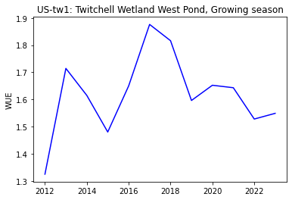
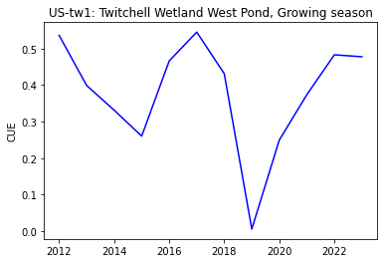
Notes:
US-TW1 WUE increase until 2016 then drop
US-Myb WUE consistently increase after 2016
CUE trend is not always inverse to WUE

Slide 46
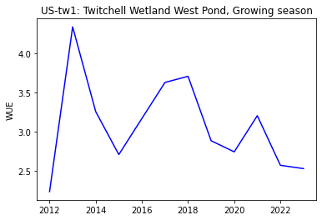
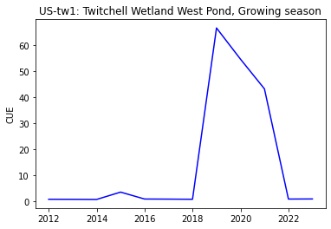
Maximum WUE: How will you calculate

Slide 47
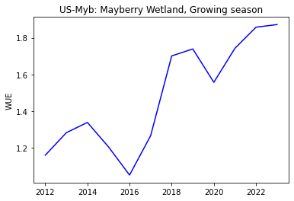
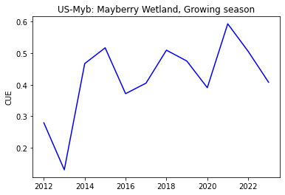
Notes:
US-Myb

Slide 48
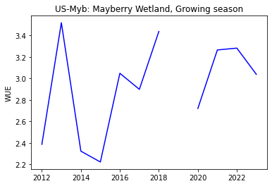
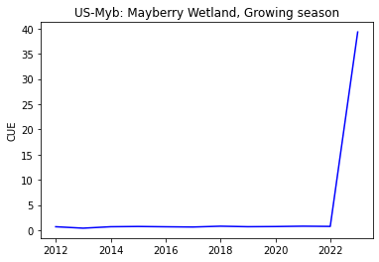
Slope or move to next reasonable value

Slide 49
Calculate slope by year
Maximum how to calculate slope

Slide 50
Background
Measuring soil moisture and hydro-edaphic factors is complex
WUE as a measure of capturing shifts in soil condition
Carbon and water cycle are linked.
Increase WUE: less water is lost per unit of carbon fixed, reducing the total carbon fixed (more carbon loss).
Decrease WUE: maximizing carbon gain (increased photosynthesis) can result in higher water loss
WUE= GPP/ET, CUE=NEP/GPP, NEP=GPP-Res
Climate change effect on water and carbon cycle: Drought: WUE increases (abiotic), Humid: WUE decrease (biotic factor)
Notes:
Measuring soil moisture and hydro-edaphic factors is complex. Because Vegetation responds to water availability in the soil, measuring changes in WUE may be an efficient means of capturing shifts in soil conditions and detecting salinity shifts in coastal ecosystems.
Water use efficiency (WUE) is the relationship between carbon gain and water loss and was introduced over a hundred years ago
Global carbon and water cycles are tightly linked through the plant stomatal conductance that limits water loss through transpiration at the cost of limiting carbon uptake
Plants often face trade-offs in balancing water loss and carbon gain. While increasing WUE typically means less water is lost per unit of carbon fixed,
Climate changes will affect the carbon and water cycles individually and in aggregate.
Reducing the total carbon fixed means a carbon loss because "carbon fixation" refers to the process where carbon dioxide is converted into organic compounds by plants, so a reduction in carbon fixation indicates less carbon is being captured from the atmosphere and stored as organic matter, resulting in a net loss of carbon.

Slide 51
Methods
Gap filled LE, NEE
Partitioned NEE to GPP and Res
Day time (light response curve) and nighttime fluxes
Day time (higher photosynthesis, LRC)
Calculate WUE and CUE

Slide 52
Look at California sites separately to get an idea of growing season, when is high temp and ET
Changes in salinity: across time
Average salinity monthly
GPP (y axis), ET (x) graph slope on monthly data. can calculate slope by year or slope by site.
As leaf out happening, because take a while , California feb, April , check NEE, GPP
Graph WUE (monthly on y) and salinity on x axis. In this graph several months in a year

Slide 53
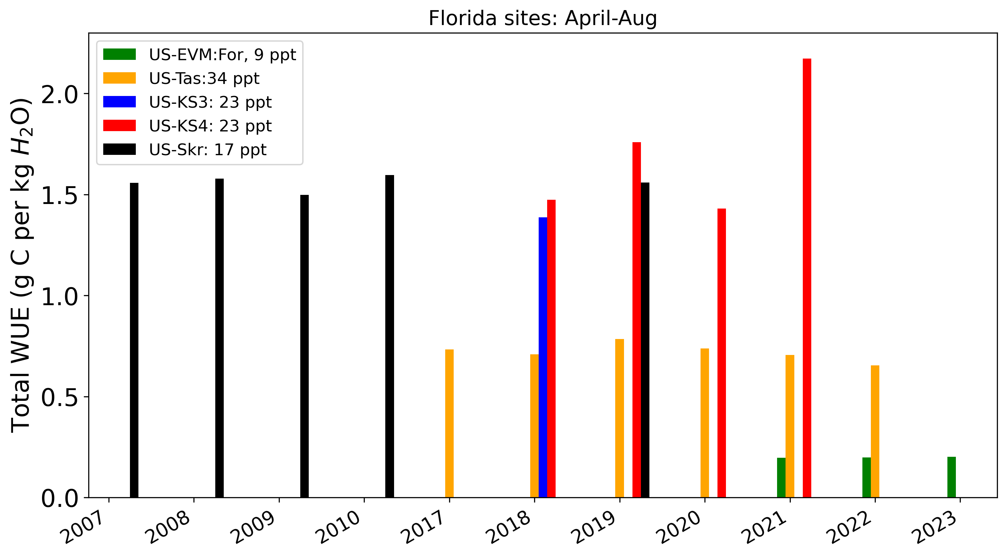
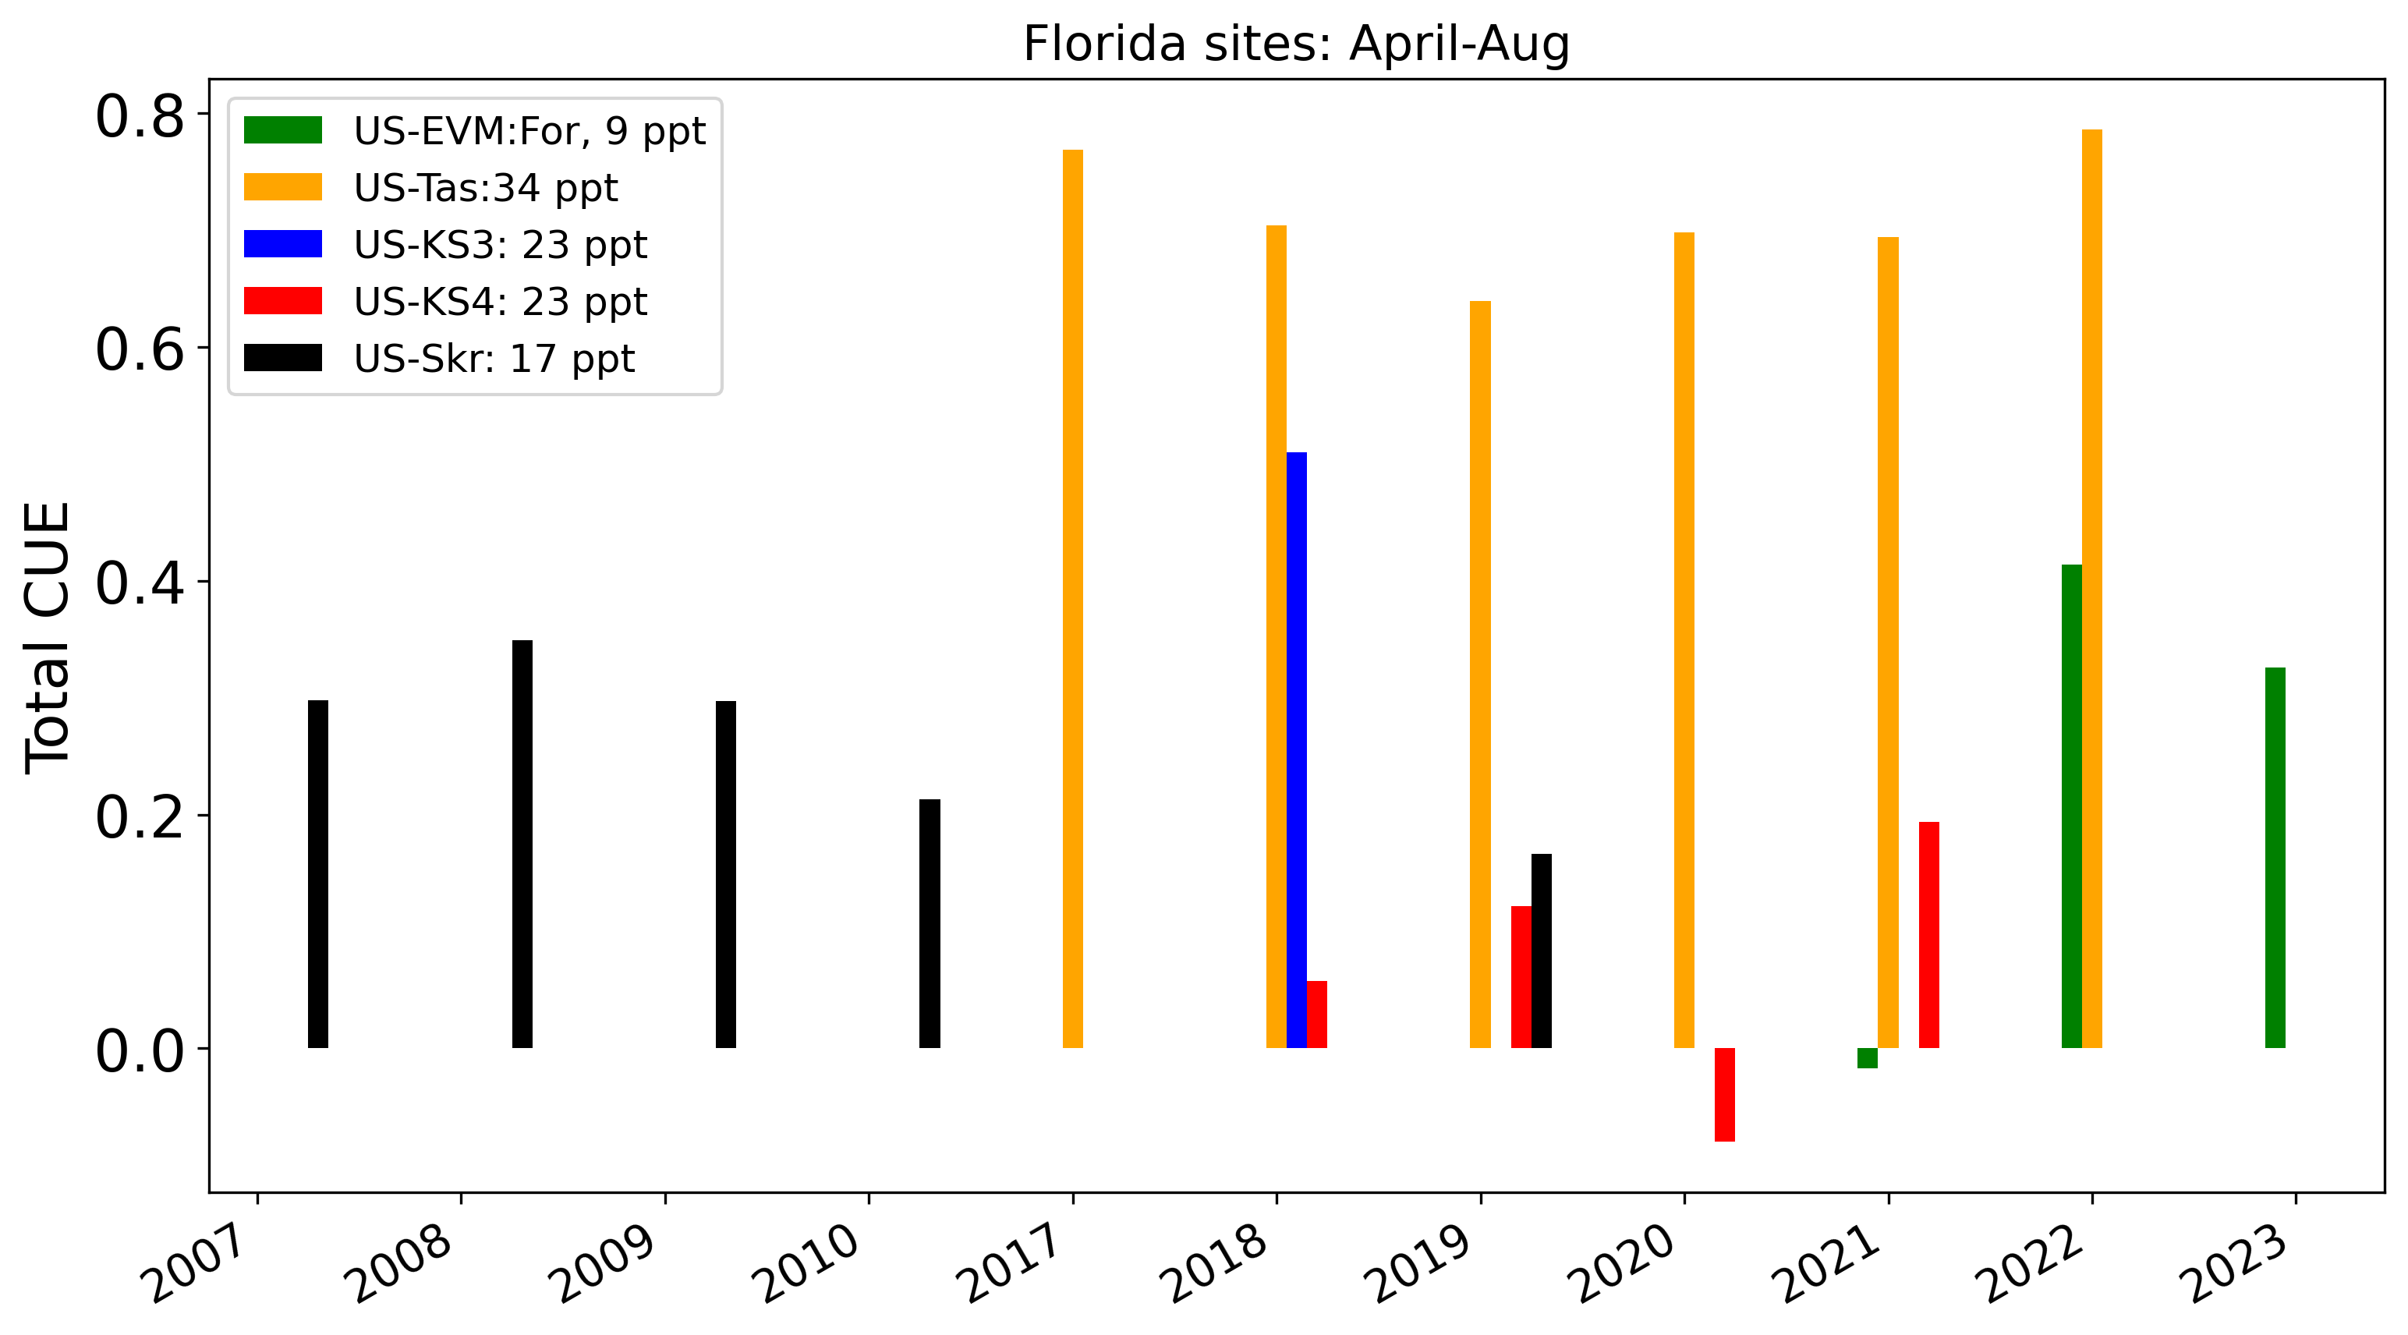
5 Florida sites
Salinity:9-34 ppt
Compare sites in the same year
2018: US-Tas higher salinity, lower WUE
2019: US-Tas higher salinity, lower WUE
2021: US-EVM lower salinity, low WUE
Different biome forest versus wetland
low salinity and high salinity both means low WUE
US-Tas: high salinity, high CUE

Slide 54
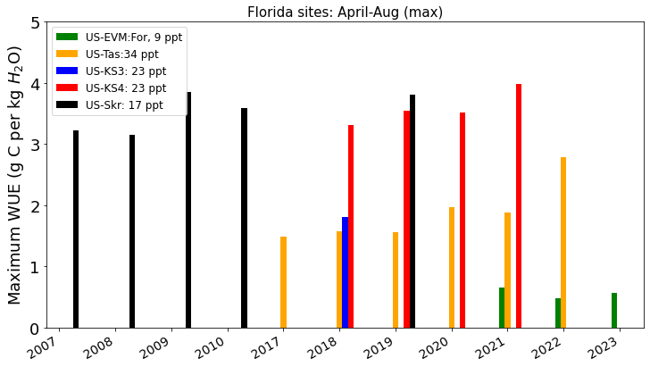
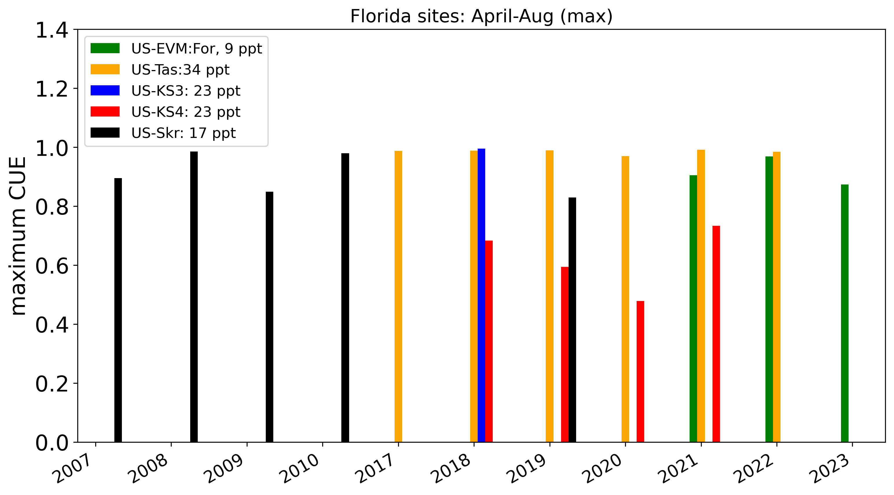
Salinity:9-34 ppt
Compare sites in the same year
2018: US-Tas higher salinity, lower WUE
2019: US-Tas higher salinity, lower WUE
2021: US-EVM lower salinity, low WUE
Different biome forest versus wetland
low salinity and high salinity both means low WUE

Slide 55
Site name | NEE gcm-2 | ET mm | GPP | NPP | WUE=GPP/ET | CUE= NPP/GPP | Salinity (min, max, avg) ppt, psu Growing season, April-aug
US-EvM (2021-2023) wetland | -43 to 9 | 724-760 | 146-151 | -2-63 |  |  | 1-16 ppt range Avg 9ppt
US-Skr (2007-2010, 2019) Forest | -402 to -328 | 677-792 |  |  |  |  | 2004-2022 0.1-37.2, avg 15.0 April-June highest salinity 19 ppt (2009) 15 ppt (2004-2022)
US-KS4 (2017-2021) wetland | -232 to -10 | 431-500 |  |  |  |  | 23 ppt (2021-2024)
US-KS3 (2018) wetland | -349.6 | 477 |  |  |  |  | 23 ppt (2021-2024)
US-TaS (2017-2022) wetland | -490 to -82 | 499-587 |  |  |  |  | 2024 average 27.9 ppt 33 ppt (2009)
Notes:
NEP = GPP - ER, with GPP = gross primary production.
and
NEE = -NEP
Common years
2021,2022,2023

Slide 56
Site name | NEE gcm-2 | ET mm | GPP | NPP | WUE=GPP/ET | CUE= NPP/GPP | Salinity (min, max, avg) ppt, psu Growing season, April-aug
US-Dmg 2022-2023
US-EDN 2018-2021 |  |  |  |  |  |  | 24.2 ppt in Apr 2006 Jul 2005: 68ppt, aug 2005: 77ppt Jul 2006: 53ppt, aug 70ppt 2003-2005: April-aug 60-70 ppt
US-EKH 2022-2023
US-EKP 2021-2024
US-Myb 2011-2023
US-Srr
US-Tw1
Notes:
NEP = GPP - ER, with GPP = gross primary production.
and
NEE = -NEP
Common years
2009
2021
2017,2018
2022

Slide 58
First do yearly analysis
Question
US-Dmg no storage term for Co2 fluxes
NEE=FC+SC

Slide 59
Do monthly and then plot monthly salinity and monthly WUE

Slide 60
Effect of salinity on NEE/ET
NEE/ET
Low salinity: Higher NEE/ET ratio
Higher NEE/ET ratio seem to decrease with high salinity, but then bounce back

Slide 61
Focused sites
US-Skr: Shark River Slough (Tower SRS-6) Everglades, 2004-present, Evergreen Broadleaf Forests, salinity range (20-30 ppt), Florida
(SRS6, SRS5), high salinity in may June
US-Tas Taylor Slough/Panhandle. 2016-2021, wetland (Florida)
US-EvM: Everglades Saltwater intrusion marsh, 2020-present, wetland (salinity >18 psu), Florida
US-KS3: Kennedy Space Center (salt marsh), 2017-2020, wetlands (salinity<6 ppt, > 6 ppt) fluxnet (2018), Florida
US-KS4: Kennedy Space Center (Spartina marsh), 2017-present (~ 6 ppt), wetlands, Florida
US-EDN: Eden Landing Ecological Reserve, 2018-present, wetland , 30–35 ppt, mean 34 ppt (26-46 range), fluxnet (California), fluxnet
US-Dmg: Dutch Slough Marsh Gilbert Tract, wetland 2021-present, California
US-MCP: Moro Cojo Slough, PG&E Treatment Wetland, 2023-present, wetlands California
US-EKY: Elkhorn Slough Yampah Marsh, wetland 2022-present, California
US-EKP: Elkhorn Slough Porter Marsh, wetlands, 2022-present, California
US-EKN: Elkhorn Slough North Marsh, 2023-present, 2023, California
US-Myb: Mayberry Wetland, CO2, CH4, H2O, 2010-present California, little far
US-Tw1: Twitchell Wetland West Pond , Reference site to compare US-Myb, California, reference site
US-Srr, Suisun marsh - Rush Ranch, salinity 4.6 (0.25–12.3), 2014-present, wetlands fluxnet (2014-2017), wetlands (California) fluxnet
Notes:
Going through iterative process. First looking at coordinates on google maps, literature to find salinity for particular years and then include sites back even bit far
Can include far away sites as re
Mayberry Wetland
Twitchell Wetland West Pond

Slide 62
Survey question
1: Salinity
2: Fresh waster, salt intrusion, ID of your site
3: Gap filled data
4: Salinity range or value
5: Any other site other than sites written above
Email all PI, In intro write names of all sites
should i use xgboost for all sites for consistency
GPP?
email ameriflux

Slide 63
Do across sites, growing season (May-sept) temp cut off for growing season
Filter data by temp. above 5 degree Celsius , height of growing season. For warmest month what is WUE. What is maximum WUE
July warmest month
Height of growing season and WUE for those time.
There are other ways to calculate WUE, if dont want to use GPP.
NEE can be use used as NEP. Can I calculate
Look for conditions, multiple years WUE, relative moisture condition. Is it because of precip , drought, moisture index. Climate change or salinity
Growing season WUE. How many years , conditions of those site
Scale: day, month

Slide 64
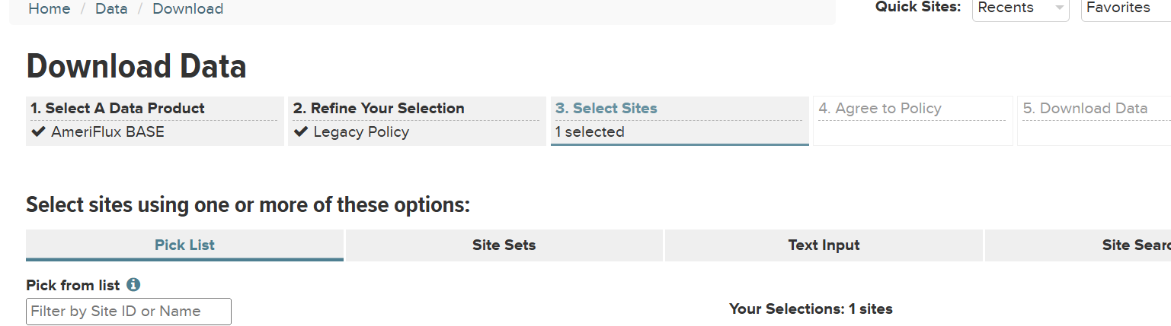
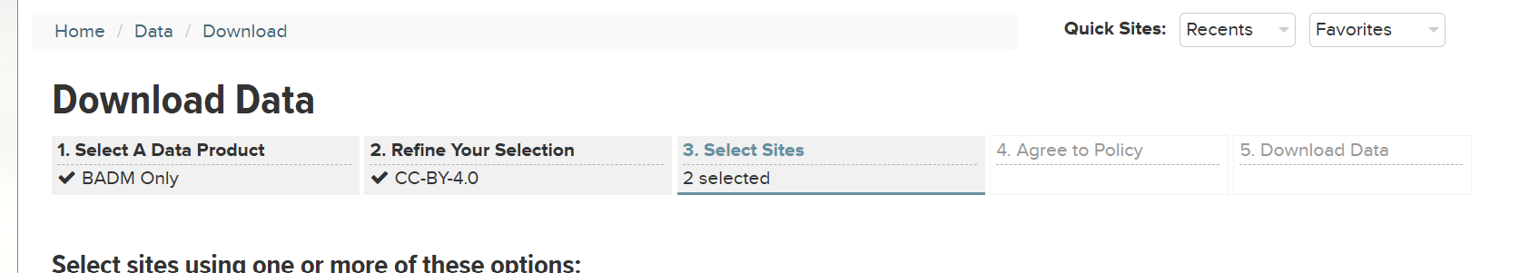

Slide 65
32 sites
10 sites short term gap filled (fluxnet data)
17 sites with long term data
1 site with gap filled short term
14 sites missing data

Slide 66
10 ameriflux site
US-EDN
US-NGB
US-ASH
US-Srr
US-ASM
US-PSH
US-PSL
US-HB1
US-KS3
US-StJ

Slide 67
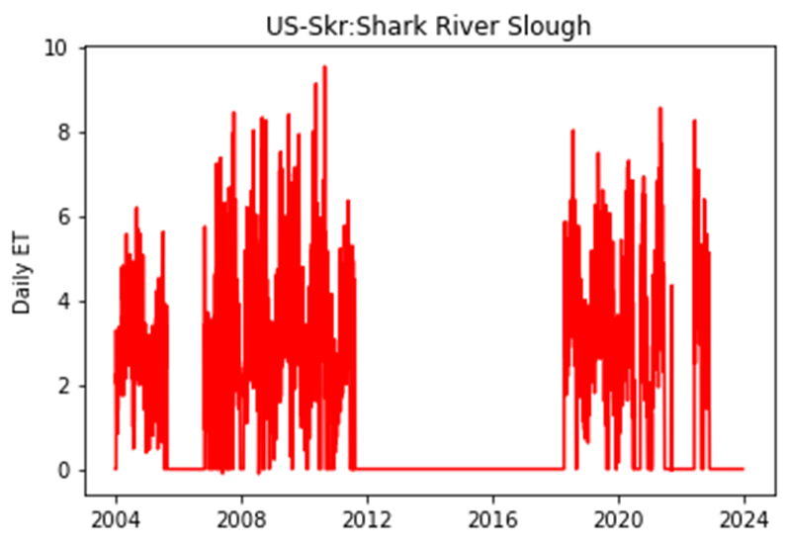
Data
Total 32 sites
19, Wetlands
5, forest
4, Tundra
3, Marsh
1, Desert
Notes:
Some reason to believe
Just use data. WUE across the site

Slide 68
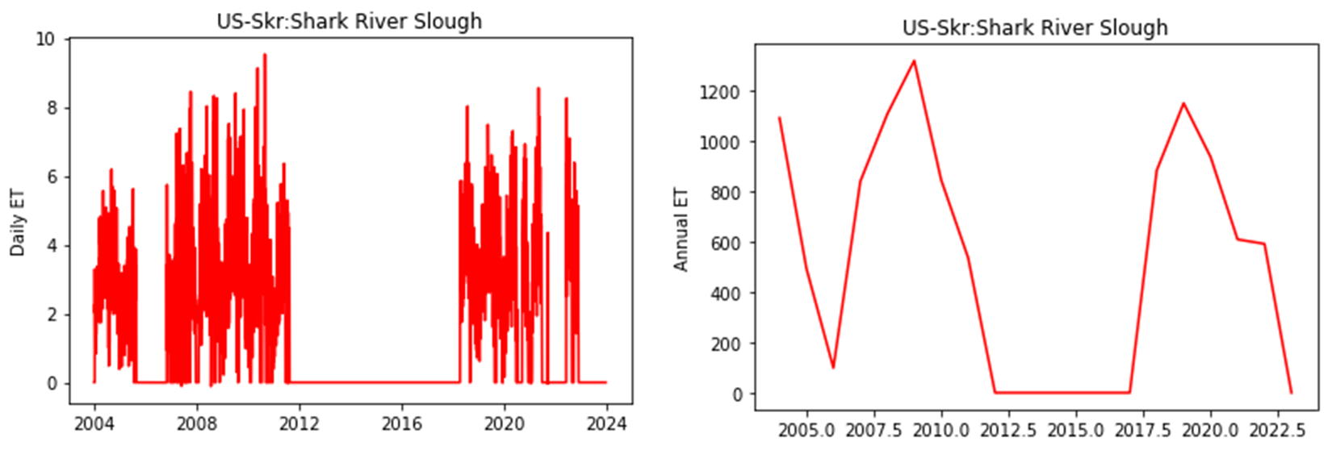

Slide 69
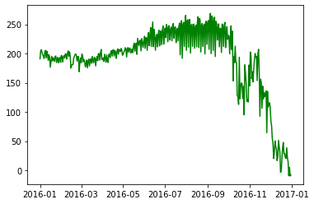
Daily GPP

Slide 70
Do another filter by using wetlands, marsh

Slide 71
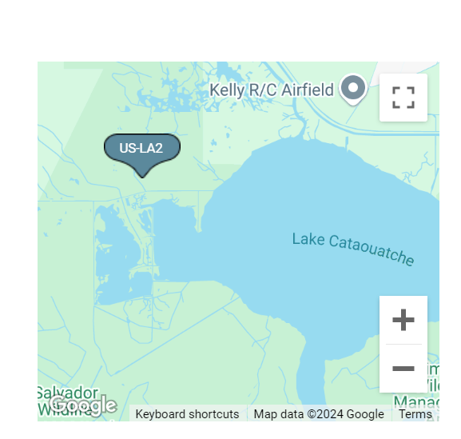
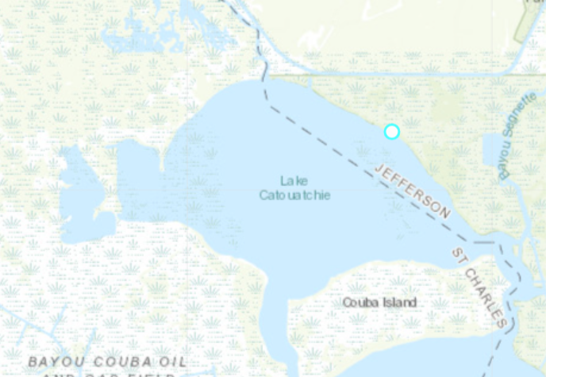
US-LA2

Slide 72
WUE: Coastal Sites
Project Meeting: 10-07-2024
US-Skr: Shark River Slough (Tower SRS-6) Everglades: 2004-present, EBF (Evergreen Broadleaf Forests:, Station SREF1 - Shark River, FL, normal salinity condition
US-EvM: Everglades Saltwater intrusion marsh, 2020-present, wetland. No salinity data. Near cooling canals
US-KS4: Kennedy Space Center (Spartina marsh) wetlands, 2017-present, no salinity data
US-StS: Strawberry Swamp: 2015-2016, normal
US-HB2: Hobcaw Barony Mature Longleaf Pine, 2018-present, normal salinity
US-HB3: Hobcaw Barony Mature Longleaf Pine, 2019-present, normal salinity
US-HB1: North Inlet Crab Haul Creek, 2017-present, normal salinity
Notes:
EBF (Evergreen Broadleaf Forests:
Only Co2:
US-ELM, US ESM, US-MAC
US-KS1, US-KS2, US-KS4

Slide 73
Salt, salinity , coast

Slide 74
US-A03: ARM-AMF3-Oliktok. Alaska tunda, BSV (Barren Sparse Vegetation: 2014-present (Alaska)
US-A10: ARM-NSA-Barrow, 2012-present (Barren sparse vegetation), Tundra (Alaska)
US-Atq: Atqasuk, wetland, 1999-present, Tundra (Alaska)
US-NGB: NGEE Arctic Barrow, 2012-2023, Tundra, fluxnet, wetland (Alaska), fluxnet
US-EDN: Eden Landing Ecological Reserve, 2018-present, wetland , 30–35 ppt, mean 34 ppt (26-46 range), fluxnet (California), fluxnet,
US-ASL: USSL San Joaquin Valley Almond Low Salinity, 2016-present, salinity (0.65-0.964), Deciduous Broadleaf Forests, California, inland salinity,
US-PSL: USSL San Joaquin Valley Pistachio Low, 2016-present, salinity (0.545-1.07), Deciduous Broadleaf Forests, California, fluxnet (2016), inland salinity
US-ASH: USSL San Joaquin Valley Almond High Salinity, 2016-present (0.648-0.964), desert fluxnet (California), fluxnet, inland salinity
9. US-ASM: USSL San Joaquin Valley Almond Medium Salinity, 2016-present, salinity (0.91- 1.835), Deciduous Broadleaf Forests, California, fluxnet (2016), inland salinity
10. US-PSH: USSL San Joaquin Valley Pistachio High, 2016-present, salinity (1.18-2.509), Deciduous Broadleaf Forests, California fluxnet (2016), inland salinity
11. US-Nrf: Nisqually reference, 2017-present, wetlands. 0.0-7.0 psu, Washington , inland salinity
12. US-Nrs: Nisqually restoring, 2017-present, wetlands, 5-30 psu, Washington, inland salinity
13. US-Skr: Shark River Slough (Tower SRS-6) Everglades, 2004-present, Evergreen Broadleaf Forests, salinity range (20-30), Florida
14. US-Tas Taylor Slough/Panhandle. 2016-2021, wetland (Florida)
15. US-EvM: Everglades Saltwater intrusion marsh, 2020-present, wetland (salinity >18 psu), Florida
16. US-KS3: Kennedy Space Center (salt marsh), 2017-2020, wetlands (salinity<6 ppt, > 6 ppt) fluxnet (2018), Florida
17. US-KS4: Kennedy Space Center (Spartina marsh), 2017-present (~ 6 ppt), wetlands, Florida
18. US-LA1: Pointe-aux-Chenes Brackish Marsh, wetland, (Louisiana), 2011-2012
19. US-LA2: Salvador WMA Freshwater Marsh, 2011, 2022, wetland Louisiana
20. US-LA3: Barataria Bay Saline Marsh, 2019-2022, wetkand Louisiana
Notes:
Sites with C02, CH4, H20 data
US-A03, US-A10, US-Atq, US-NGB, US-EDN, US-TaS, US-EvM, US-MRM, US-Srr, US-HPY, US-HRP, US-BSM, US-PLM, US-HB1, US-StJ, US-DMG, US-MCP, US-EKY, US-EKH, US-EKP, US-EKN, US-Plo, US-LA1, US-LA2, US-LA3, US-Myb, US-TW1
Sites with Co2 and H20
US-ASL, US-PSL, US-ASH, US-ASM, US-PSH, US-Skr, US-KS3, US-KS4, US-PHM, US-VFP, US-Tx9, US-HB2, US-HB3, US-StS
Co2 and CH4
US-NC4,
Only Co2
US-KS1, US-KS2, US-GCE
Ask about central valley
Far from coast
US-TX7, US-TX8, US-LA1, using island filter, US-Bi1, US-Bi2, US-Myb, US-Si1, US-Sne, US-Snf, US-Tw1, TW4, TW5, US-Twt: Twitchell Island
too short,,,
Sites that are fresh water
US-xDL: NEON Dead Lake (DELA) fresh water . Does not look like saline water
US-GL1, GL2

Slide 75
21. US-MRM. Tidal marsh, salinity (1-10 ppt), 2009-2019, wetlands (New Jersey) river near bay salinity
22. US-Srr, Suisun marsh - Rush Ranch, salinity 4.6 (0.25–12.3), 2014-present, wetlands fluxnet (2014-2017), wetlands (California) fluxnet
23. US-HPY, Hawk Property, 2012-2019, wetland, urban tidal, New Jersey, river near bay
24. US-HRP: Herring River Phragmites, wetland, 2017-present, wetland, salinity 4–25 psu, (Cape Cod, Massachusetts)
25. US-BSM: Barnstable Great Marsh, 2017-present, wetlands, cape code, Massachusetts
26. US-PHM: Plum Island High Marsh, 2013-present, salt marsh, wetland, Massachusetts
27. US-PLM: Plum Island Low Marsh, 2015-present, 29.1 (25–33), mean (range), wetlands, Massachusetts
28. US-HB1: North Inlet Crab Haul Creek, 2017-present, wetland, salinity 32 PSU, fluxnet (2019), South Carolina
29. US-HB2: Hobcaw Barony Mature Longleaf Pine, 2018 present South Carolina, close to coast
30. US-HB3: Hobcaw Barony Longleaf Pine Restoration, 2019-present south Carolina, close to coast
28. US-StJ: St Jones Reserve, 2015-present, tidal, 10 (0.3–23) mean and range, wetlands, fluxnet, long (2015-2017), Delaware
29. US-VFP, 2014-present, salt marsh, wetland (Virginia)
32. US-Tx9: Sargent Unit Salt Marsh, 2017-present, wetlands, Texas
Notes:
Low, mid, high
WUE is changing
Survery. Whether their site is useful
Is there salt in site
Source of salinity data
Variation in water use efficiency
16 g/L, and the individual salinity values for each site in the secondary study were also in the brackish range (0.5 g/L < salinity < 30 g/L,

Slide 76
US-Dmg: Dutch Slough Marsh Gilbert Tract, wetland 2021-present, California
US-MCP: Moro Cojo Slough, PG&E Treatment Wetland, 2023-present, wetlands California
US-StS: Strawberry Swamp, 2015-2016, wetland, south Carolina
US-EKY: Elkhorn Slough Yampah Marsh, wetland 2022-present, California
US-EKH: Elkhorn Slough Hester Marsh, wetland, 2022-present, California
US-EKP: Elkhorn Slough Porter Marsh, wetlands, 2022-present, California
US-EKN: Elkhorn Slough North Marsh, 2023-present, 2023
US-PLo: Plum Island Oligohaline Marsh, 2022-present , wetland MA
Key words for salt, salinity , estuary, coastal, island, brackish

Slide 77
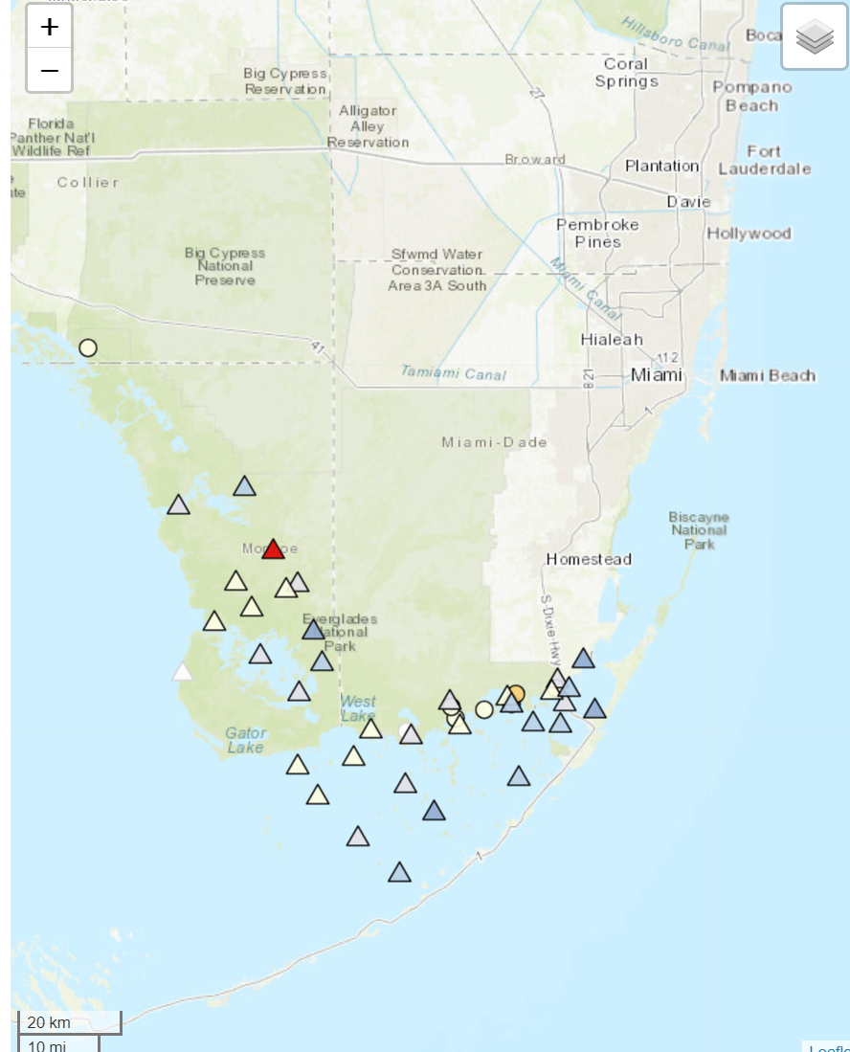
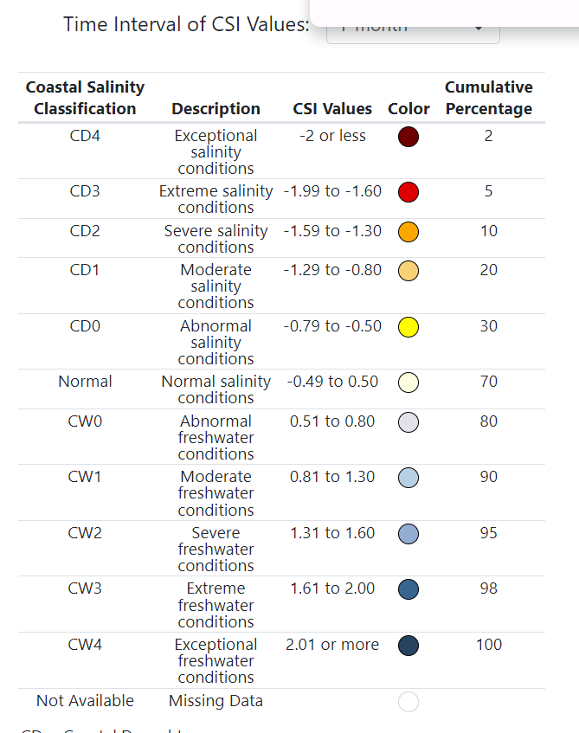
US-PiU
US-TCS
US-DCS
US-SKR
US-EVM:
normal

Slide 78


US-DPP
US-DPW
US-BCM
US-IL1

Slide 79

US-KS4: Kennedy Space Center (Spartina marsh) wetlands, 2017-present
US-KS4
Notes:
US-KS4: Kennedy Space Center (Spartina marsh)

Slide 80


US-GCE
No water data

Slide 81


US-StS: Strawberry Swamp
US-HB2: Hobcaw Barony Longleaf Pine Restoration
US-HB3: Hobcaw Barony Longleaf Pine Restoration
US-HB1: North Inlet Crab Haul Creek
US-HB3
US-HB1
US-StS
US-HB2

Slide 82


Slide 83
US-TCS: Tall Cypress Swamp, 2012-2020
US-DCS: Dwarf Cypress Swamp, 2012-2014
US-PiU: Pine Upland: 2012-2014
US-IL1: 2013 present
US-DPW: Disney Wilderness Preserve Wetland, 2013-2017
US-DPP: Disney Wilderness Preserve Pine Flatwoods, 2010-2016
US-xDS: NEON Disney Wilderness Preserve (DSNY), 2017-present
US-BCM: Blue Cypress Marsh, 2009-2014

