Slide 1

UNEMPLOYMENT IN EUROPE
Ironhack, Data Analytics, 18 Sept 2020
Akinbuwa Oluwadare Sunday
Julia Zimpel
Malon Kraaijvanger
Rinze Douma

Slide 2



UNEMPLOYMENT RATE VS. EMPLOYMENT RATE
Unemployed
aged 15 to 74
without work
actively sought employment
in the last 4 weeks
Employed
no. of people engaged in productive
activities in an economy

Slide 3
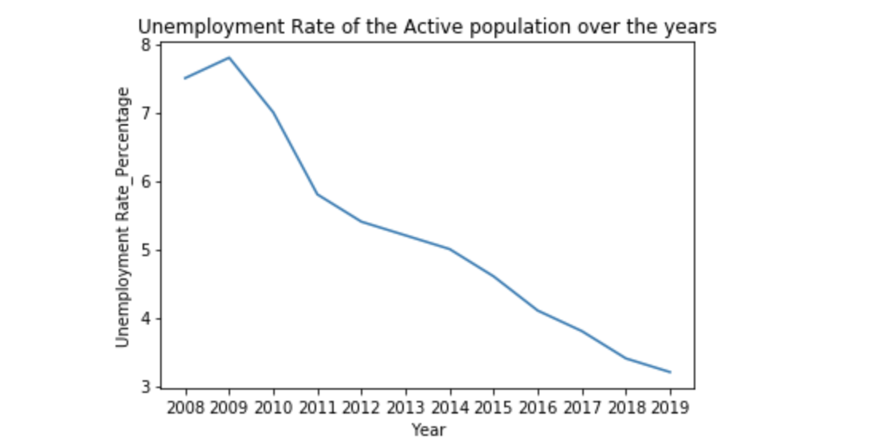
UNEMPLOYMENT DECREASING
FiFinancial Crisis

Slide 4
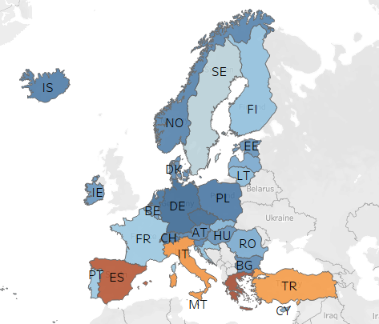
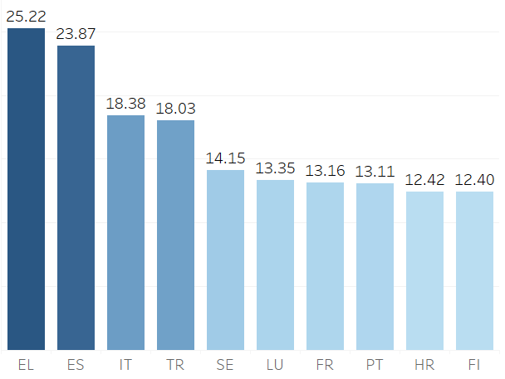
COUNTRIES WITH HIGH UNEMPLOYMENT
Top 10 Countries %
Country Comparison
GERMANY
GREECE

Slide 5
LESS UNEMPLOYMENT IN COUNTRIES WITH A HIGH GDP
Germany
Greece

Slide 6
HIGHER EDUCATION ENSURES JOB SECURITY
Germany
Greece

Slide 7
HIGHER UNEMPLOYMENT AMONG FEMALES
Germany
Greece

