Slide 1

UNEMPLOYMENT IN EUROPE
Ironhack, Data Analytics, 18 Sept 2020
Akinbuwa Oluwadare Sunday
Julia Zimpel
Malon Kraaijvanger
Rinze Douma

Slide 2
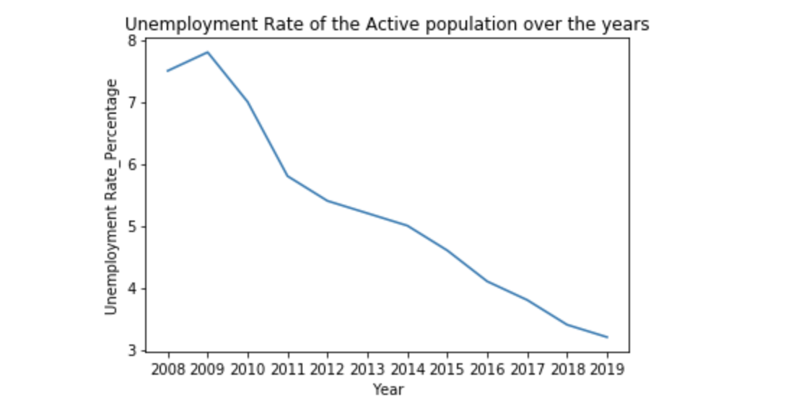
UNEMPLOYMENT DECREASING
FiFinancial Crisis

Slide 3
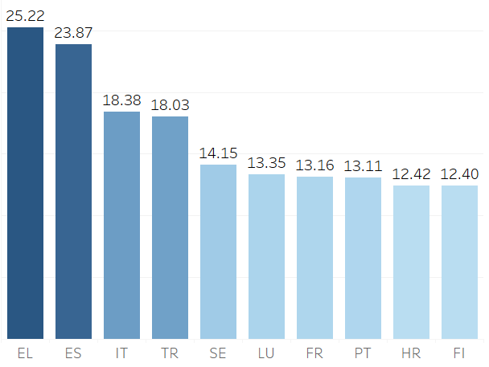
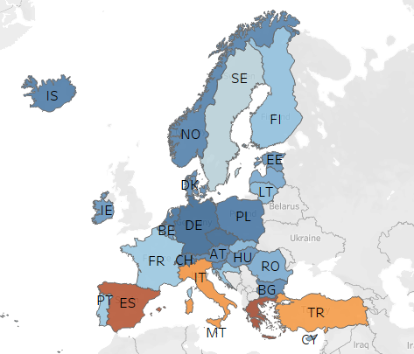
COUNTRIES WITH HIGH UNEMPLOYMENT
Top 10 Countries %
Country Comparison
GERMANY
GREECE

Slide 4
LESS UNEMPLOYMENT IN COUNTRIES WITH A HIGH GDP
Germany
Greece

Slide 5
HIGHER EDUCATION ENSURES JOB SECURITY
Germany
Greece

Slide 6
HIGHER UNEMPLOYMENT AMONG FEMALES
Germany
Greece

Slide 7


Data Sources

