Slide 1
Complete Genomics
July 6, 2021

Slide 2
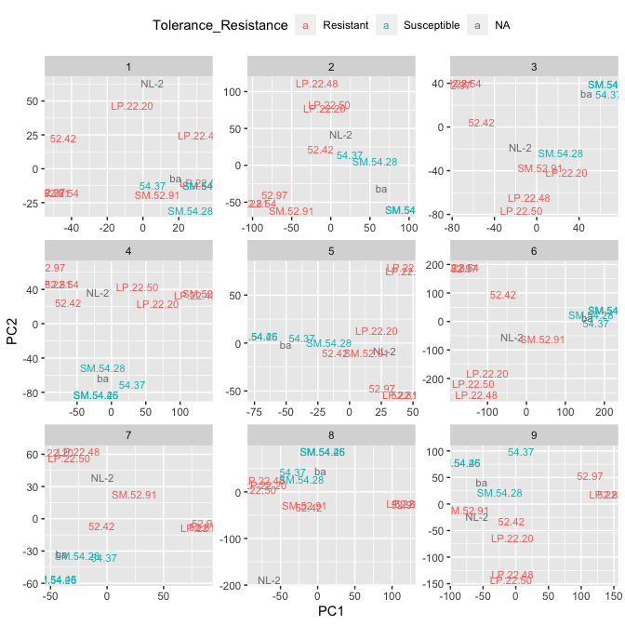
PCAs calculated by subsampling 200 contigs

Slide 3
PCAs calculated by subsampling 100M bases

Slide 4
Other stuff
Include ”XL” samples in PCA: currently running
Use quantitative resistance data: will run today
Fst or other tests for selection:
We do not have appropriate sampling for this
Population based tests but we have (very few) half sibs
Could do dN/dS tests between TanOak and closest relative (does not address disease susceptibility)

