Slide 1
Exploring homologs
Tanoak
Maloof
07/18/2022

Slide 2
Goals
Confirm that oak (Qrob) homologs of tanoak high dN/dS genes are actual orthologs
Figure out if changes are in Qrob or tanoak lineage

Slide 3
Methods / Progress
Start with two of the high dN/dS genes “804” and “585”
BLASTp tanoak high dN/dS genes against:
Oak (Q. robur)
Phytozome
Red oak (Q. rubrus)
American chestnut (C. dentata)
Poplar (P. trichocarpa)
Soy (G. max)
Arabidopsis
Align (MAFFT)
Reconstruct phylogenetic tree (FastTree)

Slide 4
Tree
Show interactive tree
Conclusions from tree:
Q. robus homologs are correct orthologs
Lots of expansion of this family within each lineage
Show pruned tree
Changes on both branches, more in Q. robur

Slide 5
Update August 15, 2022
Looked more closely at alignments.
I think annotation needs to be improved

Slide 6
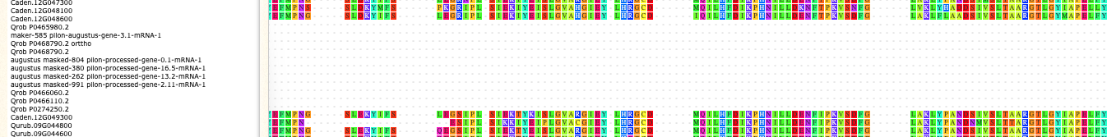
Truncated gene model for LRK10L2
N-terminal is good:
But then no alignment. True truncation or missing annotation?

Slide 7
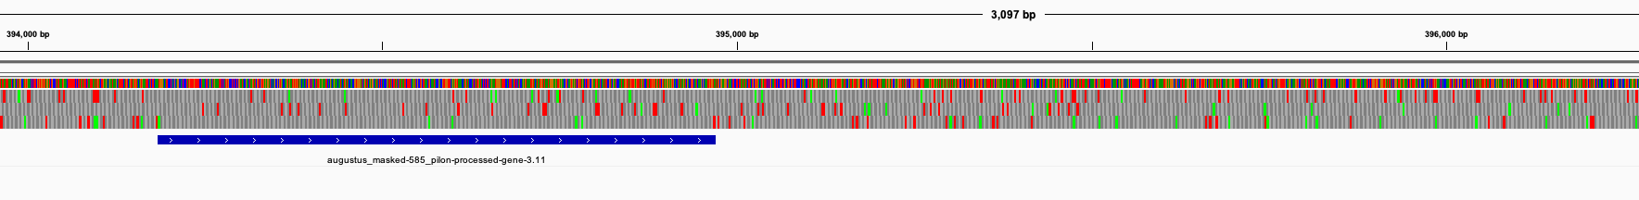
Gff3 has a single exon for this gene:

Slide 8
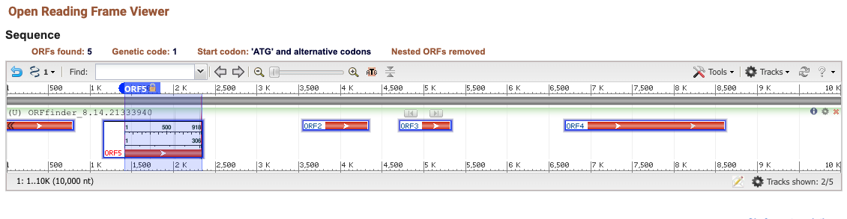
NCBI ORFfinder shows downstream ORFs
10KB starting from ATG of 585_pilon_mRNA_3.11
First ORF is the one annotated in the gff3
Highlighted ORF (as well as the others) are not in gff3 file

Slide 9
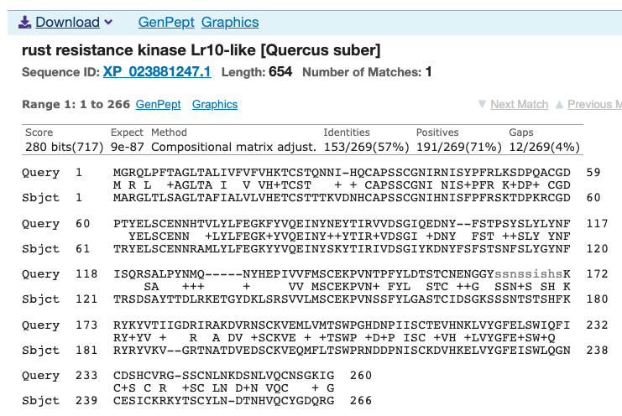
What is the second ORF?
Remember that first ORF matches the first ~ 260aa of LRK10L

Slide 10
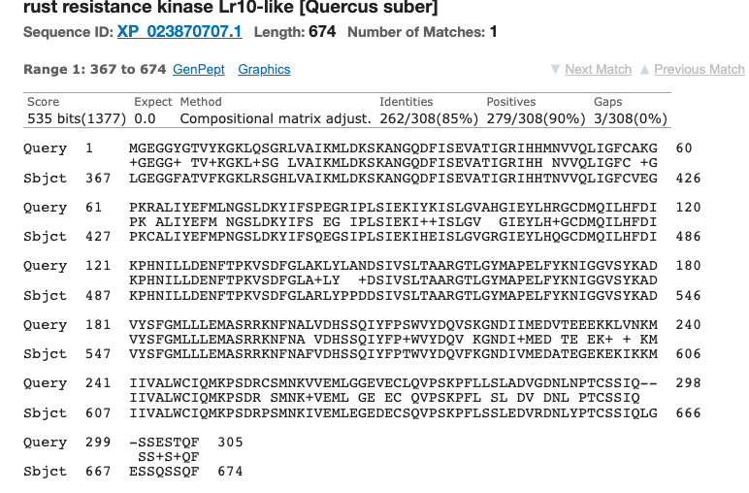
The second ORF is the C-term of LRK10L2

