Slide 1
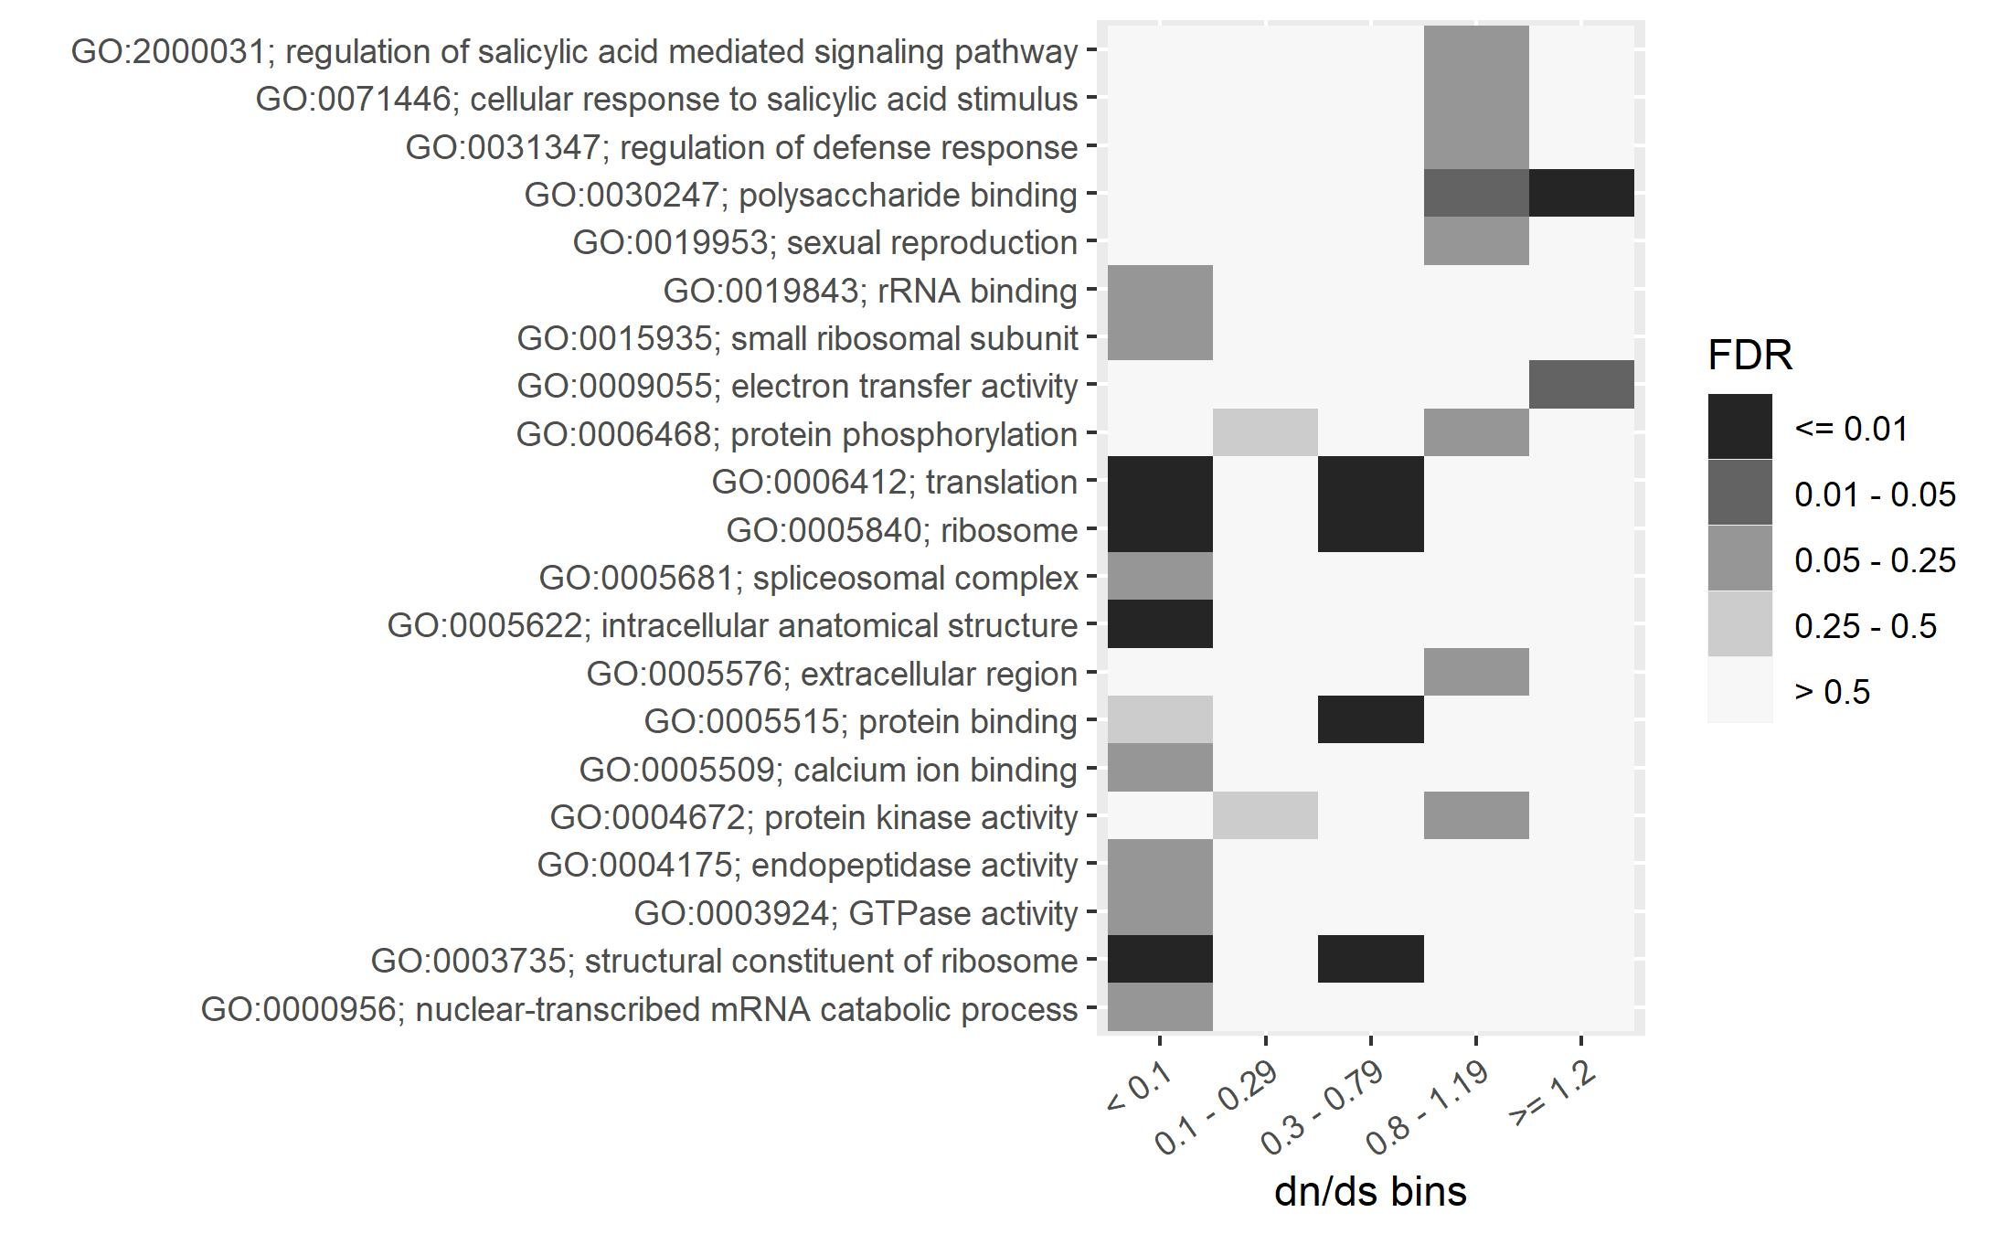

GO terms “polysaccharide binding” and “electron transfer activity” are enriched in high dN/dS genes
Paulo Magalang, Julin Maloof

Slide 2
Many high dN/dS polysaccharide binding genes have homology to defense response genes
Of the 10 genes in the “polysaccharide binding” category with dN/dS > 1.2:
6 Have homology to LEAF RUST RESISTANCE 10 RECEPTOR KINASE-LIKE genes
2 Have homology to other cell wall associated kinases
Paulo Magalang, Julin Maloof

