Slide 1
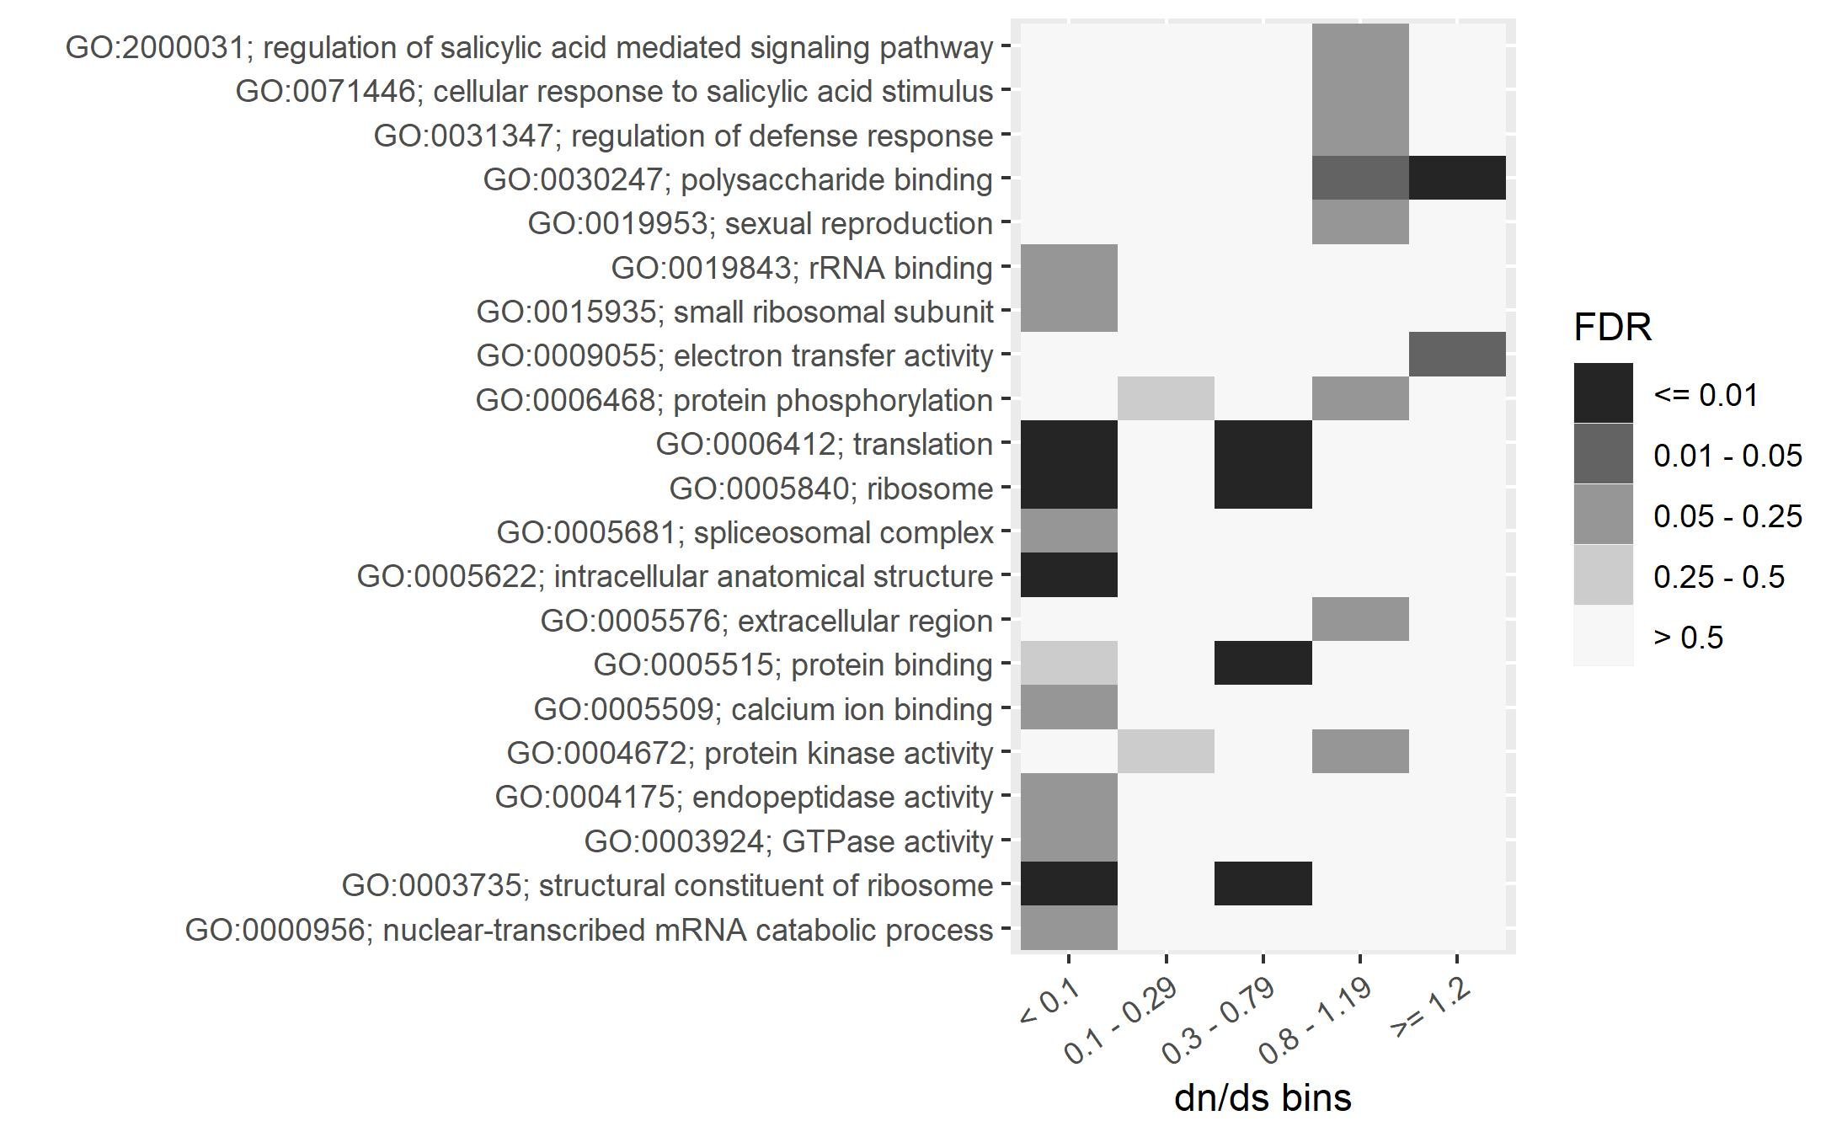

GO terms “polysaccharide binding” and “electron transfer activity” are enriched in high dN/dS genes
Paulo Magalang, Julin Maloof

Slide 2
Many high dN/dS polysaccharide binding genes have homology to defense response genes
Of the 10 genes in the “polysaccharide binding” category with dN/dS > 1.2:
6 Have homology to LEAF RUST RESISTANCE 10 RECEPTOR KINASE-LIKE (LRK10L) genes
2 Have homology to other cell wall associated kinases
Paulo Magalang, Julin Maloof

Slide 3
Confirm correct ortholog ID for two LRK10 genes
If we mis-identified oak homologs, the high dN/dS could be an artefact
Align query similar genes and align, build tree
Find many lineage-specific expansions of this gene family
Correct orthlogs ID’d (next slide)
Notes:
Mafft alignment
Fasttree for ML phylogeny reconstruction
TanOak genes are the ones with long names, no colors

Slide 4
More changes in Oak than Tanoak
Branch length longer for Oak than Tanoak
Suggests that selection was stringer to change protein sequence in Oak lineage

