Slide 1
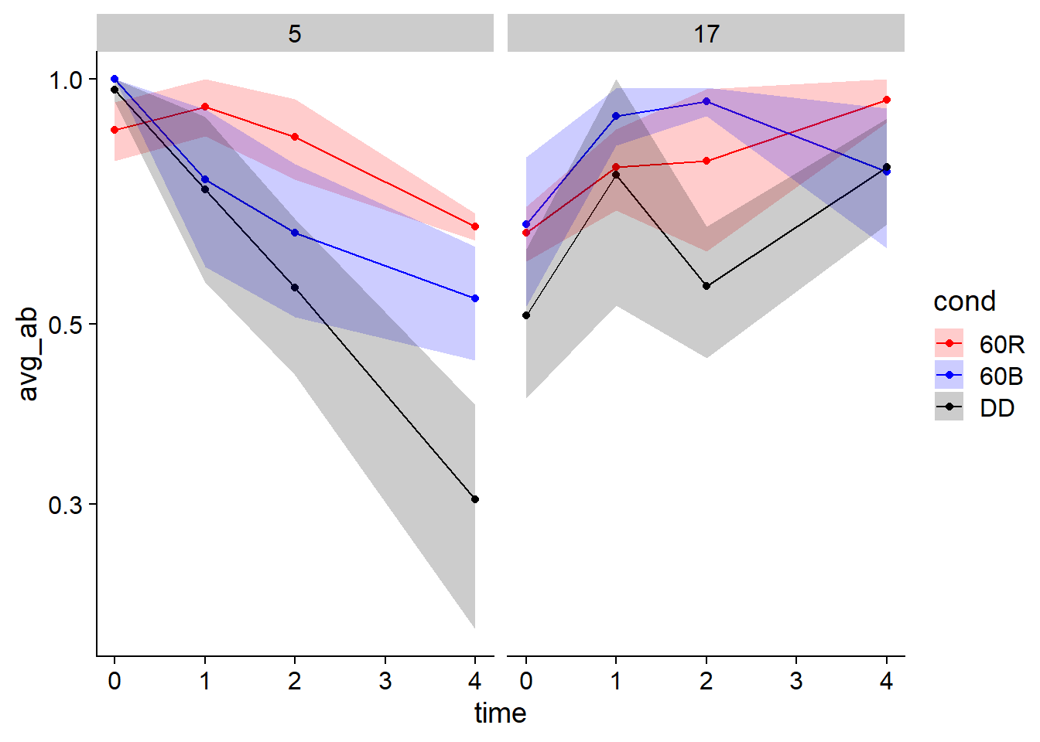
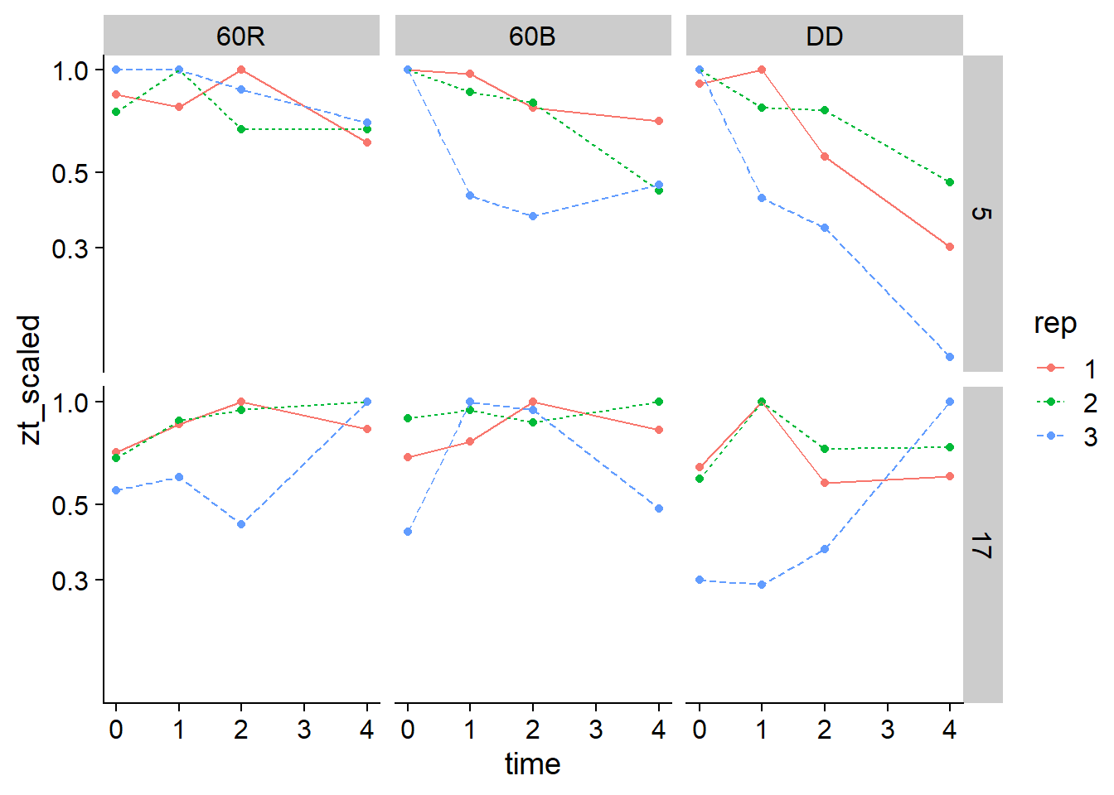
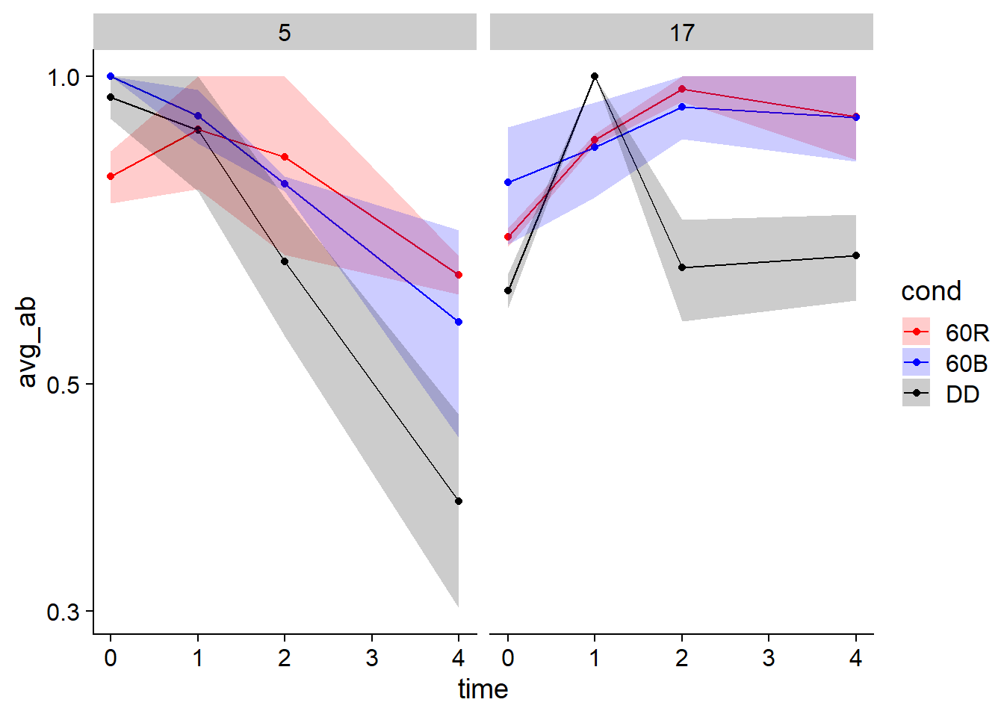
RVE4
All 3 reps
Scaled for each ZT
This is how I graphed RVE8
Rep 1 and 2

Slide 2
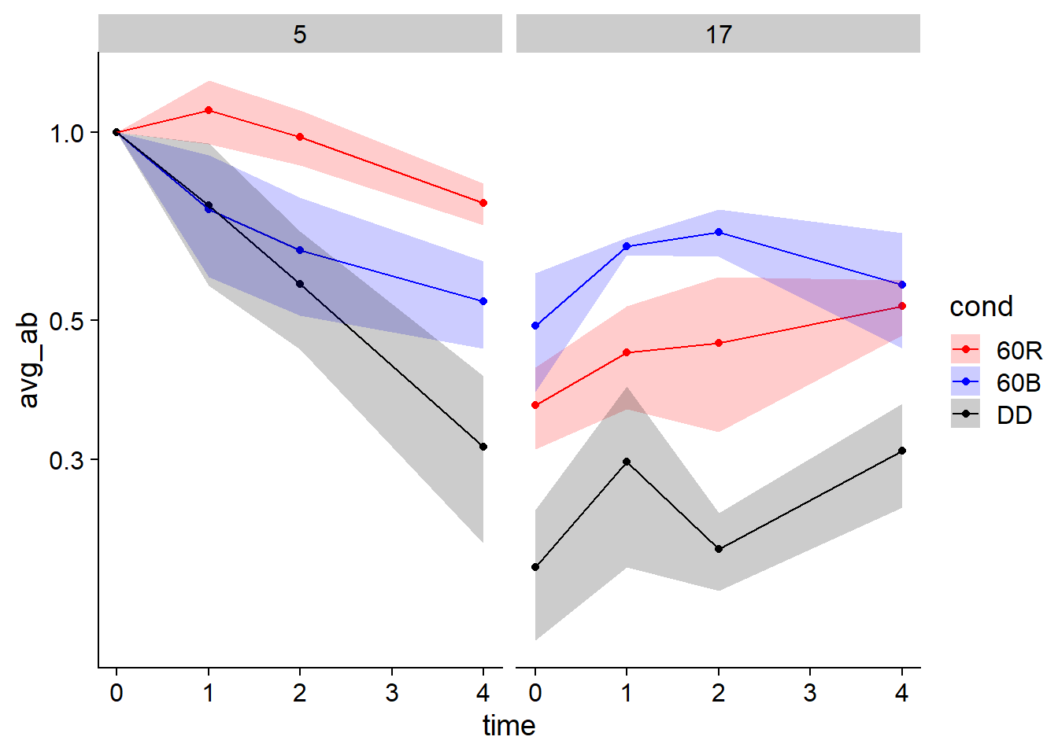
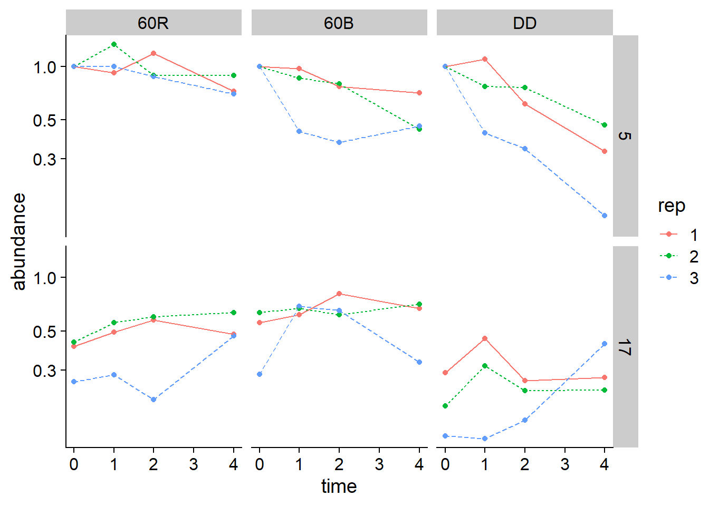
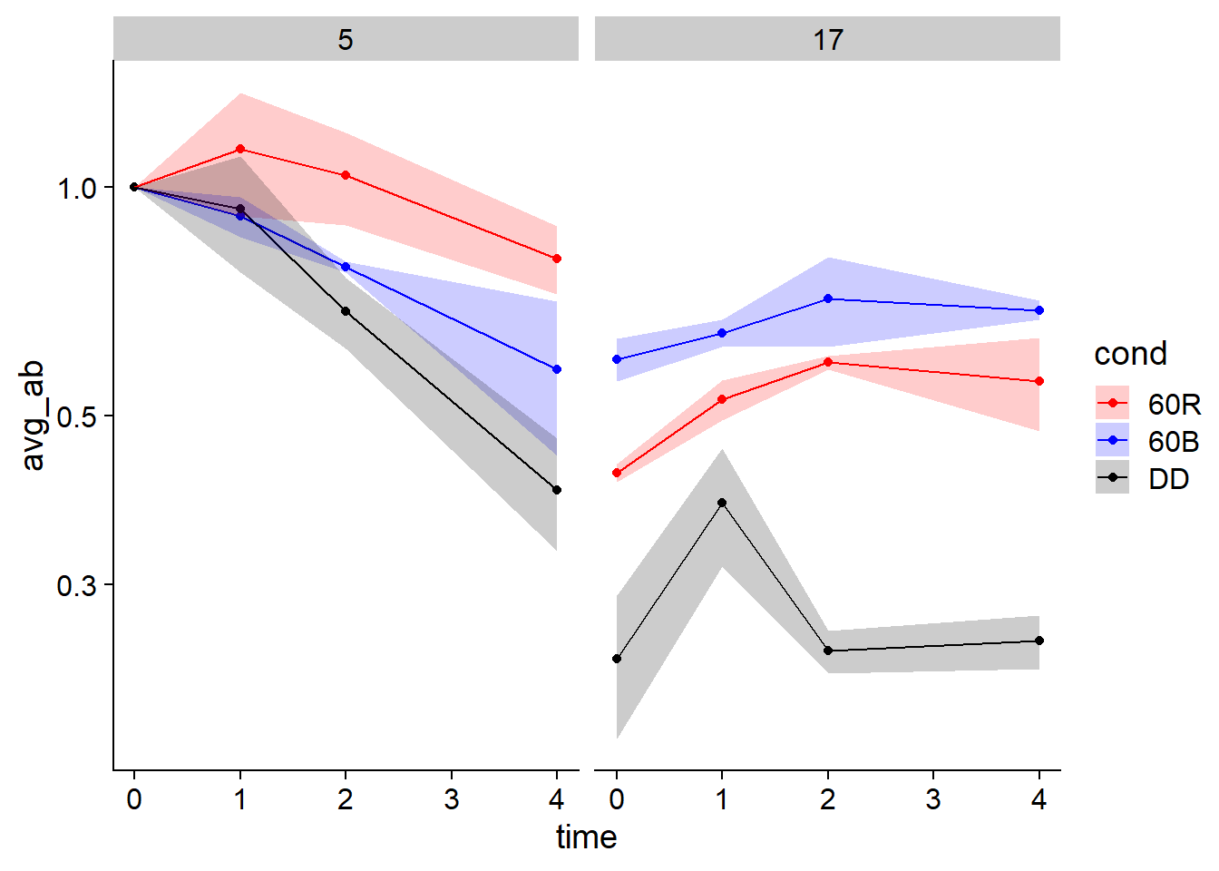
RVE4
All 3 reps
Just relative abundance from ImageLab
Rep 1 and 2

Slide 3
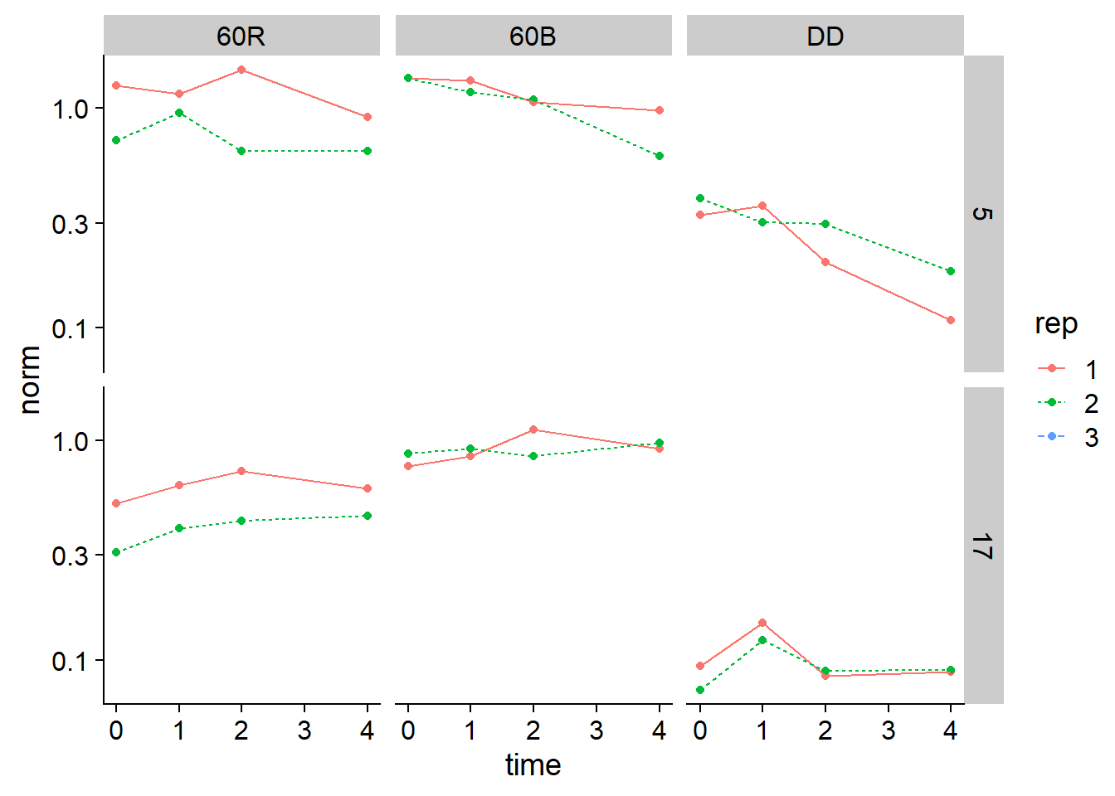
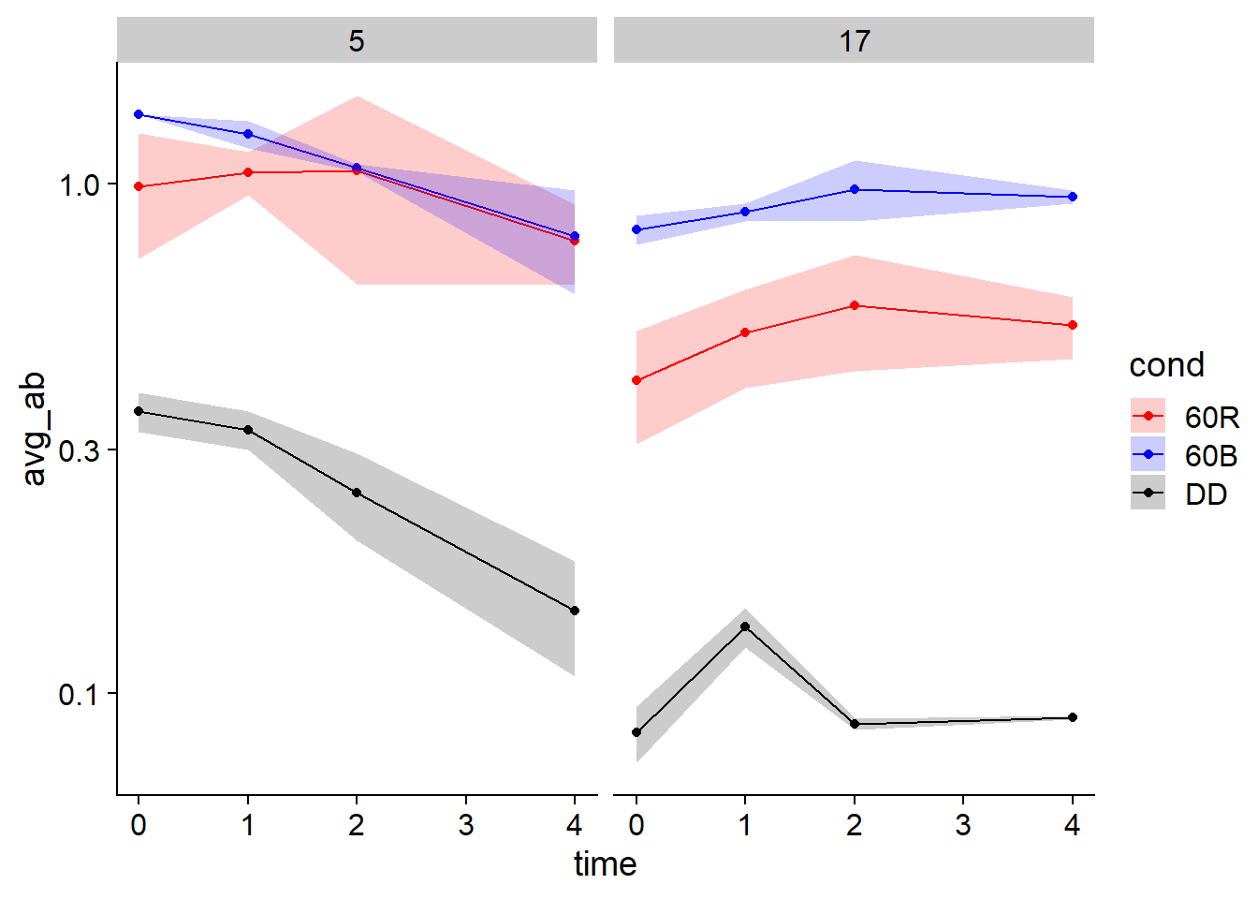
RVE4
Normalized using control sample
This is what Yuyan graphed
Rep 1 and 2

Slide 4
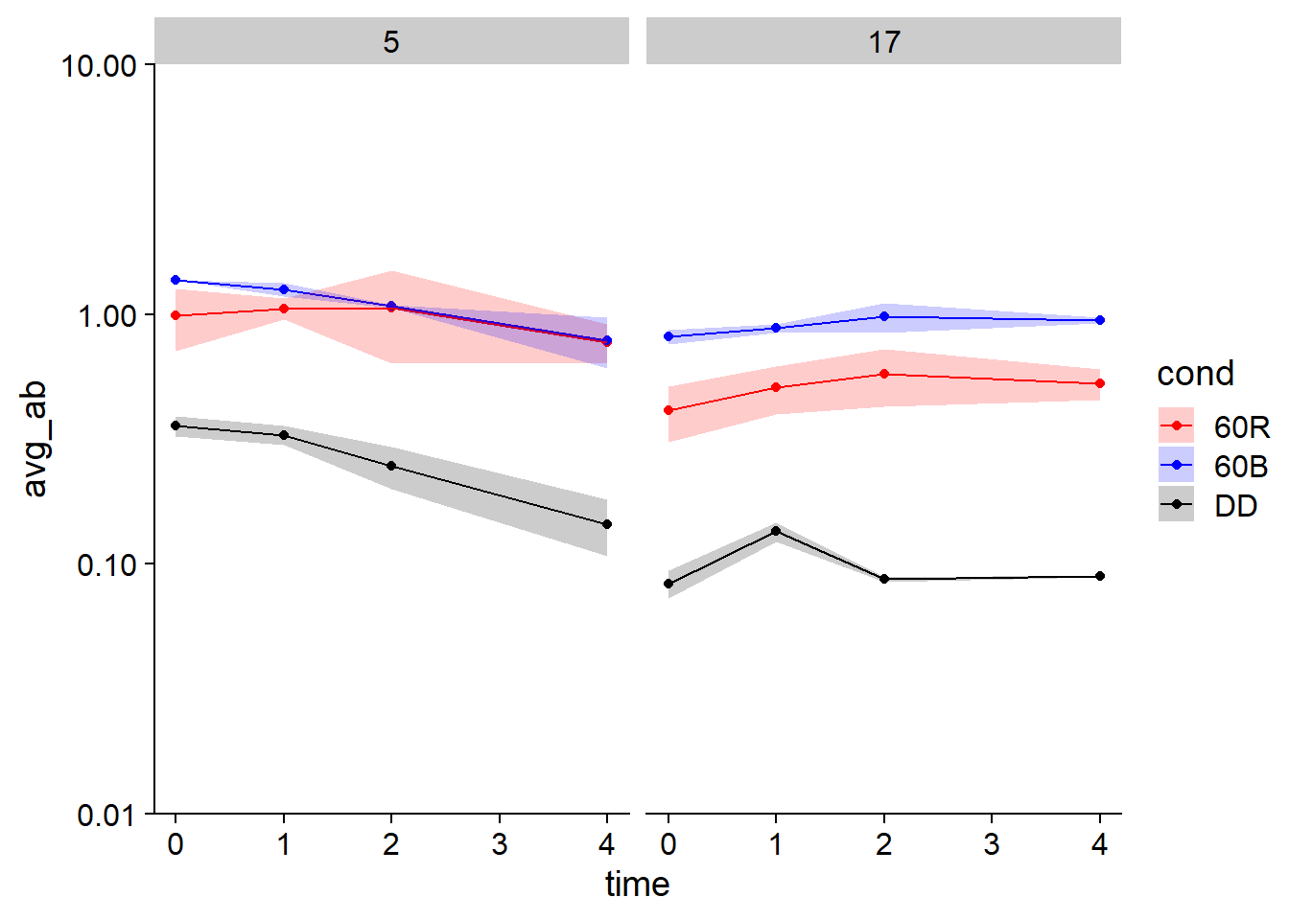
RVE4
Compare to Yuyan’s graphs

Slide 5
