Slide 1
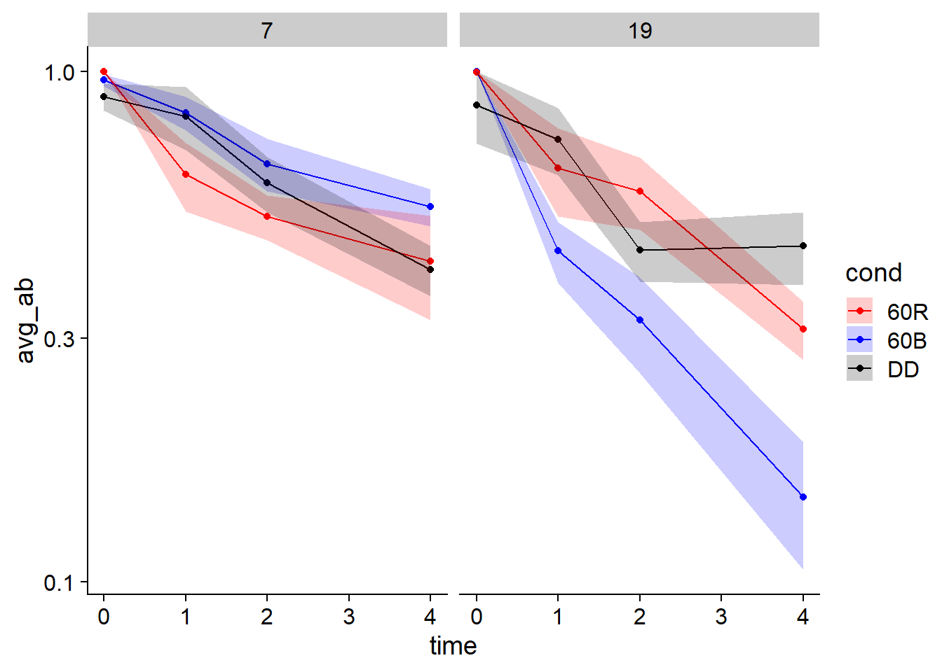
RVE8 (WT background)
Blue
ZT7 half-life: 4.21
ZT19 half-life: 1.1
Significant difference in deg rate and half-life between ZT7 and ZT19
Red
ZT7 half-life: 2.7
ZT19 half-life: 1.7
No significant difference in deg rate or half-life between ZT7 and ZT19
Dark
ZT7 half-life: 3.53
ZT19 half-life: 2.57
No significant difference in deg rate or half-life between ZT7 and ZT19
File: RVE8_half-life_analysis
No significant difference in deg rate or half-life between blue and red (at ZT7 or ZT19)
File: RvB_half-life_analysis

Slide 2
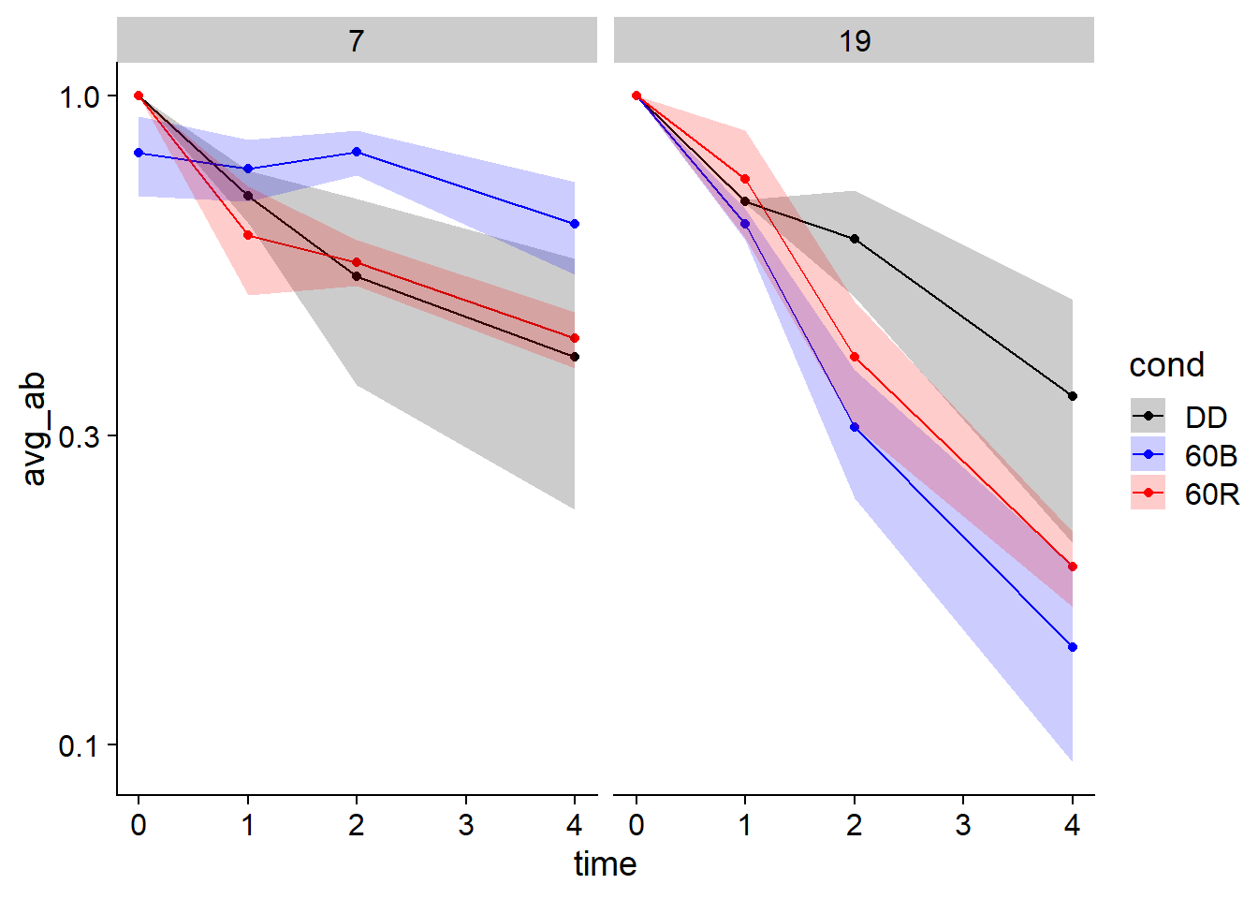
RVE8 (ztl background)
Blue
ZT7 half-life: 12.24
ZT19 half-life: 1.22
Significant difference in deg rate (but not half-life?) between ZT7 and ZT19
Red
ZT7 half-life: 2.6
ZT19 half-life: 1.39
No significant difference in deg rate or half-life between ZT7 and ZT19
Dark
ZT7 half-life: 2.86
ZT19 half-life: 1.84
No significant difference in deg rate or half-life between ZT7 and ZT19
File: RVE8_ztl_half-life_analysis
Significant difference in deg rate (but not half-life) between blue and red at ZT7
No significant difference at ZT19
File: RvB_half-life_analysis

Slide 3
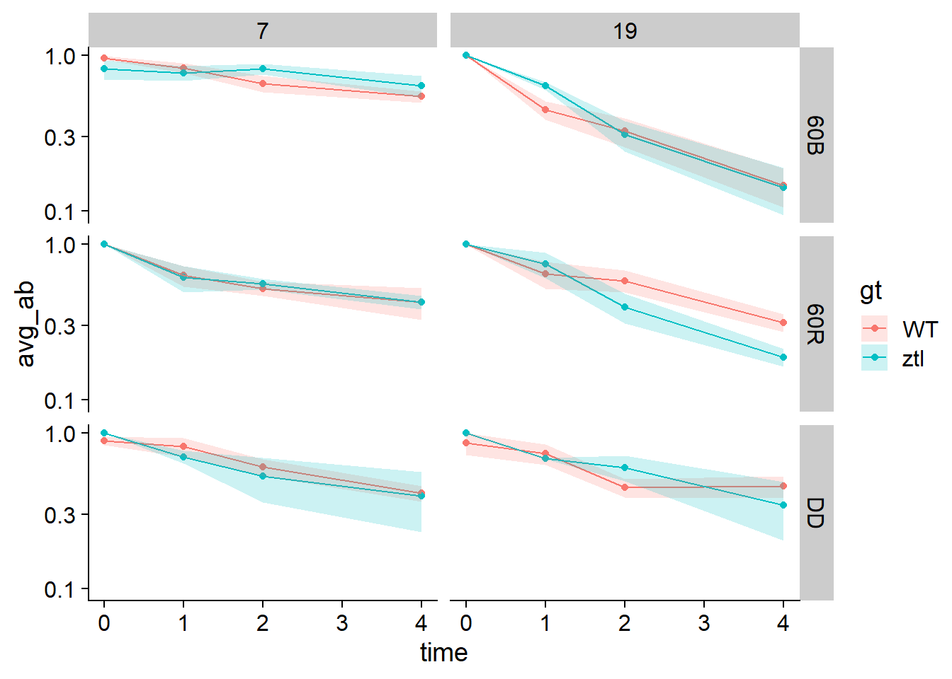
RVE8 (WT vs ztl background)
Blue
Significant difference in deg rate (but not half-life) between WT and ztl at ZT7
No significant difference at ZT19
Red
No significant difference in deg rate (or half-life) between WT and ztl at ZT7 or ZT19
Dark
No significant difference in deg rate (or half-life) between WT and ztl at ZT7 or ZT19
File: WTvztl_half-life_analysis

Slide 4
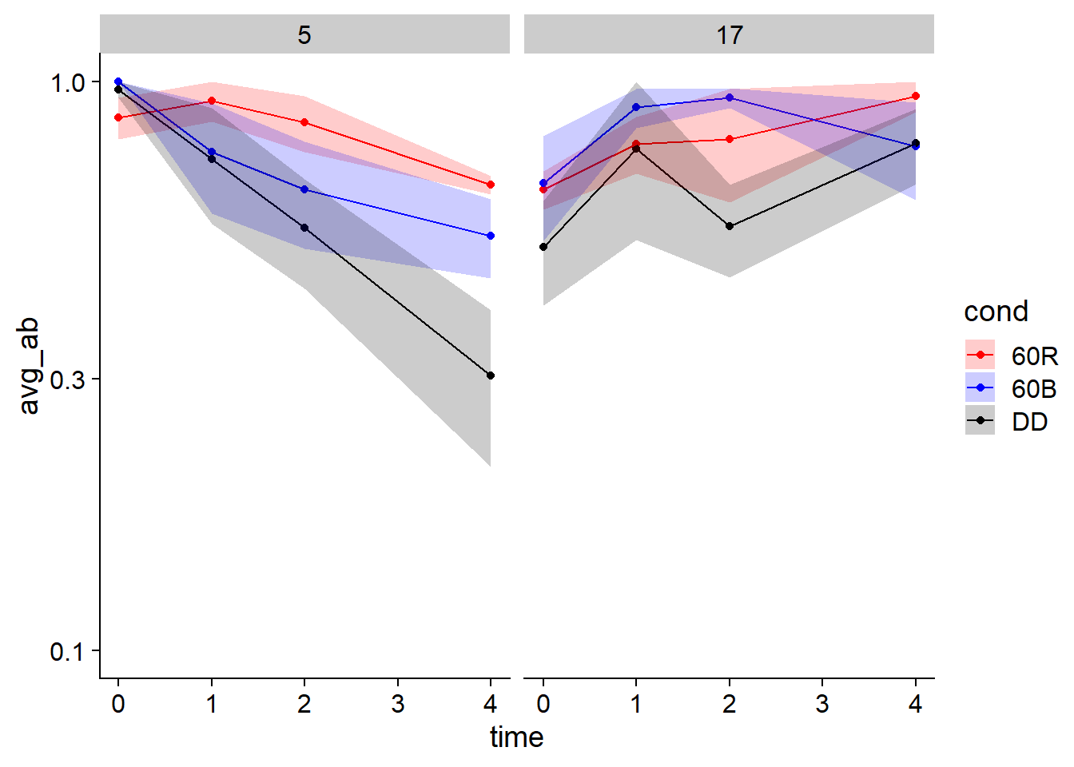
RVE4
Blue
ZT5 half-life: 4.09
ZT17 half-life:
Red
ZT5 half-life: 10.13
ZT17 half-life:
Dark
ZT5 half-life: 2.43
ZT17 half-life:
File: RVE4_half-life_analysis
No significant difference in deg rate or half-life between blue and red at ZT5
File: RvB_half-life_analysis

