Slide 1
Ceratopteris LFY RNAseq Update
Feb 18, 2025

Slide 2
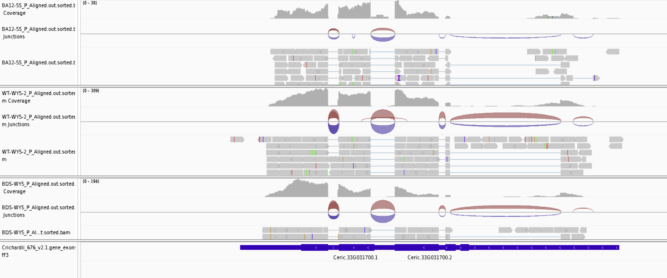
Is the annotation for LFY1 OK? Yes

Slide 3
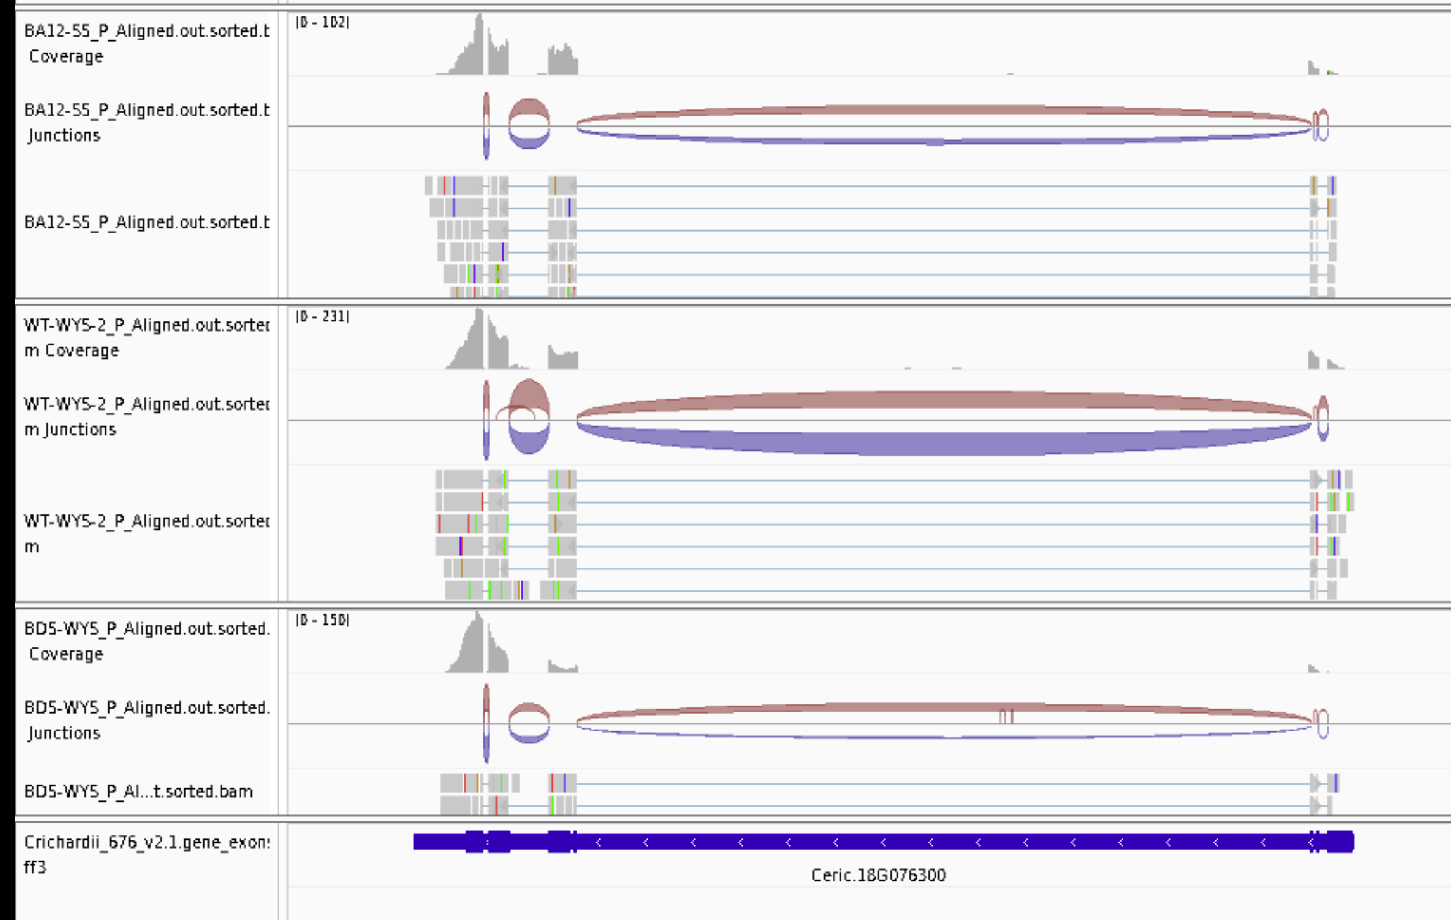
Is the annotation for LFY2 OK? Yes

Slide 4
Was I counting reads correctly? NO
The annotation file has multiple isoforms and did not account for the correctly in my original analysis. Now fixed.

Slide 5
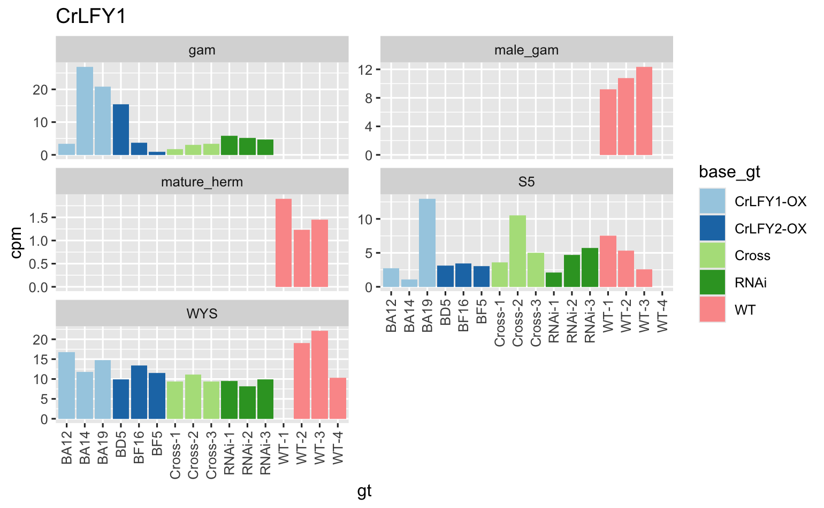
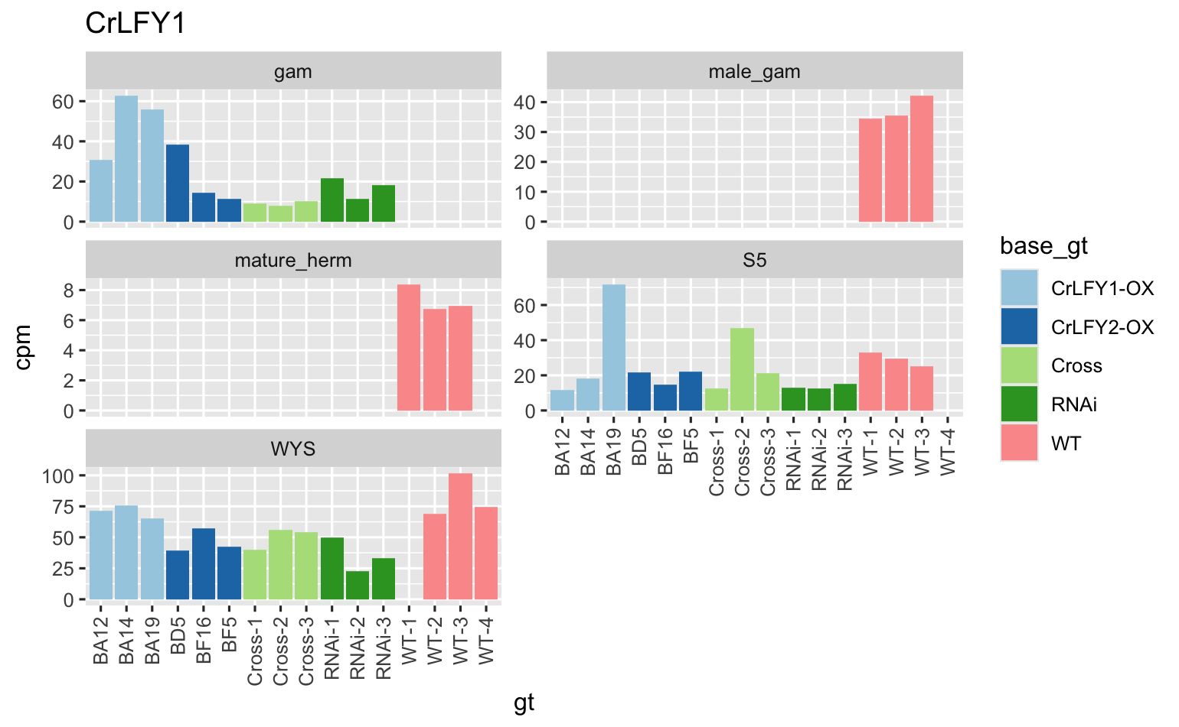
LFY1: old on left, new on right. Pattern is similar but counts are more reasonable.

Slide 6
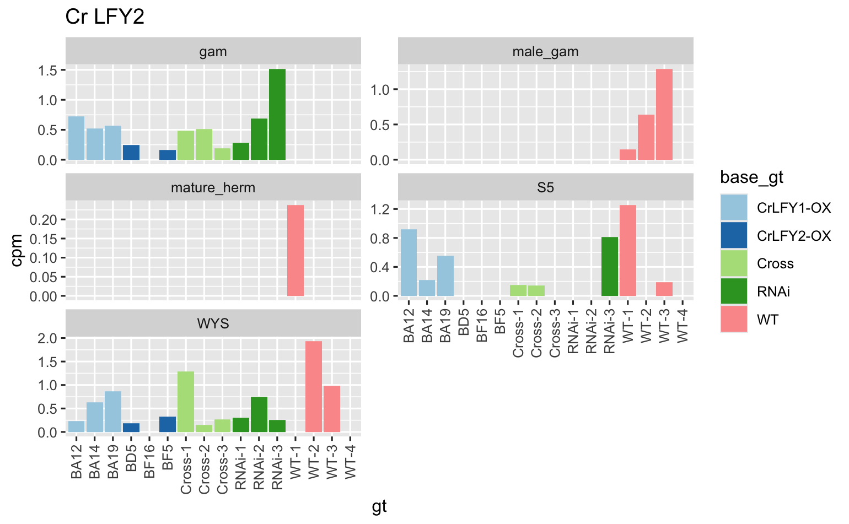
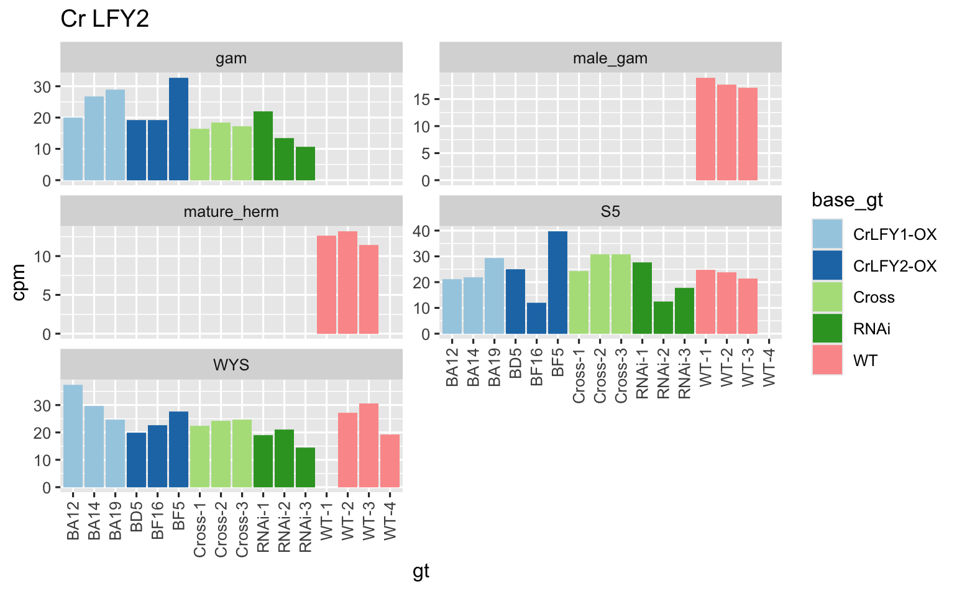
LFY2: old on left, new on right. Pattern is similar but counts are more reasonable.

Slide 7
LFY1 vs LFY2

Slide 8
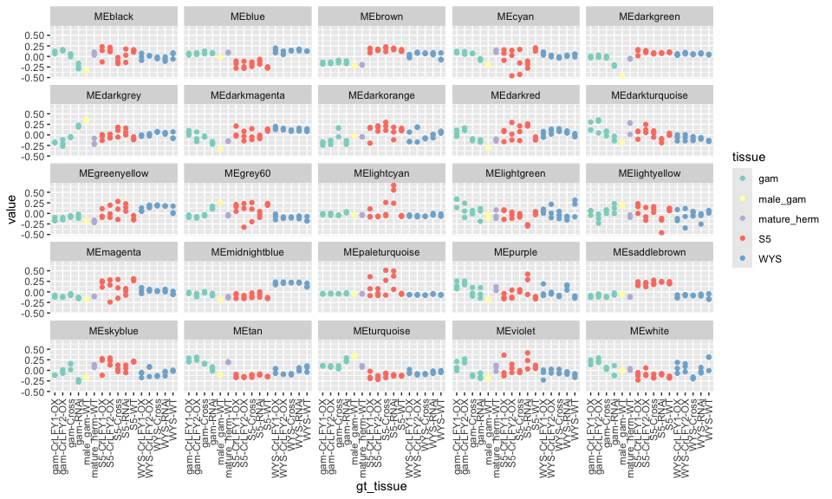
Network attempt 1: WGCNA, all samples
Each “color” is a module
Y-axis is first PC of expression of that module
LFY1 is in MIDNIGHT BLUE
LFY2 is in MAGENTA

Slide 9
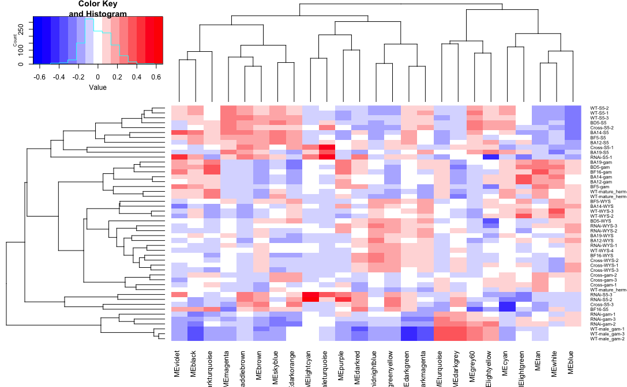
Network attempt 1: WGCNA, all samples
Each “color” is a module
heatmap is first PC of expression of that module
LFY1 is in MIDNIGHT BLUE
LFY2 is in MAGENTA

Slide 10
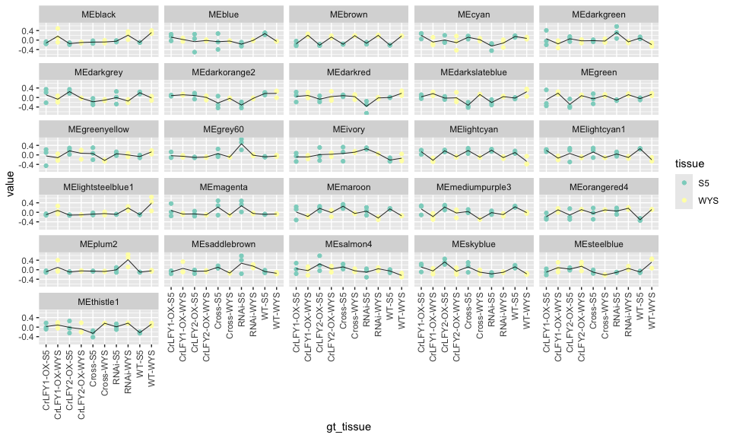
Network attempt 1: WGCNA, sporophyte
Each “color” is a module
Y-axis is first PC of expression of that module
LFY1 is in BROWN
LFY2 is in BLUE

Slide 11
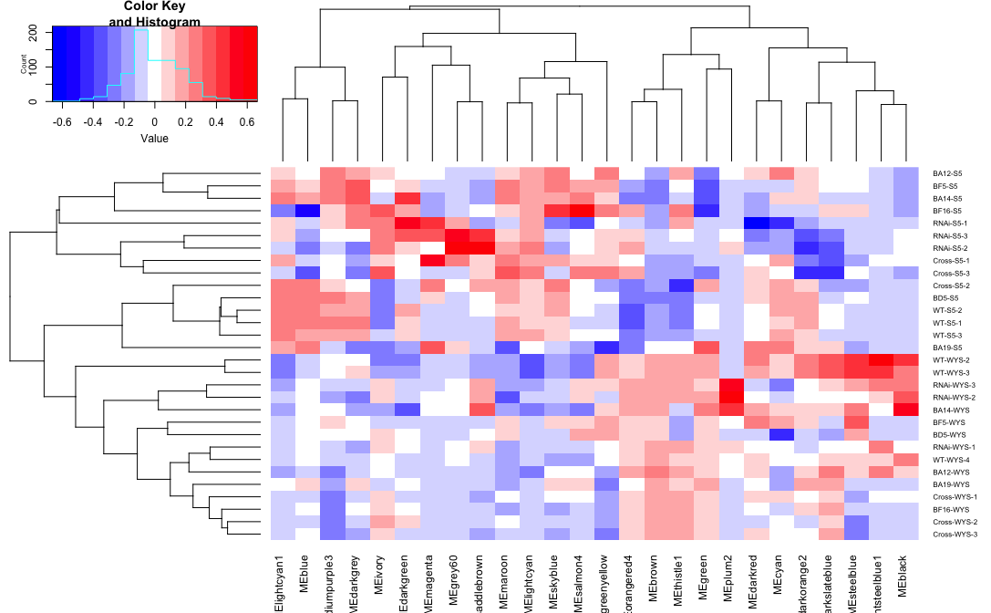
Network attempt 1: WGCNA, sporophyte
Each “color” is a module
heatmap is first PC of expression of that module
LFY1 is in BROWN
LFY2 is in BLUE

Slide 12
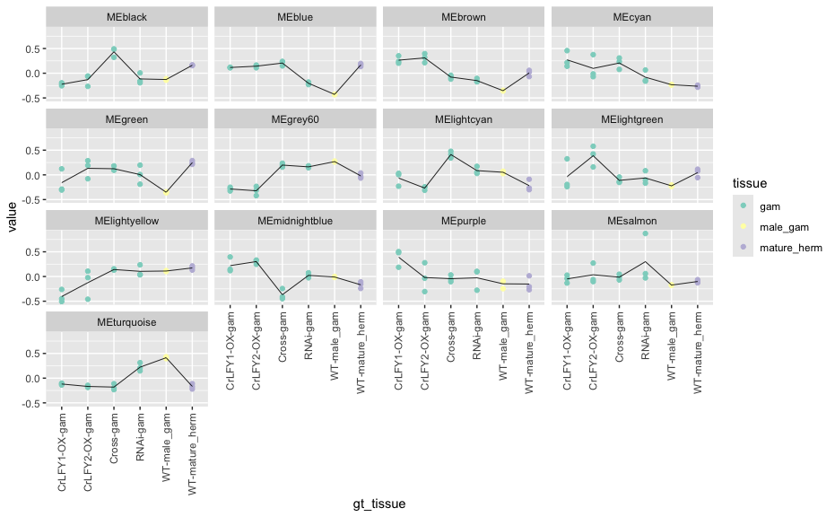
Network attempt 1: WGCNA, gametophyte
Each “color” is a module
Y-axis is first PC of expression of that module
LFY1 is in TURQUOISE
LFY2 is in BROWN

Slide 13
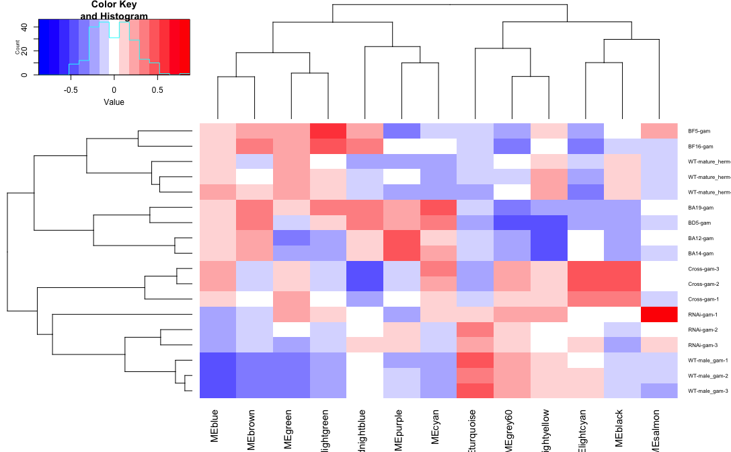
Network attempt 1: WGCNA, gametophyte
Each “color” is a module
LFY1 is in TURQUOISE
LFY2 is in BROWN

Slide 14
Next Steps
Gene Ontology (GO) categories for each module
Enriched promoter motifs for each modules
Build a mutual rank (MR) network
Rationale:
Current LFY modules are very large many hundreds to thousands of genes
A MR network will allow me to more easily identify LFYs’ closest connections

