Slide 1
Ceratopteris LFY RNAseq Update
Feb 18, 2025

Slide 2
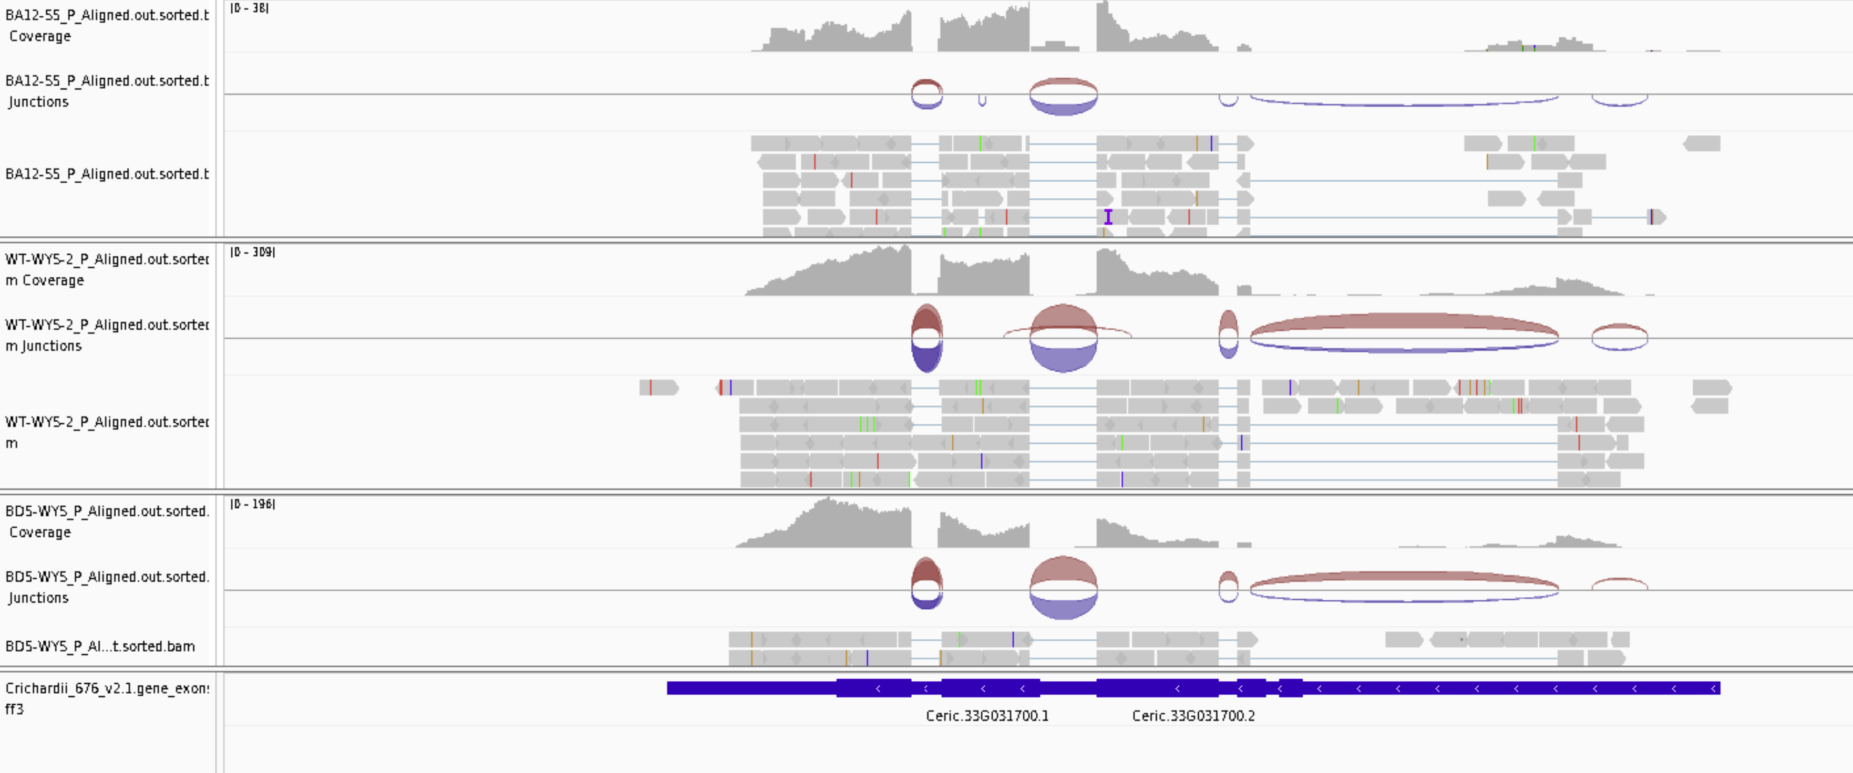
Is the annotation for LFY1 OK? Yes

Slide 3
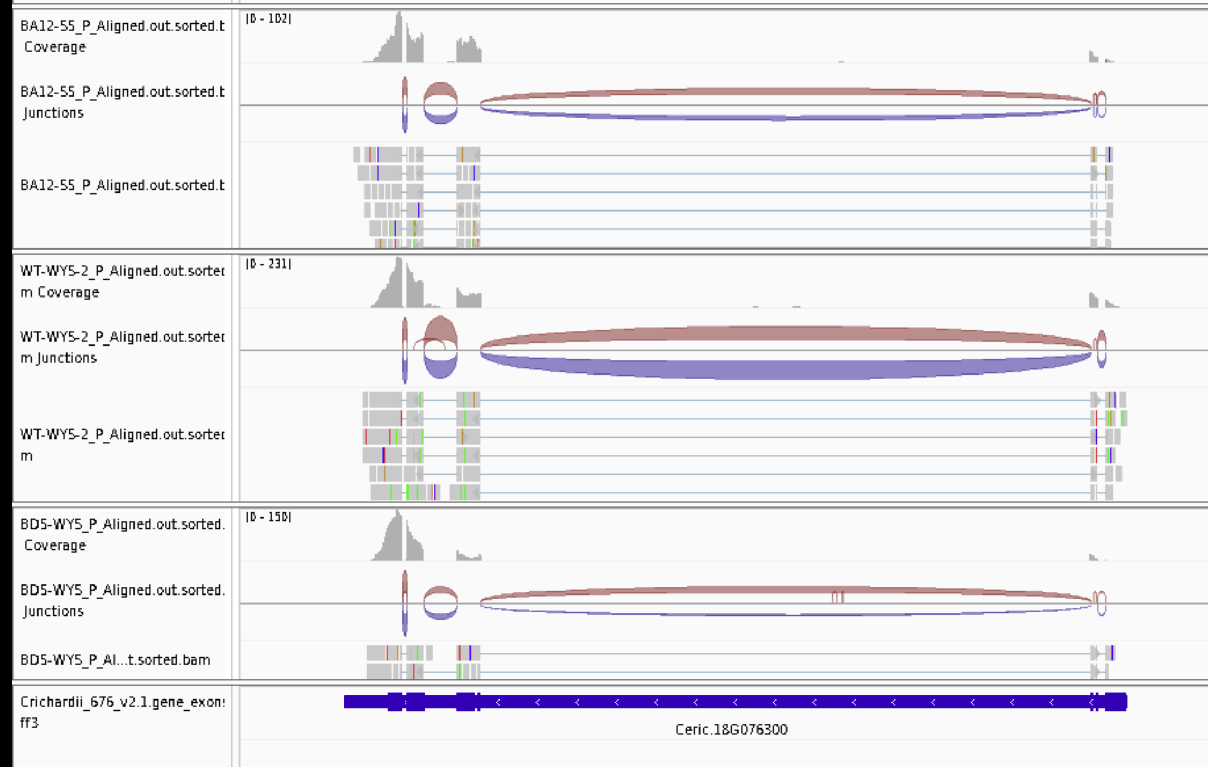
Is the annotation for LFY2 OK? Yes

Slide 4
Was I counting reads correctly? NO
The annotation file has multiple isoforms and did not account for the correctly in my original analysis. Now fixed.

Slide 5
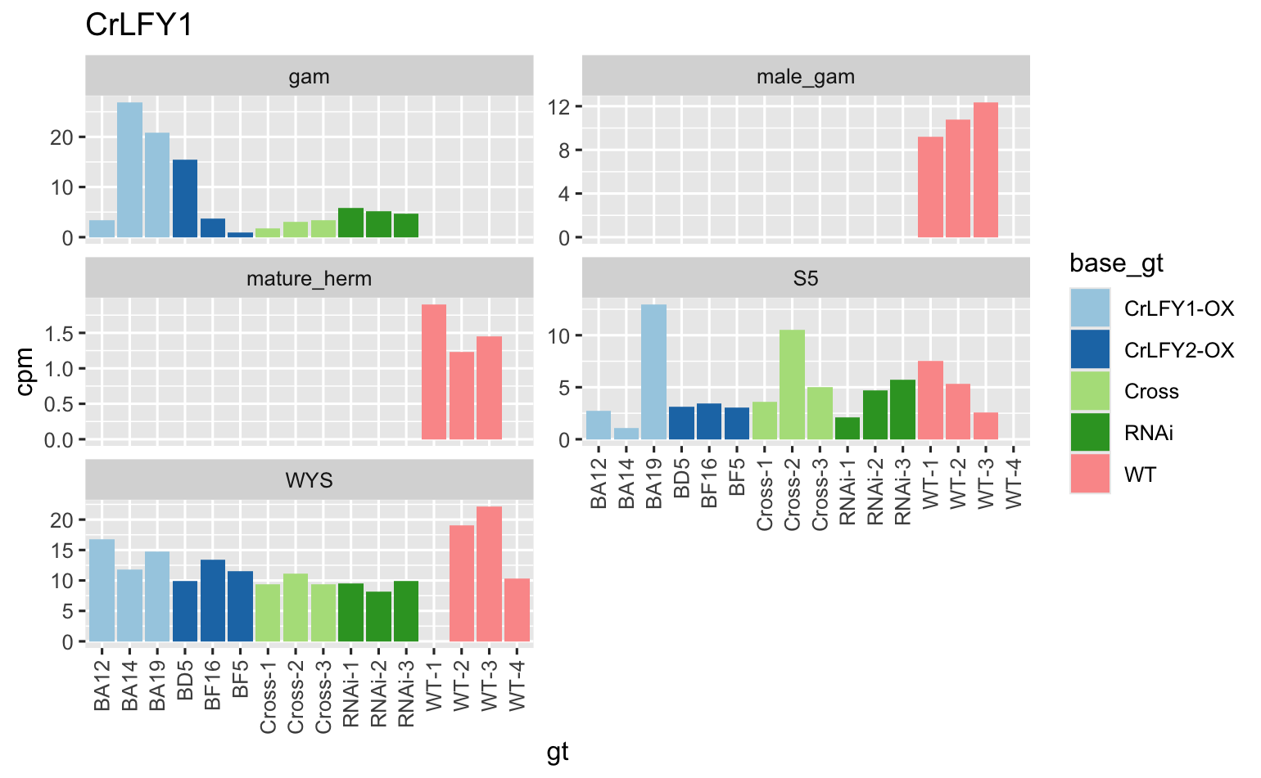
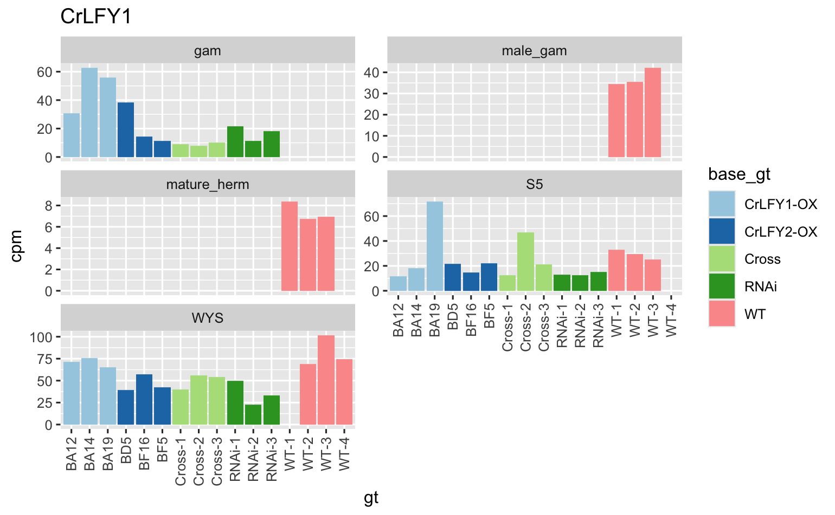
LFY1: old on left, new on right. Pattern is similar but counts are more reasonable.

Slide 6
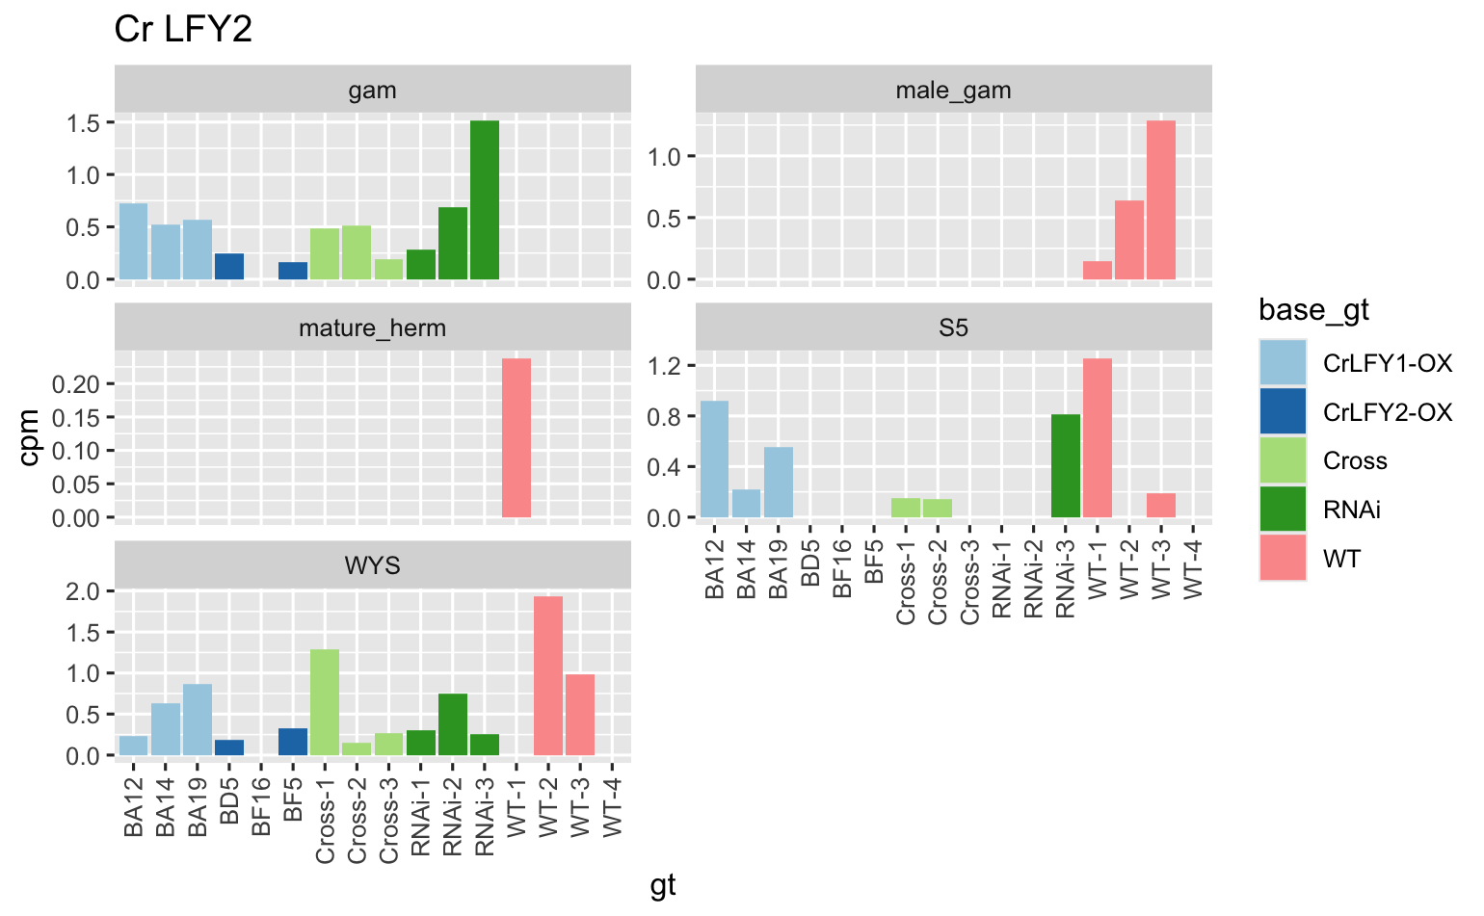
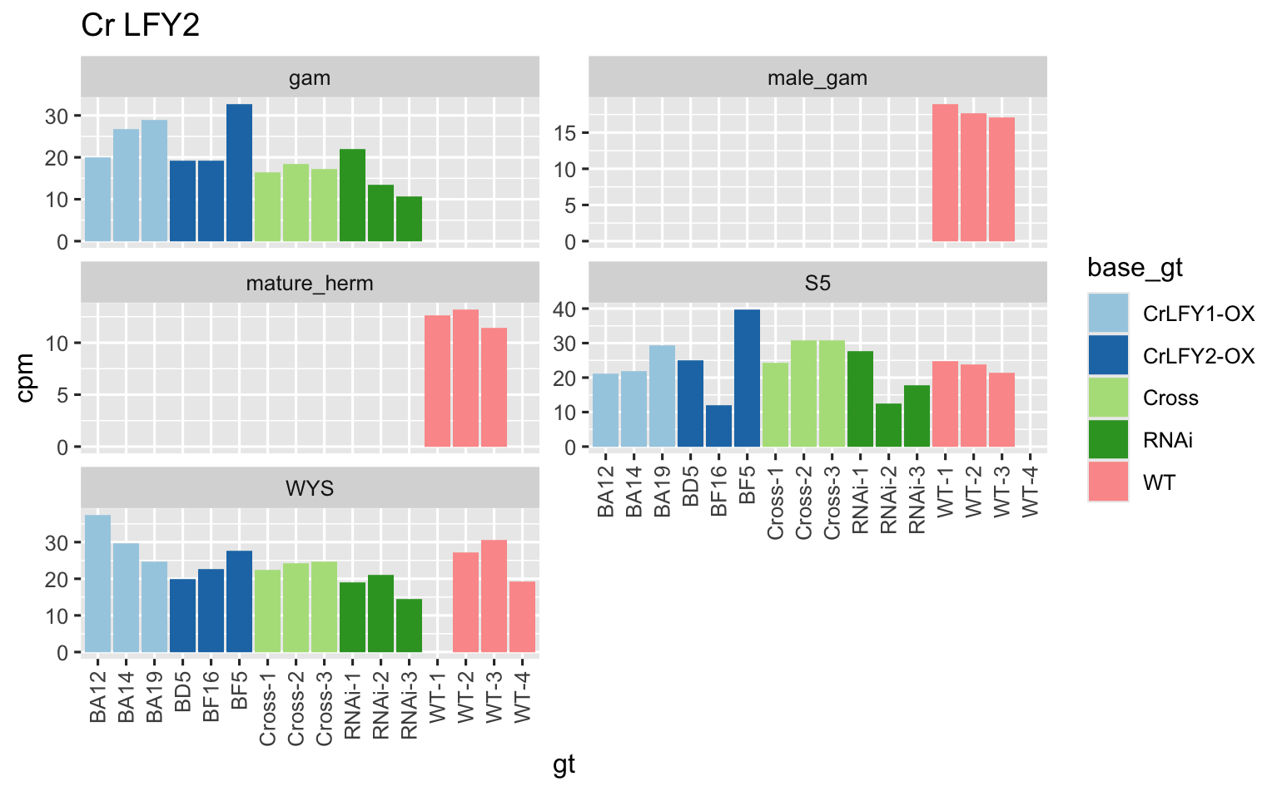
LFY2: old on left, new on right. Pattern is similar but counts are more reasonable.

Slide 7
LFY1 vs LFY2

Slide 8
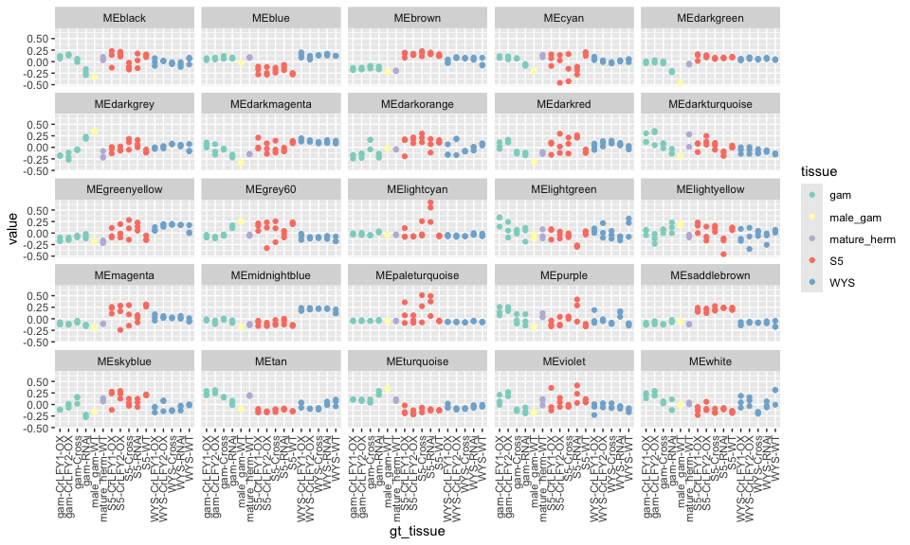
Network attempt 1: WGCNA, all samples
Each “color” is a module
Y-axis is first PC of expression of that module
LFY1 is in MIDNIGHT BLUE
LFY2 is in MAGENTA

Slide 9
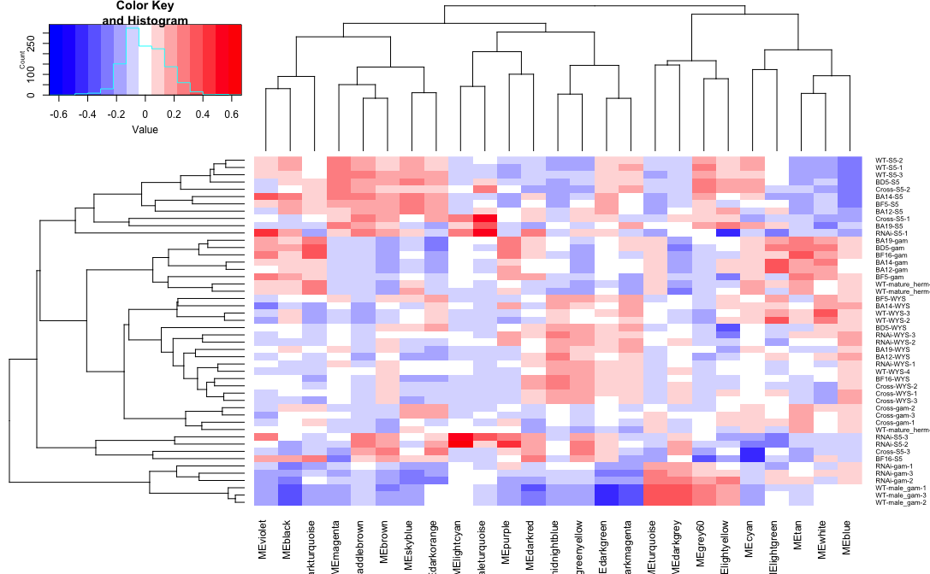
Network attempt 1: WGCNA, all samples
Each “color” is a module
heatmap is first PC of expression of that module
LFY1 is in MIDNIGHT BLUE
LFY2 is in MAGENTA

Slide 10
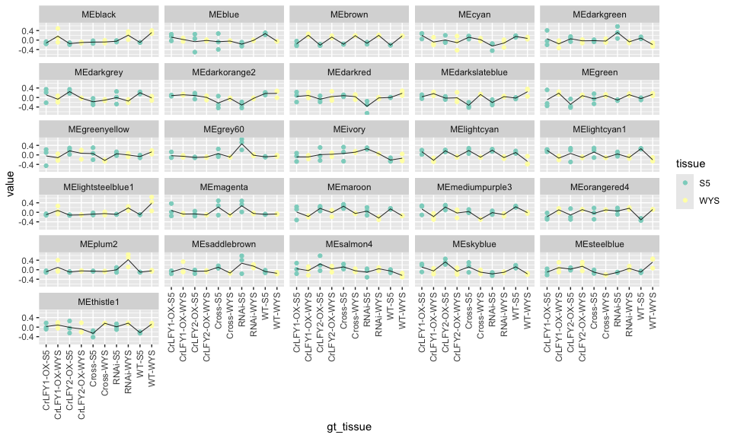
Network attempt 1: WGCNA, sporophyte
Each “color” is a module
Y-axis is first PC of expression of that module
LFY1 is in BROWN
LFY2 is in BLUE

Slide 11
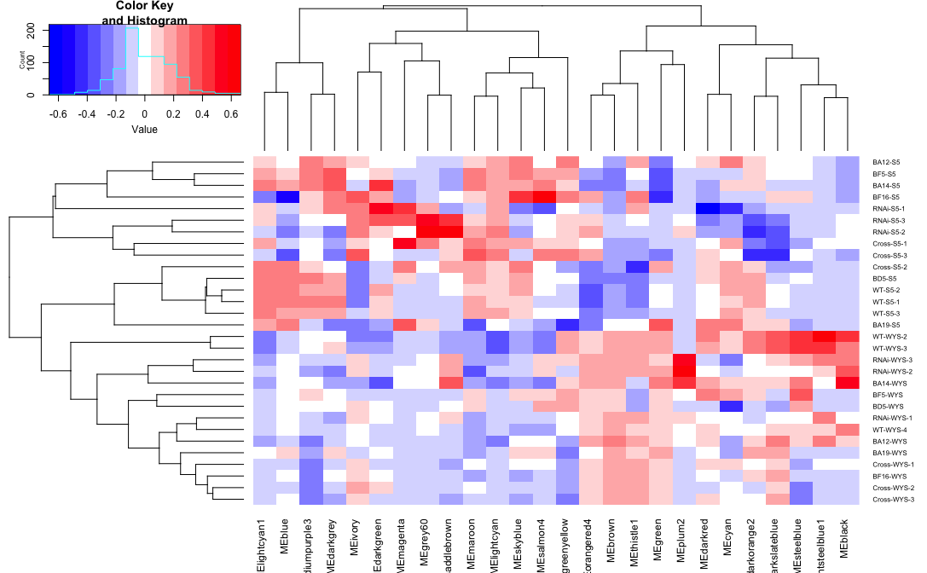
Network attempt 1: WGCNA, sporophyte
Each “color” is a module
heatmap is first PC of expression of that module
LFY1 is in BROWN
LFY2 is in BLUE

Slide 12
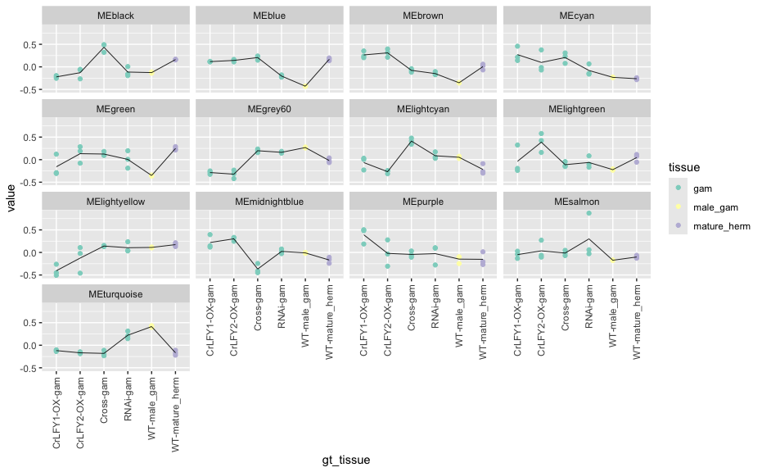
Network attempt 1: WGCNA, gametophyte
Each “color” is a module
Y-axis is first PC of expression of that module
LFY1 is in TURQUOISE
LFY2 is in BROWN

Slide 13
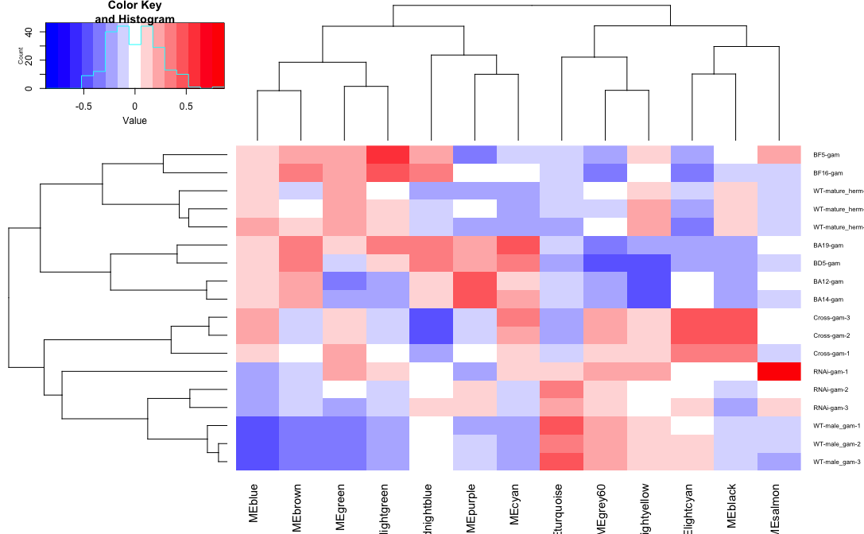
Network attempt 1: WGCNA, gametophyte
Each “color” is a module
LFY1 is in TURQUOISE
LFY2 is in BROWN

Slide 14
Next Steps
Gene Ontology (GO) categories for each module
Enriched promoter motifs for each modules
Build a mutual rank (MR) network
Rationale:
Current LFY modules are very large many hundreds to thousands of genes
A MR network will allow me to more easily identify LFYs’ closest connections

Slide 15
Update March 13, 2025

Slide 16
Overview of new progress
GO enrichment of WGCNA modules
Looked for module membership of MADS box genes
Tried a new method “Targeted Gene Correlation Network” (TGCN)
Built mutual rank (MR) networks

Slide 17
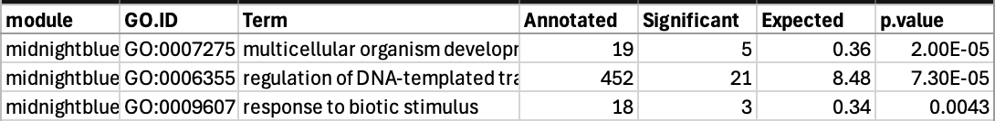
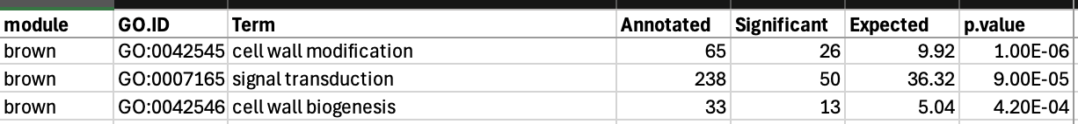
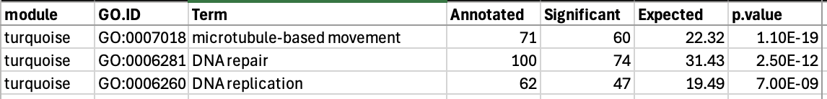
TOP3 GO Enrichment: LFY1
All Samples:
Sporophyte:
Gametophyte:

Slide 18
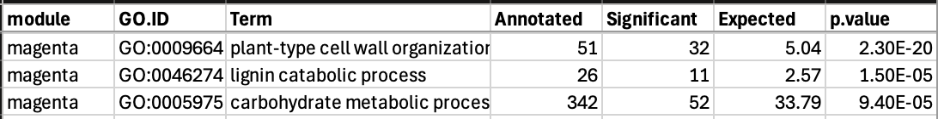
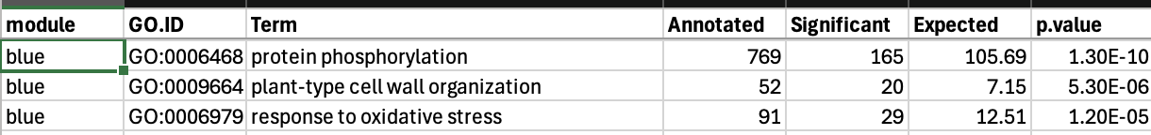
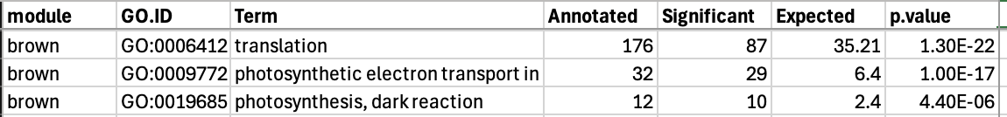
Top3 GO Enrichment: LFY2
All Samples:
Sporophyte:
Gametophyte:

Slide 19


What modules are the MADS box genes in?
WGCNA all samples: LFY1 = midnightblue, LFY2 = magenta
Sporophyte: LFY1 = brown, LFY2 = blue
Gametophyte: LFY1 = turquoise, LFY2 = brown

Slide 20
TGCN network
Idea: build network around a trait (or gene expression) of interest
Method:
LASSO regression to identify genes that are good predictors of the trait
Bootstrap replicates to test reproducibility
Resulting genes from LASSO are “hubs”
Use the LASSO hub genes to build subnetworks via correlation

Slide 21
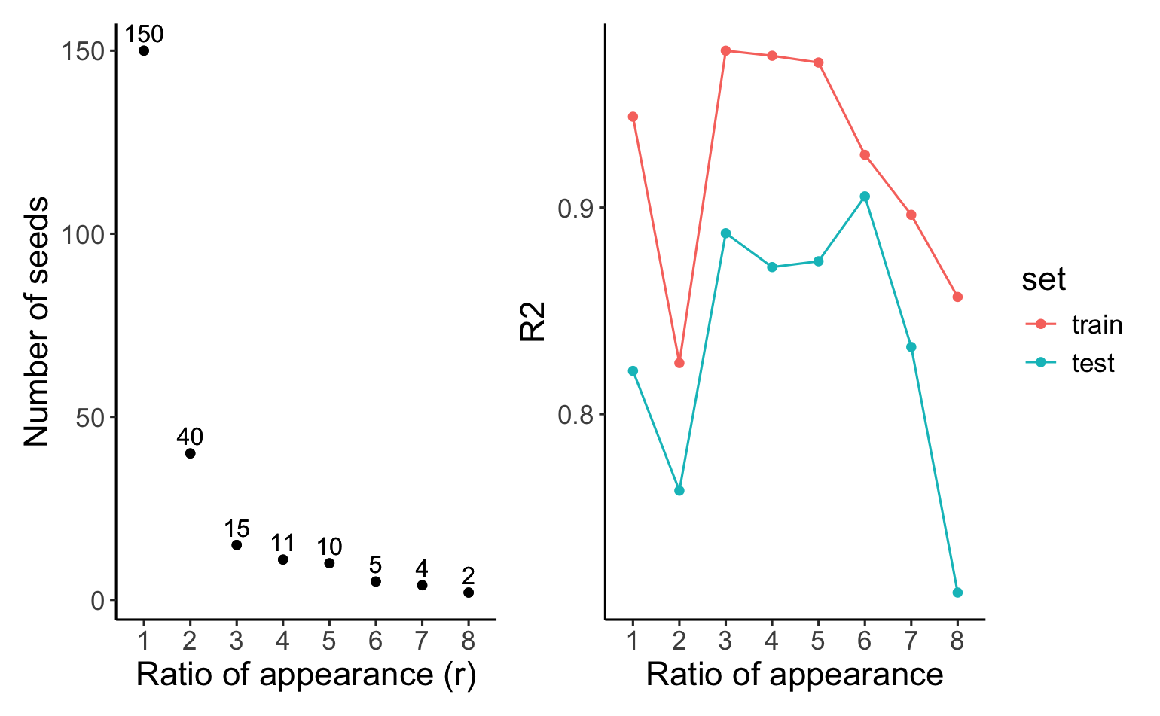
TGCN LASSO Diagnostics LFY1
Ratio of appearance = number of times a gene appeared in 10 bootstrap.

Slide 22
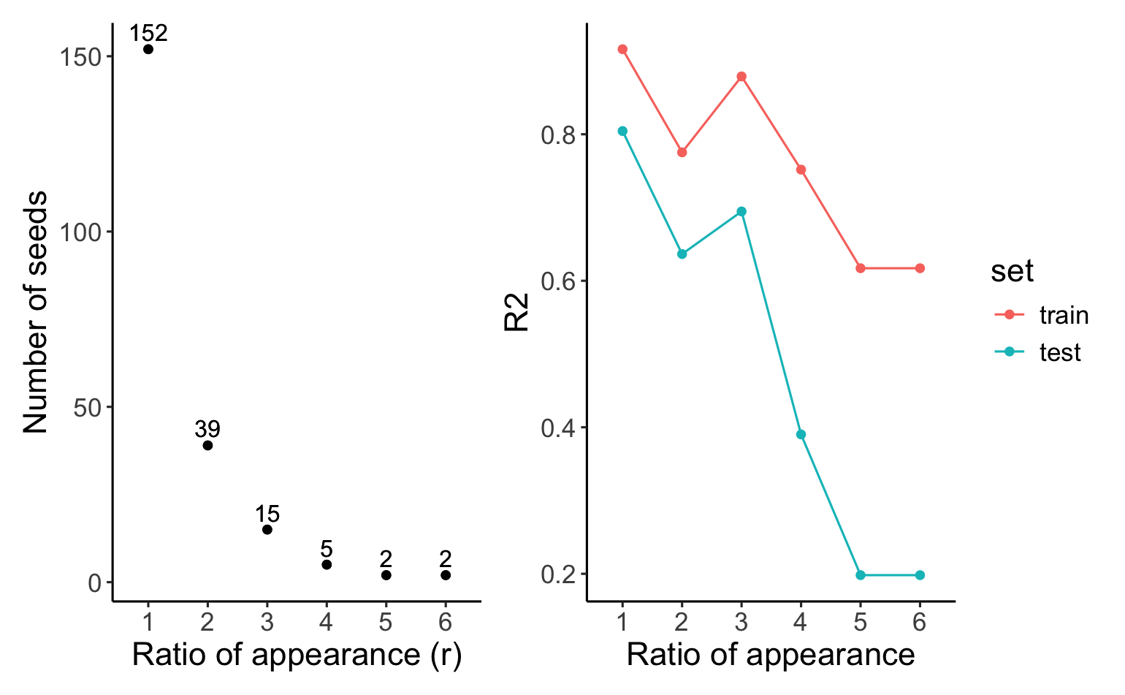
TGCN LASSO Diagnostics LFY2
Ratio of appearance = number of times a gene appeared in 10 bootstrap.

Slide 23
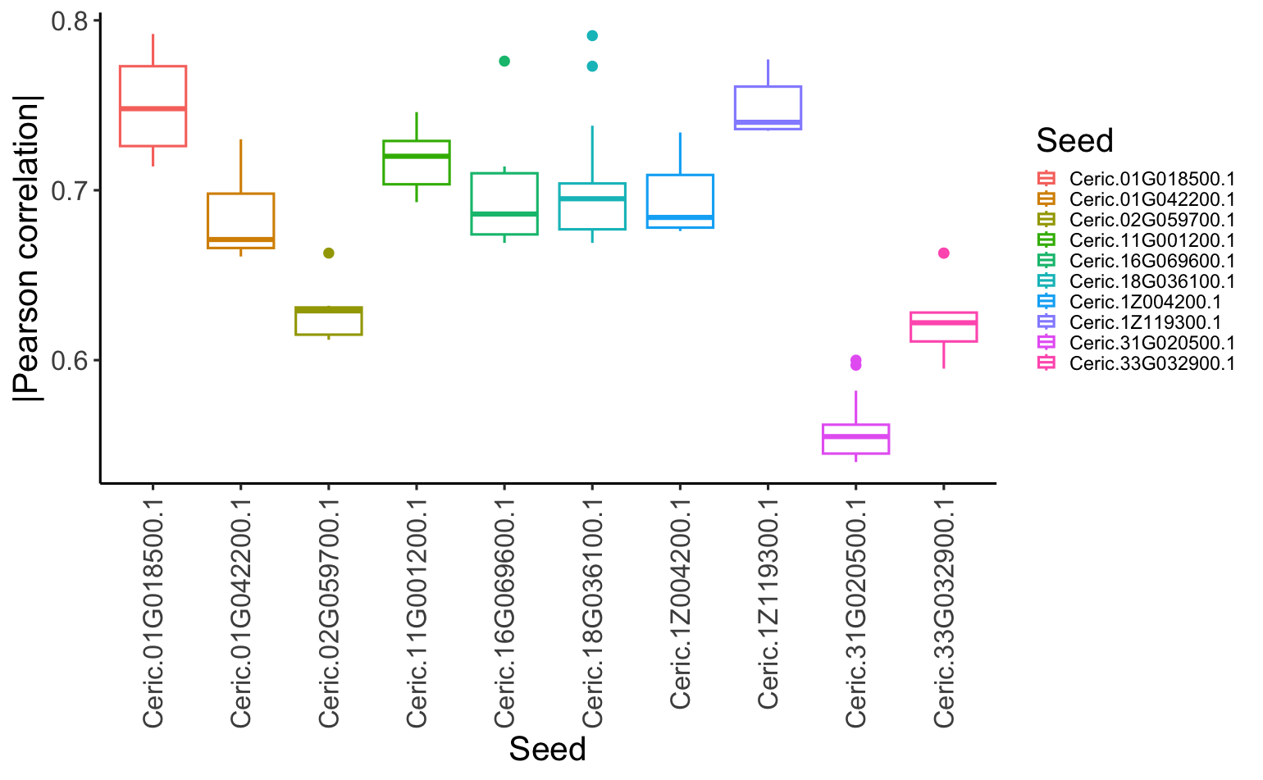
TGCNc5 LFY 1 subnetwork correlation with LFY1

Slide 24
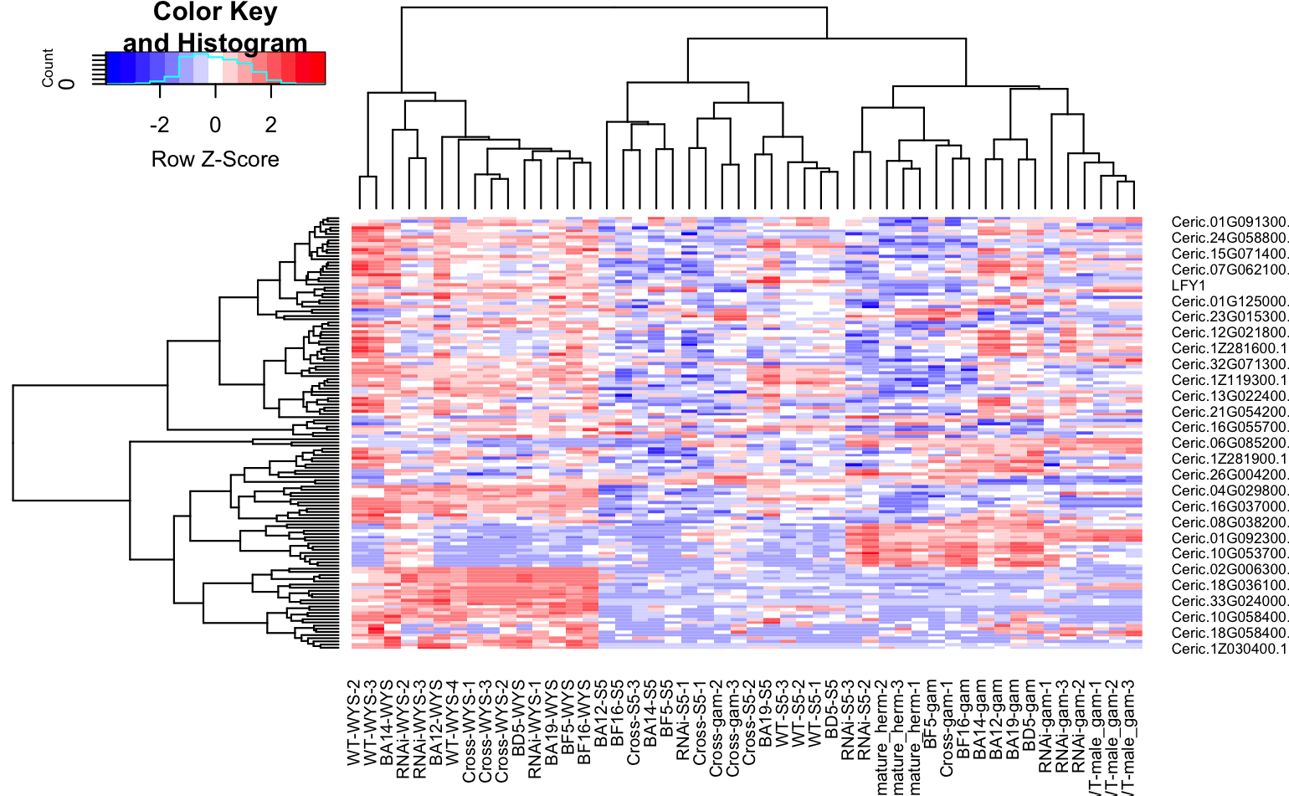
TGCNc5 LFY 1 heatmap

Slide 25
TGCNc5 LFY 1 GO terms (should redo on whole list)
query | GO.ID | Term | Annotated | Significant | Expected | p_value
Ceric.01G018500.1 | GO:0010411 | xyloglucan metabolic process | 21 | 1 | 0.02 | 0.016
Ceric.01G018500.1 | GO:0007275 | multicellular organism development | 25 | 1 | 0.02 | 0.019
Ceric.01G018500.1 | GO:0042546 | cell wall biogenesis | 35 | 1 | 0.03 | 0.026
Ceric.01G018500.1 | GO:0009664 | plant-type cell wall organization | 52 | 1 | 0.04 | 0.039
Ceric.01G042200.1 | GO:0006355 | regulation of DNA-templated transcriptio... | 603 | 2 | 0.23 | 0.016
Ceric.02G059700.1 | GO:0009116 | nucleoside metabolic process | 18 | 1 | 0.01 | 0.009
Ceric.02G059700.1 | GO:0006479 | protein methylation | 20 | 1 | 0.01 | 0.01
Ceric.02G059700.1 | GO:0016567 | protein ubiquitination | 63 | 1 | 0.03 | 0.031
Ceric.11G001200.1 | GO:0006633 | fatty acid biosynthetic process | 87 | 1 | 0.03 | 0.033
Ceric.11G001200.1 | GO:0009058 | biosynthetic process | 2357 | 3 | 0.89 | 0.036
Ceric.16G069600.1 | GO:0007275 | multicellular organism development | 25 | 1 | 0.01 | 0.0063
Ceric.16G069600.1 | GO:0030001 | metal ion transport | 167 | 1 | 0.04 | 0.0417
Ceric.18G036100.1 | GO:0009664 | plant-type cell wall organization | 52 | 2 | 0.05 | 0.00087
Ceric.18G036100.1 | GO:0010411 | xyloglucan metabolic process | 21 | 1 | 0.02 | 0.01839
Ceric.18G036100.1 | GO:0042546 | cell wall biogenesis | 35 | 1 | 0.03 | 0.03049
Ceric.1Z004200.1 | GO:0007275 | multicellular organism development | 25 | 1 | 0.01 | 0.013
Ceric.1Z004200.1 | GO:0006355 | regulation of DNA-templated transcriptio... | 603 | 2 | 0.3 | 0.031
Ceric.1Z119300.1 | GO:0006364 | rRNA processing | 33 | 1 | 0.01 | 0.012
Ceric.1Z119300.1 | GO:0006470 | protein dephosphorylation | 121 | 1 | 0.05 | 0.045
Ceric.31G020500.1 | GO:0006189 | 'de novo' IMP biosynthetic process | 6 | 1 | 0.01 | 0.0083
Ceric.31G020500.1 | GO:0006108 | malate metabolic process | 13 | 1 | 0.02 | 0.0179
Ceric.33G032900.1 | GO:0045892 | negative regulation of DNA-templated tra... | 6 | 1 | 0 | 0.003
Ceric.33G032900.1 | GO:0006535 | cysteine biosynthetic process from serin... | 18 | 1 | 0.01 | 0.009
Ceric.33G032900.1 | GO:0006096 | glycolytic process | 48 | 1 | 0.02 | 0.024

Slide 26
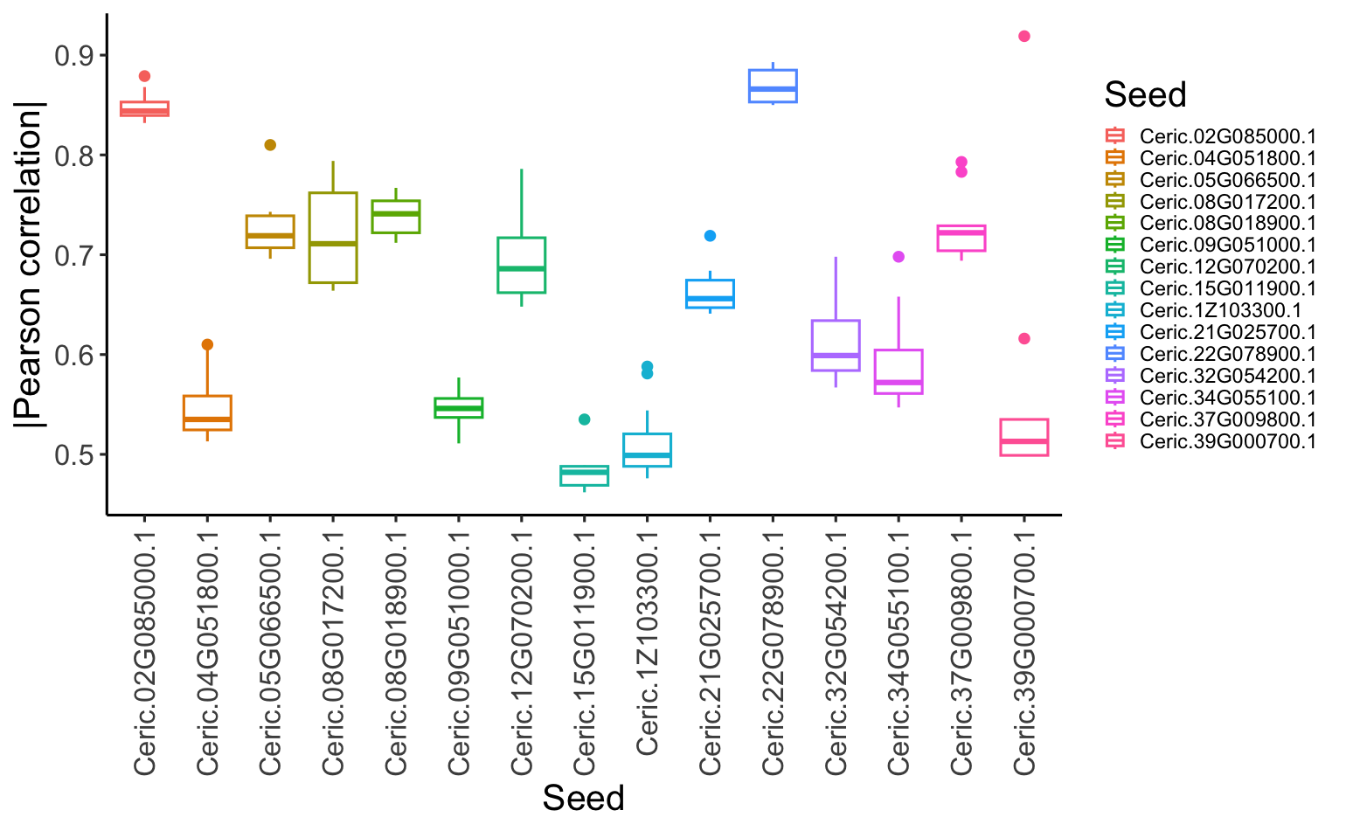
TGCNc3 LFY2 subnetwork correlation with LFY2

Slide 27
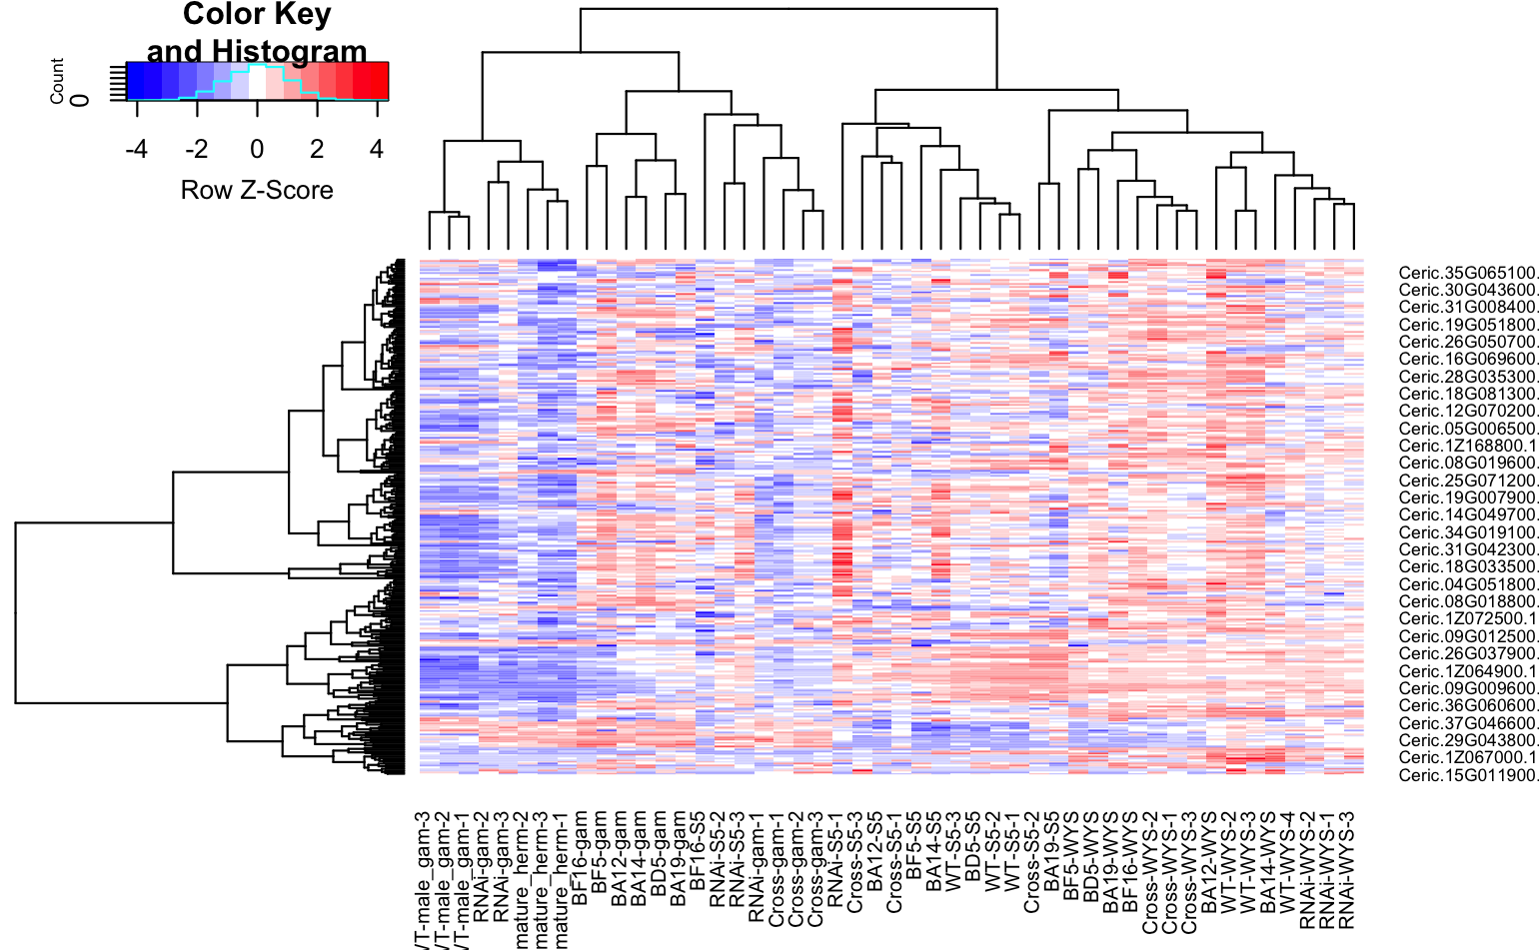
TGCNc3 LFY2 heatmap

Slide 28
TGCNc3 LFY2 GO terms (should redo on whole list)
query | GO.ID | Term | Annotated | Significant | Expected | p_value
Ceric.02G085000.1 | GO:0006075 | (1->3)-beta-D-glucan biosynthetic proces... | 16 | 1 | 0.02 | 0.016
Ceric.02G085000.1 | GO:0006820 | monoatomic anion transport | 17 | 1 | 0.02 | 0.017
Ceric.02G085000.1 | GO:0006355 | regulation of DNA-templated transcriptio... | 603 | 3 | 0.61 | 0.018
Ceric.02G085000.1 | GO:0007275 | multicellular organism development | 25 | 1 | 0.03 | 0.025
Ceric.04G051800.1 | GO:0006355 | regulation of DNA-templated transcriptio... | 603 | 4 | 0.76 | 0.0048
Ceric.04G051800.1 | GO:0009107 | lipoate biosynthetic process | 5 | 1 | 0.01 | 0.0063
Ceric.04G051800.1 | GO:0009116 | nucleoside metabolic process | 18 | 1 | 0.02 | 0.0225
Ceric.04G051800.1 | GO:0006352 | DNA-templated transcription initiation | 38 | 1 | 0.05 | 0.0469
Ceric.05G066500.1 | GO:0007165 | signal transduction | 327 | 1 | 0.08 | 0.081
Ceric.08G017200.1 | GO:0016998 | cell wall macromolecule catabolic proces... | 8 | 1 | 0 | 0.004
Ceric.08G017200.1 | GO:0006888 | endoplasmic reticulum to Golgi vesicle-m... | 17 | 1 | 0.01 | 0.0085
Ceric.08G017200.1 | GO:0030163 | protein catabolic process | 69 | 1 | 0.03 | 0.0344
Ceric.08G017200.1 | GO:0016192 | vesicle-mediated transport | 129 | 2 | 0.07 | 0.0349
Ceric.08G018900.1 | GO:0006468 | protein phosphorylation | 983 | 3 | 0.62 | 0.016
Ceric.09G051000.1 | GO:0006419 | alanyl-tRNA aminoacylation | 3 | 1 | 0 | 0.0019
Ceric.09G051000.1 | GO:0009107 | lipoate biosynthetic process | 5 | 1 | 0 | 0.0031
Ceric.09G051000.1 | GO:0030042 | actin filament depolymerization | 12 | 1 | 0.01 | 0.0075
Ceric.12G070200.1 | GO:0006412 | translation | 447 | 11 | 1.18 | 1.90E-08
Ceric.12G070200.1 | GO:0044571 | [2Fe-2S] cluster assembly | 2 | 1 | 0.01 | 0.0053
Ceric.12G070200.1 | GO:0030042 | actin filament depolymerization | 12 | 1 | 0.03 | 0.0313
Ceric.12G070200.1 | GO:0006888 | endoplasmic reticulum to Golgi vesicle-m... | 17 | 1 | 0.05 | 0.0441
Ceric.15G011900.1 | GO:0006508 | proteolysis | 350 | 1 | 0.13 | 0.13
Ceric.1Z103300.1 | GO:0006166 | purine ribonucleoside salvage | 2 | 1 | 0 | 0.0018
Ceric.1Z103300.1 | GO:0006412 | translation | 447 | 3 | 0.39 | 0.0052

Slide 29
TGCNc3 LFY2 GO terms (should redo on whole list)
Ceric.21G025700.1 | GO:0051252 | regulation of RNA metabolic process | 605 | 2 | 0.38 | 0.0011
Ceric.21G025700.1 | GO:0006099 | tricarboxylic acid cycle | 14 | 1 | 0.01 | 0.0088
Ceric.21G025700.1 | GO:0019290 | siderophore biosynthetic process | 41 | 1 | 0.03 | 0.0256
Ceric.22G078900.1 | GO:0009956 | radial pattern formation | 1 | 1 | 0 | 0.00038
Ceric.22G078900.1 | GO:0008356 | asymmetric cell division | 1 | 1 | 0 | 0.00038
Ceric.22G078900.1 | GO:0048366 | leaf development | 1 | 1 | 0 | 0.00038
Ceric.22G078900.1 | GO:0006511 | ubiquitin-dependent protein catabolic pr... | 46 | 1 | 0.02 | 0.0173
Ceric.22G078900.1 | GO:0006979 | response to oxidative stress | 105 | 1 | 0.04 | 0.03919
Ceric.32G054200.1 | GO:0015693 | magnesium ion transport | 7 | 1 | 0 | 0.0044
Ceric.32G054200.1 | GO:0007034 | vacuolar transport | 17 | 1 | 0.01 | 0.0107
Ceric.34G055100.1 | GO:0009956 | radial pattern formation | 1 | 1 | 0 | 0.0011
Ceric.34G055100.1 | GO:0048366 | leaf development | 1 | 1 | 0 | 0.0011
Ceric.34G055100.1 | GO:0008356 | asymmetric cell division | 1 | 1 | 0 | 0.0011
Ceric.34G055100.1 | GO:0015693 | magnesium ion transport | 7 | 1 | 0.01 | 0.0079
Ceric.34G055100.1 | GO:0010468 | regulation of gene expression | 628 | 3 | 0.71 | 0.0236
Ceric.37G009800.1 | GO:0005992 | trehalose biosynthetic process | 20 | 1 | 0.01 | 0.005
Ceric.37G009800.1 | GO:0006633 | fatty acid biosynthetic process | 87 | 1 | 0.02 | 0.022

Slide 30
MR
Wasn’t able to prepare slides yet
Quick look suggests that at least for LFY1 TGCN and MR are pulling out similar genes

Slide 31
Next Steps
Promoter motif enrichment
Expand to include samples from NCBI?

